Slide 1
Lecture 21
Graphs

Slide 2
Linked List
Priority Queue
Stack
Heap
Queue
BST
AVL
Hash Table
MULTIWAY
Tries
RED-BLACK

Slide 3
How to store relation among elements?

Slide 4
Graph (V,E)
V: Set of nodes V
E: Collection of edges

Slide 5
Flight Network
849
PVD
1843
ORD
142
SFO
802
LGA
337
1743
1387
HNL
2555
1099
LAX
1233
DFW
1120
MIA
V = {HNL, SFO, ORD, LAX, DFW, LGA, PVD, MIA}
E = {(HNL,LAX, 2555), (SFO, LAX, 337),…}

Slide 6
Trees Vs Graphs
Relations
Root
Loops/cycles
No of edges
Type of edges

Slide 7
What is the difference?
1. Flight network
2. Social network

Slide 8
Directed edges – Directed graph

Slide 9
Undirected edge – Undirected graph

Slide 10
Applications
Electronic Circuits
Transportation network
Computer Network
Databases

Slide 11
Terminology

Slide 12
An edge a connecting endpoints U and V is represented as ordered pair (u,v).
V
a
b
h
j
U
d
X
Z
c
e
i
W
g
f
Y

Slide 13
Edges incident on a vertex:
-a, d, and b are incident on V
-outgoing edges, incoming edges
V
a
b
h
j
U
d
X
Z
c
e
i
W
g
f
Y

Slide 14
Adjacent vertices:
U and V are adjacent
V
a
b
h
j
U
d
X
Z
c
e
i
W
g
f
Y

Slide 15
Degree of a vertex:
-X has degree 5
-in-degree, out-degree
V
a
b
h
j
U
d
X
Z
c
e
i
W
g
f
Y

Slide 16
Parallel edges: h and i are parallel edges
V
a
b
h
j
U
d
X
Z
c
e
i
W
g
f
Y

Slide 17
Self-loop: j is a self-loop
V
a
b
h
j
U
d
X
Z
c
e
i
W
g
f
Y

Slide 18
A graph with no parallel edges and self loops is called simple graph!

Slide 19
In a simple graph with m edges, what is the sum of degrees of all vertices?

Slide 20
What if G is a directed graph with m edges?
In-degree?
Out-degree?

Slide 21
Path: sequence of alternating vertices and edges
V
a
b
P₁
d
U
X
Z
P₂
h
c
e
W
g
f
Y

Slide 22
Simple path: all vertices and edges are distinct
V
a
b
P₁
d
U
X
Z
P₂
h
c
e
W
g
P1 is simple
P2 is not simple
f
Y

Slide 23
  Cycle: circular sequence of alternating vertices and edges
V
a
b
d
U
X
Z
C₂
h
e
C₁
c
W
g
f
Y

Slide 24
  Simple Cycle: cycle such that all its vertices and edges are distinct
V
a
b
d
U
X
Z
C₂
h
e
C₁
c
W
g
C1 is simple
C2 is not simple
f
Y

Slide 25
Reachable:
V is reachable from U if there is a path from U to V
Reachability is symmetric for undirected graph

Slide 27
Subgraph:
Any subset of V and E
V
V
a
a
b
d
U
U
X
Z
h
c
c
e
W
W
g
Subgraph
f
Y
Graph

Slide 28
Connected Component: maximal connected subgraph

Slide 29
A Directed Graph is
Strongly connected if there is a directed path between every pair of vertices
Weakly connected if the equivalent undirected graph is connected

Slide 30
Find Weekly and Strongly Connected Components
V
a
b
U
X
T
Z
d
h
c
e
W
g
f
Y

Slide 31
Tree:
A connected component with no cycles!
There is no root, however!

Slide 32
Forest

Slide 33
Complete graph
m=n(n-1)/2
incomplete ➔ m<n(n-1)/2

Slide 34
For a tree, m=n-1

Slide 35
Can we have a connected graph with m < n-1?

Slide 36
Spanning Tree

Slide 37
Can you draw this graph without lifting your pencil, and without repeating edges!

Slide 38
Eulerian Tour: path that traverses every edge exactly once and returns to the first vertex

Slide 39
Euler’s Theorem:
A graph has a Eulerian tour if and only if all vertices have even degree

Slide 40
The Graph ADT
Vertex
Edge
Graph

Slide 41
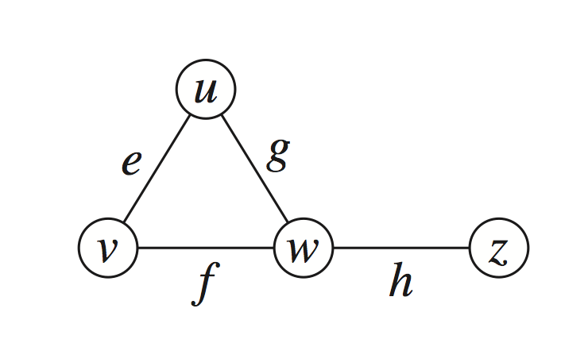
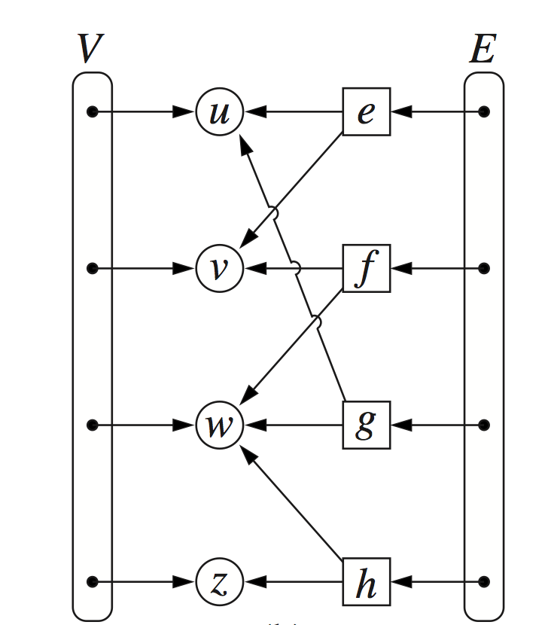
Edge List Structure

Slide 42
Example

Slide 43
Performance
n vertices, m edges no parallel edges no self-loops | Edge List | Adjacency List | Adjacency Matrix
Space | n + m | n + m | n²
incidentEdges(v) | m | deg(v) | n
areAdjacent (v, w) | m | min(deg(v), deg(w)) | 1
insertVertex(o) | 1 | 1 | n²
insertEdge(v, w, o) | 1 | 1 | 1
removeVertex(v) | m | deg(v) | n²
removeEdge(e) | 1 | 1 | 1

Slide 44
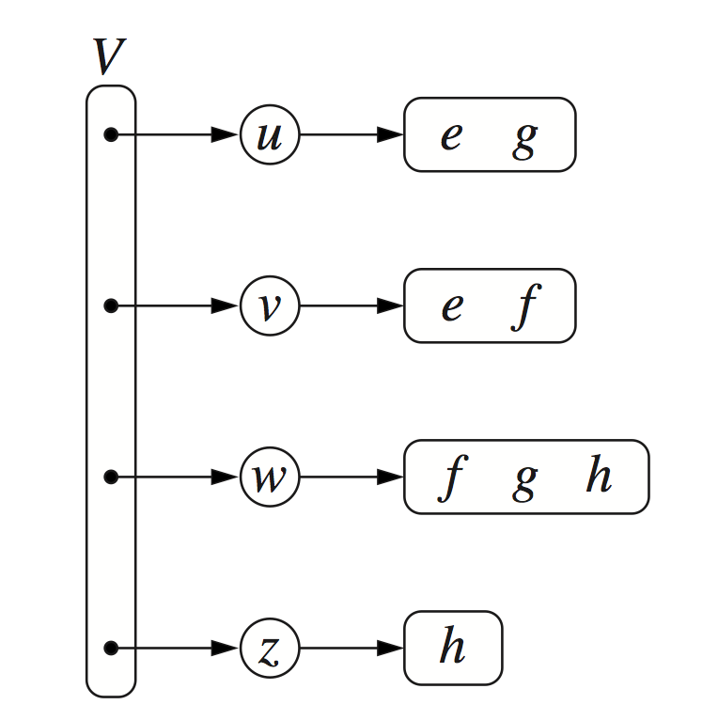
Adjacency List Structure

Slide 45
Example

Slide 46
Performance
n vertices, m edges no parallel edges no self-loops | Edge List | Adjacency List | Adjacency Matrix
Space | n + m | n + m | n²
incidentEdges(v) | m | deg(v) | n
areAdjacent (v, w) | m | min(deg(v), deg(w)) | 1
insertVertex(o) | 1 | 1 | n²
insertEdge(v, w, o) | 1 | 1 | 1
removeVertex(v) | m | deg(v) | n²
removeEdge(e) | 1 | 1 | 1

Slide 47
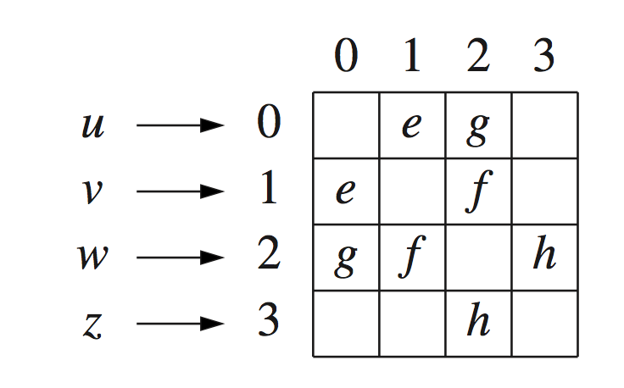
Adjacency Matrix Structure

Slide 48
Example

Slide 49
Performance
n vertices, m edges no parallel edges no self-loops | Edge List | Adjacency List | Adjacency Matrix
Space | n + m | n + m | n²
incidentEdges(v) | m | deg(v) | n
areAdjacent (v, w) | m | min(deg(v), deg(w)) | 1
insertVertex(o) | 1 | 1 | n²
insertEdge(v, w, o) | 1 | 1 | 1
removeVertex(v) | m | deg(v) | n²
removeEdge(e) | 1 | 1 | 1

Slide 50
Select a candidate with the help of adjacency matrix:
Relation (edges) – preference
Let (a, b) mean b prefers a

Slide 51
Graph Search Algorithms:
A systematic way of visiting every edge and vertex of the graph!

Slide 52
Breadth-First Search
(BFS)

Slide 53
Example

Slide 60
BFS Algorithm
Algorithm BFS(G, s)
L₀ ← new empty sequence
  L₀.addLast(s)
  setLabel(s, VISITED)
  i ← 0
  while !L_{i}.isEmpty()
  L_{i +1} ← new empty sequence
  for all v ∈ L_{i}.elements()
  for all e ∈ G.incidentEdges(v)
  if getLabel(e) = UNEXPLORED
  w ← opposite(v,e)
  if getLabel(w) = UNEXPLORED
  setLabel(e, DISCOVERY)
  setLabel(w, VISITED)
  L_{i +1}.addLast(w)
  else
  setLabel(e, CROSS)
  i ← i +1
Algorithm BFS(G)
Input graph G
Output labeling of the edges
and partition of the
vertices of G
  for all u ∈ G.vertices()
  setLabel(u, UNEXPLORED)
  for all e ∈ G.edges()
  setLabel(e, UNEXPLORED)
  for all v ∈ G.vertices()
  if getLabel(v) = UNEXPLORED
  BFS(G, v)

Slide 61
Another example
A
unexplored vertex
A
visited vertex
unexplored edge
discovery edge
cross edge

Slide 62
L₀
A
L₀
A
L₁
B
C
D
L₁
B
C
D
E
F
E
F
L₀
A
L₀
A
L₁
B
C
D
L₁
B
C
D
E
F
E
F

Slide 63
A
unexplored vertex
A
visited vertex
unexplored edge
discovery edge
cross edge
L₀
A
L₁
B
C
D
L₂
E
F

Slide 64
Analysis
Each vertex is labeled twice
  once as UNEXPLORED
  once as VISITED
Each edge is labeled twice
  once as UNEXPLORED
  once as DISCOVERY or CROSS

Slide 65
Time Complexity
O(n+m)

Slide 66
Properties of BFS Tree
Gs =(Vs, Es)

Slide 67
Vs consists of the vertices reachable from s
L₀
A
A
L₁
B
C
D
B
C
D
L₂
E
F
E
F

Slide 68
For all v in Vs there the path from s to v is shortest in terms of number of edges
L₀
A
A
L₁
B
C
D
B
C
D
L₂
E
F
E
F

Slide 69
The discovery edges labeled by BFS(G, s) form a spanning tree Ts of Gs
L₀
A
A
L₁
B
C
D
B
C
D
L₂
E
F
E
F

Slide 70
Level number of cross edge vertices can differ utmost by 1
L₀
A
A
L₁
B
C
D
B
C
D
L₂
E
F
E
F

Slide 71
Applications
Determines whether G is connected
Computes the connected components of G
Computes a spanning forest of G

Slide 72
Computing Connected Components

Slide 73
Computing Spanning Forest

Slide 74
Bipartite graph
v₄
v₁
v₅
v₃
v₇
v₆

Slide 75
Bipartite graph
v₂
v₂
v₃
v₁
v₄
v₆
v₅
v₄
v₃
v₅
v₇
v₁
v₆
v₇

Slide 76
How will you determine if a graph is bipartite?
Hint: use BFS

Slide 77
If no edge joins two vertices in the same level of BFS, the graph is bipartite!
L₁
L₁
L₂
L₂
L₃
L₃

Slide 78
What if there is an edge connecting vertices in the same level?

Slide 79
If G has an odd cycle, then it cannot be bipartite!
bipartite
(2-colorable)
not bipartite
(not 2-colorable)

Slide 80
If a graph has only even cycles, is it bipartite?

Slide 81
Depth First Search
(DFS)

Slide 88
A
unexplored vertex
A
visited vertex
unexplored edge
discovery edge
back edge
A
B
D
E
C

Slide 89
DFS Algorithm
Algorithm DFS(G, v)
Input graph G and a start vertex v of G
Output labeling of the edges of G
in the connected component of v
as discovery edges and back edges
setLabel(v, VISITED)
  for all e ∈ G.incidentEdges(v)
  if getLabel(e) = UNEXPLORED
  w ← opposite(v,e)
  if getLabel(w) = UNEXPLORED
  setLabel(e, DISCOVERY)
  DFS(G, w)
  else
  setLabel(e, BACK)
Algorithm DFS(G)
Input graph G
Output labeling of the edges of G
as discovery edges and
back edges
  for all u ∈ G.vertices()
  setLabel(u, UNEXPLORED)
  for all e ∈ G.edges()
  setLabel(e, UNEXPLORED)
  for all v ∈ G.vertices()
  if getLabel(v) = UNEXPLORED
  DFS(G, v)

Slide 90
Time complexity
Each vertex is labeled twice
  once as UNEXPLORED
  once as VISITED
Each edge is labeled twice
  once as UNEXPLORED
  once as DISCOVERY or BACK

Slide 91
Properties of DFS Tree
Gs =(Vs, Es)

Slide 92
DFS visits all vertices in the connected component!

Slide 93
DFS tree is a spanning tree of the connected component!

Slide 94
Using DFS, find a path from node s to node t!

Slide 95
Count number of connected components is a graph using DFS!

Slide 96
Using DFS, find a cycle in a given graph!

Slide 97
DFS Vs BFS
Applications | DFS | BFS
Connected components paths, | √ | √
Spanning forest | √ | √
Path/Cycles | √ | √
Shortest paths |  | √

Slide 98
DFS Vs BFS
L₀
A
A
L₁
B
C
D
B
C
D
L₂
E
F
E
F
DFS
BFS

Slide 99
Directed Graphs
(Diagraph)
E
D
C
B
A

Slide 100
Directed DFS
  discovery/tree edges
  back edges
  forward edges
  cross edges
E
D
C
B
A

Slide 101
Directed DFS
E
arr-2
arr-4
Forward edge (u, v)
arr(u)<arr(v)<dep(v)<dep(u)
Back edge (u, v)
arr(v)<arr(u)<dep(u)<dep(v)
Cross edge (u, v)
arr(v)<dep(v)<arr(u)<dep(u)
dep-3
dep-5
D
C
arr-1
dep-6
B
arr-7
dep-8
A
arr- 0
dep-9

Slide 102
DFS tree visits all vertices reachable from v via directed paths!

Slide 103
Strong Connectivity
Each vertex can reach all other vertices
a
g
c
d
e
b
f

Slide 104
Determine strong connectivity with DFS?

Slide 105
Transitive Closure of a Diagraph
Transitive closure has the same vertices as the diagraph
If diagraph has a directed path from u to v (u  v), transitive closure has a directed edge from u to v

Slide 106
Transitive Closure
If there is a directed path from u to v, add an edge from u to v (if its not there already)!
a
a
g
g
c
c
d
d

Slide 107
Transitive Closure
D
E
D
E
B
G
B
C
C
A
A
G*

Slide 108
What is transitive closure of a cycle?
a
g
c
d

Slide 109
Calculate Transitive closure with DFS!
DFS from each vertex
Keep adding edges to all reachable vertices
O(n(n+m))

Slide 110
Floyd-Warshall Transitive Closure
Uses only vertices numbered 1,…,k
(add this edge if it’s not already in)
i
j
Uses only vertices
numbered 1,…,k-1
Uses only vertices
numbered 1,…,k-1
k

Slide 111
Example
BOS
ORD
v
4
JFK
v
2
v
6
SFO
DFW
LAX
v
v
3
1
MIA
v
5

Slide 112
Iteration 1
BOS
ORD
v
4
JFK
v
2
v
6
SFO
DFW
LAX
v
v
3
1
MIA
v
5

Slide 113
Iteration 2
BOS
ORD
v
4
JFK
v
2
v
6
SFO
DFW
LAX
v
v
3
1
MIA
v
5

Slide 114
Iteration 3
BOS
ORD
v
4
JFK
v
2
v
6
SFO
DFW
LAX
v
v
3
1
MIA
v
5

Slide 115
Iteration 4
BOS
ORD
v
4
JFK
v
2
v
6
SFO
DFW
LAX
v
v
3
1
MIA
v
5

Slide 116
Iteration 5
BOS
ORD
v
4
JFK
v
2
v
6
SFO
DFW
LAX
v
v
3
1
MIA
v
5

Slide 117
Iteration 6
BOS
ORD
v
4
JFK
v
2
v
6
SFO
DFW
LAX
v
v
3
1
MIA
v
5

Slide 118
Final
BOS
ORD
v
4
JFK
v
2
v
6
SFO
DFW
LAX
v
v
3
1
MIA
v
5

Slide 119
Floyd-Warshall’s Algorithm
Algorithm FloydWarshall(G)
Input digraph G
Output transitive closure G* of G
i ← 1
for all v ∈ G.vertices()
denote v as v_{i}
i ← i + 1
G₀ ← G
for k ← 1 to n do
G_{k} ← G_{k - 1}
for i ← 1 to n (i ≠ k) do
for j ← 1 to n (j ≠ i, k) do
if G_{k - 1}.areAdjacent(v_{i}, v_{k}) ∧
G_{k - 1}.areAdjacent(v_{k}, v_{j})
if ¬G_{k}.areAdjacent(v_{i}, v_{j})
G_{k}.insertDirectedEdge(v_{i}, v_{j} , k)
return G_{n}

Slide 120
Directed Acyclic Graphs (DAG)
A directed graph with no cycles!

Slide 121
How will you find if a directed graph is a DAG?

Slide 122
Back edge in DFS implies a cycle!

Slide 123
Topological Sorting
Number vertices, so that (u,v) in E implies u < v
wake up
1
2
3
CSL201
eat
A typical student day
4
5
nap
more CSL201
7
play
8
write CSL201program
6
9
work out
bake cookies
10
sleep
11
dream about CSL201

Slide 124
Algorithm for Topological Sorting
Algorithm TopologicalSort(G)
H ← G // Temporary copy of G
n ← G.numVertices()
while H is not empty do
Let v be a vertex with no outgoing edges
Label v ← n
n ← n - 1
Remove v from H

Slide 125
Implementation with DFS
Algorithm topologicalDFS(G, v)
Input graph G and a start vertex v of G
Output labeling of the vertices of G
in the connected component of v
setLabel(v, VISITED)
  for all e ∈ G.outEdges(v)
  { outgoing edges }
  w ← opposite(v,e)
  if getLabel(w) = UNEXPLORED
  { e is a discovery edge }
  topologicalDFS(G, w)
  else
  { e is a forward or cross edge }
  Label v with topological number n
  n ← n - 1
Algorithm topologicalDFS(G)
Input dag G
Output topological ordering of G
n ← G.numVertices()
  for all u ∈ G.vertices()
  setLabel(u, UNEXPLORED)
  for all v ∈ G.vertices()
  if getLabel(v) = UNEXPLORED
  topologicalDFS(G, v)

Slide 126
Topological Sorting

Slide 127
Topological Sorting
9

Slide 128
Topological Sorting
8
9

Slide 129
Topological Sorting
7
8
9

Slide 130
Topological Sorting
6
7
8
9

Slide 131
Topological Sorting
6
5
7
8
9

Slide 132
Topological Sorting
4
6
5
7
8
9

Slide 133
Topological Sorting
3
4
6
5
7
8
9

Slide 134
Topological Sorting
2
3
4
6
5
7
8
9

Slide 135
Topological Sorting
2
1
3
4
6
5
7
8
9

Slide 136
Example of Negative Edge
In Vegas, they pay you to visit their resort!
Positive cycle, good example of maximum cost!
Negative cycle, good example of positive cost!

Slide 137
Weighted Graph
849
PVD
1843
ORD
142
SFO
802
LGA
1743
1205
337
1387
HNL
2555
1099
LAX
1233
DFW
1120
MIA

Slide 138
Shortest Path
849
PVD
1843
ORD
142
SFO
802
LGA
1743
1205
337
1387
HNL
2555
1099
LAX
1233
DFW
1120
MIA

Slide 139
A subpath of a shortest path is itself a shortest path!
849
PVD
1843
ORD
142
SFO
802
LGA
1743
1205
337
1387
HNL
2555
1099
LAX
1233
DFW
1120
MIA

Slide 140
Dijkstra’s Shortest Path Algorithm

Slide 141
Basic Idea
v4
2
v1
0.5
v1
0.5
1.5
2.1
v5
s
v2
2.1
0.5
s
v2
1.1
1.1
v3
2
v3

Slide 142
Edge Relaxation
d(u) = 50
10
d(z) = 75
u
e
s
z
d(u) = 50
10
d(z) = 60
u
e
s
z

Slide 143
Example

Slide 144
0
8
A
4
2
∞
7
∞
1
∞
B
C
D
∞
3
9
∞
2
E
F
5

Slide 145
0
8
A
4
2
8
7
2
1
4
B
C
D
∞
3
9
∞
2
E
F
5

Slide 146
0
8
A
4
2
8
7
2
1
3
B
C
D
5
3
9
11
2
E
F
5

Slide 147
0
8
A
4
2
8
7
2
1
3
B
C
D
5
3
9
8
2
E
F
5

Slide 148
0
8
A
4
2
7
7
2
1
3
B
C
D
5
3
9
8
2
E
F
5

Slide 149
0
8
A
4
2
7
7
2
1
3
B
C
D
5
3
9
8
2
E
F
5

Slide 150
0
8
A
4
2
7
7
2
1
3
B
C
D
5
3
9
8
2
E
F
5

Slide 151
Diagraph Example

Slide 152
Distance(source) = 0
0
∞
Distance (all vertices but source) =
A
2
B
∞
4
1
3
10
∞
C
2
D
2
E
∞
5
8
∞
4
6
F
1
G
∞
∞

Slide 153
Distance(source) = 0
A
2
B
4
1
3
10
C
2
D
2
E
5
8
4
6
F
1
G

Slide 154
0
2
A
2
B
4
1
3
10
∞
C
2
D
2
E
∞
5
8
1
4
6
Distance(B) = 2
F
1
G
Distance(D) = 1
∞
∞

Slide 155
0
2
A
2
B
4
1
3
10
∞
C
2
D
2
E
∞
5
8
1
4
6
F
1
G
∞
∞

Slide 156
0
2
A
2
B
4
1
3
10
3
C
2
D
2
E
3
5
8
1
4
6
Distance(C) = 1 + 2 = 3 Distance(E) = 1 + 2 = 3 Distance(F) = 1 + 8 = 9 Distance(G) = 1 + 4 = 5
F
1
G
9
5

Slide 157
0
2
A
2
B
4
1
3
10
3
C
2
D
2
E
3
5
8
1
4
6
F
1
G
9
5

Slide 158
0
2
A
2
B
4
1
3
10
3
C
2
D
2
E
3
5
8
1
4
6
F
1
G
9
5

Slide 159
0
2
A
2
B
4
1
3
10
3
C
2
D
2
E
3
5
8
1
4
6
Distance(F) = 3 + 5 = 8
F
1
G
8
5

Slide 160
0
2
A
2
B
4
1
3
10
3
C
2
D
2
E
3
5
8
1
4
6
F
1
G
Previous distance
6
5
Distance(F) = min (8, 5+1) = 6

Slide 161
0
2
A
2
B
4
1
3
10
3
C
2
D
2
E
3
5
8
1
4
6
F
1
G
6
5

Slide 162
Time Complexity
O((n + m) log n)

Slide 163
Correctness of Dijkstra’s algorithm!

Slide 165
Why not negative edges!

Slide 166
Dijkstra’s Algorithm
store temporary distance from s in d(v)
add to the cloud the vertex u outside the cloud with the smallest distance label, d(u)
update the labels of the vertices adjacent to u

