Slide 1
Sample Course Projects

Slide 2
Transportation Networks
Intersection between 5th Ave SE and 5th St
Intersection between 5th Ave SE and 4th St
Source: Google Maps
Attributes of 5th Ave SE road segment between N4 and N7
N7
N4

Slide 3
Temporally Detailed (TD) Roadmaps
Per minute speed/travel time values
100 million road segments in US
Can reach Petabytes very quickly
NAVTEQ’s highly compressed weekly speed profile data
Source: ESRI and NAVTEQ

Slide 4
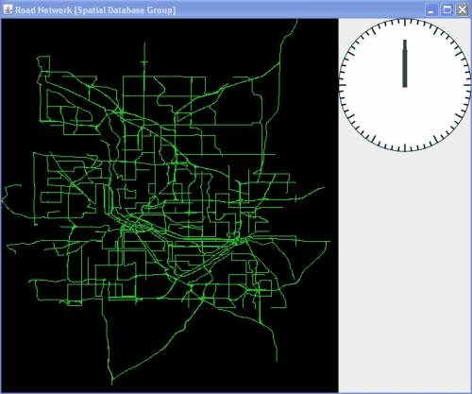
Temporally Detailed (TD) Roadmap
Data Courtesy: NAVTEQ Image Courtesy: KwangSoo Yang

Slide 5
Projects on TD Roadmaps
Given a source, a destination, and an desired arrival time interval at the destination. Find shortest paths for all the desired arrival times at the destination
Given a destination and an arrival time at the destination. Find shortest routes from k-different source nodes to the destination. --- under capacity constraints
Given a source, a destination and a departure-time at source. Find the path with least uncertainty in travel-time. Assume that with each edge variation in travel-time is given.
Bi-directional algorithms for TD roadmaps
Hierarchical routing for TD roadmaps

Slide 6

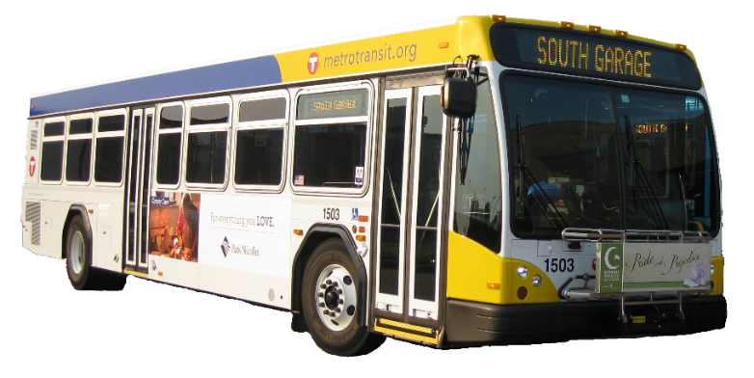
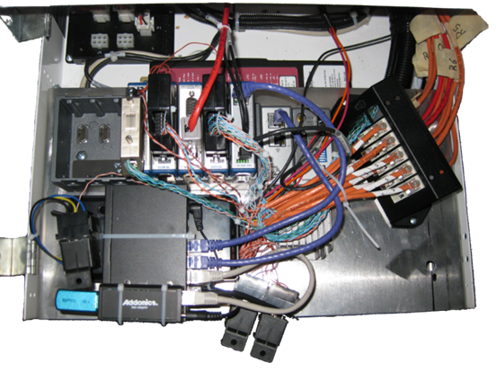
Engine measurement dataset
Engine Sub-system Measurements from Metro-Transit Buses in Twin-Cities
Sample Engine Variables:
GPS Speed and Position
Vehicle Load
Engine and Heater Fuel Flow
Exhaust Temp and Mass Flow
Intake Temp And Mass Flow
Engine Torque and RPM
Engine Coolant Temp
Odometer
….measurements on 20 engine variables

Slide 7
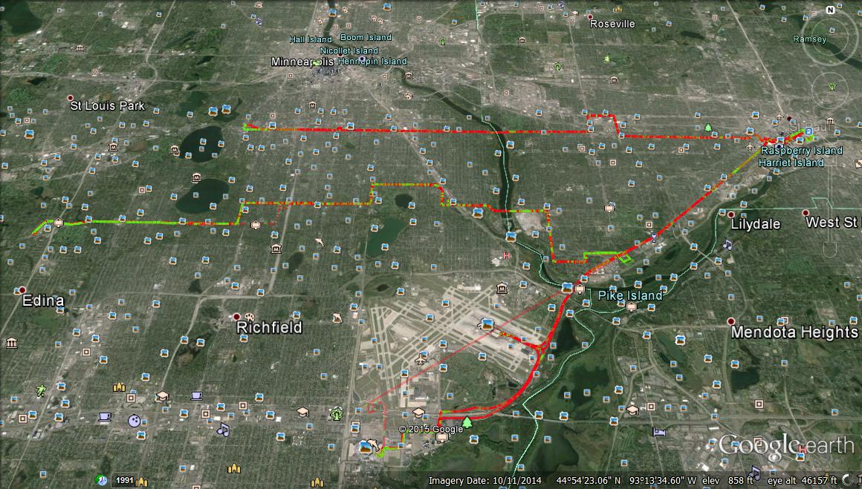
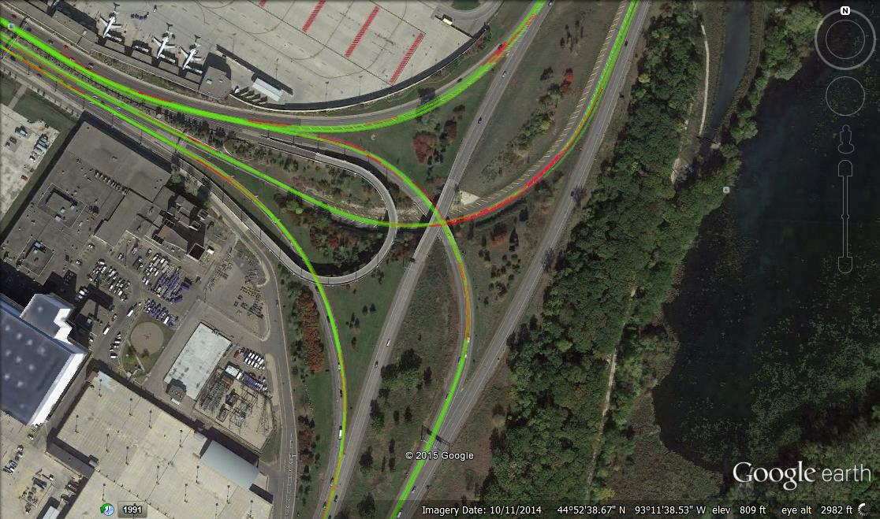
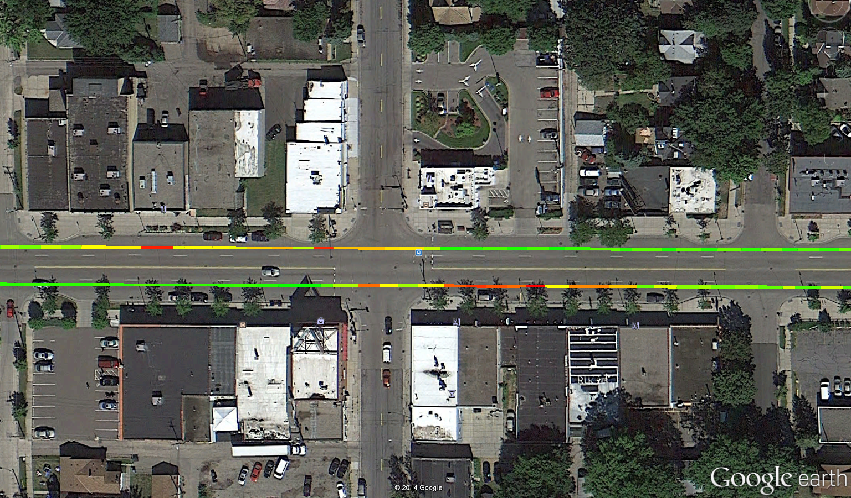
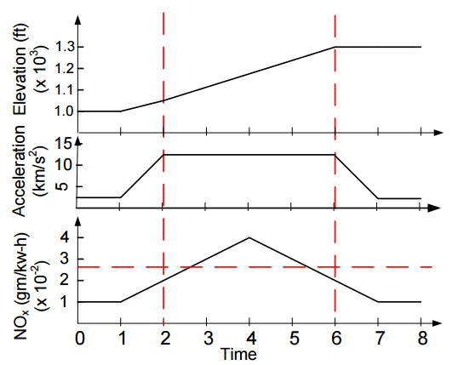
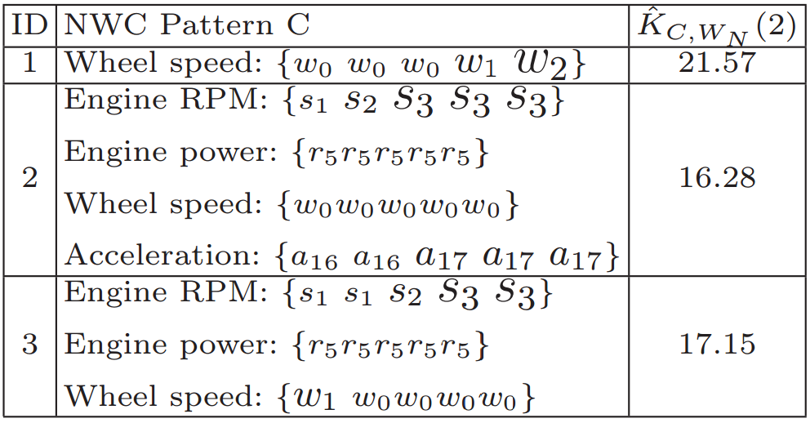
Engine measurement dataset
Temporal Pattern
Diesel Bus
Route 21
Route 46
Route 54
Red color indicates NO_{X} emission exceeding EPA regulations
Red color indicates NO_{X} emission exceeding EPA regulations
Temporal signatures of engine variables which are highly associated elevated NOx
Spatial Pattern
Emission
Hot Spots After Bus Stops
gNO_{X}/m
0.016
0.000
Hybrid Bus

Slide 8
Engine measurement dataset Projects
Spatio-temporal network hotspot detection.
  Find all the sub-graphs of the network which have significantly
  higher emissions than others
Spatio-temporal network anomalies
  Find all the spatio-temporal locations where the emissions/fuel consumption is “anomalous.”
Route 21
Route 46
Route 54

Slide 9
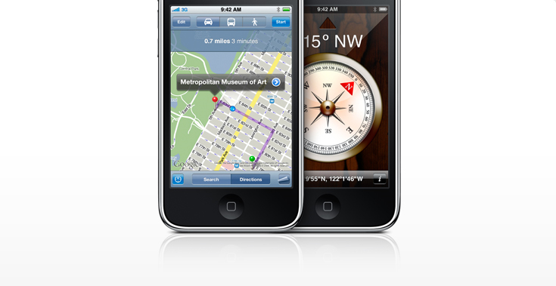
Other Projects
Literature-Survey: Survey papers from GPS track mining (30-40)
  Propose classification of techniques
  Gap analysis would be expected:
    Aka what new problems can be explored in this area.
Clustering of GPS traces which maximizes the gap between clusters.
  Note: This is different from K-means objective function.
  Can be used to determine primary corridors from a set of GPS tracks.
Route 21
Route 46
Route 54

