Slide 1
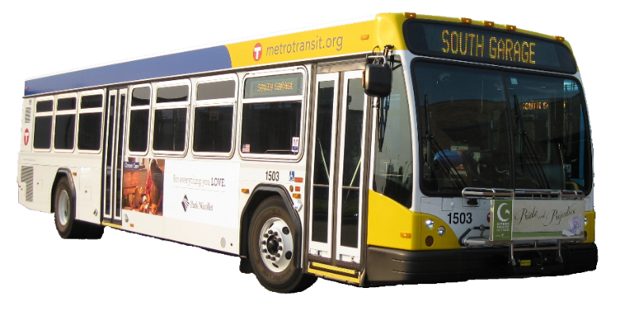
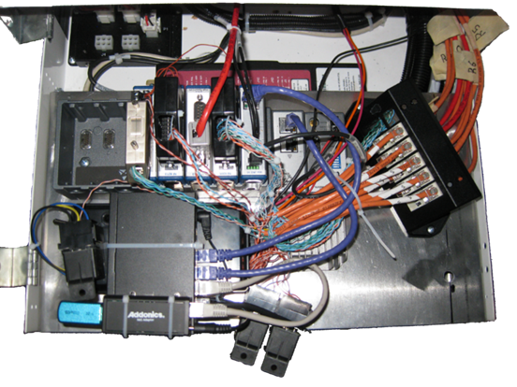
Engine measurement dataset
Engine Sub-system Measurements from Metro-Transit Buses in Twin-Cities
Sample Engine Variables:
GPS Speed and Position
Vehicle Load
Engine and Heater Fuel Flow
Exhaust Temp and Mass Flow
Intake Temp And Mass Flow
Engine Torque and RPM
Engine Coolant Temp
Odometer
….measurements on 20 engine variables

Slide 2
Some Meta-Level Challenges
Large Sizes of Datasets
Currently one Year of data
Approximately 37GB per bus
Over 8 million data points
Potential size over ~100 million US light-duty vehicles
Assumptions of Classical Techniques
Classical data mining techniques make assumptions limited to Monotonic interest measures
Statistical interest measures are often non-monotonic in nature.
~${10}^{15}$data items
per year

Slide 3
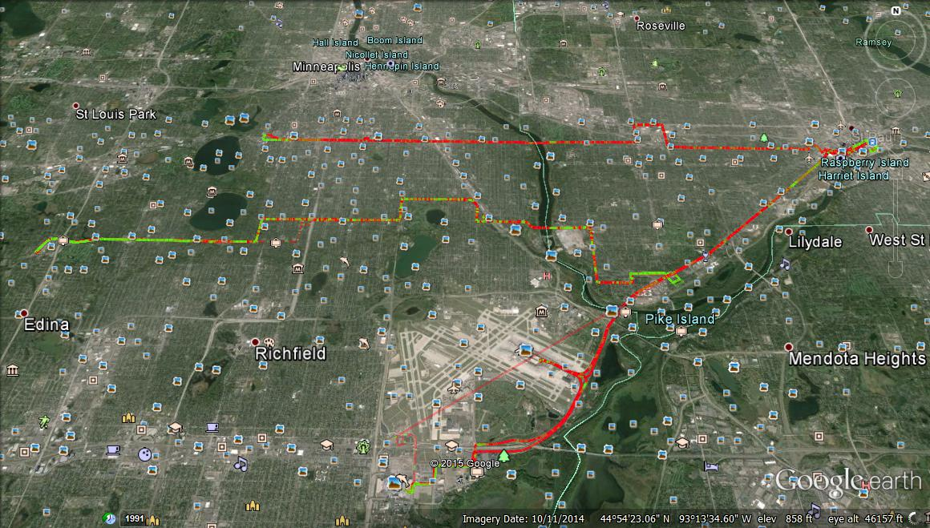
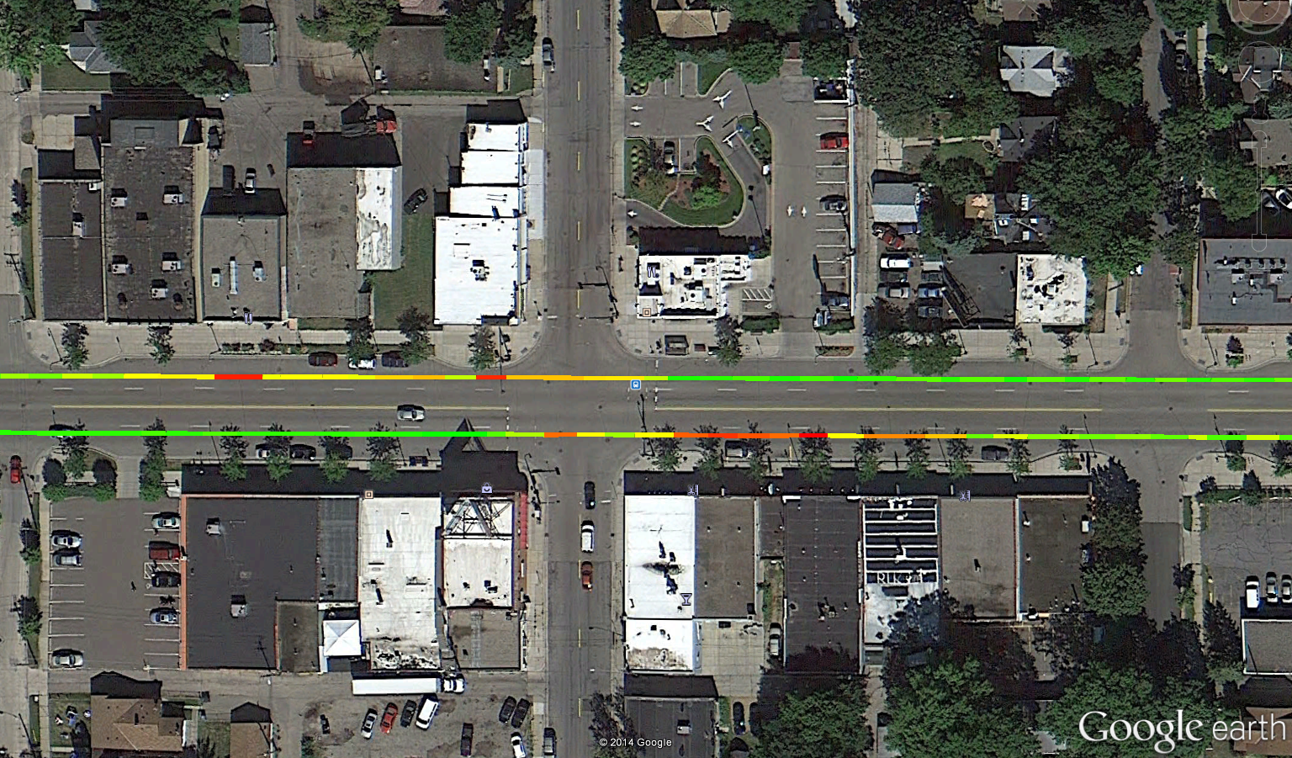
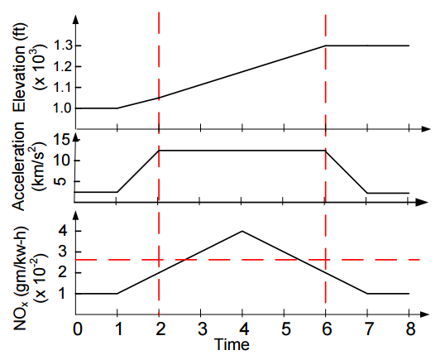
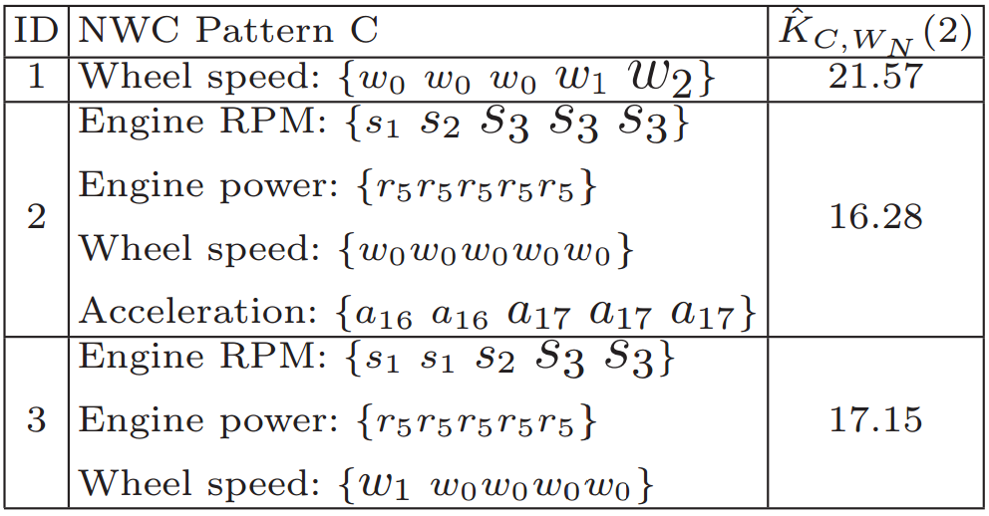
Engine measurement dataset
Temporal Pattern
Diesel Bus
Route 21
Route 46
Route 54
Red color indicates NO_{X} emission exceeding EPA regulations
Red color indicates NO_{X} emission exceeding EPA regulations
Temporal signatures of engine variables which are highly associated elevated NOx
Spatial Pattern
Emission
Hot Spots After Bus Stops
gNO_{X}/m
0.016
0.000
Hybrid Bus

Slide 4
Basic Concepts (1/4)
An event: An event e_{i}(v) is a reading where variable v falls within a predefined range [v_{i},v_{i+1}).
Example: For the wheel speed variable v, e₁(v): v ϵ [0, 5) km/h, e₂(v): means v ϵ [5, 10) km/h, etc.
A multivariate event trajectory (MET): a sequence of multi-variate points defined over a set of discretized explanatory variables V and a target variable y ϵ R
An event-sequence S(v): Given a variable v, an event-sequence S(v) is a sequence of events e_{i}(v) that are temporally contiguous in a MET.
Explanatory variables
Target variable

Slide 5
Basic Concepts (2/4)
A non-compliant window (W_{N}): Given a window length L and a MET m, a non-compliant window W_{N} is a temporal window in m, of length L, where the target variable y exceeds a user supplied standard
Example:
Standard: % of increase in NOx between the start and end of a window of length = 3 should not exceed 100%
Window <1,3> is a non-compliant window ([0.023−0.011]/0.011 = 109%>100%.)

Slide 6
Basic Concepts (3/4)
A Non-compliant Window Co-occurrence (NWC) pattern:
A set of equal-length event-sequences, defined on a subset of the explanatory variables V, that started at the same time, and within a time lag δ preceding the start of a non-compliant window.
C = {S_{i}(u_{i}) | u_{i} ϵ U, U ⊆ V }
Example:
δ =1 sec
ID | Candidate NWC Pattern | Dim (C)
1 | {a₂a₃a₂} | 1
2 | {b₁b₂b₃} | 1
3 | {a₂a₃a₂, b₁b₂b₃} | 2
4 | {a₁a₂a₃} | 1
5 | {b₁b₁b₂} | 1
6 | {a₁a₂a₃, b₁b₁b₂} | 2

Slide 7
Basic Concepts (4/4)
Interest Measure: Cross-K function
Measures how much the association between a pattern C and the non-compliant windows W_{N} at a given lag distance deviates from the assumption of independence.
|W_{N}|: number of non-compliant windows
|C|: pattern cardinality
|C ⋈ W_{N}|: the cardinality of the join set between instances of pattern C and non compliant windows, where C_{i} and W_{Nj} are joined only if C_{i} preceeded W_{Nj} by a time t, 0 ≤ t≤ δ
Under independence:
K_{C,WN} (δ) = δ +1

Slide 8
Problem Definition
Input
A set M of multivariate event trajectories (METs) defined on a set of explanatory variables V and a target variable y,
A window length L and a standard for defining non-compliant windows on y.
A time lag δ,
A temporal cross-K function threshold ε
A minimum support threshold minsupp (optional, default value = 0)
Find:
All NWC patterns C where K_{C,WN} (δ) > ε
Objective:
Reduce computational cost

Slide 9
Example
Window length L = 3
Lag δ = 1 sec
cross-K threshold ε = 5
minsupp = 0
Time series length T = 8
Input data with one non-compliant window identified
Candidate NWC Patterns

Slide 10
Computational Challenges
Cross-K-function lacks monotonicity
A huge number of candidate patterns to consider.
Exponential in the number of variables.
Data volume is potentially large.
May reach 3 x 10¹⁵ data items per year.
Notes:
Cross-K-function lacks monotonicity
A pattern representing an engine signature over multiple variables may be interesting even though its component single-variable signatures are not. This property renders Apriori-based pruning inapplicable.
A huge number of candidate patterns to consider.
For each non-compliant window, the number of associated candidate patterns is exponential in the number of variables.
Data volume is potentially large.
For example, measurements of 10 engine variables, taken once per second, over the 233 million US light-duty vehicles on the road for one hour per day would result in 3 x 10¹⁵ data items per year.

Slide 11
Naïve Approach (Brute-Force)
Window length L = 3
Lag δ = 1 sec
cross-K threshold ε = 5
minsupp = 0
Time series length T = 8
Find all non-compliant windows
For each non-compliant window w
For each window within δ from w
Enumerate all candidate NWC patterns
[1,3]
[0,2]

Slide 12
Multi-parent Tracking Approach for mining NWC Patterns (MTNMiner)
A Filter-n-Refine approach:
Using 2 pruning filters:
Local Upper Bound
Lattice Upper Bound
Definition: Subset/Superset Pattern:
Let C = {S_{i}(u_{i}): u_{i} ϵ U, 1 ≤ i ≤ |U|}, and C’ = {S_{i}(q_{i}): q_{i} ϵ Q, 1≤ i ≤ |Q|} be two NWC patterns.
Then C’ is said to be a subset of C (i.e. C is superset of C’) iff:
Length(C) = Length(C’)
Q ⊆ U and
For every S_{i}(q_{i}) ϵ C’, we have S_{i}(q_{i}) ϵ C
Example:
C={a₁a₂a₃, b₁b₂b₃}
C₁= {a₁a₂a₃}, C₂ = {b₁b₂b₃}
Therefore, C₁ and C₂ are subsets of C

Slide 13
Pruning Filters: Local Upper Bound
Filter 1: Local Upper Bound of K_{C,WN}(δ)
Given an NWC pattern C = {S_{i}(u_{i}): u_{i} ϵ U, 1 ≤ i ≤ |U|, U ⊆ V} and a time lag δ, the local upper bound of K_{C,WN}(δ) can be computed as follows:

Slide 14
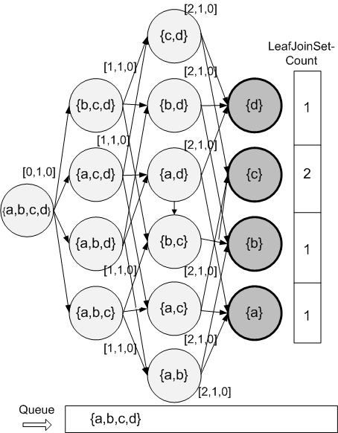
Pruning Filters: Local Upper Bound
Enumeration for window <0,2>:
LeafJoinSet-Count
L = 3 sec, δ = 1 sec, ε = 3.5, minsupp = 0
Node | |C| | |C⋈W_{N}| | K_{C,WN}(δ)
{a} | 3 | 1 | 2
{b} | 2 | 1 | 3
{c} | 3 | 2 | 4
{d} | 3 | 1 | 2
{a,b,c,d} | 2 | 1 | 3

Slide 15
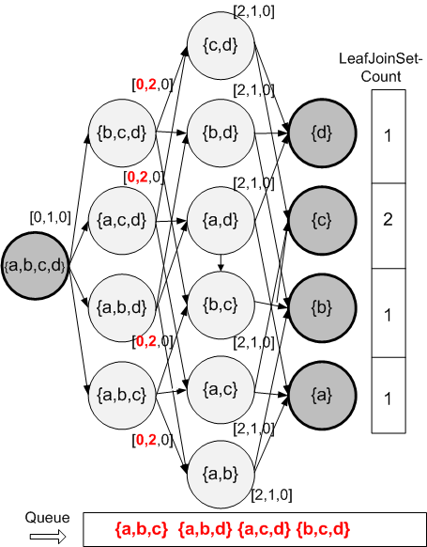
Node | |C| | |C⋈W_{N}| | K_{C,WN}(δ)
{a,b,c,d} | 2 | 1 | 3

Slide 16
L = 3 sec, δ = 1 sec, ε = 3.5, minsupp = 0
Node | |C| | |C⋈W_{N}| | K_{C,WN}(δ)
{a,b,c} | ? | ? | ?
{a,b,c} | - | - | -
⋈
⋈
⋈
UB_{local}(K_{abc,WN}(δ)) =
= 12/2 x min(1,1,2)/2
= 3 < ε = 3.5
{a,b,c} will be pruned

Slide 17
Pruning Filters: Lattice Upper Bound
Lattice Upper Bound of K_{C,WN}(δ)
Given an NWC pattern C = {S_{i}(u_{i}): u_{i} ϵ U, 1 ≤ i ≤ |U|, U ⊆ V} and a time lag δ, the lattice upper bounds of K_{C,WN}(δ) can be computed as follows:

Slide 18
Pruning Filters: Lattice Upper Bound
Filter 2: Conditional Monotone Property of the Lattice Upper Bound:
Given an NWC pattern C, and a time lag δ, then:
UB_{lattice} (K_{C,WN}(δ)) is monotonically decreasing with decreasing Dim(C) if Lower(|C|) is kept monotonically increasing.
i.e., given two NWC patterns C and C’ where C’ ⊂ C, then if Lower(|C’|) ≥ Lower(|C|), then:
UB_{lattice}(K_{C’,WN}(δ)) ≤ UB_{lattice}( K_{C,WN}(δ)).
Notes:
i.e., given two NWC patterns C and C’ where C’ ⊂ C, then if Lower(|C’|) ≥ Lower(|C|), then:
UB_{lattice}(K_{C’,WN}(δ)) ≤ UB_{lattice}( K_{C,WN}(δ)).
i.e. The lattice upper bound is not only an upper bound on the cross k function of the node but also on all the nodes in the lattice for which this node is the root (all descendants)

Slide 19
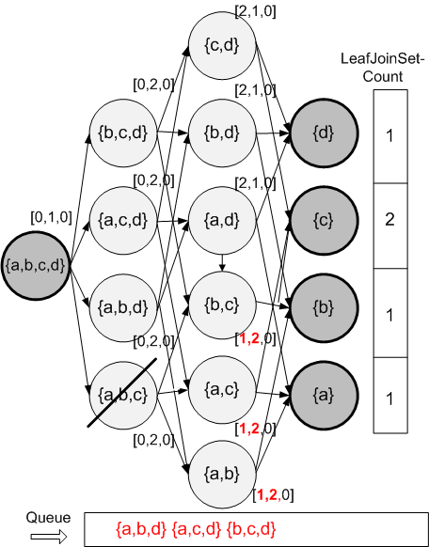
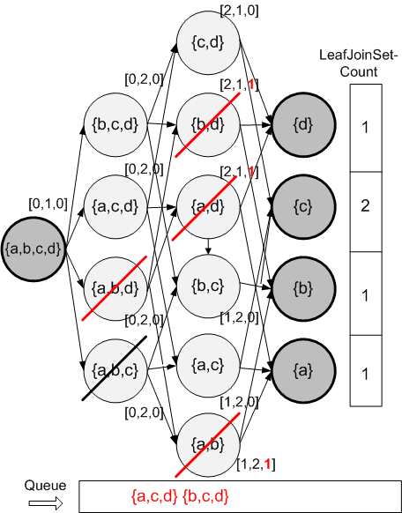
L = 3 sec, δ = 1 sec, ε = 3.5, minsupp = 0
Node | |C| | |C⋈W_{N}| | K_{C,WN}(δ)
{a,b,d}
⋈
⋈
⋈
UB_{local}(K_{abd,WN}(δ)) =
= 12/2 x max(1,1,1)/2
= 3 < ε = 3.5
Node {a,b,d} and its descendant lattice are pruned

