Slide 1
Introduction to Spatial Computing CSE 5ISC
Week Aug-10 – Aug-15
Some slides adapted from Worboys and Duckham (2004) GIS: A Computing Perspective, Second Edition, CRC Press

Slide 2
Geometry and Invariance
Geometry: provides a formal representation of the abstract properties and structures within a space
Invariance: a group of transformations of space under which propositions remain true
  Distance- translations and rotations
  Angle and parallelism- translations rotations, and scaling

Slide 3
Coordinate Based Geometry

Slide 4
Euclidean Space
Euclidean Space: coordinatized model of space
  Transforms spatial properties into properties of tuples of real numbers
  Coordinate frame consists of a fixed, distinguished point (origin) and a pair of orthogonal lines (axes), intersecting in the origin
Point objects
Line objects
Polygonal objects

Slide 5
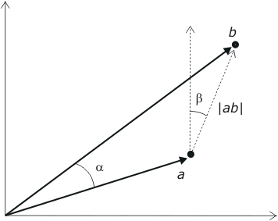


Points
A point in the Cartesian plane R² is associated with a unique pair of real number a = (x,y) measuring distance from the origin in the x and y directions. It is sometimes convenient to think of the point a as a vector.
  Scalar: Addition, subtraction, and multiplication, e.g.,
  (x₁, y₁) − (x₂, y₂) =
  (x₁ − x₂, y₁ − y₂)
  Norm:
  Distance: |ab| = ||a-b||
  Angle between vectors:

Slide 6
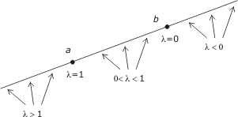

Lines
The line incident with a and b is defined as the point set
{λa + (1 −λ )b | λ is a real number }
The line segment between a and b is defined as the point set {λa + (1 −λ )b | λ $∈$ [0, 1]}
The half line radiating from b and passing through a is defined as the point set {λa + (1 − λ)b | λ $≥$ 0}

Slide 7
Polygon Objects
A polyline in R² is a finite set of line segments (called edges) such that each edge end-point is shared by exactly two edges, except possibly for two points, called the extremes of the polyline.
If no two edges intersect at any place other than possibly at their end-points, the polyline is simple.
A polyline is closed if it has no extreme points.
A (simple) polygon in R² is the area enclosed by a simple closed polyline. This polyline forms the boundary of the polygon. Each end-point of an edge of the polyline is called a vertex of the polygon.
A convex polygon has every point intervisible
A star-shaped or semi-convex polygon has at least one point that is intervisible

Slide 8
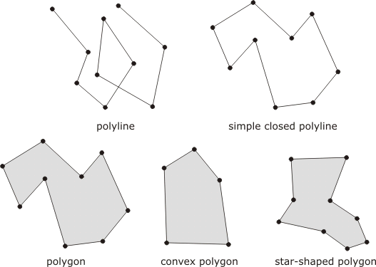
Polygon Objects

Slide 9
Polygonal Objects
Monotone chain: there is some line in the Euclidean plane such that the projection of the vertices onto the line preserves the ordering of the list of points in the chain
Monotone polygon: if the boundary can be split into two polylines, such that the chain of vertices of each polyline is a monotone chain
Triangulation: partitioning of the polygon into triangles that intersect only at their mutual boundaries

Slide 10
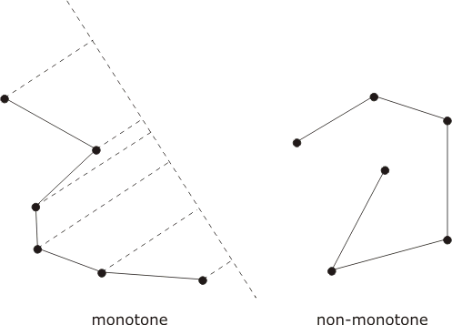
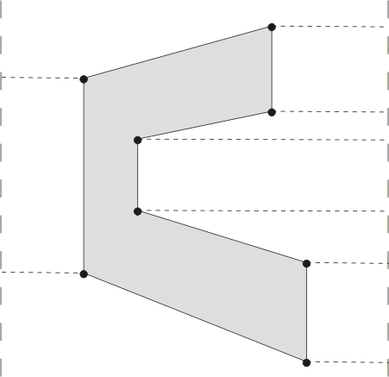
Polygonal Objects
monotone polyline

Slide 11
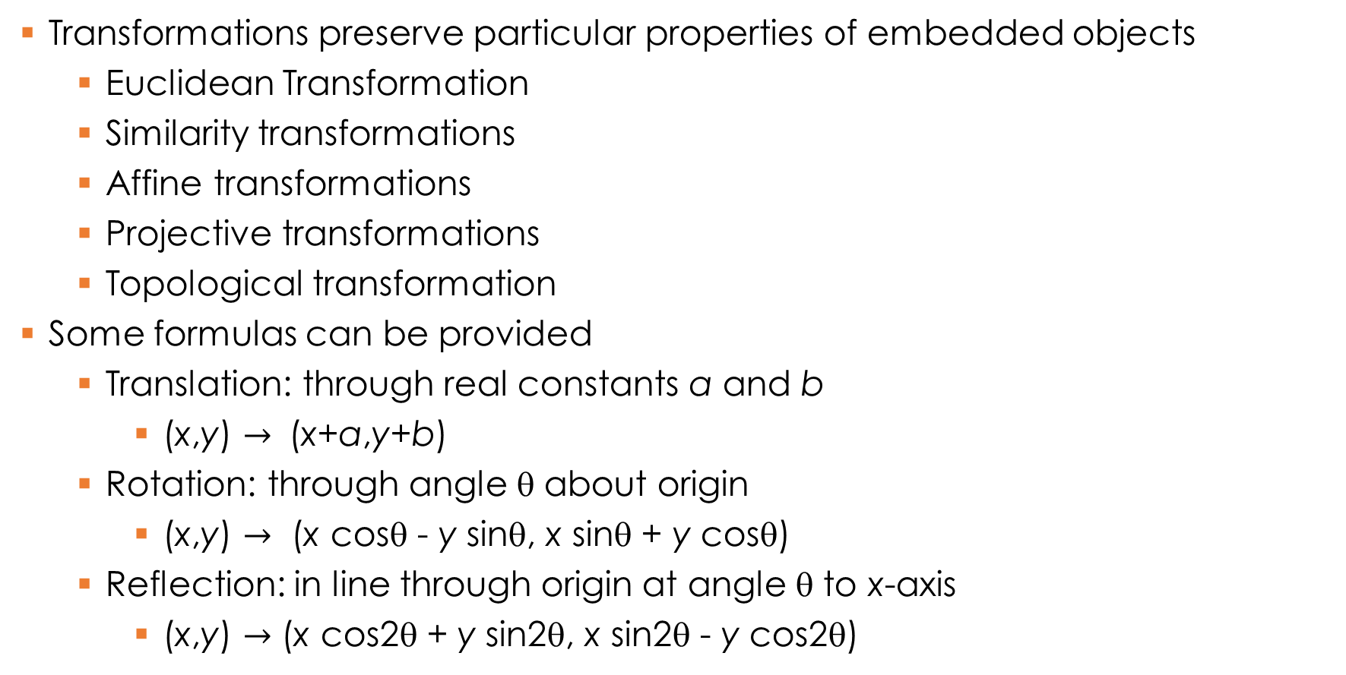
Transformations
Transformations preserve particular properties of embedded objects
  Euclidean Transformation
  Similarity transformations
  Affine transformations
  Projective transformations
  Topological transformation
Some formulas can be provided
  Translation: through real constants a and b
    (x,y) $→$ (x+a,y+b)
  Rotation: through angle θ about origin
    (x,y) $→$ (x cosθ - y sinθ, x sinθ + y cosθ)
  Reflection: in line through origin at angle θ to x-axis
    (x,y) $→$ (x cos2θ + y sin2θ, x sin2θ - y cos2θ)

Slide 12
Coordinate systems for Earth

Slide 13
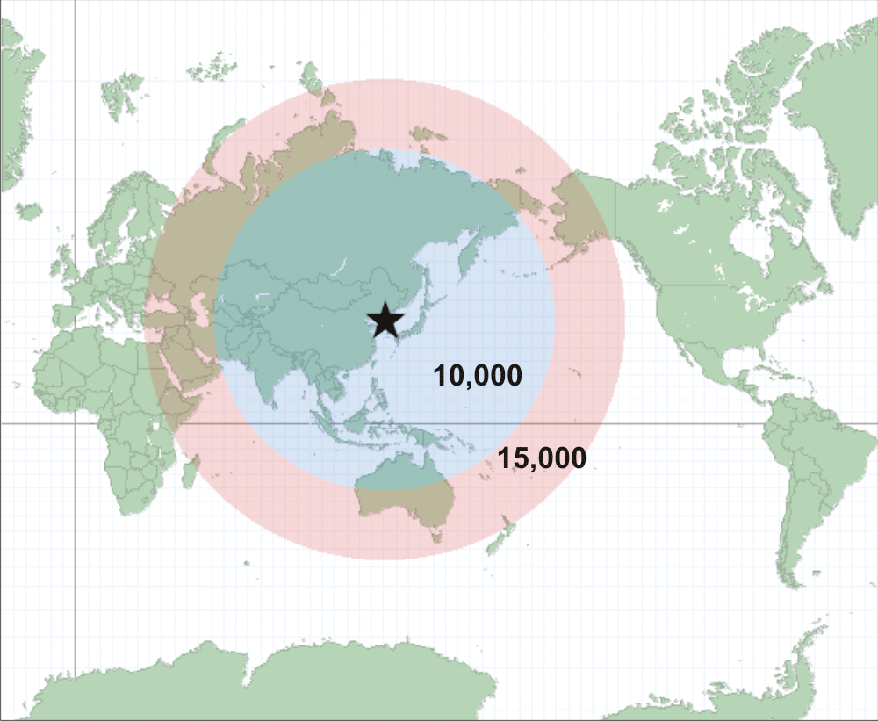
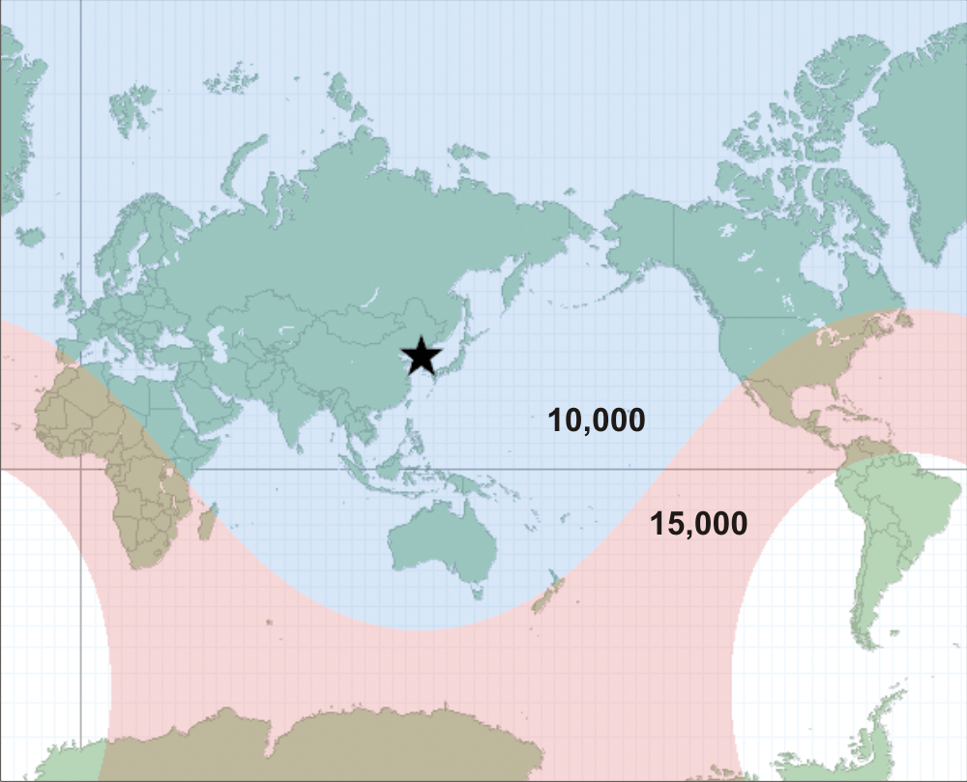
Euclidean space for Earth??
Original map showing regions with 10,000 and 15,000 km from North Korea
Corrected map using Geodesic distances.
More info on http://www.esri.com/news/arcuser/0111/geodesic.html

Slide 14
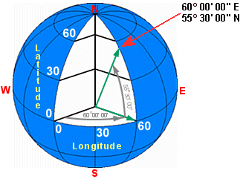
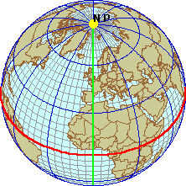
Geographic Coordinates: spherical model
Latitude
  Angle between the equatorial plane and line joining the point to the center of the ellipsoid
Longitude
  Angle east or west from a reference meridian to another meridian that passes through that point
Prime Meridian

Slide 15
Geodetic Coordinates –Ellipsoid model
Another coordinate system which uses a different set of reference points (Datums) for locating places.
A Datum defines a reference point (or a reference frame) for localizing.
Datum uses an ellipsoid to defines latitude, longitude and altitude coordinates.
  Horizontal Datum: For latitude and Longitude
  Vertical Datum: For elevation
Multiple standards exist.
  WGS 84, AD83 and ETRS89
Refer https://en.wikipedia.org/wiki/Geodetic_datum

Slide 16
Geodetic Coordinates –Lat ($φ)$ and Long ($λ)$
The geoid is a representation of the surface of the earth that it would assume if the sea covered the earth

Slide 17
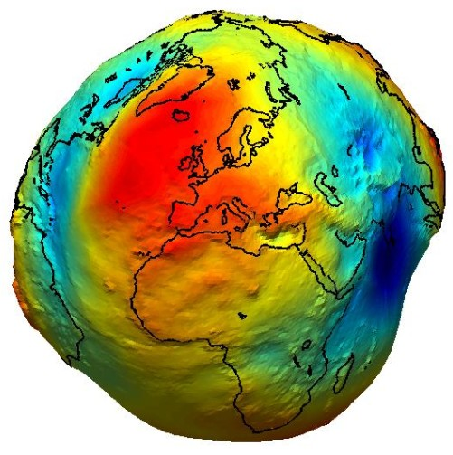
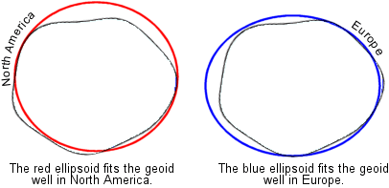
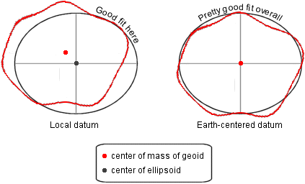
Multiple datums
The geoid is a representation of the surface of the earth that it would assume if the sea covered the earth
An equipotential surface with respect to gravity
Refer https://en.wikipedia.org/wiki/Geodetic_datum

Slide 18
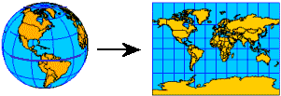
Projected Coordinates
Flattening the Earth

Slide 19
Projected Coordinates
A map project can distort one or several of the following properties
  Shape
  Area
  Distance
  Direction
Some projections specialize in preserving one or several of these features, but none preserve all

Slide 20
Map-Projection Distortion: Shape
Projection can distort the shape of a feature.
Conformal maps preserve the shape of smaller, local geographic features, while general shapes of larger features are distorted. That is, they preserve local angles; angle on map will be same as angle on globe.
Conformal maps also preserve constant scale locally

Slide 21
Map-Projection Distortion: Area
Projection can distort the property of equal area (or equivalent), meaning that features have the correct area relative to one another. Map projections that maintain this property are often called equal area map projections.
For instance, if S America is 8x larger than Greenland on the globe, it will be 8x larger on map as well
No map projection can have conformality and equal area; sacrifice shape to preserve area and vice versa

Slide 22
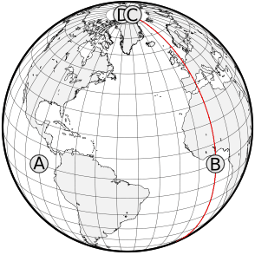
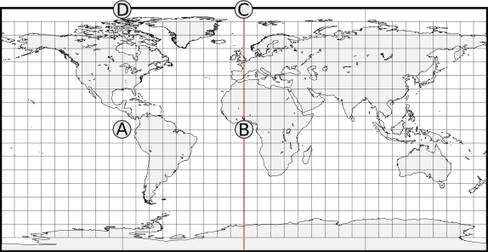
Map-Projection Distortion: Distance
If a line from a to b on a map is the same distance (accounting for scale) that it is on the earth, then the map line has true scale.
No map has true scale everywhere, but most maps have at least one or two lines of true scale.
An equidistant map is one that preserves true scale for all straight lines passing through a single, specified point.
A is equidistant from B and C.
Distance between D and C is actually zero (they are at pole)

Slide 23
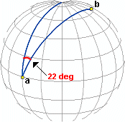
Map-Projection Distortion: Direction
Direction, or azimuth, is measured in degrees of angle from north.
On the earth, this means that the direction from a to b is the angle between the meridian on which a lies and the great circle arc connecting a to b.
If the azimuth value from a to b is the same on a map as on the earth, then the map preserves direction from a to b.
An azimuthal projection is one that preserves direction for all straight lines passing through a single, specified point. No map has true direction everywhere.

Slide 24
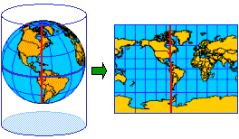
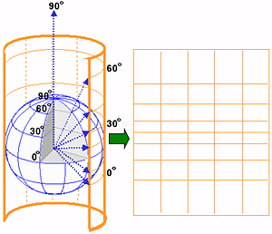
Cylindrical Map Projection
Created by wrapping a cylinder around a globe
The meridians in cylindrical projections are equally spaced.
The spacing between parallel lines of latitude increases toward the poles
meridians never converge so poles can’t be shown
Source: ESRI

Slide 25
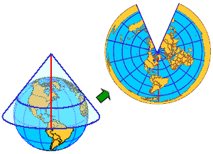
Conical Projection
Projects a globe onto a cone
In simplest case, globe touches cone along a single latitude line, or tangent, called standard parallel
Other latitude lines are projected onto cone
To flatten the cone, it must be cut along a line of longitude (see image)
The opposite line of longitude called the central meridian
Source: ESRI
Source: ESRI
Standard Parallel
Central Meridian

Slide 26
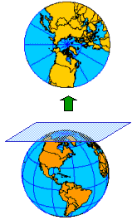
Azimuthal Projection
Planar or Azimuthal Projections: simply project a globe onto a flat plane
Any point of contact may be used but the poles are most commonly used
When another location is used, it is generally to make a small map of a specific area
When the poles are used, longitude lines look like hub and spokes
Source: ESRI

Slide 27
Pop Question
Consider the following classes of transformations for Euclidean spaces
  Translation (e.g., moving an object linearly)
  Similarity (e.g., rotation, rotation & scaling)
  Affine (e.g., combinations of contraction, expansion, shear, reflection, shear, similarity)
    Basically any transformation which preserves collinearity of three points and ratio of distances.
  Projective (e.g., slide projectors)
  Topological (e.g., elastic deformation without tear)
Which of the following are preserved by each of the above transformations:
(a) Shape, (b) Size, (c) Distance, (d) Direction, (e) Occlusion (in front of)

Slide 28
Pop Question
Consider the following classes of transformations for Euclidean spaces
  Translation (e.g., moving an object linearly)
  Similarity (e.g., rotation, rotation & scaling)
  Affine (e.g., combinations of contraction, expansion, shear, reflection, shear, similarity)
    Basically any transformation which preserves collinearity of three points and ratio of distances.
  Projective (e.g., slide projectors)
  Topological (e.g., elastic deformation without tear)
Which of the above transformations are closest to following map projections
(a) Cylindrical, (b) Azimuthal projection

Slide 29
Set Based Geometry of Space

Slide 30
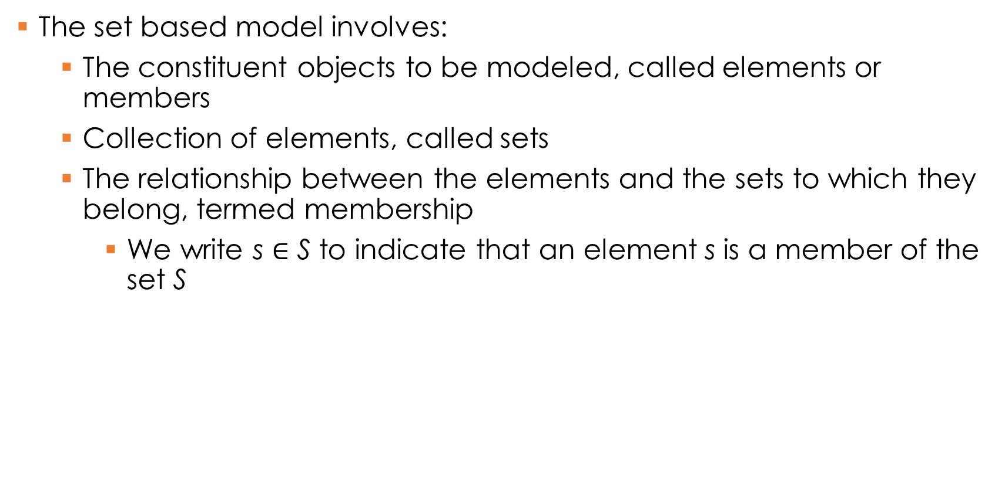
Sets
The set based model involves:
  The constituent objects to be modeled, called elements or members
  Collection of elements, called sets
  The relationship between the elements and the sets to which they belong, termed membership
    We write s $∈$ S to indicate that an element s is a member of the set S

Slide 31
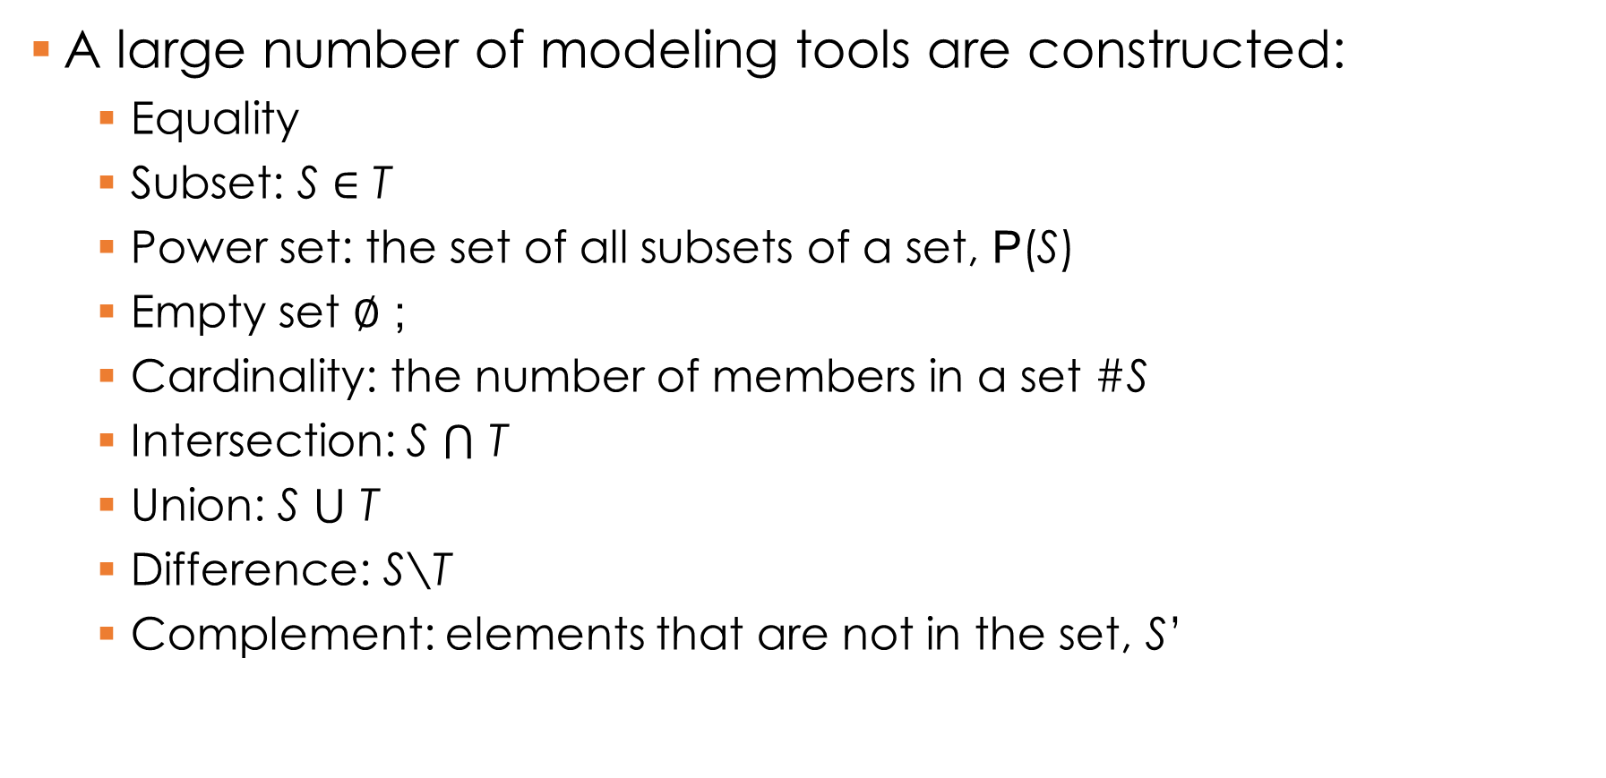
Sets
A large number of modeling tools are constructed:
  Equality
  Subset: S $∈$ T
  Power set: the set of all subsets of a set, P(S)
  Empty set $∅$ ;
  Cardinality: the number of members in a set #S
  Intersection: S $⋂$ T
  Union: S $⋃$ T
  Difference: S\T
  Complement: elements that are not in the set, S’

Slide 32
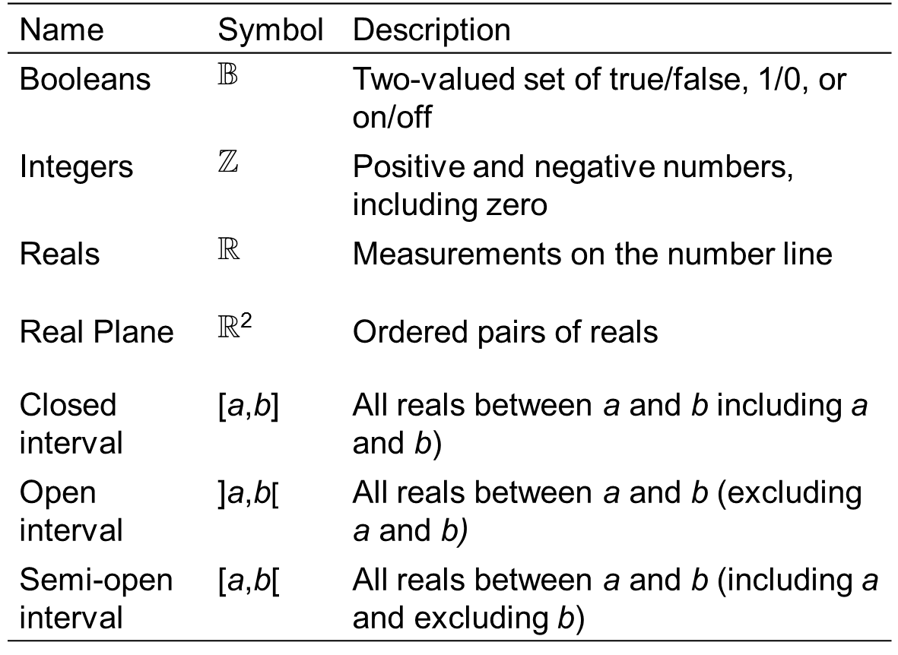
Distinguished sets

Slide 33
Relations
Product: returns the set of ordered pairs, whose first element is a member of the first set and second element is a member of the second set
Binary relation: a subset of the product of two sets, whose ordered pairs show the relationships between members of the first set and members of the second set
Reflexive relations: where every element of the set is related to itself
Symmetric relations: where if x is related to y then y is related to x
Transitive relations: where if x is related to y and y is related to z then x is related to z
Equivalence relation: a binary relation that is reflexive, symmetric and transitive

Slide 34
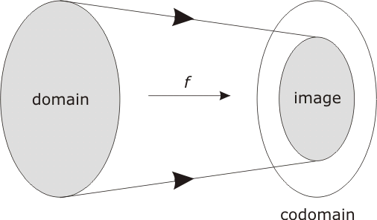

Functions
Function: a type of relation which has the property that each member of the first set relates to exactly one member of the second set
  f: S $→$ T

Slide 35
Functions
Injection: any two different points in the domain are transformed to two distinct points in the codomain
Image: the set of all possible outputs
Surjection: when the image equals the codomain
Bijection: a function that is both a surjection and an injection

Slide 36
Inverse Functions
Injective function have inverse functions
Projection
  Given a point in the plane that is part of the image of the transformation, it is possible to reconstruct the point on the spheroid from which it came
  Example:
    A new function whose domain is the image of the UTM maps the image back to the spheroid

Slide 37
Convexity
A set is convex if every point is visible from every other point within the set
Let S be a set of points in the Euclidean plane
Visible:
  Point x in S is visible from point y in S if either
    x=y or;
    it is possible to draw a straight-line segment between x and y that consists entirely of points of S

Slide 38
Convexity
Observation point:
  The point x in S is an observation point for S if every point of S is visible from x
Semi-convex:
  The set S is semi-convex (star-shaped if S is a polygonal region) if there is some observation point for S
Convex:
  The set S is convex if every point of S is an observation point for S

Slide 39
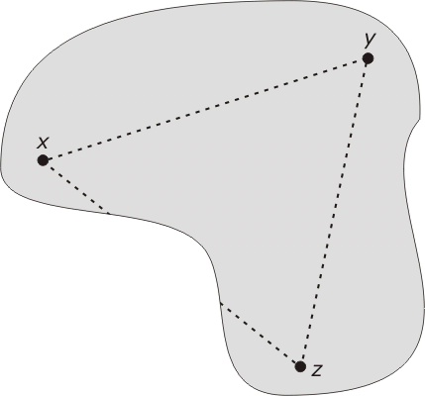
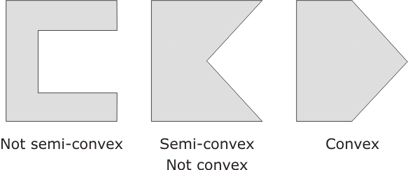
Convexity
Visibility between points x, y, and z

Slide 40
Topology of Space

Slide 41
Topology
Topology: “study of form”; concerns properties that are invariant under topological transformations
Intuitively, topological transformations are rubber sheet transformations
Topological | A point is at an end-point of an arc
 | A point is on the boundary of an area
 | A point is in the interior/exterior of an area
 | An arc is simple
 | An area is open/closed/simple
 | An area is connected
Non-topological | Distance between two points
 | Bearing of one point from another point
 | Length of an arc
 | Perimeter of an area

Slide 42
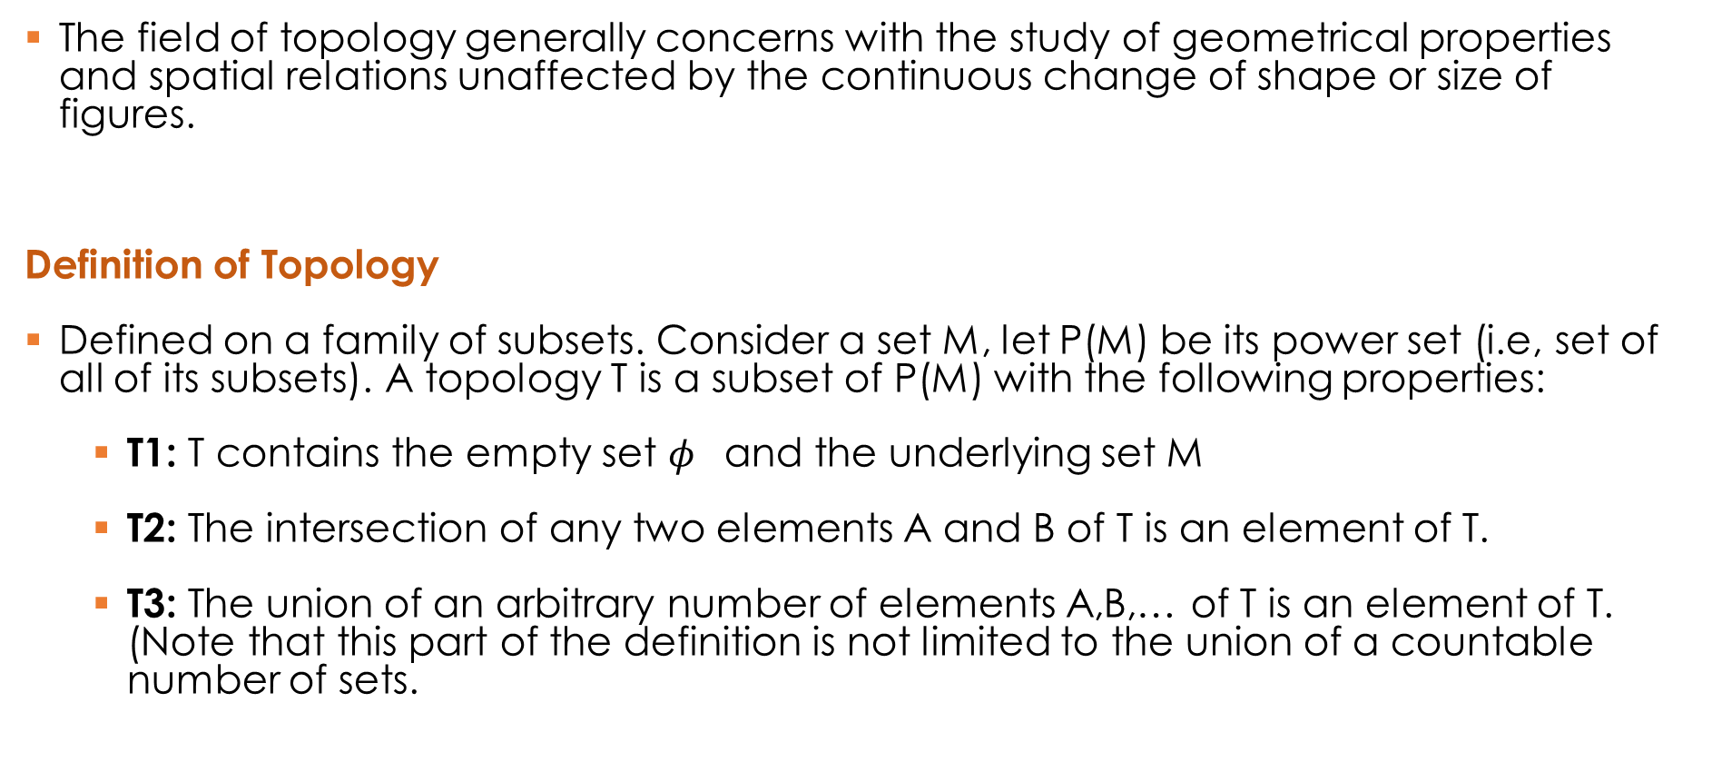
Brief Introduction to Topology
The field of topology generally concerns with the study of geometrical properties and spatial relations unaffected by the continuous change of shape or size of figures.
Definition of Topology
Defined on a family of subsets. Consider a set M, let P(M) be its power set (i.e, set of all of its subsets). A topology T is a subset of P(M) with the following properties:
  T1: T contains the empty set $φ$ and the underlying set M
  T2: The intersection of any two elements A and B of T is an element of T.
  T3: The union of an arbitrary number of elements A,B,… of T is an element of T. (Note that this part of the definition is not limited to the union of a countable number of sets.

Slide 43
Brief Introduction to Topology
Topological Space:
A domain (M ; T) is called a topological space if T is a topology on the underlying set M. Every element of the underlying set M is called a point of the topological space. Every element of the topology T is called an open set of the topological space and is a subset of M.
Open Sets (An example):
Formally, a subset A of points of a topological space (M;T) is called an open set of it is an element of the topology of the space (i.e., it is member of T).
Consider the real number set R.
A subset U⊆R is 'open' if for every point x∈U there is some ε>0 such that (x−ε,x+ε)⊆U. Equivalently, if |x−y|<ε then y∈U.
Intuitively, for sets defined using geometric shapes (e.g., circles) the boundary of the shape is not included in the set.

Slide 44
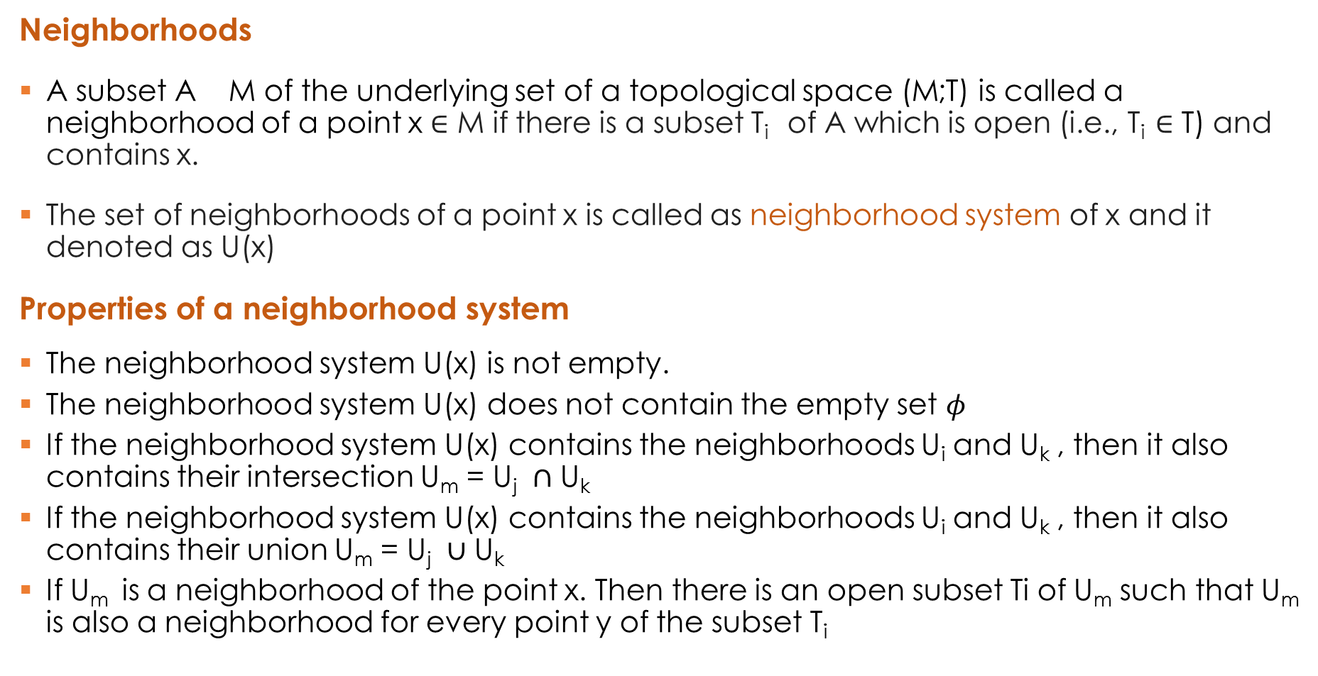
Brief Introduction to Topology
Neighborhoods
A subset A M of the underlying set of a topological space (M;T) is called a neighborhood of a point x ∈ M if there is a subset T_{i} of A which is open (i.e., T_{i} $∈$ T) and contains x.
The set of neighborhoods of a point x is called as neighborhood system of x and it denoted as U(x)
Properties of a neighborhood system
The neighborhood system U(x) is not empty.
The neighborhood system U(x) does not contain the empty set $φ$
If the neighborhood system U(x) contains the neighborhoods U_{i} and U_{k} , then it also contains their intersection U_{m} = U_{j} $∩$ U_{k}
If the neighborhood system U(x) contains the neighborhoods U_{i} and U_{k} , then it also contains their union U_{m} = U_{j} $∪$ U_{k}
If U_{m} is a neighborhood of the point x. Then there is an open subset Ti of U_{m} such that U_{m} is also a neighborhood for every point y of the subset T_{i}

Slide 45
Brief Introduction to Topology
Neighborhood Axioms (alternative definition of topology)
A neighborhood topology on a set X assigns to each x∈X a non empty set U(x) of subsets of X, called neighborhoods of x, with the properties:
U1: Each point belongs to each of its neighborhoods
U2: The union of an arbitrary number of neighborhoods of a point x is also neighborhood of x.
U3: The intersections of two neighborhoods of x is a neighborhood of x.
U4: Every neighborhood U_{m} of a point x contains a neighborhood U_{i} U_{m} of x such that, U_{m} is a neighborhood of every point of U_{i}

Slide 46
Brief Introduction to Topology
Basis of a Topology
Let (M ; T) be a topological space. A subset B of the topology
T is called a basis of the topology if T contains exactly those sets which result from arbitrary unions of elements of B.
Generating set of a Topology
A subset E of the power set P(M) is called a generating set on the underlying set M if :
E1: The underlying set M is a union of elements of E.
E2: For every point x of the intersection A of two elements of E there is an element of E which contains x and is a subset of A.
Construction of Topology
A generating set E is a basis for a topological space with the underlying set M. The set T which contains every union of elements of E is therefore a topology on M.

Slide 47
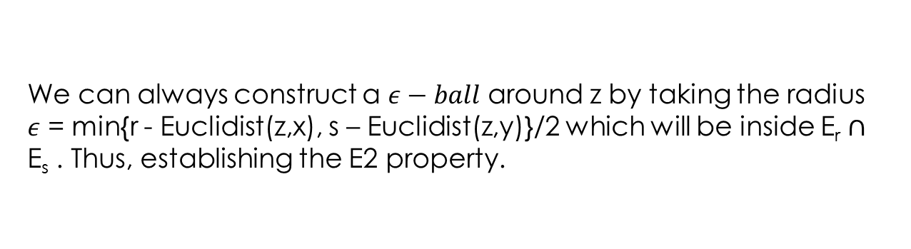
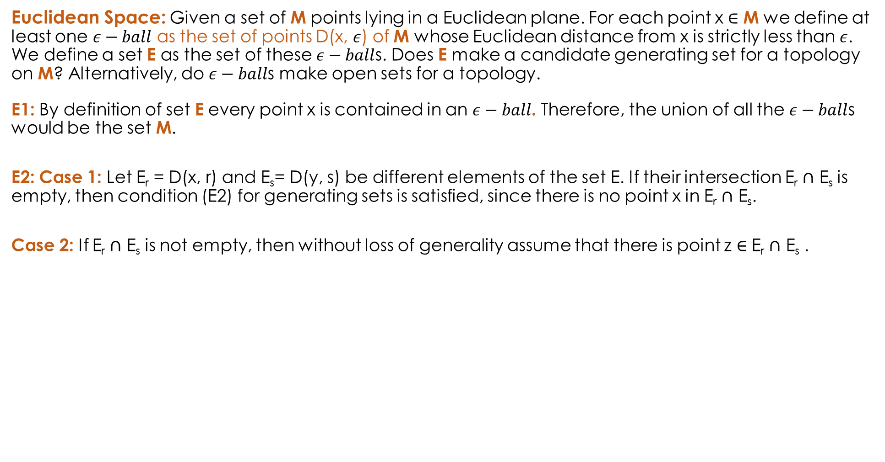
Examples of Generating Sets (1/2)
Euclidean Space: Given a set of M points lying in a Euclidean plane. For each point x $∈$ M we define at least one $ε−ball$ as the set of points D(x, $ε$) of M whose Euclidean distance from x is strictly less than $ε$. We define a set E as the set of these $ε−ball$s. Does E make a candidate generating set for a topology on M? Alternatively, do $ε−ball$s make open sets for a topology.
E1: By definition of set E every point x is contained in an $ε−ball$. Therefore, the union of all the $ε−ball$s would be the set M.
E2: Case 1: Let E_{r} = D(x, r) and E_{s}= D(y, s) be different elements of the set E. If their intersection E_{r} $∩$ E_{s} is empty, then condition (E2) for generating sets is satisfied, since there is no point x in E_{r} $∩$ E_{s}.
Case 2: If E_{r} $∩$ E_{s} is not empty, then without loss of generality assume that there is point z $∈$ E_{r} $∩$ E_{s} .
We can always construct a $ε−ball$ around z by taking the radius $ε$ = min{r - Euclidist(z,x), s – Euclidist(z,y)}/2 which will be inside E_{r} $∩$ E_{s} . Thus, establishing the E2 property.
r
s
x
z
y

Slide 48

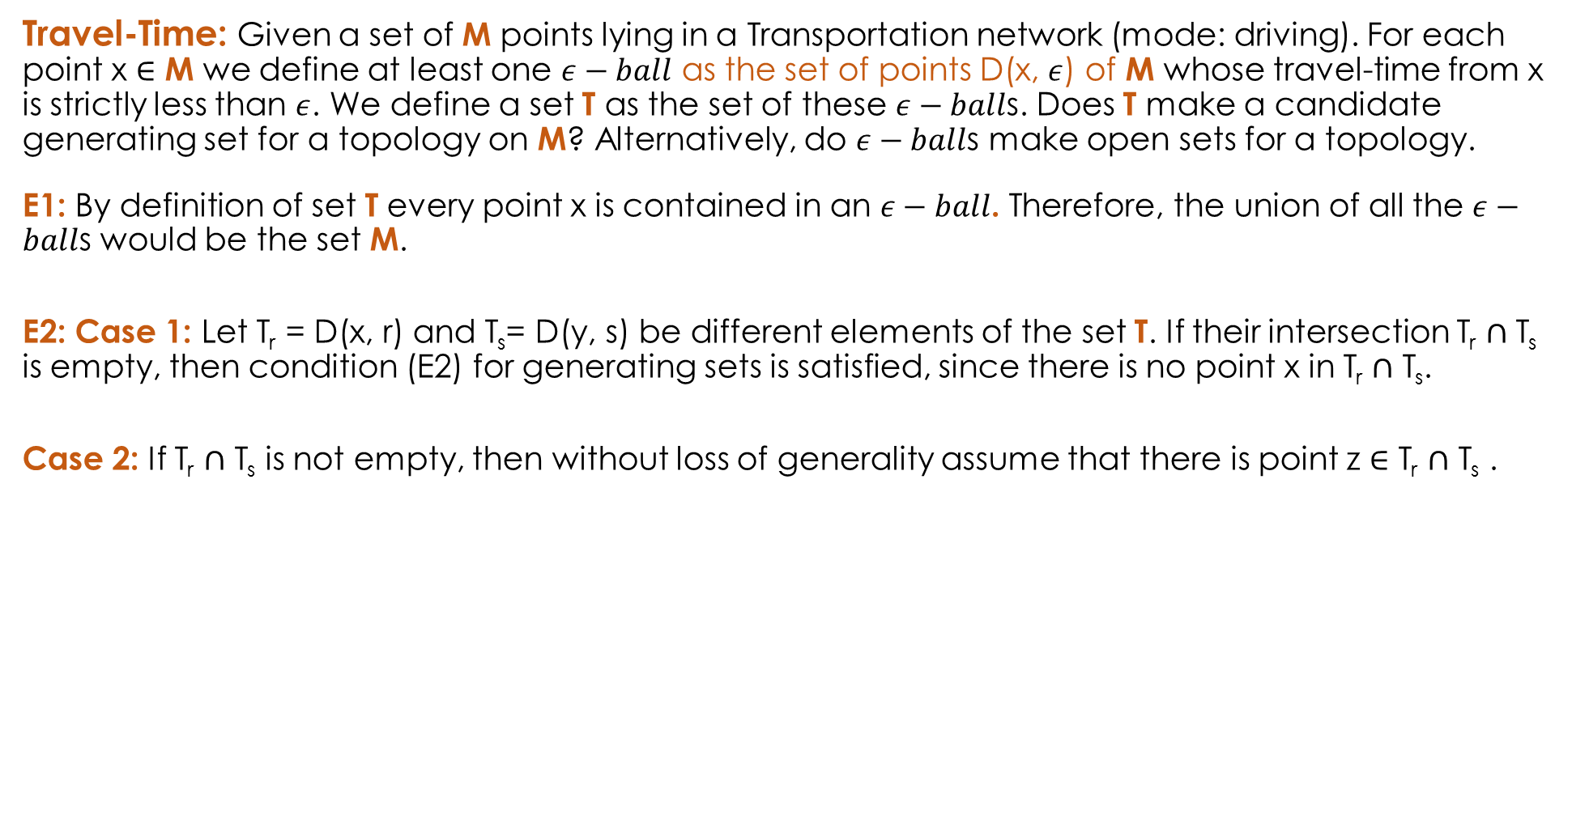
Examples of Generating Sets (2/2)
Travel-Time: Given a set of M points lying in a Transportation network (mode: driving). For each point x $∈$ M we define at least one $ε−ball$ as the set of points D(x, $ε$) of M whose travel-time from x is strictly less than $ε$. We define a set T as the set of these $ε−ball$s. Does T make a candidate generating set for a topology on M? Alternatively, do $ε−ball$s make open sets for a topology.
E1: By definition of set T every point x is contained in an $ε−ball$. Therefore, the union of all the $ε−ball$s would be the set M.
E2: Case 1: Let T_{r} = D(x, r) and T_{s}= D(y, s) be different elements of the set T. If their intersection T_{r} $∩$ T_{s} is empty, then condition (E2) for generating sets is satisfied, since there is no point x in T_{r} $∩$ T_{s}.
Case 2: If T_{r} $∩$ T_{s} is not empty, then without loss of generality assume that there is point z $∈$ T_{r} $∩$ T_{s} .
Can we still construct a $ε−ball$ around z which will completely inside the area of intersection?
r
s
x
z
y

Slide 49
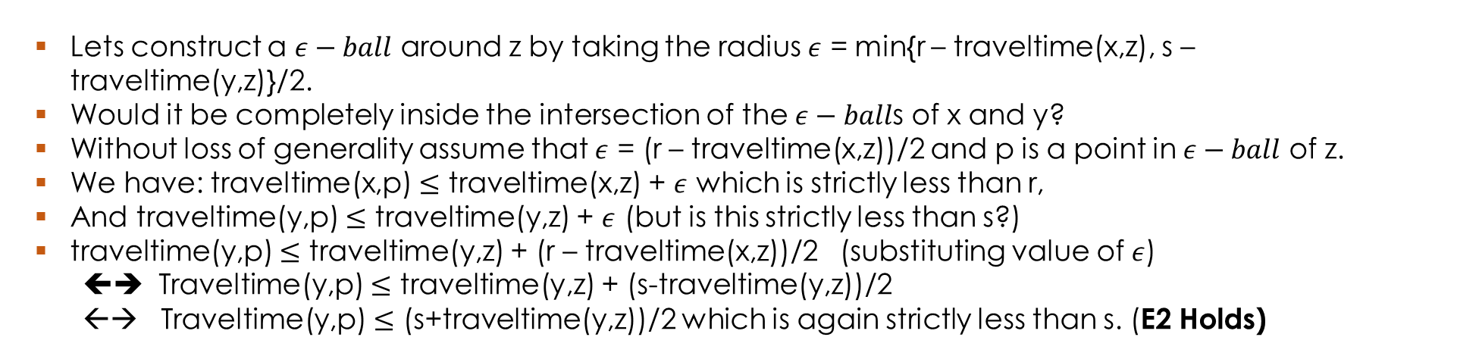

Examples of Generating Sets (2/2)
Case 2: If T_{r} $∩$ T_{s} is not empty, then without loss of generality assume that there is point z $∈$ T_{r} $∩$ T_{s} .
r
z
s
x
y
Lets construct a $ε−ball$ around z by taking the radius $ε$ = min{r – traveltime(x,z), s – traveltime(y,z)}/2.
Would it be completely inside the intersection of the $ε−ball$s of x and y?
Without loss of generality assume that $ε$ = (r – traveltime(x,z))/2 and p is a point in $ε−ball$ of z.
We have: traveltime(x,p) $≤$ traveltime(x,z) + $ε$ which is strictly less than r,
And traveltime(y,p) $≤$ traveltime(y,z) + $ε$ (but is this strictly less than s?)
traveltime(y,p) $≤$ traveltime(y,z) + (r – traveltime(x,z))/2 (substituting value of $ε$)
⬅➔ Traveltime(y,p) $≤$ traveltime(y,z) + (s-traveltime(y,z))/2
←→ Traveltime(y,p) $≤$ (s+traveltime(y,z))/2 which is again strictly less than s. (E2 Holds)

Slide 50
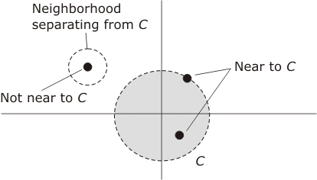
Nearness
Let S be a topological space. Then S has a set of neighborhoods associated with it.
Let C be a subset of points in S and c an individual point in S
Define c to be near C if every neighborhood of c contains some point of C

Slide 51
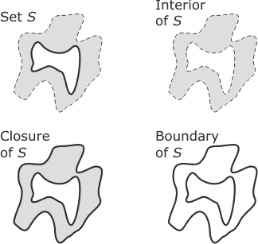
Closure, Boundary and Interior
Let X be a topological space and S be a subset of points of X
The closure of S is the union of S with the set of all its near points
The interior of S consists of all points which belong to S and not near points of compliment of S
  denoted S°
Boundary of S: it is the set of points in the closure of S, not belonging to the interior of S. It is denoted by ∂S

Slide 52
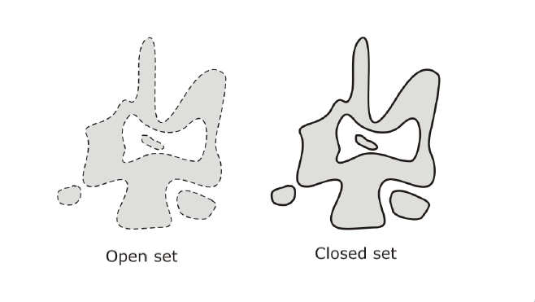
Open and Closed Sets
Let X be a topological space and S be a subset of points of X.
  Then S is open if every point of S can be surrounded by a neighborhood that is entirely within S.
    Alternatively: a set that does not contain its boundary
  Then S is closed if it contains all its near points
    Alternatively: a set that does contain its boundary

Slide 53
Metric Spaces

Slide 54
Definition
A point-set S is a metric space if there is a distance function d, which takes ordered pairs (s,t) of elements of S and returns a distance that satisfies the following conditions
  For each pair s, t in S, d(s,t) >0 if s and t are distinct points and d(s,t) =0 if s and t are identical
  For each pair s,t in S, the distance from s to t is equal to the distance from t to s, d(s,t) = d(t,s)
  For each tripe s,t,u in S, the sum of the distances from s to t and from t to u is always at least as large as the distance from s to u

Slide 55
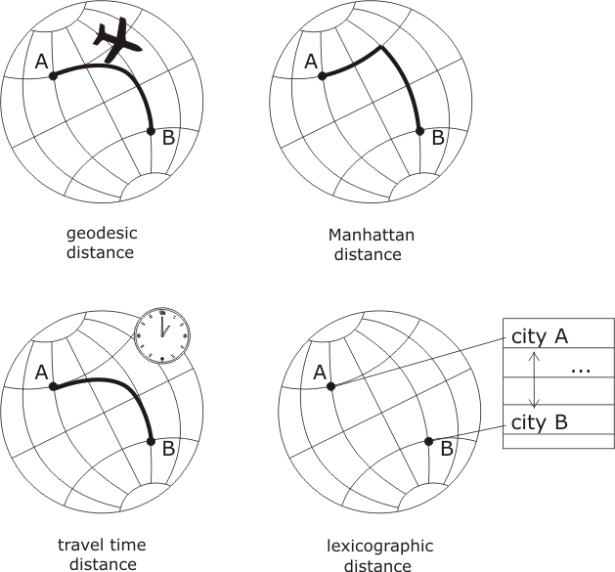
Distances Defined on Globe
Metric space
Metric space
Quasimetric
As travel-time
Not always
symmetric
Metric space

