Slide 1
Introduction to Spatial Computing CSE 5ISC
Week Aug-17 – Aug-22
Some slides adapted from Worboys and Duckham (2004) GIS: A Computing Perspective, Second Edition, CRC Press

Slide 2
Algorithms
An algorithm is a specification of a computational process required to perform some operation
For a given algorithm, we are usually interested in how efficient it is. Efficient algorithms require less computing resources when actually implemented
The efficiency of an algorithm is usually measured in terms of the time the algorithm uses, called time complexity or the amount of storage space required, called space complexity
For example, the time required to compute the breadth first search for any graph G = (V, E) is proportional to |V|, the number of input nodes
We use the “big-oh” notation to classify algorithms according to time complexity
O(n) stands for the set of algorithms that have a time complexity that is at most linearly proportional to n

Slide 3
Common Complexity Orders
We all like these
O(1) | Constant time | Very fast
O(log_{e}n) | Logarithmic time | Fast
O(n) | Linear time | Moderate
O(n logn) | Sub-linear time | Moderate
O(n^{k}) | Polynomial time | Slow
O(k^{n}) | Exponential time | Intractable
Not so much!

Slide 4
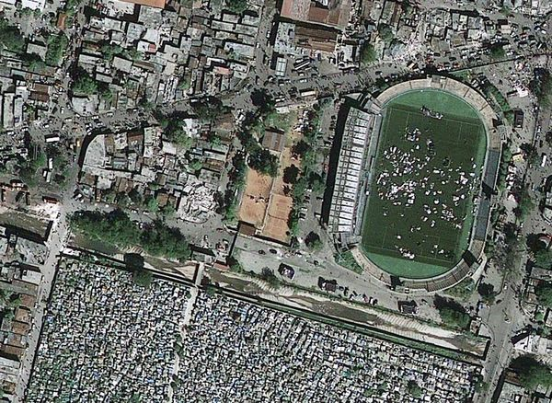
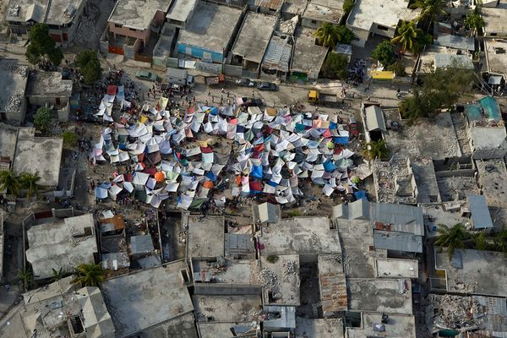
What about the complexity of these tasks? Can even have a correct and complete algorithm?
Examples:
Geo-locate all human settlements e.g. tents (or usable roads) after an earthquake. You are given aerial images.
Given a digital satellite image, create an object based model for water bodies including wells (points), streams (line string) and lakes (polygons).
Given a news article (e.g. those from Google News), photograph, or video-clip, identify the geographic location it is describing.
Given postal addresses of hotels, determine the hotel closest to a specified point of interest (POI). Assume the availability of a geo-coding service to convert postal addresses to geographic point-locations

Slide 5
Special Considerations for Discrete Euclidean Plane

Slide 6
Geometric domains
Geometric domain is a triple <G,P,S>, where:
G, the domain grid, is a finite connected portion of the discrete Euclidean plane, Z²
P is a set of points in Z²
S is a set of line segments in Z²
Subject to the following closure conditions:
Each point of P is a point in the domain grid G
Any line segment in S must have its end-points as members of P
Any point in P that is incident with a line segment in S must be one of its end-points
If any two line segments in S intersect as a point, then that point must be a member of P

Slide 7
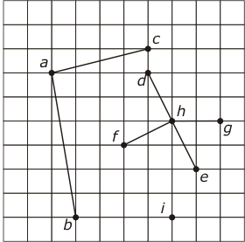
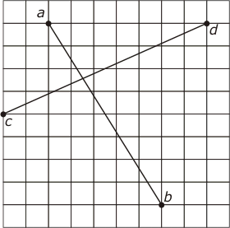
Grid Structures
A structure that forms a geometric domain
A structure that does not form a geometric domain

Slide 8
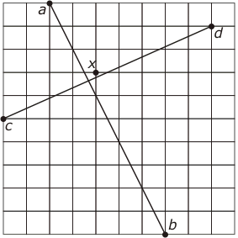
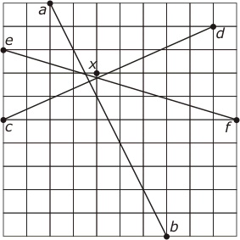
Discretization
Discretization: moving data from a continuous to a discrete domain (some precision will be lost)
Can snap the intersection point to a nearest gird point? Point x in this example
May not always work. Here the intersection point change its location with respect to line ef

Slide 9
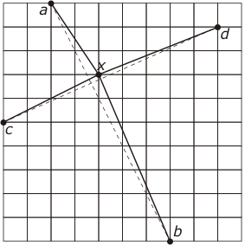
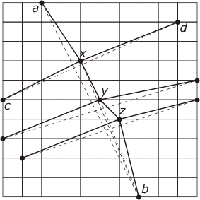
Discretization – Drifting problem
Say we go ahead snapping the intersection point to the grid point x anyways
The chain axyzb has strayed well away from the original line segment ab

Slide 10
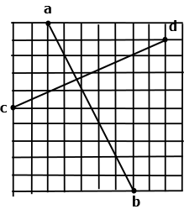
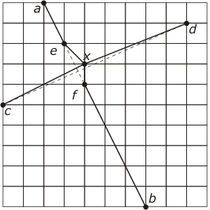
Green Yao Algorithm for Drifting problem
Imagine pegs put on the grid points.
Lines are imagined to be rubber strings
Lines can be stretched to include a point, but not cross a peg.

Slide 11
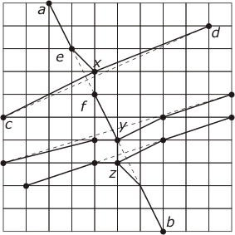
Green Yao Algorithm for Drifting problem

Slide 12
Discretizing Arcs
Problem: Given an chain of vertices $V=\{v_{1},v_{2},v_{3},..v_{n}\}$ representing an arc, the problem is to find a subsequence of vertices that approximates the chain V.
No self intersections.
Overall Idea (Douglas and Peucker Algorithm):
Approximate $V=\{v_{1},v_{2},v_{3},..v_{n}\}$ by a single line $v_{1}v_{n}$
Determine the farthest point $v_{j}$ from $v_{1},v_{n}.$
If distance $d(v_{j}, v_{1}v_{n}$) is $≤ε (input threshold)$ then stop.
Otherwise break-up $V$ into $\left\{v_{1},..v_{j}\right\} \& \{v_{j}, …, v_{n}\}$ and proceed recursively.

Slide 13
Discretizing Arcs
Douglas and Peucker Algorithm :
Approximate $V=\{v_{1},v_{2},v_{3},..v_{n}\}$ by a single line $v_{1}v_{n}$
Determine the farthest point $v_{j}$ from $v_{1},v_{n}.$
If distance $d(v_{j}, v_{1}v_{n}$) is $≤ε (input threshold)$ then stop.
Otherwise break-up $V$ into $\left\{v_{1},..v_{j}\right\} \& \{v_{j}, …, v_{n}\}$ and proceed recursively.

Slide 14
Spatial Algorithms for Raster data

Slide 15
Calculating Accumulated Water flow
Given the elevation filed of an geographic region.
Compute the water accumulated
Assume that water flows along the direction of steepest flow
1 | 1 | 1 | 1
1 | 1 | 1 | 1
1 | 1 | 1 | 1
1 | 1 | 1 | 1
90 | 80 | 70 | 35
85 | 75 | 65 | 55
70 | 100 | 50 | 40
60 | 55 | 45 | 30
0 | 0 | 0 | 5
0 | 0 | 0 | 0
0 | 0 | 0 | 0
0 | 0 | 0 | 11
Rainfall Field
Elevation Field
Accumulated water
Is this a local, focal or a zonal operation?

Slide 16
Intuition for Algorithm
Construct a gradient descent graph.
Each node is connected to node with greatest descent.
Reverse the edges.
Perform a depth first search from each node.
Total water at a node = water from its descendants + self water
90 | 80 | 70 | 35
85 | 75 | 65 | 55
70 | 100 | 50 | 40
60 | 55 | 45 | 30
A | B | C | D
E | F | G | H
I | J | K | L
M | N | O | P
A
B
C
D
E
F
G
H
I
J
K
L
M
N
O
P
Elevation Field
Gradient Descent Graph

Slide 17
Intuition for algorithm
Construct a gradient descent graph.
Each node is connected to node with greatest descent.
Reverse the edges.
Perform depth first search from each node
Total water at a node = water from its descendants + self water
90 | 80 | 70 | 35
85 | 75 | 65 | 55
70 | 100 | 50 | 40
60 | 55 | 45 | 30
A | B | C | D
E | F | G | H
I | J | K | L
M | N | O | P
A
B
C
D
E
F
G
H
I
J
K
L
M
N
O
P
Elevation Field
Reverse Gradient Descent Graph

Slide 18
Intuition for algorithm
Construct a gradient descent graph.
Each node is connected to node with greatest descent.
Reverse the edges.
Perform depth first search from each node to get
Total water at a node = water from its descendants + self water
90 | 80 | 70 | 35
85 | 75 | 65 | 55
70 | 100 | 50 | 40
60 | 55 | 45 | 30
A | B | C | D
E | F | G | H
I | J | K | L
M | N | O | P
A
B
C
D
E
F
G
H
I
J
K
L
M
N
O
P
Elevation Field
Reverse Gradient Descent Graph

Slide 19
Intuition for algorithm
Construct a gradient descent graph.
Each node is connected to node with greatest descent.
Reverse the edges.
Perform depth first search from each node to get
Total water at a node = water from its descendants + self water
90 | 80 | 70 | 35
85 | 75 | 65 | 55
70 | 100 | 50 | 40
60 | 55 | 45 | 30
A | B | C | D
E | F | G | H
I | J | K | L
M | N | O | P
A
B
C
D
E
F
G
H
I
J
K
L
M
N
O
P
Elevation Field
Reverse Gradient Descent Graph

Slide 20
Intuition for algorithm
Construct a gradient descent graph.
Each node is connected to node with greatest descent.
Reverse the edges.
Perform depth first search from each node to get
Total water at a node = water from its descendants + self water
90 | 80 | 70 | 35
85 | 75 | 65 | 55
70 | 100 | 50 | 40
60 | 55 | 45 | 30
A | B | C | D
E | F | G | H
I | J | K | L
M | N | O | P
A
B
C
D
E
F
G
H
I
J
K
L
M
N
O
P
Elevation Field
Reverse Gradient Descent Graph

Slide 21
Intuition for algorithm
Construct a gradient descent graph.
Each node is connected to node with greatest descent.
Reverse the edges.
Perform depth first search from each node to get
Total water at a node = water from its descendants + self water
90 | 80 | 70 | 35
85 | 75 | 65 | 55
70 | 100 | 50 | 40
60 | 55 | 45 | 30
A | B | C | D
E | F | G | H
I | J | K | L
M | N | O | P
A
B
C
D
E
F
G
H
I
J
K
L
M
N
O
P
Elevation Field
Reverse Gradient Descent Graph

Slide 22
Intuition for algorithm
Construct a gradient descent graph.
Each node is connected to node with greatest descent.
Reverse the edges.
Perform depth first search from each node to get
Total water at a node = water from its descendants + self water
90 | 80 | 70 | 35
85 | 75 | 65 | 55
70 | 100 | 50 | 40
60 | 55 | 45 | 30
A | B | C | D
E | F | G | H
I | J | K | L
M | N | O | P
A
B
C
D
E
F
G
H
I
J
K
L
M
N
O
P
Elevation Field
Reverse Gradient Descent Graph

Slide 23
Intuition for algorithm
Construct a gradient descent graph.
Each node is connected to node with greatest descent.
Reverse the edges.
Perform depth first search from each node to get
Total water at a node = water from its descendants + self water
90 | 80 | 70 | 35
85 | 75 | 65 | 55
70 | 100 | 50 | 40
60 | 55 | 45 | 30
A | B | C | D
E | F | G | H
I | J | K | L
M | N | O | P
A
B
C
D
E
F
G
H
I
J
K
L
M
N
O
P
Elevation Field
Reverse Gradient Descent Graph

Slide 24
Intuition for algorithm
Construct a gradient descent graph.
Each node is connected to node with greatest descent.
Reverse the edges.
Perform depth first search from each node to get
Total water at a node = water from its descendants + self water
90 | 80 | 70 | 35
85 | 75 | 65 | 55
70 | 100 | 50 | 40
60 | 55 | 45 | 30
A | B | C | D
E | F | G | H
I | J | K | L
M | N | O | P
A
B
C
D
E
F
G
H
I
J
K
L
M
N
O
P
Elevation Field
Reverse Gradient Descent Graph

Slide 25
Intuition for algorithm
Construct a gradient descent graph.
Each node is connected to node with greatest descent.
Reverse the edges.
Perform depth first search from each node to get
Total water at a node = water from its descendants + self water
90 | 80 | 70 | 35
85 | 75 | 65 | 55
70 | 100 | 50 | 40
60 | 55 | 45 | 30
A | B | C | D
E | F | G | H
I | J | K | L
M | N | O | P
A
B
C
D
E
F
G
H
I
J
K
L
M
N
O
P
Elevation Field
Reverse Gradient Descent Graph

Slide 26
Intuition for algorithm
Construct a gradient descent graph.
Each node is connected to node with greatest descent.
Reverse the edges.
Perform depth first search from each node to get
Total water at a node = water from its descendants + self water
90 | 80 | 70 | 35
85 | 75 | 65 | 55
70 | 100 | 50 | 40
60 | 55 | 45 | 30
A | B | C | D
E | F | G | H
I | J | K | L
M | N | O | P
A
B
C
D
E
F
G
H
I
J
K
L
M
N
O
P
Elevation Field
Reverse Gradient Descent Graph

Slide 27
Question
What should be the termination condition for the algorithm?
Does it need to keep track of any other information during the depth first search?
Hint: Think “what operation would get me to the equilibrium stage of accumulation?”
90 | 80 | 70 | 35
85 | 75 | 65 | 55
70 | 100 | 50 | 40
60 | 55 | 45 | 30
A | B | C | D
E | F | G | H
I | J | K | L
M | N | O | P
A
B
C
D
E
F
G
H
I
J
K
L
M
N
O
P
Elevation Field
Reverse Gradient Descent Graph

Slide 28
Pseudo-Code (1/2)
Input: Gradient descent graph with a set of N nodes and E edges. Each node is contains a value (rvalue) which denotes the amount of rainfall it received.
Output: Modified gradient descent graph where each node contains the accumulated rain in its “rvalue” attribute.
Modified-Depth-First (node)
IF node is Null then return -1
Accum_rain $←$ 0
For all children of node do
3.1 If Child’s rvalue $≠$0
3.1.1 Accum_rain $←$ Accum_rain + Modified-Depth-First(child node)
3.1.2 Set Child’s rvalue to 0
Node rvalue $←$ Node rvalue + Accum_rain
Return Node rvalue

Slide 29
Pseudo-Code (2/2)
Input: Gradient descent graph with a set of N nodes and E edges. Each node is contains a value (rvalue) which denotes the amount of rainfall it received.
Output: Modified gradient descent graph where each node contains the accumulated rain in its “rvalue” attribute.
Main Routine
While there exists a node with a child with non-zero “rvalue”
1.1 For all nodes $n∈N$ in the descent graph
1.1.1 If $n$has a child with non-zero “rvalue”
1.1.2 Modified-Depth-First($n$)
2. Return the accumulated rainfall on all nodes.
What is the time complexity of the algorithm?

Slide 30
Spatial Algorithms for Point Data

Slide 31
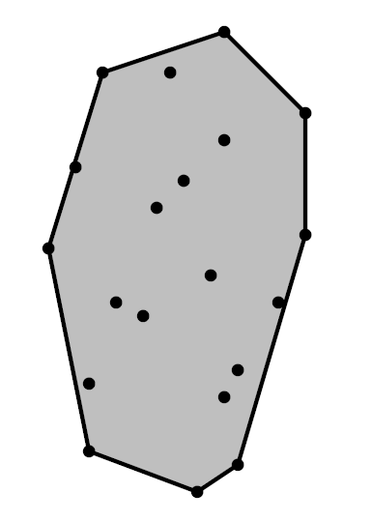
Convex Hull of N points in a plane
Definition: Given set of N points in the Euclidean plane, convex hull is the minimum area convex region that contains every point.
Intuition: points are nails perpendicular to plane, stretch an elastic rubber bound around all points; it will minimize length.
The input at 2N coordinates.
Size of the convex hull O(N)
Sample Convex Hull
Slides Adapted from http://www.cs.uu.nl/docs/vakken/ga/slides1.pdf

Slide 32
Convex Hull of N points in a plane
Definition: Given set of N points in the Euclidean plane, convex hull is the minimum area convex region that contains every point.
Intuition: points are nails perpendicular to plane, stretch an elastic rubber bound around all points; it will minimize length.
The output is returned as a sorted sequence of the points, clockwise (CW) along the boundary
Sample Convex Hull
Slides Adapted from http://www.cs.uu.nl/docs/vakken/ga/slides1.pdf

Slide 33
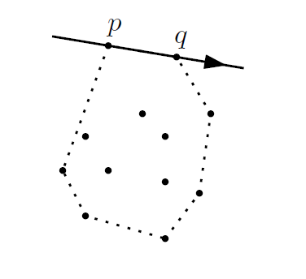
Intuitions used in the Algorithm
Property: The vertices of the convex hull are always points from the input.
Consequently, the edges of the convex hull connect two points of the input
Property: The supporting line of any convex hull edge has all input points to one side
all points lie right of the
directed line from p to q,
if the edge from p to q is
a convex hull edge

Slide 34
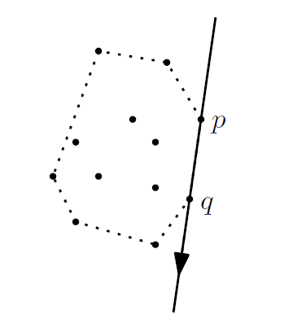
Intuitions used in the Algorithm
Property: The vertices of the convex hull are always points from the input.
Consequently, the edges of the convex hull connect two points of the input
Property: The supporting line of any convex hull edge has all input points to one side
all points lie right of the
directed line from p to q,
if the edge from p to q is
a convex hull edge

Slide 35
Simple Algorithm for Convex Hull
Input: A set of P points in a Plane.
Output: A list containing the vertices of the convex hull CH(P) in clockwise order.
$E←∅ and valid←true$
For all ordered pairs $\left(p,q\right)∈PXP$ with $p≠q$
2.1 Do while $valid is true$
2.2 For all points $r∈P$ and $r≠p and r≠q$
2.2.1 If $r$ lies to the left of the directed lines from $p to q$
Then $valid←false$
2.3 If $valid==true$then add the directed edge $pq$to $E$
From the set $E$ of edges construct a list of vertices $CH(P)$, sorted in clockwise order.

Slide 36
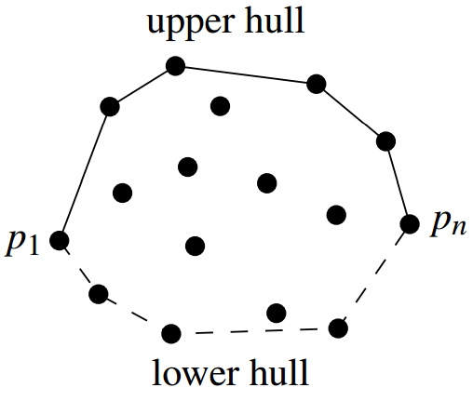
Incremental Algorithm for Convex Hull
Main idea: Sort the points from left to right (= by x-coordinate).
Insert the points in this order, and maintain the upper hull so far
First compute the upper boundary of the convex hull and then the lower part.

Slide 37
Incremental Algorithm for Convex Hull
Right
Turn
Observation: from left to right, there would be only right turns
on the upper hull.

Slide 38
Incremental Algorithm for Convex Hull
Initialize by inserting the leftmost two points

Slide 39
Incremental Algorithm for Convex Hull
P8
If we add the third point there will be a right turn at the previous point, so we add it
P5
P6
P4
P7
P3

Slide 40
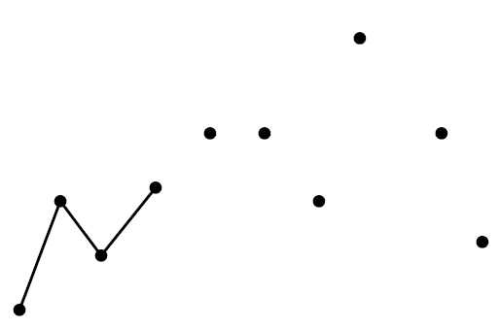
Incremental Algorithm for Convex Hull
P8
If we add the fourth point we get a left turn at the third
point
P5
P6
P4
P7
P3

Slide 41
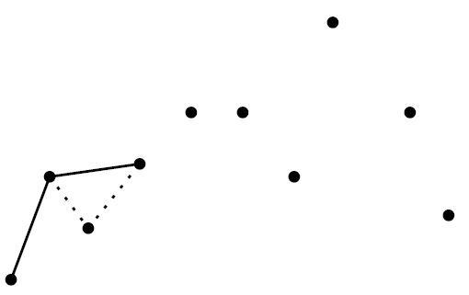
Incremental Algorithm for Convex Hull
P8
…..so we remove the third point from the upper hull when we add the fourth
P5
P6
P4
P7
P3

Slide 42
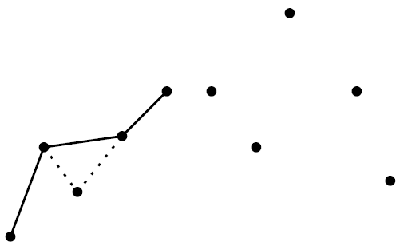
Incremental Algorithm for Convex Hull
P8
If we add the fifth point we get a left turn at the fourth point
P5
P6
P4
P7
P3

Slide 43
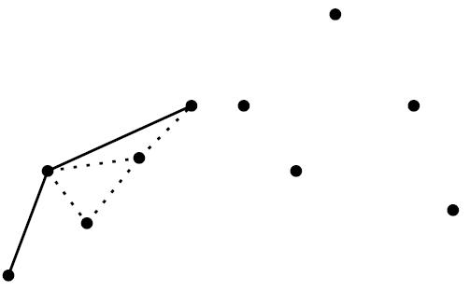
Incremental Algorithm for Convex Hull
P8
….so we remove the fourth point when we add the fifth
P5
P6
P4
P7
P3

Slide 44
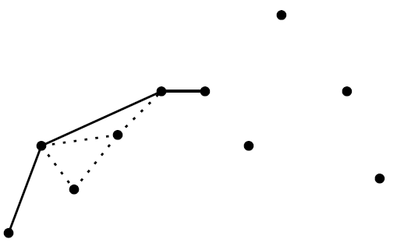
Incremental Algorithm for Convex Hull
P8
If we add the sixth point we get a right turn at the fifth point, so we just add it
P5
P6
P4
P7
P3

Slide 45
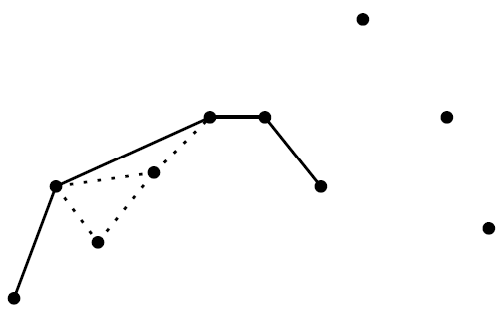
Incremental Algorithm for Convex Hull
P8
We also just add the seventh point as it was also a right turn.
P5
P6
P4
P7
P3

Slide 46
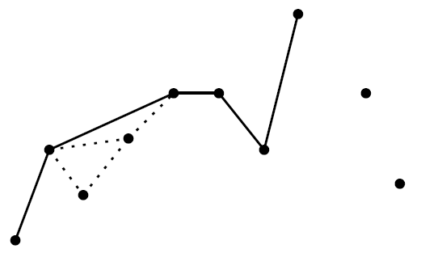
Incremental Algorithm for Convex Hull
P8
When adding the eight point (a left turn) we must remove the seventh point
P5
P6
P4
P7
P3

Slide 47
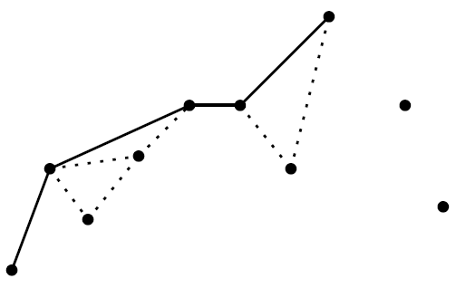
Incremental Algorithm for Convex Hull
P8
….we must also remove the seventh point.
It is also a left turn from current edge.
P5
P6
P4
P7
P3

Slide 48
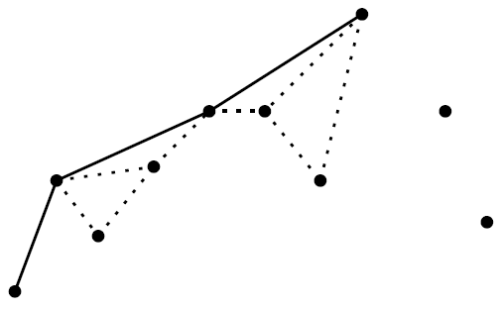
Incremental Algorithm for Convex Hull
P8
…. and also the sixth point.
P5
P6
P4
P7
P3

Slide 49
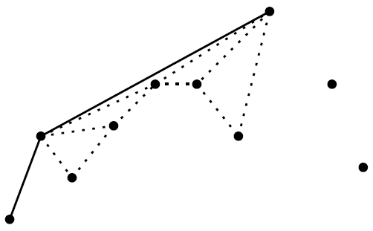
Incremental Algorithm for Convex Hull
P8
…. and also the fifth point.
P5
P6
P4
P7
P3

Slide 50
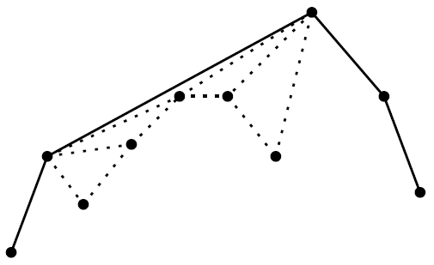
Incremental Algorithm for Convex Hull
After two more steps we get the result.

Slide 51
Pesudo-code for the Incremental algorithm
Input: A set of points P in a Plane.
Upper Part of Convex Hull
Sort the points by x-coordinate, resulting in a sequence$p_{1},…,p_{n}$
Put the points $p_{1}$ and $p_{2}$ in a list $L_{upper}$, with $p_{1}$ as the first point.
For $i←3 to |P|$
3.1 Do append $p_{i} to L_{upper}$
3.2 While $L_{upper }$contains more that two points and the last three points in $L_{upper}$ do not make a right turn.
3.3 Delete the middle of the last three points from $L_{upper}$

Slide 52
Pesudo-code for the Incremental algorithm
Input: A set of points P in a Plane.
Upper Part of Convex Hull
Sort the points by x-coordinate, resulting in a sequence$p_{1},…,p_{n}$
Put the points $p_{1}$ and $p_{2}$ in a list $L_{upper}$, with $p_{1}$ as the first point.
For $i←3 to |P|$
3.1 Do append $p_{i} to L_{upper}$
3.2 While $L_{upper }$contains more that two points and the last three points in $L_{upper}$ do not make a right turn.
3.2.1 Delete the middle of the last three points from $L_{upper}$

Slide 53
Pesudo-code for the Incremental algorithm
Input: A set of points P in a Plane.
Lower Part of Convex Hull
Put points$p_{n} and p_{n−1 }$in a list $L_{lower}$, with $p_{n}$ as the first point.
For $i←\left|P\right|−2 downto 1$
5.1 Do append $p_{i} to L_{lower}$
5.2 While $L_{lower }$contains more that two points and the last three points in $L_{lower}$ do not make a right turn.
5.2.1 Delete the middle of the last three points from $L_{lower}$
6. Remove the first and the last point from $L_{lower}$ to avoid duplication of the points where the upper and lower hull meet.
7. Append $L_{lower}$ and $L_{upper}$ and return the result.

