Slide 1
Introduction to Spatial Computing CSE 5ISC
Week Aug-24 – Aug-29
Some slides adapted from the book Computing with Spatial Trajectories, Yu Zheng and Xiaofang Zhou. Springer

Slide 2
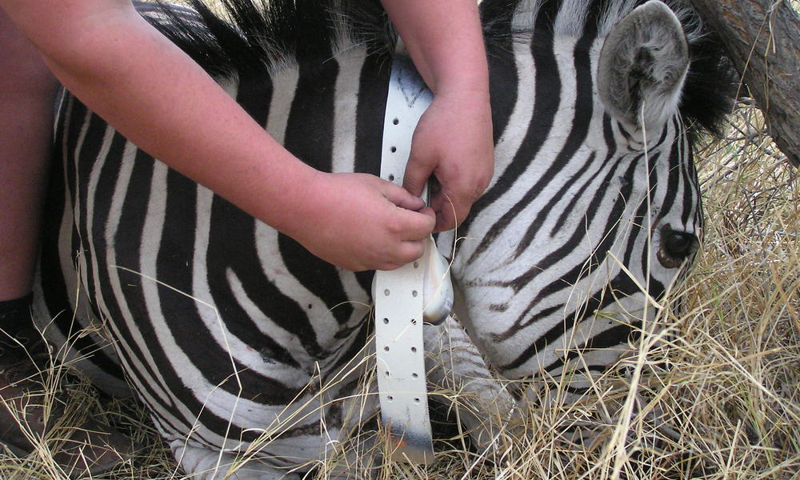
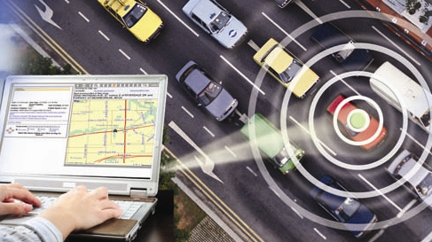
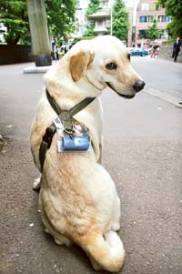
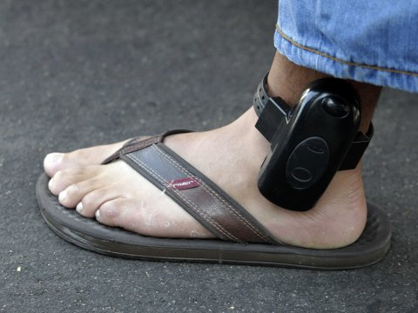
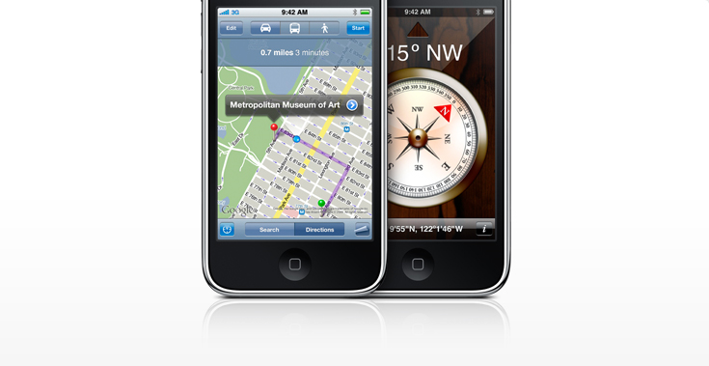
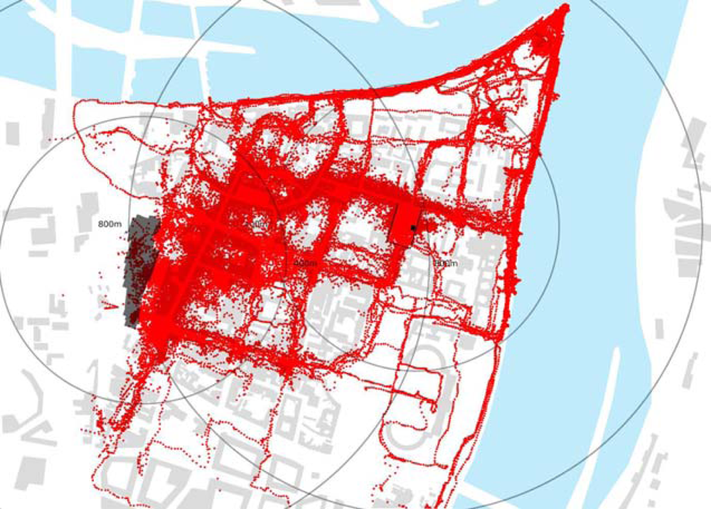
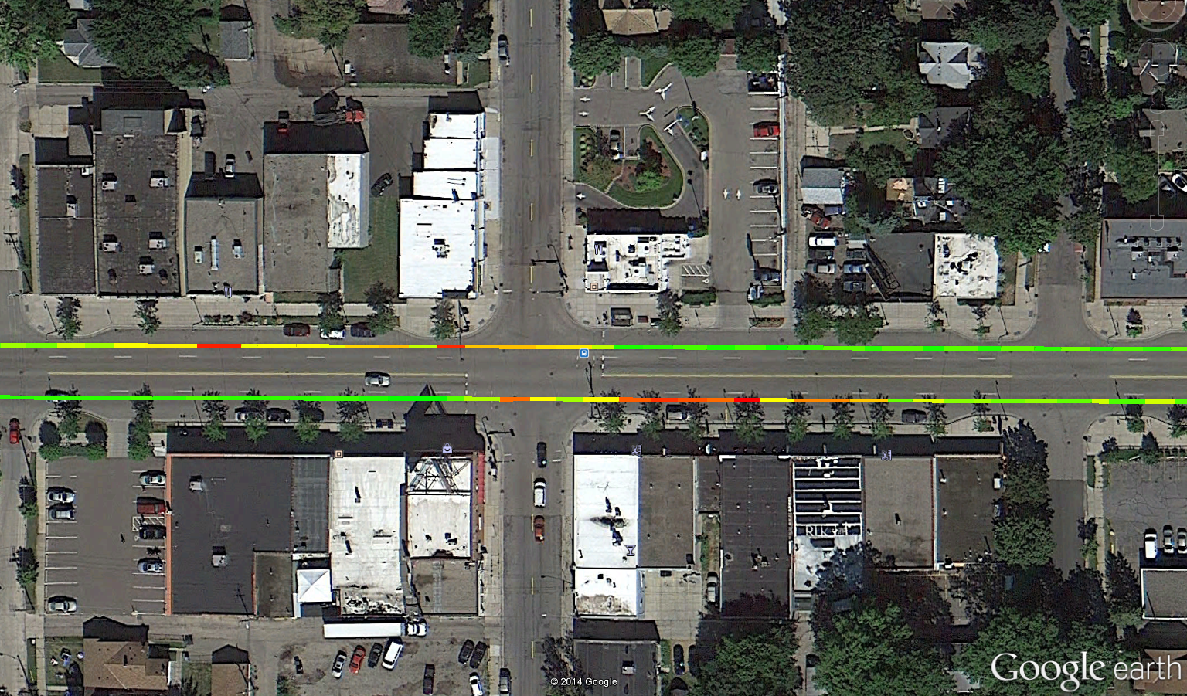
GPS Tracking
www.worldwildlife.org
www.safetytrack.net
Emission
Hot Spots After Bus Stops
www.businessinsider.com
gNO_{X}/m
0.016
0.000
www.mdpi.com

Slide 3
GPS Track Processing

Slide 4
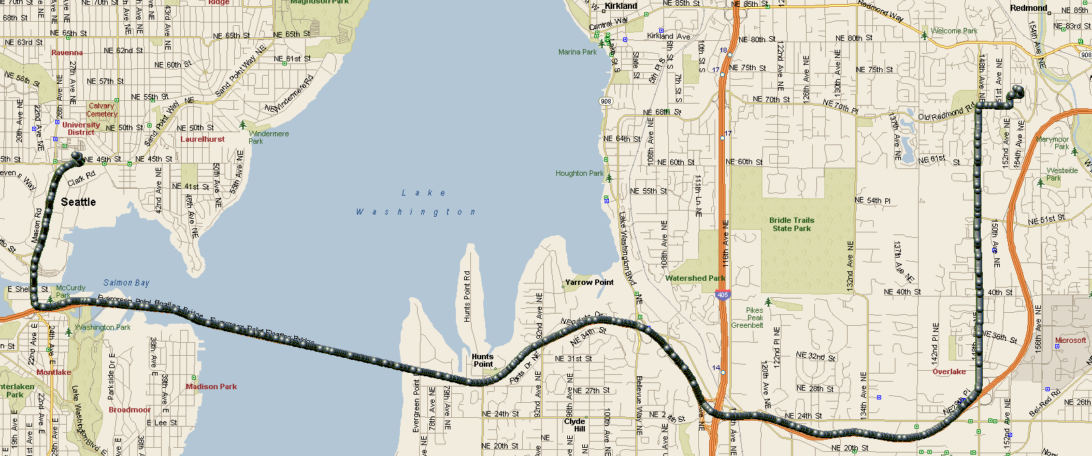
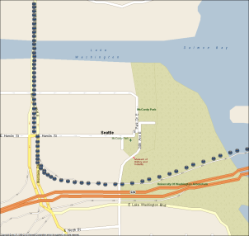
GPS Tracking
{< x₁, y₁, t₁>, < x₂, y₂, t₂>, ..., < x_{N}, y_{N}, t_{N}>}
Positioning technologies
  Global positioning system (GPS)
  Network-based (e.g., using cellular or wifi access points)
  Dead-Reckoning (for estimation)

Slide 5
Trajectory Preprocessing
Problems to solve with trajectories
  Lots of trajectories → lots of data
  Noise and Errors complicates analysis and inference
    Example, errors caused due inaccuracy from switch between GPS / Wi-Fi /cell phone tower signals.
Employ the data reduction and filtering techniques
  Specialized data compression for trajectories
  Principled filtering techniques

Slide 6
GPS Track Processing: Data Reduction

Slide 7
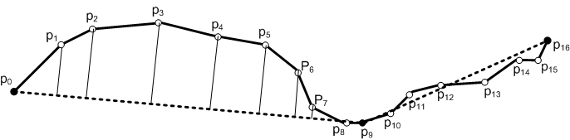

Trajectory Preprocessing - Compression
Goal: Approximate the Trajectory ($p_{0} p_{1} p_{2} …p_{16}$) using few locations
Assumption: Object travels in straight lines between sampled points

Slide 8
Performance metrics for Trajectory Compression
Trajectory data reduction techniques aims to reduce trajectory size w/o compromising much precision.
Performance Metrics
  Processing time
  Compression Rate
  Error Measure
The distance between a location on the original trajectory and the corresponding estimated location on the approximated trajectory is used to measure the error introduced by data reduction.
  Examples are Perpendicular Euclidean Distance or Time Synchronized Euclidean Distance.

Slide 9
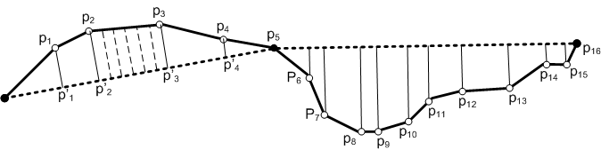
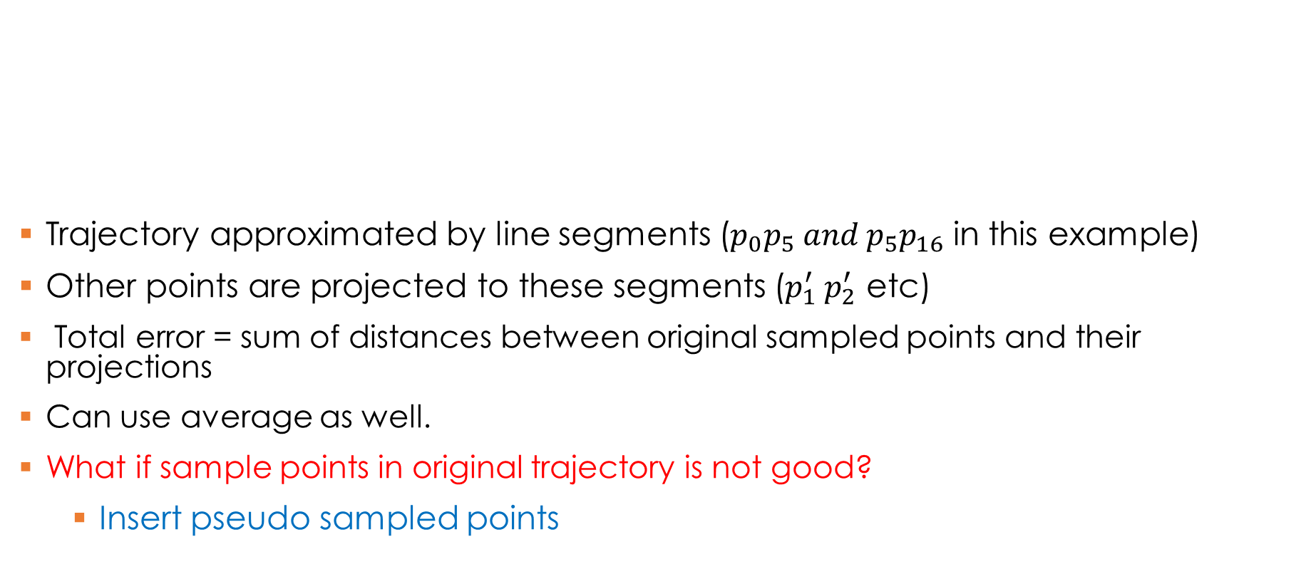
Common Error Measures: Perpendicular Euclidean Distance
Trajectory approximated by line segments ($p_{0}p_{5} and p_{5}p_{16}$ in this example)
Other points are projected to these segments ($p_{1}^{′} p_{2}^{′}$ etc)
Total error = sum of distances between original sampled points and their projections
Can use average as well.
What if sample points in original trajectory is not good?
  Insert pseudo sampled points

Slide 10
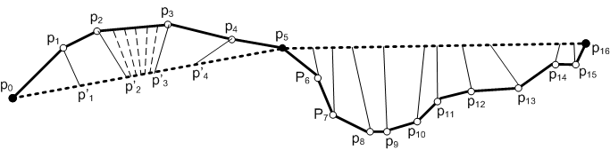

Common Error Measures: Time Synchronized Distance
Considers time coordinate as well: $p_{0 }=\left(x_{0} y_{0} t_{0}\right) p_{1}=\left(x_{1}y_{1}t_{1}\right) .. etc$
Intuition: Movement projected on approximated trajectories should be synchronized in terms of “time”.
Assumes object moving in constant speed on segments and thus synchronizes the original points with the mapped points by time.
Coordinates of the projected point $p_{1}^{′}$
$x_{1}^{′}=x_{0}+ \frac{t_{1}− t_{0}}{t_{5} − t_{0}}×(x_{5}−x_{0})$
$y_{1}^{′}=y_{0}+ \frac{t_{1}− t_{0}}{t_{5} − t_{0}}×(y_{5}−y_{0})$

Slide 11
Trajectory Data Reduction Techniques
What if we just sample every i^{th} point from the trajectory and call it a compressed trajectory?

Slide 12
Trajectory Data Reduction Techniques
Batched Compression:
  Collect full set of location points and then compress the data set for transmission to the location server.
  Applications: content sharing sites such as Everytrail and Bikely.
  Techniques include Douglas-Peucker Algorithm, top-down time-ratio (TD-TR), and Bellman's algorithm.

Slide 13
Batched Compression: Douglas-Peucker Algorithm
Preserve directional trends in the approximated trajectory using the perpendicular Euclidean distance as the error measure.
Replace the original trajectory by an approximate line segment.
If the replacement does not meet the specified error requirement, it recursively partitions the original problem into two subproblems by selecting the location point contributing the most errors as the split point.
This process continues until the error between the approximated trajectory and the original trajectory is below the specified error threshold.

Slide 14
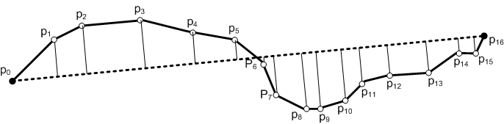
Batched Compression: Douglas-Peucker (DP) Algorithm
Split at the point with most error.
Repeat until all the errors < given threshold

Slide 15
Batched Compression: Other Algorithms
DP uses perpendicular Euclidean distance as the error measure. Also, it’s heuristic based, i.e., no guarantee that the selected split points are the best choice.
TDTR uses time synchronized Euclidean distance as the error measure to take into account the geometric and temporal properties of object movements.
Bellman Algorithm employs dynamic programming technique to ensure that the approximated trajectory is optimal
  Its computational cost is high.
  More details in Bellman 1961 http://dl.acm.org/citation.cfm?id=366611

Slide 16
Trajectory Data Reduction Techniques
Consider the scenario: You are managing a trucks fleet and are interested in collecting GPS data from the fleet. However, you have limited memory on trucks and the internet connection is not reliable. How would you proceed?
On-line Data Reduction
  Selective on-line updates of the locations based on specified precision requirements.
  Applications: traffic monitoring and fleet management.
  Techniques include Reservoir Sampling, Sliding Window, and Open Window.

Slide 17
Online Data reduction Techniques: Reservoir sampling
Generate an approximated trajectory of size R (i.e., R items).
  Maintain a reservoir of size R.
  Save first R samples in the reservoir.
  When the k^{th} location point is acquired (k > R).
    Generate a random number j between 1 and k.
    If j < R then evict j^{th} item from reservoir.
  the reservoir algorithm always maintains a uniform sample of the evolving trajectory without even knowing the eventual trajectory size.
  See (http://austinrochford.com/posts/2014-11-30-reservoir-sampling.html) for proof.
Any Comments on its solution quality?

Slide 18
Online Data reduction Techniques: Sliding Window
Fit the location points in a growing sliding window with a valid line segment and continue to grow the sliding window until the approximation error exceeds some error bound.
  First initialize the first location point of a trajectory as the anchor point p_{a} and then starts to grow the sliding window
  When a new location point p_{i} is added to the sliding window, the line segment p_{a} p_{i} is used to fit all the location points within the sliding window.
  As long as the distance errors against the line segment p_{a} p_{i} are smaller than the user-specified error threshold, the sliding window continues to grow. Otherwise, the line segment p_{a} p_{i-1} is included as part of the approximated trajectory and p_{i} is set as the new anchor point.
  The algorithm continues until all the location points in the original trajectory are visited.

Slide 19
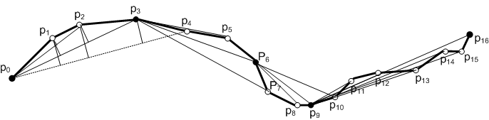
Illustration of Sliding Window
Exceeds the desired error
While the sliding window grows from {p₀} to {p₀, p₁, p₂, p₃}, all the errors between fitting line segments and the original trajectory are not greater than the specified error threshold.
When p₄ is included, the error for p₂ exceeds the threshold, so p₀p₃ is included in the approximate trajectory and p₃ is set as the anchor to continue.

Slide 20
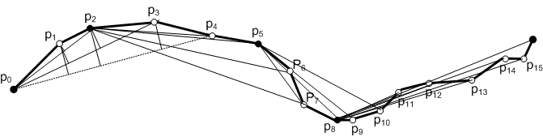
Illustration of Opening Window
Different from the sliding window, choose location points with the highest error in the sliding window as the closing point of the approximating line segment as well as the new anchor point.
When p₄ is included, the error for p₂ exceeds the threshold, so p₀p₂ is included in the approximate trajectory and p₂ is set as the anchor to continue.

Slide 21
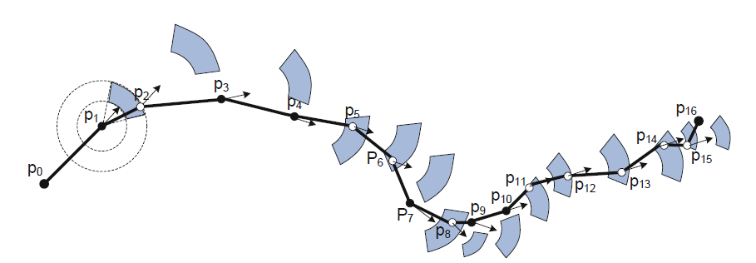
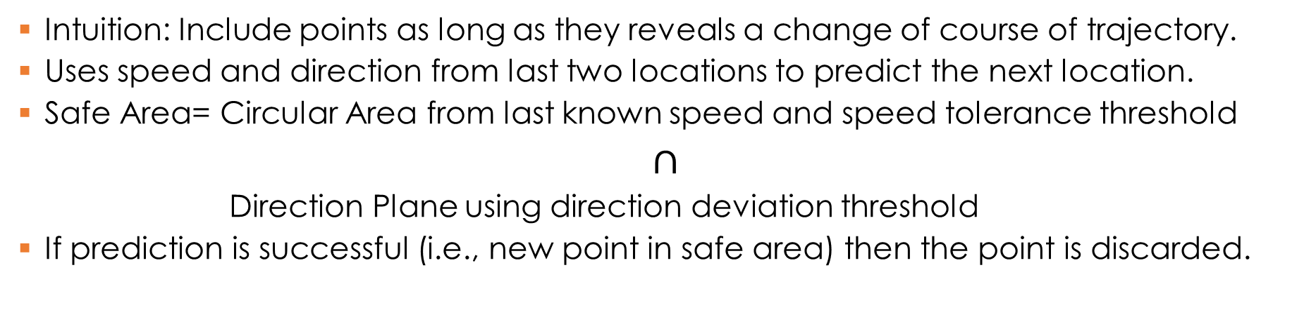
Reduction based on Speed and Direction
Intuition: Include points as long as they reveals a change of course of trajectory.
Uses speed and direction from last two locations to predict the next location.
Safe Area= Circular Area from last known speed and speed tolerance threshold
$∩$
Direction Plane using direction deviation threshold
If prediction is successful (i.e., new point in safe area) then the point is discarded.

Slide 22
GPS Track Processing: Filtering Techniques

Slide 23
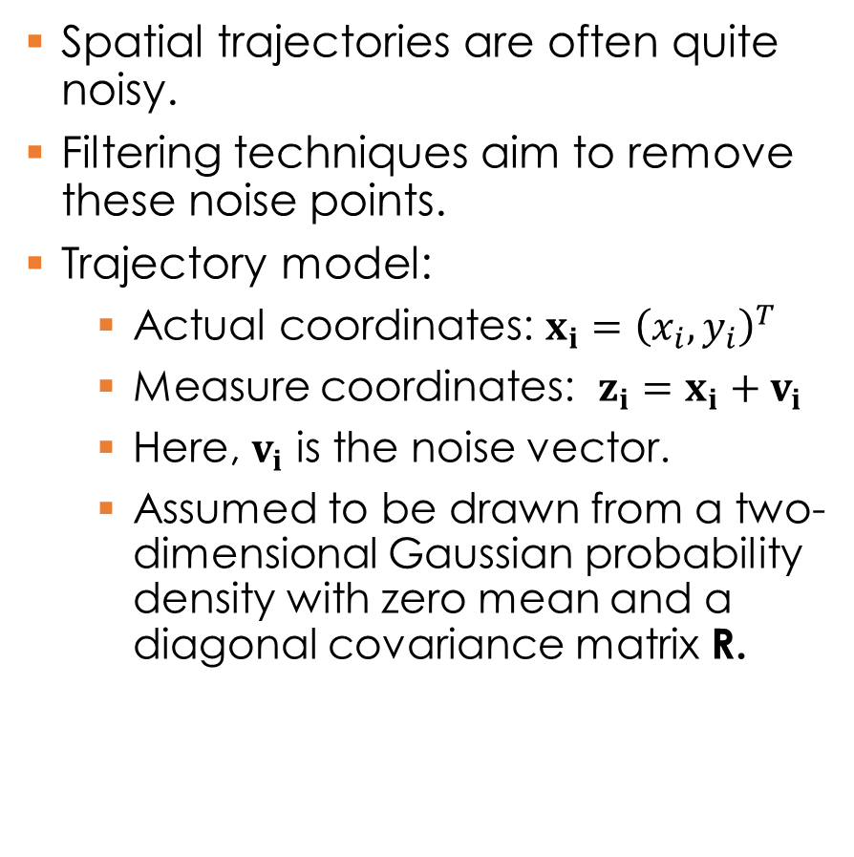
GPS Track Processing: Filtering Techniques
Spatial trajectories are often quite noisy.
Filtering techniques aim to remove these noise points.
Trajectory model:
  Actual coordinates: $x_{i}={\left(x_{i}, y_{i}\right)}^{T}$
  Measure coordinates: $z_{i}=x_{i}+v_{i}$
  Here, $v_{i}$ is the noise vector.
  Assumed to be drawn from a two-dimensional Gaussian probability density with zero mean and a diagonal covariance matrix R.

Slide 24
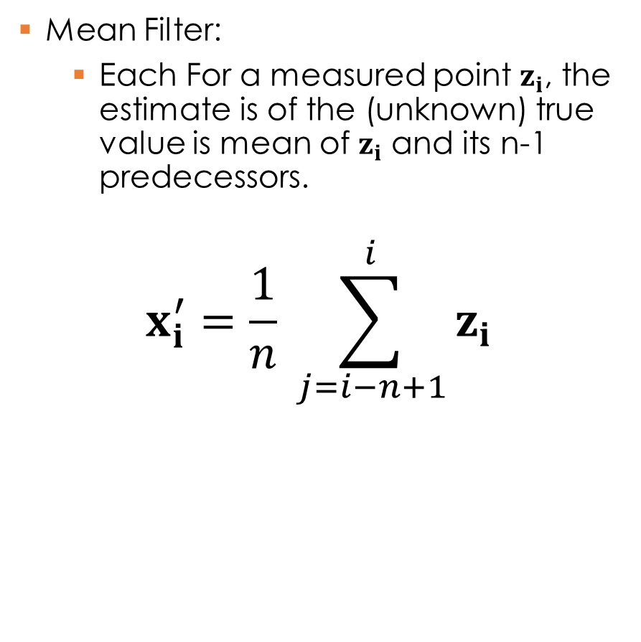
Filtering Techniques: Mean Filter
Mean Filter:
  Each For a measured point $z_{i}$, the estimate is of the (unknown) true value is mean of $z_{i}$ and its n-1 predecessors.
  $$x_{i}^{′}=\frac{1}{n} \sum_{j=i−n+1}^{i}{z_{i} }$$

Slide 25
Filtering Techniques: Mean Filter

Slide 26
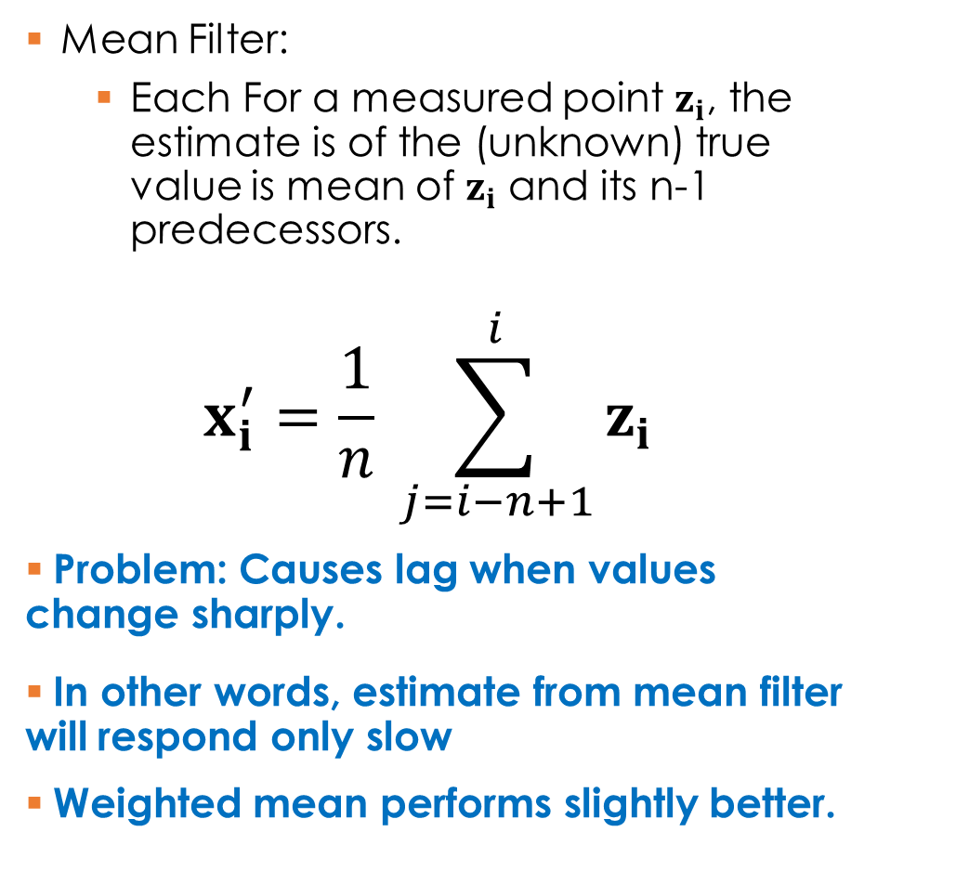
Filtering Techniques: Mean Filter
Mean Filter:
  Each For a measured point $z_{i}$, the estimate is of the (unknown) true value is mean of $z_{i}$ and its n-1 predecessors.
  $$x_{i}^{′}=\frac{1}{n} \sum_{j=i−n+1}^{i}{z_{i} }$$
Problem: Causes lag when values change sharply.
In other words, estimate from mean filter will respond only slow
Weighted mean performs slightly better.

Slide 27

Filtering Techniques: Median Filter
Median Filter:
  Each For a measured point $z_{i}$, the estimate is of the (unknown) true value is a median of $z_{i}$ and its n-1 predecessors.

Slide 28
Filtering Techniques: Median Filter

Slide 29
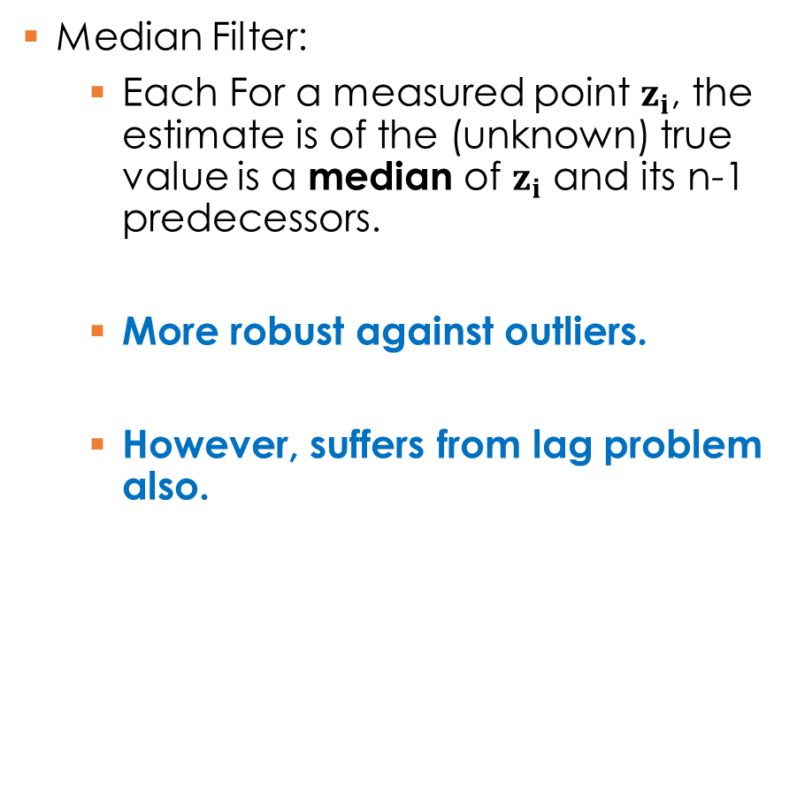
Filtering Techniques: Median Filter
Median Filter:
  Each For a measured point $z_{i}$, the estimate is of the (unknown) true value is a median of $z_{i}$ and its n-1 predecessors.
  More robust against outliers.
  However, suffers from lag problem also.

Slide 30
Filtering Techniques: Kalman Filtering
Can use physics based model for the trajectory.
The trajectory estimate from Kalman filter is basically a tradeoff between measurements and motion model (dictated by physics).
Based on Hidden Markov Models

Slide 31
Gentle Introduction to Hidden Markov Models
X_{t} and E_{t} are random variables.
X_{t} models the phenomena being tracked
  Example, actual location of an object which is being tracked.
E_{t} is observed state.
Based on E_{t}s we estimate the X_{t}
We are given transition probabilities of P(X_{t} | X_{t-1} ) and
Sensor probabilities P(E_{t} |X_{t})

Slide 32
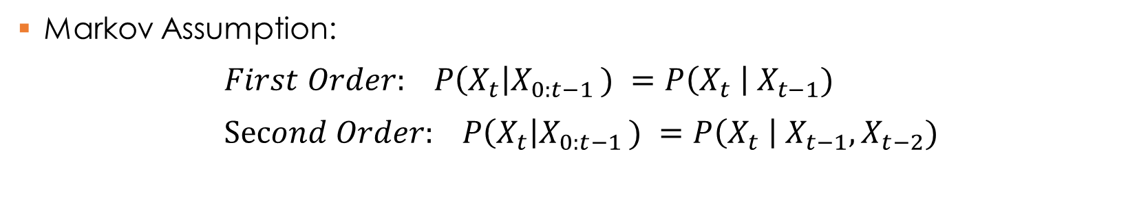
Gentle Introduction to HMM: Markov Chains
Markov Assumption:
$First Order: P\left(X_{t}\right|X_{0:t−1 }) =P\left(X_{t} \right| X_{t−1})$
$Second Order: P\left(X_{t}\right|X_{0:t−1 }) =P\left(X_{t} \right| X_{t−1}, X_{t−2})$

Slide 33


Gentle Introduction to HMM
Markov Assumption:
$P\left(X_{t}\right|X_{0:t−1 }) =P\left(X_{t} \right| X_{t−1})$
Sensor Markov Assumption:
$P\left(E_{t}\right|X_{0:t }, E_{0:t−1}) =P\left(E_{t} \right| X_{t})$

Slide 34

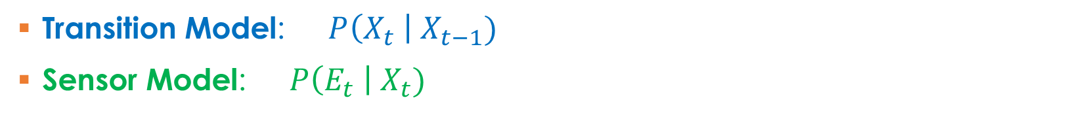

Gentle Introduction to HMM
Markov Assumption:
$P\left(X_{t}\right|X_{0:t−1 }) =P\left(X_{t} \right| X_{t−1})$
Sensor Markov Assumption:
$P\left(E_{t}\right|X_{0:t }, E_{0:t−1}) =P\left(E_{t} \right| X_{t})$
Transition Model: $P\left(X_{t} \right| X_{t−1})$
Sensor Model: $P\left(E_{t} \right| X_{t})$

Slide 35
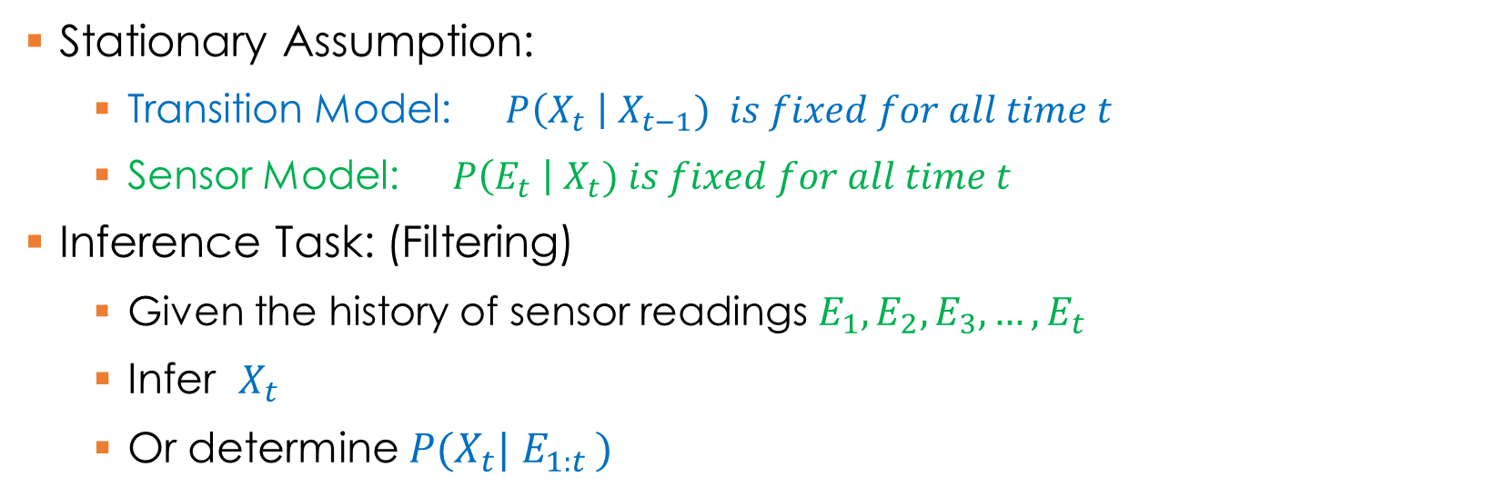
Gentle Introduction to HMM
Stationary Assumption:
  Transition Model: $P\left(X_{t} \right| X_{t−1}) is fixed for all time t$
  Sensor Model: $P\left(E_{t} \right| X_{t}) is fixed for all time t$
Inference Task: (Filtering)
  Given the history of sensor readings $E_{1}, E_{2},E_{3}, …, E_{t}$
  Infer $X_{t}$
  Or determine ${P(X}_{t}| E_{1:t })$

Slide 36
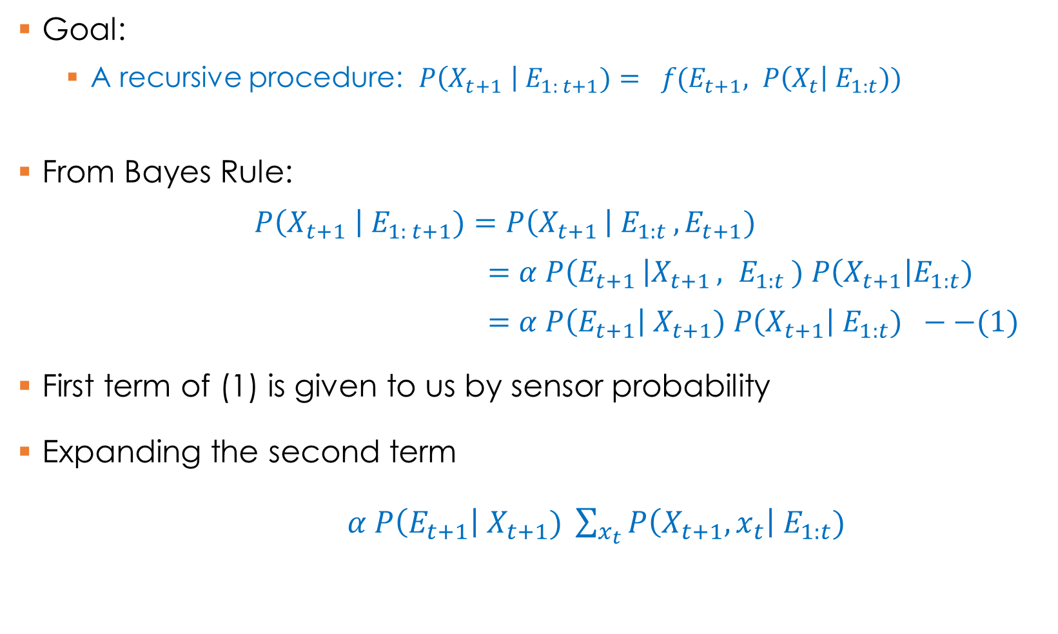
Filtering in Hidden Markov Models
Goal:
  A recursive procedure: $P\left(X_{t+1} \right| E_{1: t+1})= f(E_{t+1}, P\left(X_{t}\right| E_{1:t}))$
From Bayes Rule:
  $$P\left(X_{t+1} \right| E_{1: t+1})=P\left(X_{t+1 }\right| E_{1:t }, E_{t+1})$$
  $=α P\left(E_{t+1 }\right|X_{t+1 }, E_{1:t }) P\left(X_{t+1}\right|E_{1:t})$
  $=α P\left(E_{t+1}\right| X_{t+1}) P\left(X_{t+1}\right| E_{1:t}) −−(1)$
First term of (1) is given to us by sensor probability
Expanding the second term
$α P\left(E_{t+1}\right| X_{t+1}) \sum_{x_{t}}{P\left(X_{t+1}, x_{t}\right| E_{1:t}) }$

Slide 37

Filtering in Hidden Markov Models
Expanding the second term
$= α P\left(E_{t+1}\right| X_{t+1}) \sum_{x_{t}}{P\left(X_{t+1}, x_{t}\right| E_{1:t})}$
= $α P\left(E_{t+1}\right| X_{t+1}) \sum_{x_{t}}{P\left(X_{t+1}\right| x_{t} ,E_{1:t})} P\left(x_{t}\right|E_{1:t})$
= $α P\left(E_{t+1}\right| X_{t+1}) \sum_{x_{t}}{P\left(X_{t+1}\right| x_{t})} P\left(x_{t}\right|E_{1:t})$
One Step Prediction

Slide 38
Filtering in Hidden Markov Models
Expanding the second term
$= α P\left(E_{t+1}\right| X_{t+1}) \sum_{x_{t}}{P\left(X_{t+1}, x_{t}\right| E_{1:t})}$
= $α P\left(E_{t+1}\right| X_{t+1}) \sum_{x_{t}}{P\left(X_{t+1}\right| x_{t} ,E_{1:t})} P\left(x_{t}\right|E_{1:t})$
= $α P\left(E_{t+1}\right| X_{t+1}) \sum_{x_{t}}{P\left(X_{t+1}\right| x_{t})} P\left(x_{t}\right|E_{1:t})$
Updating using Sensor values

Slide 39
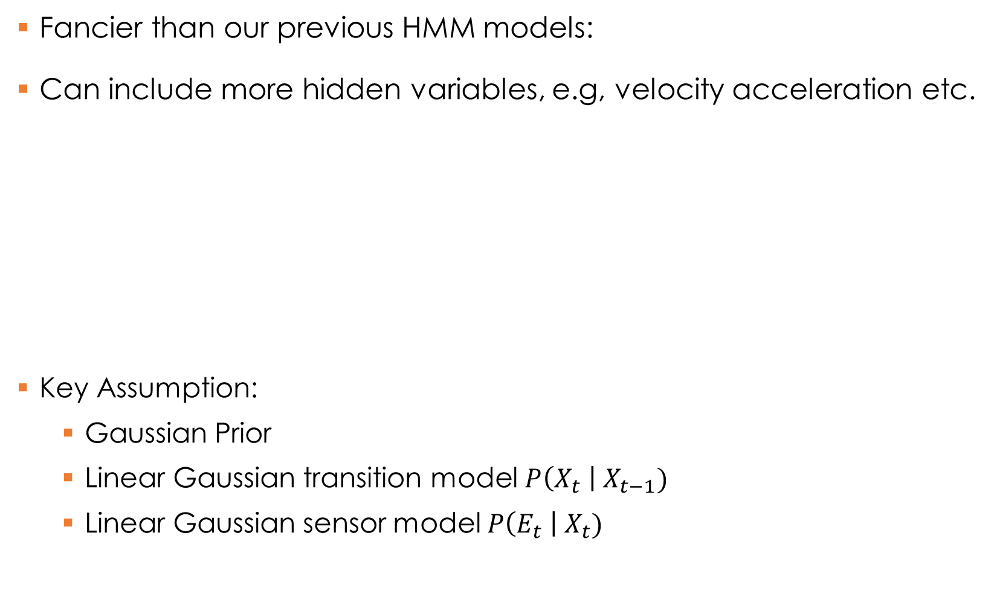
Kalman Filters
Fancier than our previous HMM models:
Can include more hidden variables, e.g, velocity acceleration etc.
Key Assumption:
  Gaussian Prior
  Linear Gaussian transition model $P\left(X_{t} \right| X_{t−1})$
  Linear Gaussian sensor model $P\left(E_{t} \right| X_{t})$
Velocity (hidden variable)
Location (hidden variable)
Observations through sensors

Slide 40
Gaussian Distributions
Univariate- x is a 1-d variable
Multi-variate– x is n-dimensional vector
Covariance Matrix

Slide 41


Fitlering in Kalman Filters – 1-d case
One Step Prediction
  If is Gaussian then the posterior is also Gaussian.
Updating with sensor values
  Filter based on evidence
  If predicted posterior is Gaussian then the filtered posterior is also Gaussian.
  Final result is a Gaussian
$$P\left(X_{t} \right| E_{1:t})$$
$$P\left(X_{t+1} \right| E_{1:t})$$
$P\left(X_{t+1} \right| E_{1:t+1})=α P\left(E_{t+1}\right|X_{t+1}) P\left(X_{t+1 }\right| E_{1:t})$

Slide 42

Fitlering in Kalman Filters for multivariate case
Final result in a multi-variate Gaussian
F is the matrix for state transition
$Σ_{x}$is the transition noise covariance
H is the matrix for sensor output
$Σ_{z}$is the sensor noise covariance.

