Slide 1
Spatial Query Languages
Standard Database Query Languages

Slide 2
Outline
What is a Query? Query Language?
Example Database Tables
SQL Overview: 3 Components
SELECT statement with 1 table
Multi-table SELECT statements
Why spatial extensions are needed?
1-table spatial queries
Multi-table spatial queries

Slide 3
What is a Query?
A query is a “question” posed to a database, expressed in a high-level declarative manner
Mouse click on a map symbol
Keyword typed in a search engine
SELECT S.name FROM Senator S
WHERE S.gender = ‘F’

Slide 4
What is a Query Language?
Query language expresses interesting questions about data, and restricts the set of possible queries
Natural language, e.g., English
Computer programming languages, e.g. Java,
Structured Query Language (SQL)
Graphical interfaces, e.g. web-search, mouse clicks on a map

Slide 5
Outline
What is a Query? Query Language?
Example Database Tables
SQL Overview: 3 Components
SELECT statement with 1 table
Multi-table SELECT statements
Why spatial extensions are needed?
1-table spatial queries
Multi-table spatial queries

Slide 6
Example: World Database
Purpose: use an example database to learn query language SQL
Conceptual model
3 Entities: country, city, river
2 Relationships: capital-of, originates

Slide 7
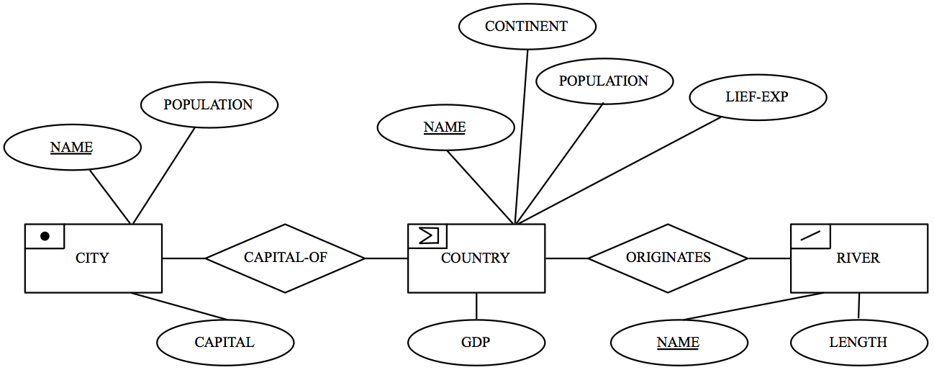
World Database Conceptual Model
Entity - relationship diagram using Chen’s notation
3 Entities: country, city, river shown as boxes
2 Relationships: capital-of, originates shown as diamonds
Attributes shown as ellipses

Slide 8
World Database: Logical Model
3 Relations
Country (Name, Cont, Pop, GDP, Life-Exp, Shape)
City (Name, Origin, Pop, Capital, Shape)
River (Name, Origin, Length, Shape)
Keys
Primary keys are Country.Name, City.Name, River.Name
Foreign keys are River.Origin, City.Country
Data for 3 tables
Shown on next slide

Slide 9
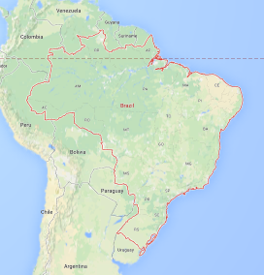
World Database Data Tables: Country
The COUNTRY table has 6 columns: Name, Continent (Cont), population (Pop), Gross domestic product (GDP), Life-expectancy (Life-exp) and Shape, Shape is boundary

Slide 10
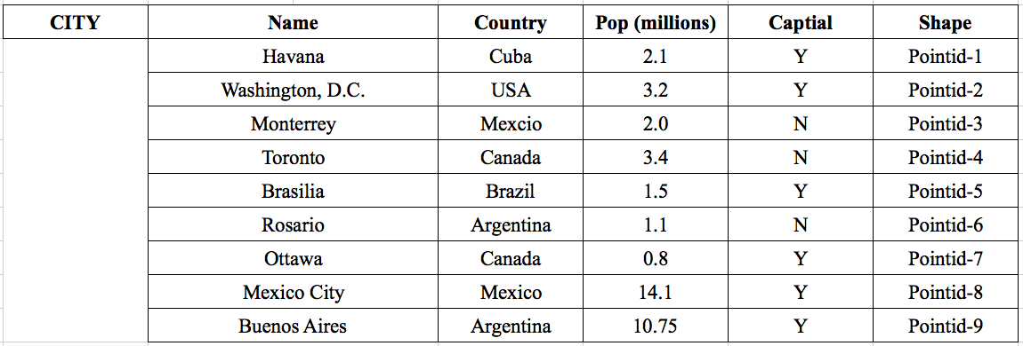
World Database Data Tables: City
The CITY table has 5 columns, Name, Country, Population (Pop), Capital and Shape, Shape is a point.

Slide 11
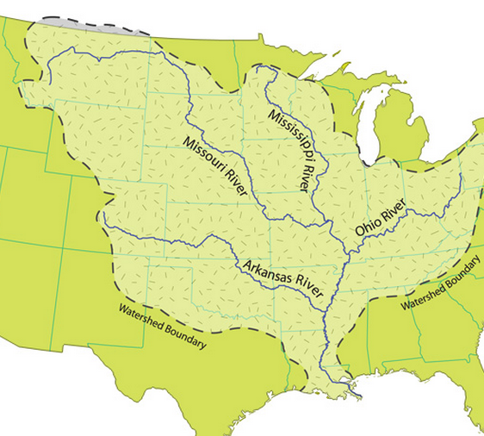
World Database Data Tables: River
The RIVER table has 4 columns, Name, Origin, Length and Shape, Shape is a line.

Slide 12
Outline
What is a Query? Query Language?
Example Database Tables
SQL Overview: 3 Components
SELECT statement with 1 table
Multi-table SELECT statements
Why spatial extensions are needed?
1-table spatial queries
Multi-table spatial queries

Slide 13
What is SQL?
Is a standard query language for relational databases
Supports logical data model concepts
Supported by major brands. e.g. IBM DB2, Oracle, MS SQL Server, Sybase, etc.
3 versions: SQL 1(1986), SQL 2(1992), SQL 3(1999)
Can express common data intensive queries
SQL 1 and SQL 2 are not suitable for recursive queries

Slide 14
SQL and Spatial Data Management
ESRI Arc/Info included a custom relational DBMS named Info
Other GIS software can interact with DBMS using SQL
Using open database connectivity (ODBC) or other protocols.
In fact, many software application use SQL to manage data in back-end DMBS
And a vast majority of SQL queries are generated by other software
Although we will be writing SQL queries manually!

Slide 15
Three components of SQL
1. Data definition language (DDL)
Creation and modification of relational schema
Schema objects include relations, indexes, etc
2. Data manipulation language (DML)
Insert, delete, update rows in tables
Query data in tables

Slide 16
Three components of SQL
3. Data control language (DCL)
Concurrency control, transactions
Administrative tasks, e.g. set up database users, security permissions
Focus for now
A little bit of table creation (DDL) and population (DML)
Primarily Querying (DML)

Slide 17
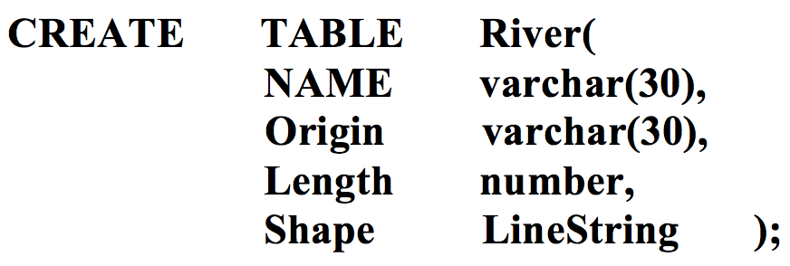
Creating Tables in SQL
Table definition
“CREATE TABLE” statement
Specifies table name, attributes names and data types
Create a table with no rows
See an example

Slide 18
Creating Tables in SQL
Related statements
ALTER TABLE modifies table schema if needed
DROP TABLE removes an empty table

Slide 19
Populating Tables in SQL
Adding a row to an existing table
“INSERT INTO” statement
Specifies table name, attributes names and values
Example:
INSERT INTO River(Name, Origin, Length)
VALUES (‘Mississippi’, ‘USA’. 6000)

Slide 20
Populating Tables in SQL
Related statements
SELECT statement with INTO clause can insert multiple rows in a table
Bulk load, import commands also add multiple rows
DELETE statement removes rows
UPDATE statement can change values within selected rows

Slide 21
Query: Exercise
Exercise:
Which one of the following operations is NOT in data definition language?
a) INSERT
b) ALTER
c) DROP
d) CREATE

Slide 22
Outline
What is a Query? Query Language?
Example Database Tables
SQL Overview: 3 Components
SELECT statement with 1 table
Multi-table SELECT statements
Why spatial extensions are needed?
1-table spatial queries
Multi-table spatial queries

Slide 23
SQL Data Manipulation Language: SELECT Statement
Purpose: Query data from database tables
Returns a table as result
Features
Has many clauses
Can refer to many operators and functions
Allows nested queries

Slide 24
SQL SELECT Statement: Scope of Our Discussion
Learn enough to appreciate spatial aspects
Observe example queries
Read & compose simple SELECT statement
With frequently used clauses
e.g., SELECT, FROM, WHERE, …
And a few operators and functions

Slide 25
Clauses of SELECT Statement
Mandatory Clauses
SELECT specifies desired columns
FROM specifies relevant tables
Optional Clauses
WHERE specifies qualifying conditions for results
ORDER BY specifies sorting columns for results
GROUP BY, HAVING specifies aggregation and statistics

Slide 26
SELECT Statement– operators, functions
Arithmetic operators, e.g. +, -, …
Comparison operators, e.g. =, <, >, BETWEEN, LIKE, …
Logical operators, e.g. AND, OR, NOT, EXISTS,
Statistical functions, e.g. SUM, COUNT, …
Set operators, e.g. UNION, IN, ALL, ANY,…
Many other operators on strings, data, currency, …

Slide 27
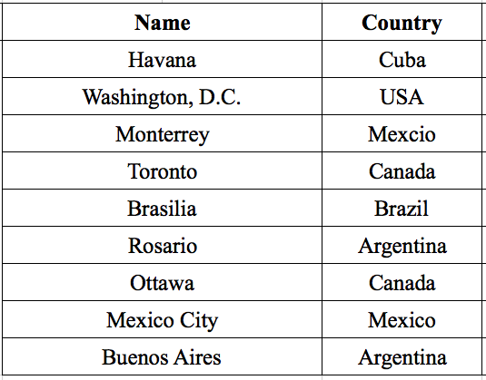
Ex. 1: Simplest SELECT query
Query: List all the cities with their country.
SELECT Name, Country
FROM CITY
Result →

Slide 28
SELECT with WHERE Clause
Commonly 3 clauses (SELECT, FROM, WHERE) are used
Query: List the names of the capital cities in the CITY table.
SELECT *
FROM CITY
WHERE CAPITAL=‘Y’
Result →

Slide 29
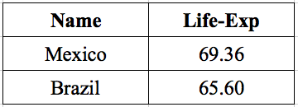
SELECT with Aliasing
Query: List names and Life-expectancy for countries,
where the life-expectancy is less than seventy years.
SELECT Co.Name, Co.Life-Exp
FROM Country Co
WHERE Co.Life-Exp < 70
Note: use of alias ‘Co’ for Table ‘Country’
Result

Slide 30
SELECT: Aggregate Queries
Query: What is the average population of the capital cities?
SELECT AVG(Ci.Pop)
FROM City Ci
WHERE Ci.Capital = ‘Y’
Query: For each continent, find the average GDP.
SELECT Co.Cont, Avg (Co.GDP) AS Continent-GDP
FROM Country Co
GROUP BY Co.Cont

Slide 31
SELECT: HAVING Clause
Query: For each country in which at least two rivers originate, find the length of the smallest river.
SELECT R.Origin, MIN (R.length) AS Min-length
FROM River
GROUP BY R.Origin
HAVING COUNT(*) > 1

Slide 32
Outline
What is a Query? Query Language?
Example Database Tables
SQL Overview: 3 Components
SELECT statement with 1 table
Multi-table SELECT statements
Why spatial extensions are needed?
1-table spatial queries
Multi-table spatial queries

Slide 33
Two-Table Query
Query: List capital cities and populations of countries whose GDP exceeds one trillion dollars.
Q? How do we find capital city for countries?

Slide 34
World Database Data Tables: City
The CITY table has 5 columns, Name, Country, Population (Pop), Capital and Shape, Shape is a point.

Slide 35
Two-Table Query
Query: List capital cities and populations of countries whose GDP exceeds one trillion dollars.
How do we find capital city for countries?
Join City table with Country table using City.Country = Country.Name
AND (City.Capital=‘Y’)

Slide 36
Two-Table Query
Query: List capital cities and populations of countries whose GDP exceeds one trillion dollars.
SELECT Ci.Name, Co.Pop
FROM City Ci, Country Co
WHERE Ci.Country = Co.Name
AND Co.GDP > 1000.0
AND Ci.Capital=‘Y’

Slide 37
Composing Multi-table Query
Three Meta-Questions
Which tables are needed?
How are the tables joined together?
Do result rows aggregate rows of input tables?
Example: What is the name and population of the capital city of the country where the St. Lawrence River originates?
A. City, Country, RIver
B. (River.Origin = Country.Name) AND (Country.Name = City.Country)
C. No.

Slide 38
Multi-table Query Composition
Query: What is the name and population of the capital city of the country where the St. Lawrence River originates?
SELECT Ci.Name, Ci.Pop
FROM City Ci, Country Co, River R
WHERE R.Origin = Co.Name
AND Co.Name = Ci.Country
AND R.Name = ‘St. Lawrence’
AND Ci.Capital = ‘Y’

Slide 39
Nested Multi-Table Queries
Query: List the countries whose Gross Domestic Product (GDP) is greater than that of Canada.
SELECT Co.Name
FROM Country Co
WHERE Co.GDP > ANY (
SELECT Co1.GDP
FROM Country Co1
WHERE Co1.Name = ‘Canada’)

Slide 40
Outline
What is a Query? Query Language?
Example Database Tables
SQL Overview: 3 Components
SELECT statement with 1 table
Multi-table SELECT statements
Why spatial extensions are needed?
1-table spatial queries
Multi-table spatial queries

Slide 41
Why Extend SQL for Spatial Data?
Original SQL had simple atomic data types
Examples: integer, dates, string, currency
Not convenient for spatial applications
Spatial Data: points, edges, rectangles, …
Example Queries:
Q1: List all rectangle with point( x = 0, y = 0) as a corner point.
Q2: List all rectangle with point( x = 0, y = 0) as an inside point.
…
P2
P3
P1
P4

Slide 42
How old SQL modeled Spatial Data?
Recall spatial data had
Points, Edges, Rectangles
Old Table Design (3rd Normal Form)
Point ( Pid, x, y)
Edge (Eid, Length)
Rectangle (Rid, Rname)
Starts_or_Ends ( Eid, Pid )
Boundary ( Rid, Eid )
P2
P3
P1
P4

Slide 43
Old Tabular Representation of Unit Square!
P2
P3
Start_or_Ends
Eid | Pid
E1 | P1
E1 | P2
E2 | P2
E2 | P3
E3 | P3
E3 | P4
E4 | P4
E4 | P1
P1
P4
Point
Edge
Boundary
Pid | x | y
P1 | 0 | 0
P2 | 0 | 1
P3 | 1 | 1
P4 | 1 | 0
Eid | Length
E1 | 1
E2 | 1
E3 | 1
E4 | 1
Rid | Eid
R1 | E1
R1 | E2
R1 | E3
R1 | E4
Rectangle
Rid | Rname
R1 | UnitSq

Slide 44
List all rectangles with origin as a corner point.
You may be able to compose this SQL query
However, joining 5 tables is challenging for average programmer
Also, joining 5 tables to retrieve a simple object is costly!
SELECT R.Rid, R.Rname
FROM Rectangle R, Edge E, Point P, Boundary B, Starts_Or_Ends S
WHERE (R.Rid=B.Rid) AND (B.Eid=E.Eid)
AND (E.Eid=S.Eid) AND (S.Pid=P.Pid)
AND (P.x = 0) AND (P.y = 0)
P2
P3
P1
P4

Slide 45
List rectangles with origin as an inside point.
Steps: A. Gather properties of each rectangle in a row!
B. Compare x- and y-coordinates of query point and each rectangle
SELECT R.Rid, R.Rname, MIN(P.x), MIN(P.y), MAX(P.x), MAX(P.y)
FROM Rectangle R, Edge E, Point P, Boundary B, Starts_Or_Ends S
WHERE (R.Rid=B.Rid) AND (B.Eid=E.Eid)
AND (E.Eid=S.Eid) AND (S.Pid=P.Pid)
GROUP BY R.Rid
HAVING (0 BETWEEN MIN(P.x) AND MAX(P.x))
AND (0 BETWEEN MIN(P.y) AND (P.y))
P2
P3
P1
P4

Slide 46
Semantic Gap, Impedance Mismatch between Old SQL and Spatial Applications!
If you found last query hard to code in SQL,
You have just experienced the pain many felt in last century
And forced SQL to support user-defined data-types!
Simpler code with user-defined spatial data-types
SELECT Rid, Rname
FROM Rectangle R
WHERE ST_Within(GeomFromText(‘POINT(0,0)’, R.shape_Polygon)
New Table Design
Rectangle( Rid, RName, Shape_Polygon )
Point (Pid, x, y)
P2
P3
P1
P4

Slide 47
Outline
What is a Query? Query Language?
Example Database Tables
SQL Overview: 3 Components
SELECT statement with 1 table
Multi-table SELECT statements
Why spatial extensions are needed?
1-table spatial queries
Multi-table spatial queries

Slide 48
Extending SQL for Spatial Data: New
SQL 3 allows user-defined data types and operations
Spatial data types and operations can be added
Open Geodata Interchange Standard (OGIS)
Half a dozen spatial data types
Over a dozen spatial operations
Supported by major vendors, e.g. ESRI, Intergraph, Oracle, IBM,...
PostGIS implementation: http://postgis.net/docs/manual-2.1/

Slide 49
OGIS Spatial Data Model
Base-class:
Geometry
Four sub-classes:
Point
Curve, e.g., LineString
Surface, e.g., Polygon
GeometryCollection
PointCollection, PolygonCollection, LineStringCollection

Slide 50
OGIS Spatial Data Model: Operations
Three Categories of Operations
Apply to all geometry types
SpatialReference, Envelope, Export, IsSimple, Boundary
Predicates for Topological relationships
Equal, Disjoint, Intersect, Touch, Cross, Within, Contains
Spatial Data Analysis
Distance, Buffer, Union, Intersection, ConvexHull, SymDiff

Slide 51
Spatial Operations: Exercise
Which topological operator is needed to report rectangles with(0,0) as an inside point?
a) Cross
b) Equal
c) Contains
d) Touch
e) Within

Slide 52
Spatial Queries with SQL/OGIS: General Information
SQL3 and OGIS are supported by many vendors
Syntax differs from vendor to vendor
Readers may need to alter SQL/OGIS queries given in
slide to make them run on specific products.
PostGIS Implementation for vector data: http://postgis.net/docs/manual-2.1/reference.html#Geometry_Outputs

Slide 53
Where is OGIS used within SQL?
SQL Data Definition Language
Spatial data-types for columns in CREATE TABLE
SQL Data Manipulation Language
Spatial operations with SELECT, INSERT, …

Slide 54
Simple SQL SELECT_FROM_WHERE Examples
Spatial analysis operations
Unary operator: Area
Binary operator: Distance
Spatial-Join using Topological operations
Touch, Cross
Using both spatial analysis and topological operations
Buffer, overlap

Slide 55
Unary Spatial Operation Area()
Query: List the name, population, and area of each country listed in the Country table
SELECT C.Name, C.Pop, ST_Area(C.Shape) AS "Area"
FROM Country C
Note: This query uses spatial operation, ST_Area()
in place of a column in SELECT clause.

Slide 56
Binary Spatial Operation: Distance()
Query: List the GDP and the distance of a country’s capital city to the “Equator” for all countries.
SELECT Co.GDP, ST_Distance(Point(0,Ci.Shape.y),Ci.Shape) AS "Distance"
FROM Country Co, City Ci
WHERE Co.Name = Ci.Country
AND Ci.Capital =‘Y’

Slide 57
Spatial Operations: Exercise
Which topological operator is needed to list rivers flowing through Argentina?
a) Cross
b) Equal
c) Contains
d) Touch

Slide 58
Outline
What is a Query? Query Language?
Example Database Tables
SQL Overview: 3 Components
SELECT statement with 1 table
Multi-table SELECT statements
Why spatial extensions are needed?
1-table spatial queries
Multi-table spatial queries

Slide 59
Spatial Join with Cross()
Query: For all the rivers listed in the River table, find the countries through which they pass.
SELECT R.Name, C.Name
FROM River R, Country C
WHERE ST_Crosses(R.Shape,C.Shape)
Note: Spatial operation “ST_Crosses” is used to join River and Country tables. This operation returns true if the input spatial objects have some but not all internal points common. This query represents a spatial join operation.

Slide 60
Spatial Self-Join with Touch()
Query: Find the names of all countries which are neighbors of the United States (USA) in the Country table.
SELECT C1.Name AS "Neighbors of USA"
FROM Country C1,Country C2
WHERE ST_Touches(C1.Shape,C2.Shape)
AND C2.Name =‘USA ’
Note: Spatial operator ST_Touch() is used in WHERE clause to join Country table with itself. This operator returns true if C1 and C2 touch each other. This query is an example of spatial self-join operation.

Slide 61
Spatial Join with Within()
Query: The St. Lawrence River can supply water to cities that are within 300 km. List the cities that can use water from the St. Lawrence.
SELECT Ci.Name
FROM City Ci, River R
WHERE ST_Within (Ci.Shape, ST_Buffer (R.Shape, 300))
AND R.Name = ‘St.Lawrence’
ST_Within returns true if Ci.shape is completely inside the buffer created by ST_Buffer operator.

Slide 62
Spatial Join & Aggregation
Query: List all countries, ordered by number of neighboring countries.
SELECT Co.Name, Count (Co1.Name)
FROM Country Co, Country Co1
WHERE ST_Touches(Co.Shape,Co1.Shape)
GROUP BY Co.Name
ORDER BY Count(Co1.Name)
Note: This query is difficult to answer in point-and-click GIS software (e.g. Arc/View) without support for programming languages, e.g., SQL.

Slide 63
Spatial Join with Nesting
Query: For each river, identify the closest city.
SELECT C1.Name, R1.Name
FROM City C1, River R1
WHERE ST_Distance (C1.Shape,R1.Shape)
<= ALL (
SELECT ST_Distance(C2.Shape, R1.Shape)
FROM City C2
WHERE C1.Name <> C2.Name
)

Slide 64
More Details
[1] S. Shekhar, and S. Chawla, Spatial Database: A Tour, Prentice Hall 2003,
ISBN 0-13-017480-7. (Chapter 3 on Spatial Query Languages).
[2] A. Neumann, Open-Source GIS Libraries, Encyclopedia of GIS, Springer, 2008,
pp. 816-820.
[3] C. Strobl, PostGIS, Encyclopedia of GIS, Springer, 2008, pp. 816-820.
pp. 891-898.
[4] R. Kothuri and S. Ravada, Oracle Spatial, Geometrics, Encyclopedia of GIS, Springer, 2008, pp. 821-826.

