Slide 1
Introduction to Spatial Computing CSE 5ISC
Spatial Indexing Techniques
Some slides adapted from Spatial Databases: A Tour by Shashi Shekhar Prentice Hall (2003)

Slide 2
Quadtrees and its Variants

Slide 3
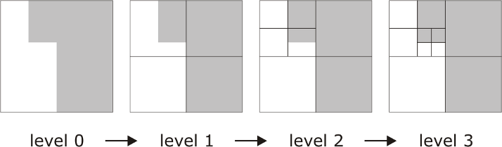
Region Quadtrees
Quadtree is a tree structure where every non-leaf node has exactly four descendents
Region quadtrees recursively subdivide non-homogenous square arrays of cells into four equal sized quadrants
Decomposition continues until all squares bound homogenous regions
Some slides borrowed from “GIS a computational perspective: second edition” by M. Worboys CRC press 2004.

Slide 4
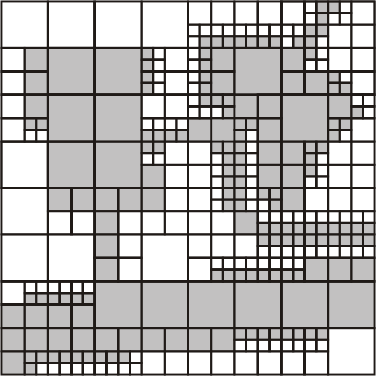
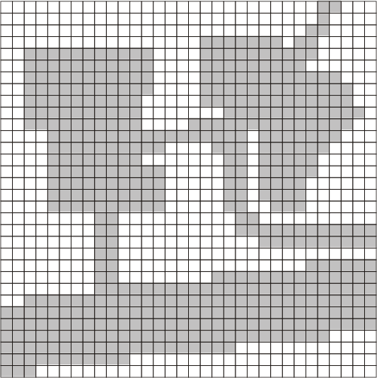
Region Quadtrees
Input Data (Raster form)
Quad Tree
Some slides borrowed from “GIS a computational perspective: second edition” by M. Worboys CRC press 2004.

Slide 5
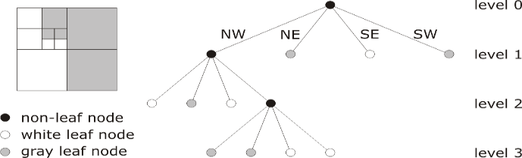
Region Quadtrees
Quadtrees take full advantage of the spatial structure, adapt to variable spatial detail
Inefficient for highly inhomogeneous rasters
Very sensitive to changes in the embedding space (e.g., translation, rotation)
Some slides borrowed from “GIS a computational perspective: second edition” by M. Worboys CRC press 2004.

Slide 6
Region Quadtrees
Quadtrees take full advantage of the spatial structure, adapt to variable spatial detail
Inefficient for highly inhomogeneous rasters
Very sensitive to changes in the embedding space (e.g., translation, rotation)
More useful for representing/compressing raster data.
Some slides borrowed from “GIS a computational perspective: second edition” by M. Worboys CRC press 2004.

Slide 7
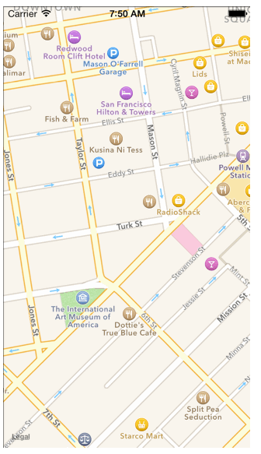
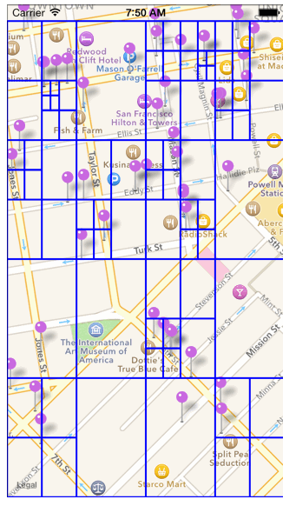
Region Quadtrees for points Insertion Animation
Animation available at this link: https://robots.thoughtbot.com/how-to-handle-large-amounts-of-data-on-maps

Slide 8
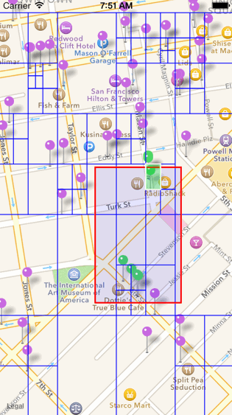
Region Quadtrees for points Range Query Example
Animation available at this link: https://robots.thoughtbot.com/how-to-handle-large-amounts-of-data-on-maps

Slide 9
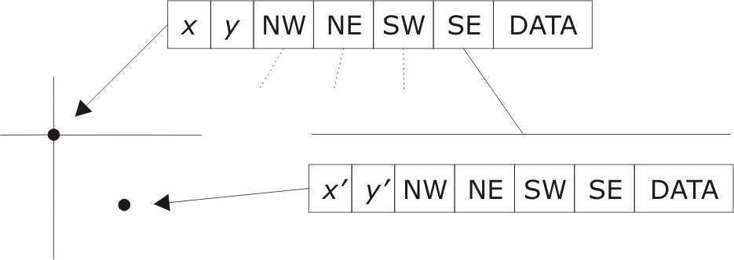
Point Quadtrees
Combination of grid approach with multidimensional binary search tree
Each non-leaf node has four descendents
Each quadrant partition is centered on a data point
Quadtree build time is O(n log n); search time is O(log n)
Some slides borrowed from “GIS a computational perspective: second edition” by M. Worboys CRC press 2004.

Slide 10
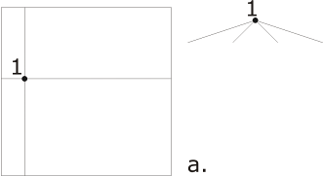
Point Quadtrees
Some slides borrowed from “GIS a computational perspective: second edition” by M. Worboys CRC press 2004.

Slide 11
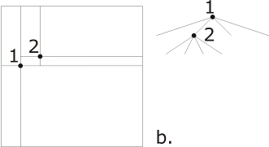
Point Quadtrees
Some slides borrowed from “GIS a computational perspective: second edition” by M. Worboys CRC press 2004.

Slide 12
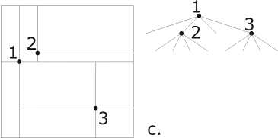
Point Quadtrees
Some slides borrowed from “GIS a computational perspective: second edition” by M. Worboys CRC press 2004.

Slide 13
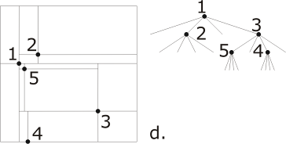
Point Quadtrees
Some slides borrowed from “GIS a computational perspective: second edition” by M. Worboys CRC press 2004.

Slide 14
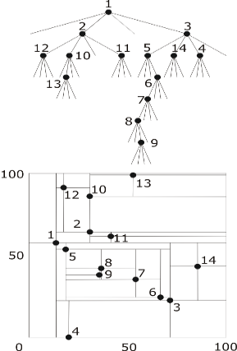
Point Quadtrees
Some slides borrowed from “GIS a computational perspective: second edition” by M. Worboys CRC press 2004.

Slide 15
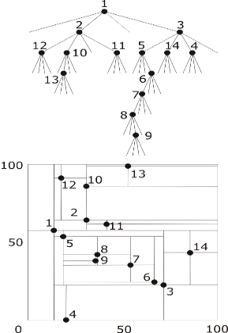
Point Quadtrees: Range Query
Some slides borrowed from “GIS a computational perspective: second edition” by M. Worboys CRC press 2004.

Slide 16
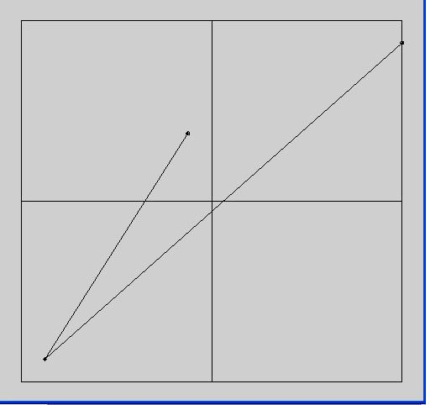
PM Quadtrees
C
Partiton: (512,512)
A
NW
Point A
Edge AB
NE
Point C
Edge CB
SW
Point B
Edge AB
Edge CB
SE
Edge CB
B

Slide 17
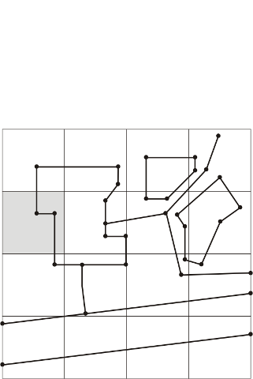
PM1 Quadtrees
Divides region into quadtree, such that all edges and vertices are separated into distinct leaf nodes
  Each leaf node contains at most one vertex
  Leaves containing a vertex contain only edges incident with that vertex
  Leaves not containing a vertex contain only one edge
Some slides borrowed from “GIS a computational perspective: second edition” by M. Worboys CRC press 2004.

Slide 18
PM1 Quadtrees
Divides region into quadtree, such that all edges and vertices are separated into distinct leaf nodes
  Each leaf node contains at most one vertex
  Leaves containing a vertex contain only edges incident with that vertex
  Leaves not containing a vertex contain only one edge
Some slides borrowed from “GIS a computational perspective: second edition” by M. Worboys CRC press 2004.

Slide 19
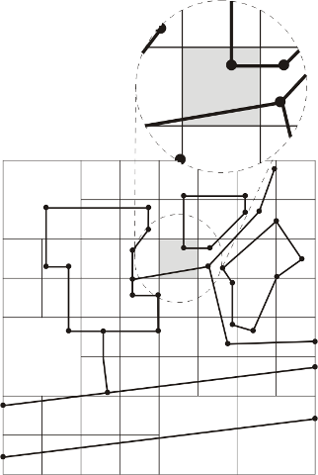
PM2 Quadtrees
Divides region into quadtree, such that all edges and vertices are separated into distinct leaf nodes
  Each leaf node contains at most one vertex
  Leaves containing a vertex contain only edges incident with that vertex
  Leaves not containing a vertex contain only one edge
Some slides borrowed from “GIS a computational perspective: second edition” by M. Worboys CRC press 2004.

Slide 20
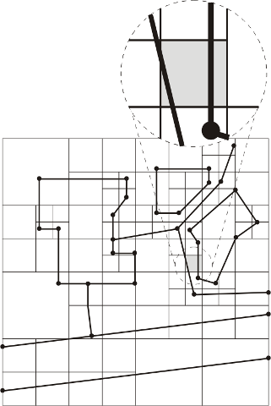
PM2 Quadtrees
Divides region into quadtree, such that all edges and vertices are separated into distinct leaf nodes
  Each leaf node contains at most one vertex
  Leaves containing a vertex contain only edges incident with that vertex
  Leaves not containing a vertex contain only one edge
Some slides borrowed from “GIS a computational perspective: second edition” by M. Worboys CRC press 2004.

Slide 21
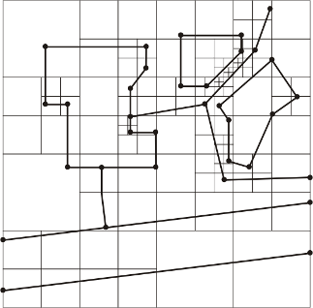
PM1 Quadtrees
Divides region into quadtree, such that all edges and vertices are separated into distinct leaf nodes
  Each leaf node contains at most one vertex
  Leaves containing a vertex contain only edges incident with that vertex
  Leaves not containing a vertex contain only one edge
Final Quadtree following all constraints.
Some slides borrowed from “GIS a computational perspective: second edition” by M. Worboys CRC press 2004.

Slide 22
R-Trees and its Variants

Slide 23
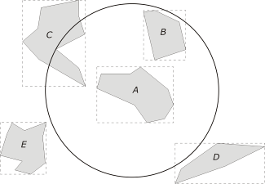
Rectangles and Mininmum Bounding Boxes
Minimum bounding box (MBB/MBR): the smallest rectangle bounding a shape with its axes parallel to the sides of the Cartesian frame
Using MBB, some queries may be answered without retrieving the geometry of an object
E.g., find all objects which lie entirely within a specified region
Some slides borrowed from “GIS a computational perspective: second edition” by M. Worboys CRC press 2004.

Slide 24
R-tree Properties and Invariants
Balanced (similar to B+ tree)
I is an n-dimensional rectangle of the form (I₀, I₁, ... , I_{n-1}) where I_{i} is a range [a,b] ∈[-∞,∞]
Leaf node index entries: (I, tuple_id)
Non-leaf node entry: (I, child_ptr)
M is maximum entries per node.
m ≤ M/2 is the minimum entries per node.
Antonin Guttman. 1984. R-trees: a dynamic index structure for spatial searching. In Proceedings of the 1984 ACM SIGMOD international conference on Management of data (SIGMOD '84)

Slide 25
R-tree Properties and Invariants
Every leaf (non-leaf) has between m and M records (children) except for the root.
Root has at least two children unless it is a leaf.
For each leaf (non-leaf) entry, I is the smallest rectangle that contains the data objects (children).
All leaves appear at the same level.
Antonin Guttman. 1984. R-trees: a dynamic index structure for spatial searching. In Proceedings of the 1984 ACM SIGMOD international conference on Management of data (SIGMOD '84)

Slide 26
R-tree - Example
M is maximum entries per node.
m ≤ M/2 is the minimum entries per node.
A. Juozapavicius. Vilnius University, Lithuania http://www.mif.vu.lt/~algis/

Slide 27
R-tree – Searching Algorithm
Given a search rectangle S.
  Start at root and locate all child nodes whose rectangle I intersects S (via linear search).
  Search the subtrees of those child nodes.
  When you get to the leaves, return entries whose rectangles intersect S.
Searches may require inspecting several paths.
Worst case running time is not so good.

Slide 28
R-tree – Searching Example
M is maximum entries per node.
m ≤ M/2 is the minimum entries per node.
Find all rectangles which contains this query point
A. Juozapavicius. Vilnius University, Lithuania http://www.mif.vu.lt/~algis/

Slide 29
R-tree – Insertion Algorithm (1/2)
Traverse the tree top down, starting from the root.
  At each level.
  If there is a node whose directory rectangle contains the MBB to be inserted, then search the subtree.
  Else choose a node such that enlargement of its directory rectangle is minimal, then search the subtree.
  If more than one node satisfy this, then choose the one with the smallest area.
Repeat until a leaf node is reached.

Slide 30
R-tree – Insertion Algorithm (2/2)
If the leaf node is not full then an entry [MBB, object-id] is inserted.
Else //the leaf node is full
  Split the leaf node.
  Update the directory rectangles of the ancestor nodes if necessary.

Slide 31
R-tree – Insertion Examples
A. Juozapavicius. Vilnius University, Lithuania http://www.mif.vu.lt/~algis/

Slide 32
R-tree – Insertion Examples
A. Juozapavicius. Vilnius University, Lithuania http://www.mif.vu.lt/~algis/

Slide 33
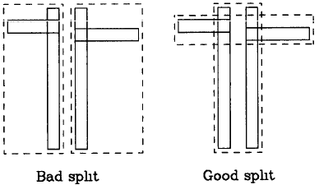
R-tree – Node Splitting
Problem: Divide M+1 entries among two nodes so that it is unlikely that the nodes are needlessly examined during a search.
Objective: Minimize total area of the covering rectangles for both nodes.
Exponential algorithm.
Quadratic algorithm.
Linear time algorithm.

Slide 34
R-tree – Node Splitting: Exponential Algorithm
Problem: Divide M+1 entries among two nodes so that it is unlikely that the nodes are needlessly examined during a search.
Solution: Minimize total area of the covering rectangles for both nodes.
Exponential algorithm
  Try all possible combinations.
  Optimal results!
  Bad running time!

Slide 35
R-tree – Node Splitting: Quadratic Algorithm
Problem: Divide M+1 entries among two nodes so that it is unlikely that the nodes are needlessly examined during a search.
Solution: Minimize total area of the covering rectangles for both nodes.
Quadratic algorithm
Find pair of entries E₁ and E₂ that maximizes area(J) - area(E₁) - area(E₂) where J is covering rectangle.
Put E₁ in one group, E₂ in the other.
If one group has M-m+1 entries, put the remaining entries into the other group and stop. If all entries have been distributed then stop.
For each entry E, calculate d₁ and d₂ where d_{i} is the minimum area increase in covering rectangle of the group when E is added.
Find E with maximum |d₁ - d₂| and add E to the group whose area will increase the least. If tied: (a) choose smaller area, (b) choose smaller group
Repeat starting with step 3.

Slide 36
R-tree – Node Splitting: Quadratic Algorithm Example
P3
P2
P6
M = 6
m = 3
P7
P4
P1
P5
Node to be Split

Slide 37
R-tree – Node Splitting: Quadratic Algorithm Step 1
P3
P2
P6
M = 6
m = 3
P7
P4
P1
P5
Node to be Split

Slide 38
R-tree – Node Splitting: Quadratic Algorithm Step 2
P3
P2
P6
M = 6
m = 3
P7
P4
P1
P5
Node to be Split

Slide 39
R-tree – Node Splitting: Quadratic Algorithm Step 3
P3
P2
P6
M = 6
m = 3
P7
P4
P1
P5
Node to be Split

Slide 40
R-tree – Node Splitting: Quadratic Algorithm Step 4
P3
P2
P6
M = 6
m = 3
P7
P4
P1
P5
Node to be Split

Slide 41
R-tree – Node Splitting: Quadratic Algorithm Step 5
P3
P2
P6
M = 6
m = 3
P7
P4
P1
P5
Node to be Split

Slide 42
R-tree – Node Splitting: Quadratic Algorithm Step 6
P3
P2
P6
M = 6
m = 3
P7
P4
P1
P5
Node to be Split

Slide 43
R-tree – Adjustment during overflow
N = leaf node. If there was a split, then NN is the other node.
If N is root, stop. Otherwise P = N’s parent and E_{N} is its entry for N. Adjust the rectangle for E_{N} to tightly enclose new N.
If NN exists (i.e., N was split and NN is its second MBB from split), add entry E_{NN} (MBB corresponding to NN) to P. E_{NN} points to NN and its MBB rectangle tightly encloses NN.
If necessary, split P
Set N=P and go to step 2.
Antonin Guttman. 1984. R-trees: a dynamic index structure for spatial searching. In Proceedings of the 1984 ACM SIGMOD international conference on Management of data (SIGMOD '84)

Slide 44
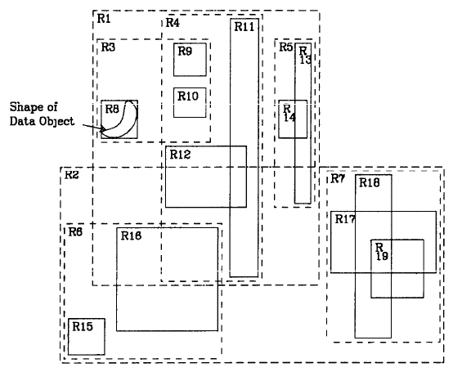
R-tree – Another Example (1/2)
Antonin Guttman. 1984. R-trees: a dynamic index structure for spatial searching. In Proceedings of the 1984 ACM SIGMOD international conference on Management of data (SIGMOD '84)

Slide 45
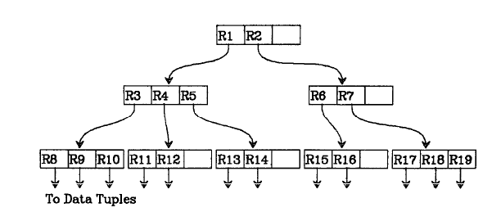
R-tree – Another Example (2/2)
Antonin Guttman. 1984. R-trees: a dynamic index structure for spatial searching. In Proceedings of the 1984 ACM SIGMOD international conference on Management of data (SIGMOD '84)

Slide 46
R-tree – Insertion Another Example (1/2)
Nw
Insert the new data point Nw into the R-tree shown
Antonin Guttman. 1984. R-trees: a dynamic index structure for spatial searching. In Proceedings of the 1984 ACM SIGMOD international conference on Management of data (SIGMOD '84)

Slide 47
R-tree – Insertion Another Example (2/2)
Nw
Nw goes here creating an overflow
Antonin Guttman. 1984. R-trees: a dynamic index structure for spatial searching. In Proceedings of the 1984 ACM SIGMOD international conference on Management of data (SIGMOD '84)

