Slide 1
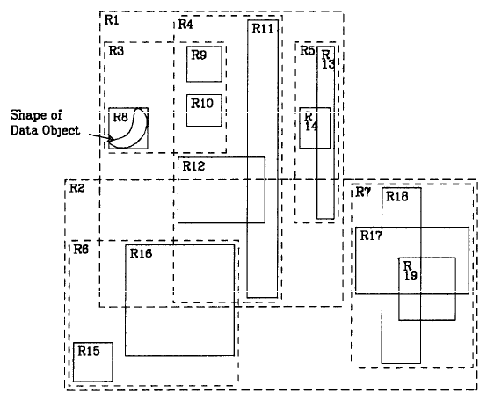
R-tree – Another Example (1/2)
Antonin Guttman. 1984. R-trees: a dynamic index structure for spatial searching. In Proceedings of the 1984 ACM SIGMOD international conference on Management of data (SIGMOD '84)

Slide 2
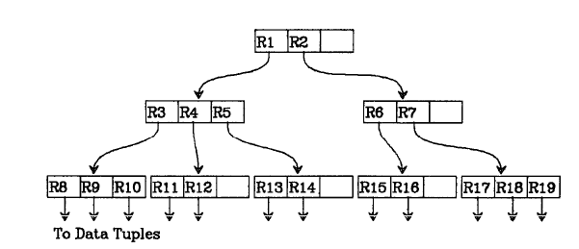
R-tree – Another Example (2/2)
Antonin Guttman. 1984. R-trees: a dynamic index structure for spatial searching. In Proceedings of the 1984 ACM SIGMOD international conference on Management of data (SIGMOD '84)

Slide 3
R-tree – Insertion Another Example
Nw
Insert the new data point Nw into the R-tree shown
Antonin Guttman. 1984. R-trees: a dynamic index structure for spatial searching. In Proceedings of the 1984 ACM SIGMOD international conference on Management of data (SIGMOD '84)

Slide 4
R-tree – Insertion Another Example
Nw
Nw goes here creating an overflow
Antonin Guttman. 1984. R-trees: a dynamic index structure for spatial searching. In Proceedings of the 1984 ACM SIGMOD international conference on Management of data (SIGMOD '84)

Slide 5
R-tree – Insertion Another Example
Nw
Nw goes here creating an overflow

Slide 6
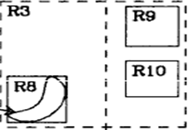
R-tree – Another Example Splitting R3
Nw

Slide 7
R-tree – Another Example Splitting R3: Step 1
Nw

Slide 8
R-tree – Another Example Splitting R3: Step 2
Nw

Slide 9
R-tree – Another Example Splitting R3: Step 3
Nw

Slide 10
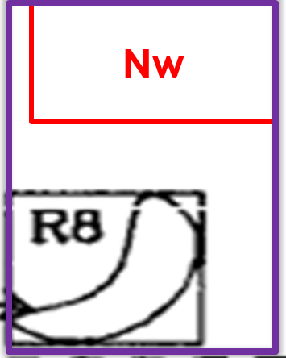
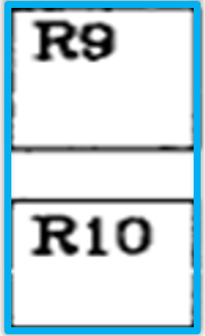
R-tree – Another Example Splitting R3
R3
R3’’

Slide 11
R-tree – Another Example Adjusting the tree
M =3 m =2
R3
R4
R5
Nw
R8
R9
R10

Slide 12
R-tree – Another Example Adjusting the tree
M =3 m =2
R3
R4
R5
R3’’ should go into this
Nw
R8
R9
R10

Slide 13
R-tree – Another Example Adjusting the tree
M =3 m =2
Overflow: This should be split
R3
R3’’
R4
R5
Nw
R8
R9
R10

Slide 14
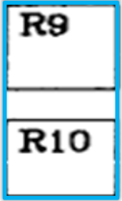
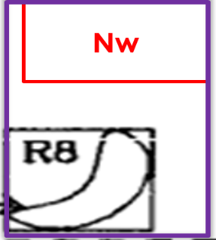
R-tree – Another Example Splitting R3 R3’’ R4 and R5
R3
R3’’

Slide 15
R-tree – Another Example Splitting R3 R3’’ R4 and R5
R3’’
R4
R3
R5

Slide 16
R-tree – Another Example Splitting R3 R3’’ R4 and R5
R4
R3
R3’’
R5

Slide 17
R-tree – Another Example Splitting R3 R3’’ R4 and R5
R3’’
R4
R3
R5

Slide 18
R-tree – Another Example Splitting R3 R3’’ R4 and R5
R1’
R4
R1
R5
R3
R3’’

Slide 19
R-tree – Another Example Adjusting the tree
M =3 m =2
R1
R2
R3
R3’’
R4
R5
Overflow: This was split
Nw
R8
R9
R10

Slide 20
R-tree – Another Example Adjusting the tree
M =3 m =2
R1
R1’
R2
R3
R3’’
R4
R5

