Slide 1
Introduction to Spatial Computing CSE 5ISC
Week Aug-3 – Aug-8
Some slides adapted from Worboys and Duckham (2004) GIS: A Computing Perspective, Second Edition, CRC Press

Slide 2
Course Logistics
Two classes per week
Tuesday and Friday 2:30pm – 4:00pm
Office hours:
Tuesday and Friday 4:00pm – 5:00pm
For other times, please send a email to fix an appointment.
Please use “CSE 5ISC” in the email subject.
Course Web page:
http://faculty.iiitd.ac.in/~gunturi/courses/mon15/cse5isc/index.html
Please check the course page for updates
Course Textbook:
Worboys and Duckham (2004) GIS: A Computing Perspective, Second Edition, CRC Press
Shashi Shekhar and Sanjay Chawla (2003): Spatial Databases: A Tour, Prentice Hall

Slide 3
Course Structure
3 homework assignments (11% each) to be done in a team (2 students only)
containing both textbook and programming parts
2 Exams (15% each)
Course project (37%)
Should be done in a team of 2 students (ideally)
Three streams
Literature review – Comprehensive with gap analysis
Research problem – Typical research oriented non-trivial problem
Comparison based – Extensive comparison of 3-4 methods for a problem
Academic Dishonesty policy of IIIT Delhi does apply
http://www.iiitd.ac.in/education/resources/academic-dishonesty

Slide 4
Spatial Computing
Broadly defined as composed of computing activities which focus on data which either spatially or spatio-temporally oriented.

Slide 5
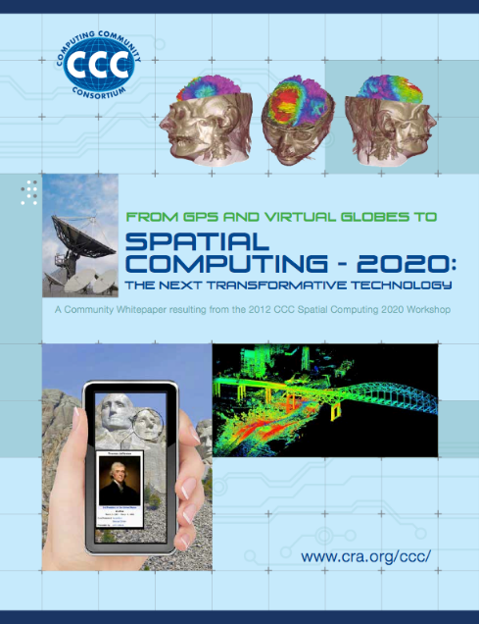
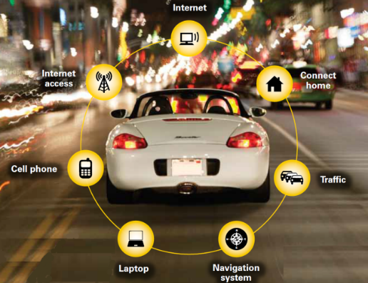
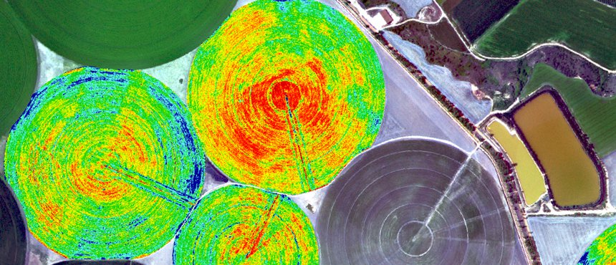
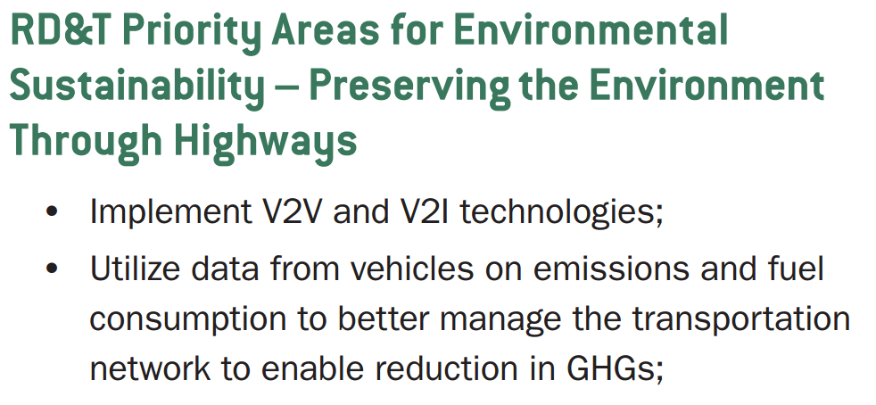
Spatial Computing: Emerging Trend
Penetration of Internet (Internet of Things)
Several platforms are location aware (e.g., smartphones)
Many more travel phenomena are observable
Smarter Planet

Slide 6
Topics planned…
Fundamental Spatial Concepts
Euclidean, set based and topological spaces.
Models of Geo-spatial information
Basic representation and algorithms
Triangulation, Vornoi diagrams etc.
Spatial index structures, r-tree, quad tree etc.
Spatial query processing
KNN and nearest neighbors etc.
Spatial Networks
Spatial Data Mining
Trends
Check schedule at: http://faculty.iiitd.ac.in/~gunturi/courses/mon15/cse5isc/schedule.html

Slide 7
Spatial Computing Vs Geographic Information Systems/Science
GIS is over grand application software to store, retrieve, visualize and analyze geo-spatial data.
Spatial Computing is the core “Computer Science” inside a GIS.
Can take space as an abstract notion,
Can go beyond geo-spatial data as well.
Typically Encompasses:
Spatial and spatio-temporal databases
Spatial and spatial-temporal data mining
Visualization and Human computer interaction
Computational Geometry
Graph algorithms

Slide 8
Sample Functionalities of GIS Aka problems considered in Spatial Computing

Slide 9
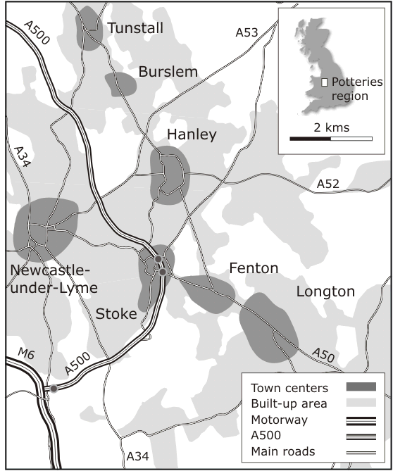
Sample Geographic Locations
Example: “The Potteries”
The Potteries comprise six pottery towns
The region developed during the English industrial revolution
Local communities produced high quality ware from conditions of poverty

Slide 10
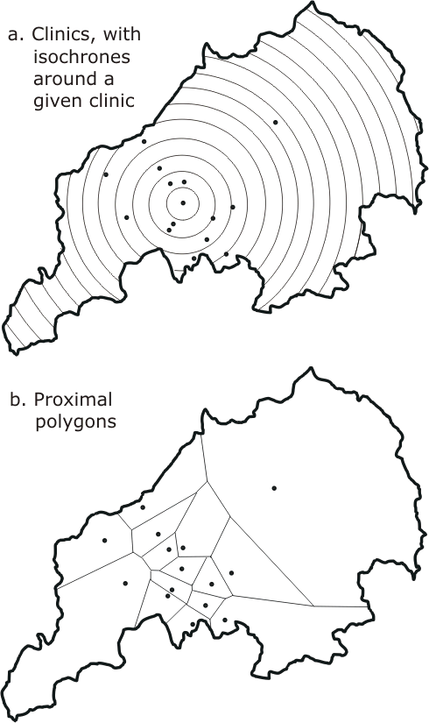
Functionality: location analysis
Locating/planning a clinic (or any public facility) in the Potteries
Construct the “neighborhood” of clinics, based upon positions of nearby clinics and travel times
We can then support decisions to relocate, close, or create a new clinic

Slide 11
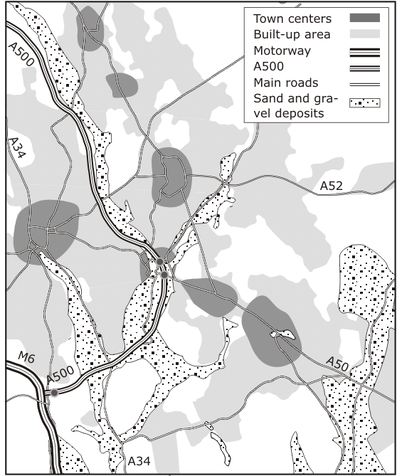
Functionality: layer-based analysis
Determining the potential of different locations for sand and gravel extraction
Drawing together and analyzing data from variety of sources
Geological data,
urban structure,
water table level,
transportation network,
land prices, and
land zoning
Locations of sand and gravel deposits in the Potteries region

Slide 12
Functionality: layer-based analysis
Query: find all locations that are within 0.5 km of a major road, not in a built-up area, and on a sand/gravel deposit
0.5 km buffer of major roads (not including the motorway
Known sand and gravel deposits
Overlay of the three other layers giving area that satisfies the query
Shaded areas indicate locations that are not built up

Slide 13
Functionality: terrain analysis
Local communities are often interested in the visual impact of proposed new opencast coal mining sites
Visibility analysis can be used to evaluate visual impact
Measuring the size of the local population within a given viewshed (a map of all the points visible from some location)
Terrain analysis is usually based upon data sets of topographic elevation at point locations

Slide 14
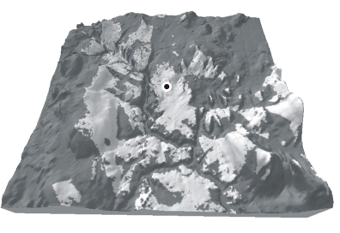
Functionality: terrain analysis
Perspective projection
Darker shaded regions give the area from which the marked point would not be visible
Contour map

Slide 15
Functionality: network analysis
We want to find a route using the major road network, visiting each pottery (and the City Museum) only once, while minimizing the traveling time
A travel-time network between potteries is the required data set
Derived from average times on the main roads shown on the map

Slide 16
Functionality: network analysis
Traveling salesperson algorithm
Construct a minimal weight route through a network that visits each node at least once
Could be dynamic; assigning weights to the edges of the network and calculating optimal routes depending upon changeable road conditions

Slide 17
Introduction to Spatial Data

Slide 18
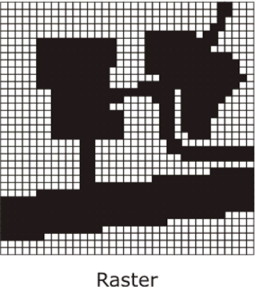
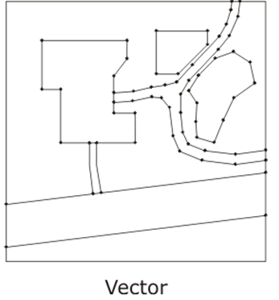
Types of Spatial Data
Vector is a finite straight line segment defined by its end points. The locations of end-points are given with respect to some coordination of the plane
Raster data is structured as an array or grid of cells, referred to as pixels

Slide 19
Types of Spatial Data
Raster
Natural structures to use in computers as programming languages commonly support array handling and operations
Inefficient in terms of usage of computer storage
Vector
More efficient in its use of computer storage as only points of interest need be stored
Assume a hard edged boundary model of the world

Slide 20
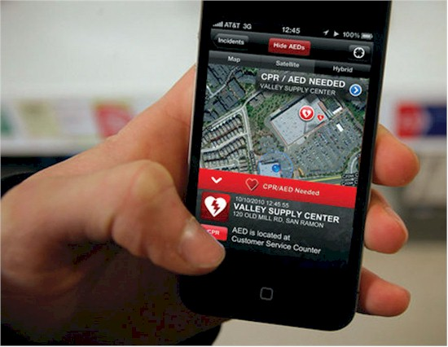
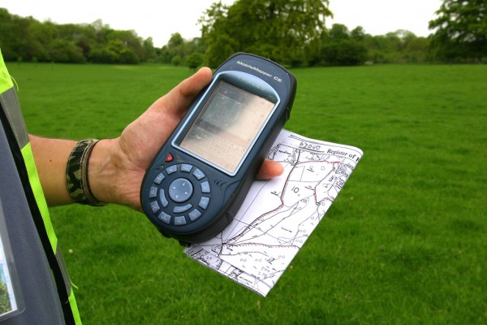
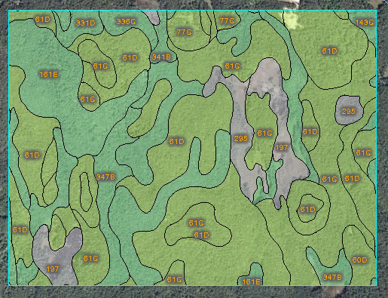
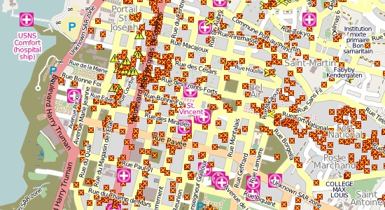
Data Capturing
Data capture: the process of collecting data from observations of the physical environment
Sensors are a primary source of data for a GIS and are used to measure some feature of the geographic environment
Volunteered Geographic Information
Land Surveying using GPS devices

Slide 21
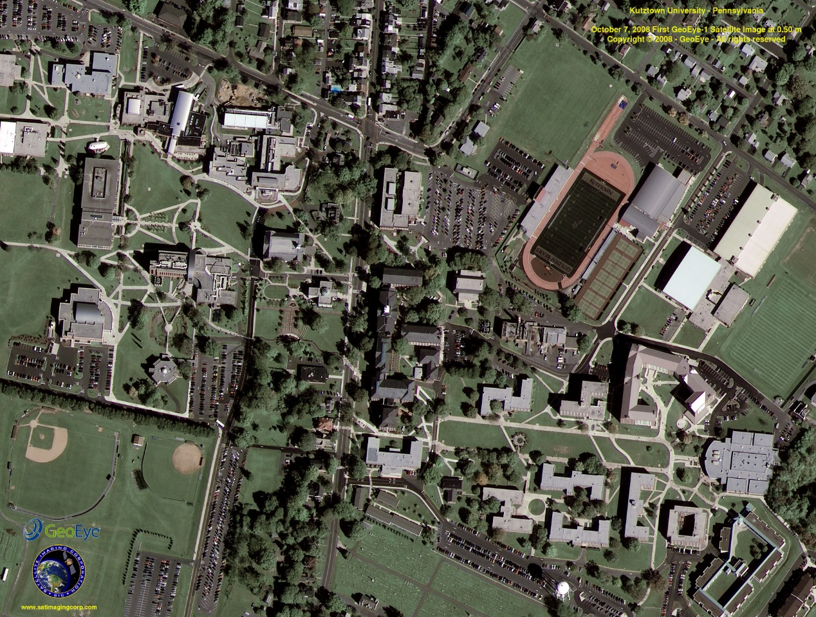
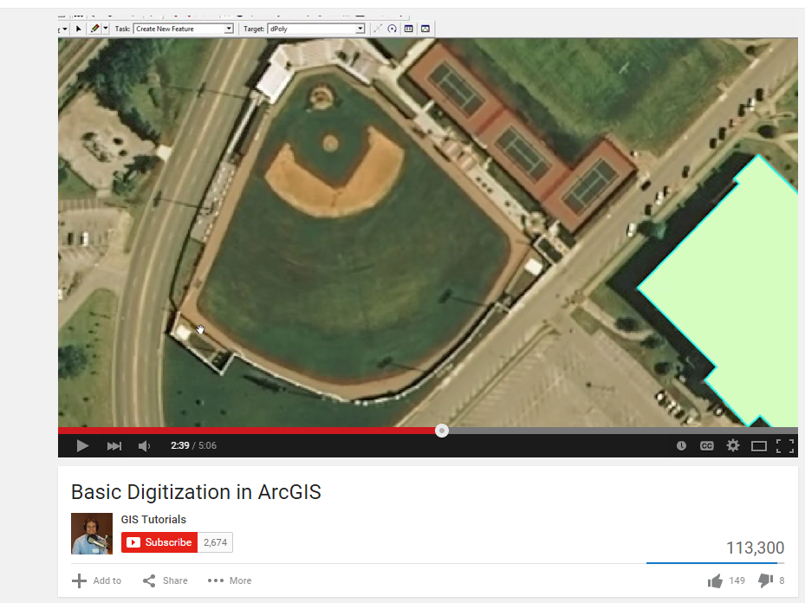
Data Capturing: Remote sensing
Aerial images of the Earth surface which are digitized to get maps.
Youtube video on digitization

Slide 22
Database Support
What is a Database? a repository of data that is logically related, but possibly physically distributed over several sites
A database is created and maintained using a database management system (DBMS)
For a database to be useful it must be:
Reliable
Correct and consistent
Secure
Fast retrieval

Slide 23
Building a System of Spatial Data
The process of developing a database is essentially a process of model building
Application domain model: describes the core requirements of users in a particular application domain, based on an initial study
Conceptual model: Illustrates the entities, the core concepts and relationships among the entities. Usually consists of conceptual models such as ER diagrams.
Logical model: An abstract layer creating between the conceptual and the physical layers to create independence between the two. Consists of abstract data types and operators defined on data.
Physical model: This is the result of a process of programming and system implementation. Query optimization can also be considered a part of physical model.

Slide 24
Data Retrieval and Analysis
To retrieve data from a databases we may perform a query:
Traditional Query
Retrieve names and addresses of all opencast coal mines in Staffordshire
Data may be retrieved by a simple look up and match
Retrieve names and addresses of all employees of Wedgwood Pottery who earn more than half the sum earned by the managing director
Numerical comparison

Slide 25
Data Retrieval and Analysis
Spatial Query: is there any correlation between:
The location of vehicle accidents (as recorded on a hospital database); and
Designated “accident black spots” for the area?
Satisfying this query will require the integration of both spatial and non-spatial information
Performance
Spatial data can be notoriously large and often hierarchically structured
Geospatial data is often embedded in the Euclidean plane, therefore spatial storage structures and access methods are required

Slide 26
Data Presentation
A report generator is a standard feature of a DBMS that allows data from a database to be laid out in a clear human-readable format
Many databases also support business graphics
Map- based presentation is a distinctive feature of a GIS
Zoom and Zoom-out features.
Map Rendering
Data needs to be summarized at different levels of zoom.
Some DBMSs and GISs provide tools for data mining

Slide 27
Pop Question
Home
Consider a sample vector data illustrated alongside.
Each of the entities has following information
Name -- String
Constructed -- Date
Location -- sequence of (latitudes, longitudes)
Q1: Design a Database schema (atleast 2NF) for this data, reduce redundancy as much as possible.
Q2: Write a SQL query to compute the length of Road2.
Road3
Office
Plaza
Road2
Road I
Highway

Slide 28
Conceptual Modeling of Spatial Data

Slide 29
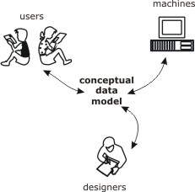
Conceptual data model
A conceptual data model provides a model of the proposed system that is independent of implementation details
An effective conceptual model will
provide a means for communication between analysts, designers and users
aid the design of the system
provide basic reference material for implemented system

Slide 30
Entity relationship model #1
The entity relationship model is a conceptual data modeling technique where
An entity type represents a collection of similar objects
An entity instance is an occurrence of a particular entity
An attribute type is a property associated with an entity
An attribute type that serves to uniquely identify an entity type is called an identifier
Identifiers are usually underlined
attribute type
entity type
identifier

Slide 31
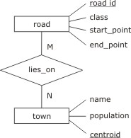
Entity relationship model #2
Entity types are connected using relationships
A relationship type connects one or more entity types
A relationship occurrence is a particular instance of a relationship
Relationships may have their own attributes independent of entities
Entity, attribute, and relationship types are shown in an entity relationship diagram (E-R diagram)
relationship
type

Slide 32
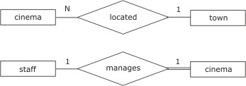
Entity relationship model #3
Relationship types may be
many-to-many: e.g., a town may have many road, which in turn may pass through many towns
many-to-one: e.g., a town may have many cinemas, but a cinema can be located in at most one town
one-to-one: e.g., a cinema may have one manager who manages only one cinema
These constraints constitute cardinality conditions

Slide 33
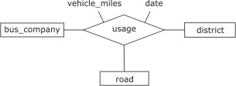
Entity relationship model #4
In addition to cardinality conditions, relationships may also have participatory conditions:
optional or mandatory (indicated with a double line)
A relationship from an entity to itself is called involutory
A relationship connecting three entities is called a ternary relationship

Slide 34
Extended entity relationship model
The extended entity relationship model (EER) adds further features:
An entity type E₁ is a subtype of E₂ if every occurrence of E₁ is also an occurrence of E₂. In this case, E₂ is a supertype of E₁
The operation of forming subtypes is called specialization; the inverse operation of forming supertypes is called generalization
For specialization (and conversely for generalization)
A subtype has the same identifying attribute(s) as the supertype
A subtype has all the attributes of the supertype, and possibly some more
A subtype enters into all the relationships in which the supertype is involved, and possibly some more.
Subtypes and supertypes are organized into an inheritance hierarchy

Slide 35
Extended entity relationship model
Subtypes may be:
disjoint: where no occurrence of one subtype is an occurrence of another
overlapping: subtypes are not disjoint
EER uses an extended diagrammatic notation to represent specialization/generalization constructs
supertype
disjoint
overlapping
subtype

Slide 36
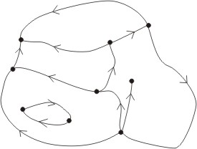
EER for spatial information #1
E-R or EER can be used to model spatial entities
Most vector-based GIS use a similar structure
Node
area
directed arc

Slide 37
Pop Question
Question: What is the minimum number of arcs associated with an area?
(0,1, or many)?
Question: What is the minimum number of nodes in an area?
(0 ,1 or many)?
Node
area
directed arc

Slide 38
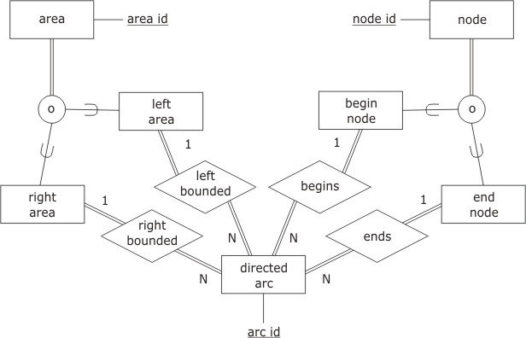
EER for spatial information #2
Question1: What is the minimum number of arcs associated with an area?
(0,1, or many)?
Question2: What is the minimum number of nodes in an area?
(0 ,1 or many)?
Question: Re-consider the implication if “overlapping” is changed to “disjoint” in the EER diagram

Slide 39
Pop question
What should be changed in the ER diagram to model this?
Node
area
directed arc

Slide 40
Modeling Spatial Data In Databases

Slide 41
Is rational database sufficient?
Consider again our previous example of nodes and arcs representation of a road network.
Each arc is represented as a line string which is a string of lines defined by end points (lat, long)
P0
R1P1
R1P2
R1P3
Road ID | Road Name
R1 | MG Road
… | …..
R1
MG Road
Road ID | Spoint_lat | Spoint_Long | Epoint Lat | Epoint Long | Order
R1 | P0 | R1P1 | .. | .. | 1
…. | ….. | ….. | .. | .. | …

Slide 42
Is rational database sufficient?
Road ID | Road Name
R1 | MG Road
… | …..
Road ID | Spoint_lat | Spoint_Long | Epoint Lat | Epoint Long | Order
R1 | P0 | R1P1 | .. | .. | 1
…. | ….. | ….. | .. | .. | …
Need Formal Definition of “on MG road”
Meter ID | Lat | Long | Tariff
M1 | X | Y | 30.00
…. | ….. | …..
Query: Increase the tariff on all meters on MG road by 20 rupees.
Is a relational model consisting of select project and join efficient for this query???
Spatial data and operations need Object Orientation!!!

Slide 43
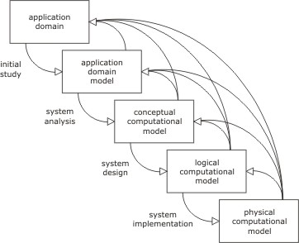
Object Orientation
The stages of the system development process present a problem
Information may be lost at each stage of the development process, termed impedance mismatch
Object-orientation aims to minimize impedance mismatch, bringing low-level system constructs closer to high-level conceptual constructs
Object oriented design
Typical relational Model design

Slide 44
Foundations of Object Orientation
The object is at the core of object-orientation
Objects have attributes that model the static, data-oriented aspects of a system (similar to tuples in a relation)
The totality of attribute values constitutes the state of an object
Objects also have operations that model the behavior of a system
Behaviors are also called methods
Objects with similar behaviors are grouped into classes
The set of behaviors for a object form an interface
object = state + behavior

Slide 45
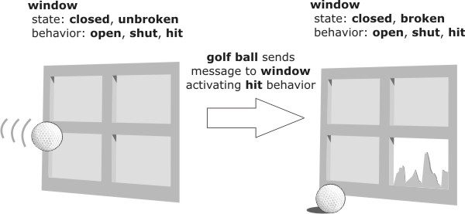
Example of Object Orientation

Slide 46
Features of Object Orientation
The four main features of object-orientation from a modeling perspective are:
Reduces complexity: decomposes complex phenomena into simpler objects
Combats impedance mismatch: object-orientation can be applied at every level of system development
Promotes reuse: System development is more efficient if constructed from collections of well-understood components
Metaphorical power: Objects in object-orientation are metaphors for physical objects, making the modeling process easier
In addition, four key constructs are closely associated with object-orientation: identity, encapsulation, inheritance, and association

Slide 47
Identity and encapsulations
An object has an identity that is independent of its attribute values
Even if an object changes all its attribute values, it retains its identity
Identity is immutable, created with an object and destroyed only when that object is destroyed
Objects hide the internal mechanisms of their behavior from the external access to that behavior, called encapsulation
What behaviors an object exhibits are separated from how those behaviors are achieved
Encapsulation promotes reuse, because changes to an object’s internal mechanisms will not affect the object’s external interface

Slide 48
Inheritance and polymorphism
Classes may be organized into an inheritance hierarchy that allows objects to share common properties
A class that provides more specialized behaviors is a subclass
A class that provides more generalized behaviors is a superclass
Inheritance allows objects to perform different roles within specific contexts, termed polymorphism
Inclusion polymorphism is where a subclass is substituted for a superclass
Overloading is where subclasses implement their own specialized versions of general behaviors
There exists two types of inheritance:
Single inheritance: each class may have zero or one superclasses
Multiple inheritance: each class may have zero or more superclasses (requires some protocol for resolving behavioral conflicts)

Slide 49
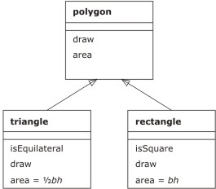
Class Diagram
superclass
behavior
(single) inheritance
subclass
overloading
(polymorphism)

Slide 50
Object Oriented Modeling (1/2)
Object-oriented modeling comprises defining the classes, attributes, behaviors, associations, and inheritance for a system
Attributes for a class can be defined in a similar way to E-R modeling
Behaviors for a class fall into three categories
Constructors are behaviors that are activated when an object is created, while destructors are activated when an object is destroyed
Accessors are behaviors that may be used to examine the state of an object
Transformers are behaviors that change the state of an object

Slide 51
Object Oriented Modeling (2/2)
Defining associations and inheritance relationships is an iterative and application-dependent process
As a rule of thumb:
Inheritance relationships can be detected by using the connection “is a” in a sentence with two classes. E.g., ‘a car “is a” vehicle’
Aggregation relationships can be detected using “part of” in a sentence. E.g., ‘a steering wheel is “part of” a car’

Slide 52
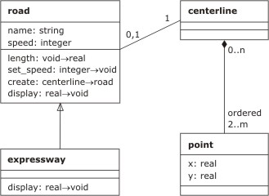
Sample Class Diagram
association
transformer
aggregation
constructor
accessor
attribute

Slide 53
Thoughts on Object Oriented database
Query Optimization is challenging
Because we now have many more operators than just select, project and join.
Indexing with encapsulation is challenging.
But still popular as object orientation reduces impedance mismatch.

