Slide 1
Introduction to Spatial Computing
Trends: Spatio-temporal graphs

Slide 2
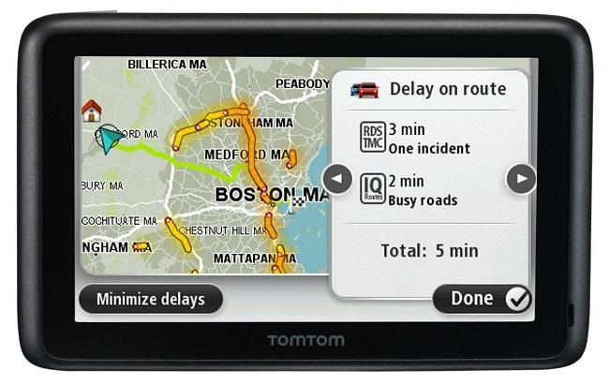
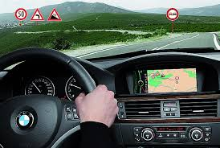
Navigation Systems
  Historical
    Navigation is a core human activity for ages!
    Trade-routes, Routes for Armed-Forces
  Recent Consumer Platforms
    Devices: Phone Apps, In-vehicle, “GPS”, …
    WWW: Google Maps, MapQuest, …
  Services
    Display map around current location
    Compute the shortest route to a destination
    Help drivers follow selected route

Slide 3
Background: Traditional Roadmaps
Dinky town Roadmap
Corresponding Digital Representation
Intersection between 5th Ave SE and 5th St
5th Ave SE edge
Intersection between 5th Ave SE and 4th St
US Road Network only
few Gigabytes
Source: Google Maps
Attributes of 5th Ave SE road segment between N4 and N7
N7
N4

Slide 4
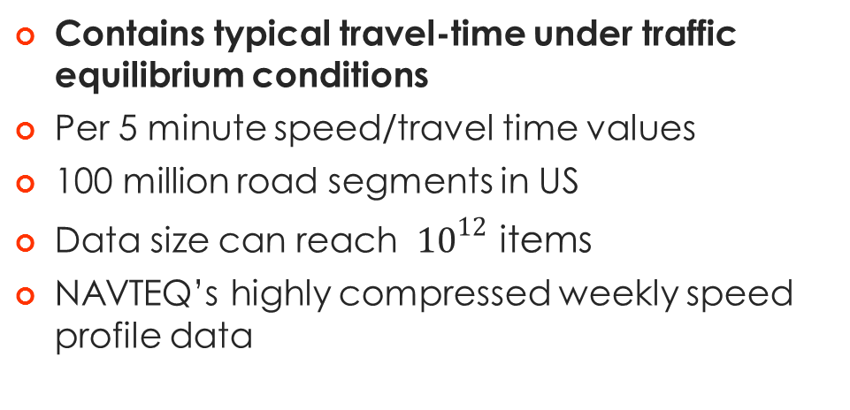
Upcoming Temporally Detailed (TD) Roadmaps
Contains typical travel-time under traffic equilibrium conditions
Per 5 minute speed/travel time values
100 million road segments in US
Data size can reach ${10}^{12}$ items
NAVTEQ’s highly compressed weekly speed profile data
Source: ESRI and NAVTEQ

Slide 5
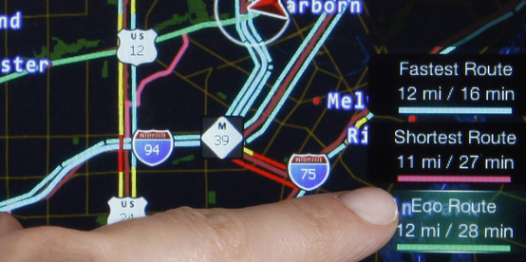
TD Roadmap Based Routing Services
Traditional routing query
  “Find shortest path between UMN and Airport”
Additional features enabled by TD roadmaps
  At what departure time?
  Non-rush hour choice ≠ Rush hour choice
  Preference metric?

Slide 6
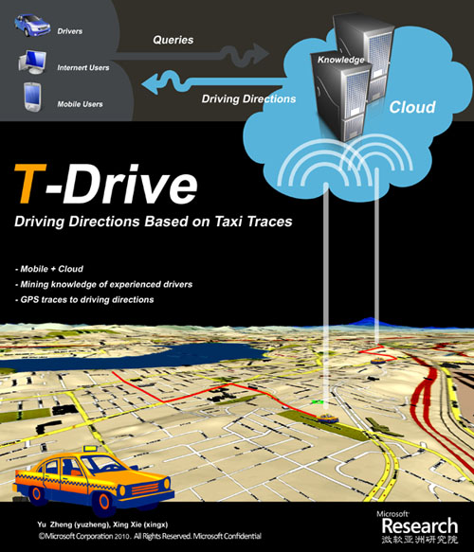

Compare TD Roadmap with Traditional Roadmap
Pilot study done by Microsoft in Beijing using 30,000 taxis
How much travel time can be saved using TD roadmaps ?
We can save on avg 20% in travel time by considering the dynamic congestion patterns.
Best paper runner up
Jing Yuan, Yu Zheng, Chengyang Zhang, Wenlei Xie, Xing Xie, and Yan Huang, T-Drive: Driving Directions Based on Taxi Trajectories, in ACM SIGSPATIAL GIS 2010,

Slide 7
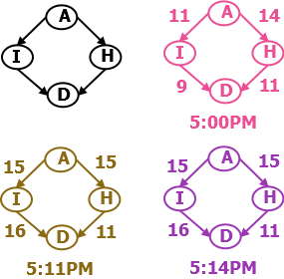
Challenges of TD Roadmap based Routing Services
Challenge 1: Candidate routes should be evaluated from the perspective of a traveler
Compare routes for 5:00pm departure
I-35W
Hiawatha Route
Digital Road Map
Legend:
A-I-D: UMN-I35W-Airport
A-H-D: UMN-Hiawatha-Airport
Path | Cost from Traveler Pers. | Cost at 5:00pm Snapshot
A-I-D | 27 mins | 20 mins
A-H-D | 25 mins | 25 mins

Slide 8

Challenges of TD Roadmap based Routing Services
Candidate routes should be evaluated from the perspective of a travelers
Compare routes for 5:00pm departure
I-35W
Hiawatha Route
Digital Road Map
Legend:
A-I-D: UMN-I35W-Airport
A-H-D: UMN-Hiawatha-Airport
Path | Cost from Traveler Pers. | 5:00PM Snapshot
A-I-D | 27 mins | 20 mins
A-H-D | 25 mins | 25 mins

Slide 9
Challenges of TD Roadmap based Routing Services
Candidate routes should be evaluated from the perspective of a travelers
Compare routes for 5:00pm departure
I-35W
Hiawatha Route
Digital Road Map
Legend:
A-I-D: UMN-I35W-Airport
A-H-D: UMN-Hiawatha-Airport
Path | Cost from Traveler Pers. | 5:00PM Snapshot
A-I-D | 27 mins | 20 mins
A-H-D | 25 mins | 25 mins

Slide 10
Challenges of TD Roadmap based Routing Services
Candidate routes should be evaluated from the perspective of a travelers
Compare routes for 5:00pm departure
I-35W
Hiawatha Route
Digital Road Map
Legend:
A-I-D: UMN-I35W-Airport
A-H-D: UMN-Hiawatha-Airport
Path | Cost from Traveler Pers. | 5:00PM Snapshot
A-I-D | 27 mins | 20 mins
A-H-D | 25 mins | 25 mins

Slide 11
Challenges of TD Roadmap based Routing Services
Candidate routes should be evaluated from the perspective of a travelers
Compare routes for 5:00pm departure
I-35W
Hiawatha Route
Digital Road Map
Legend:
A-I-D: UMN-I35W-Airport
A-H-D: UMN-Hiawatha-Airport
Path | Cost from Traveler Pers. | 5:00PM Snapshot
A-I-D | 27 mins | 20 mins
A-H-D | 25 mins | 25 mins

Slide 12
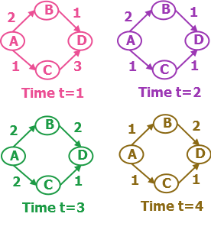
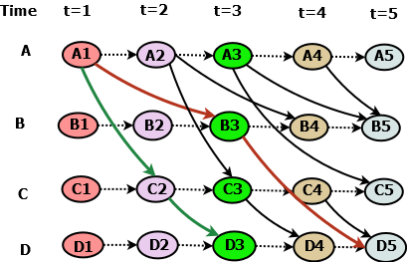
Modelling Traveler’s Frame of Reference: Time Expanded Graphs
Some edges are not drawn in the TEG to reduce clutter!

Slide 13
Optional Material on Spatio-Temporal Networks

Slide 14
Modelling Traveler’s Frame of Reference: Time Aggregated Graphs
B
[1 1 2 2]
[2 2 2 1]
A
D
[1 1 2 1]
[3 1 1 1]
C

Slide 15
Modelling Traveler’s Frame of Reference: Time Aggregated Graphs
T = 0 1 2 3 ….
+ + + +
B
[1 1 2 2]
B
[2 2 2 1]
[2 3 4 4]
[1 2 4 5]
A
D
A
D
Arrival Time Transformation
[1 1 2 1]
[3 1 1 1]
[1 2 4 4]
C
C
[3 2 3 4]

Slide 16
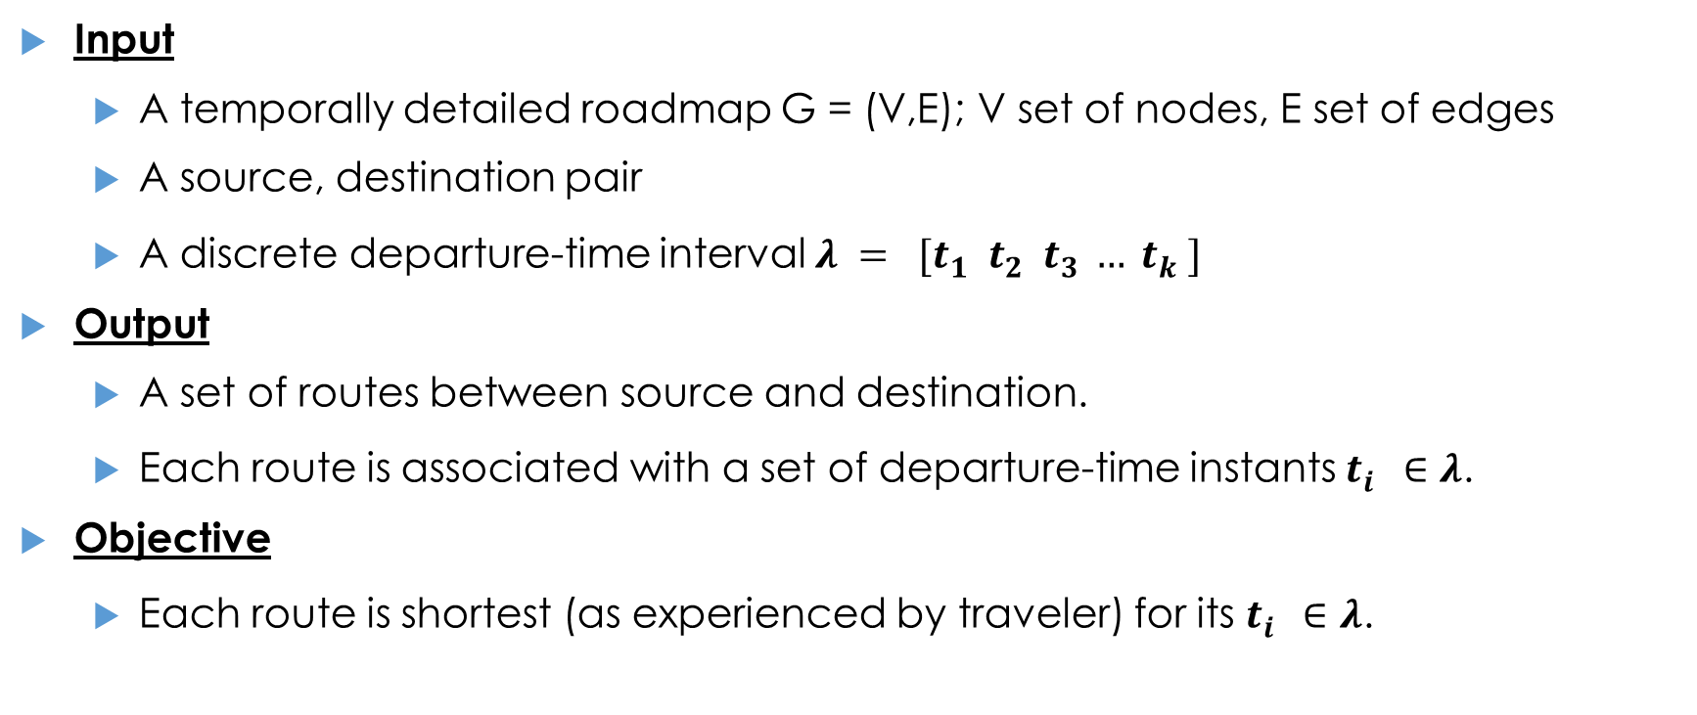
Sample Query: All start-time Lagrangian Shortest Path (ALSP) Problem
Input
  A temporally detailed roadmap G = (V,E); V set of nodes, E set of edges
  A source, destination pair
  A discrete departure-time interval $λ = [t_{1}^{} t_{2}^{} t_{3}^{}… t_{k}^{}]$
Output
  A set of routes between source and destination.
  Each route is associated with a set of departure-time instants $t_{i}^{}∈λ$.
Objective
  Each route is shortest (as experienced by traveler) for its $t_{i}^{}∈λ$.

Slide 17
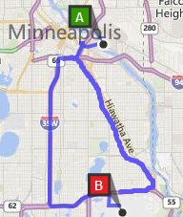
All start-time Lagrangian Shortest Path (ALSP) Problem
Problem Instance
Query Input:
  Temporally Detailed Roadmap
  Source: UMN (Point A)
  Destination: MSP Airport (Point B)
  Departure-time: 7:30am -- 9:15am
Desired Output:
  I-35 W (7:30am--8:30am)
  Hiawatha Ave (8:45am--9:15am)
  Or a best departure-time and its corresponding route
Source: Bing Maps
Time | Preferred Route
7:30am | Via I-35W
7:45am | Via I-35W
8:00am | Via I-35W
8:15am | Via I-35W
8:30am | Via I-35W
8:45am | Via Hiawatha Ave
9:00am | Via Hiawatha Ave
9:15am | Via Hiawatha Ave

Slide 18
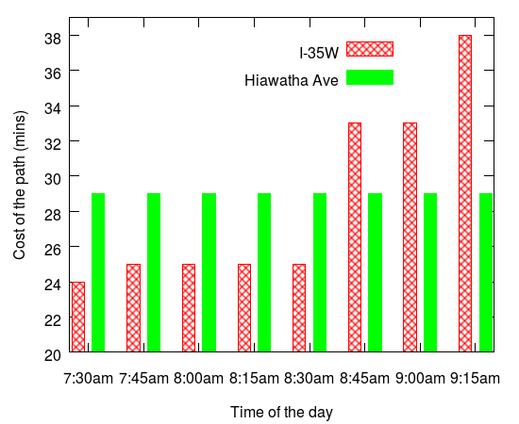
Challenges of a Naïve Approach
Source: Bing Maps
Naïve Approach → Re-compute shortest paths for all times
  → Performs redundant work, e.g. between 7:30– 8:30am
How can we reduce the redundant work?
Can we skip some departure-times?
  Can we Close nodes for multiple departure-times? → Invalidates the assumptions of Dynamic Programming!

Slide 19
Concept of Critical-time-point based Approaches
Critical-Time-Point
Source: Bing Maps
Critical-time-point:
Departure-times at which the ranking among candidate routes change e.g. 7:30am (trivially) and 8:45am.
Observation: Between any two critical-time-points ranking is
stationary, i.e., dynamic programming is applicable.

Slide 20
How to Compute Critical-time-points? (1/2)
Basic Computation Unit (one ALSP Iteration):
Compute a shortest path for one departure-time
Forecast a lower bound on next critical-time-point
Implementation Sketch:
Compute successive “Basic Computation Units” until the next lower bound forecasted is out of input departure-time interval

Slide 21
How to Compute Critical-time-points? (2/2)
Basic Framework of a Critical-time-point Approach:
Step 1: Model the cost of candidates.
  Each candidate path is associated with a cost-function.
  This cost function is put in the temporally-detailed priority queue.
Step 2: Enumerate candidates.
  Use a expand and refine strategy (similar to Dijkstra’s)

Slide 22

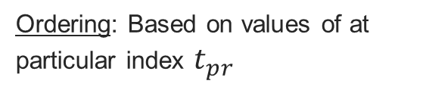
Temporally-Detailed Priority Queues
Traditional
Priority Queues
Temporally-Detailed Priority Queues
Set of Scalar Values $SV=\{SV_{1}, SV_{2}, SV_{3},…SV_{k}\}$
Set of Time Series $TS=\{TS_{1}, TS_{2},TS_{3},…TS_{k}\}$
3 | 4 | 11 | 12
30
10
14
4 | 5 | 6 | 7
8
18
8 | 9 | 15 | 16
17
12
20
9
6
Ordering: Increasing or decreasing of scalar values
Ordering: Based on values of at particular index $t_{pr}$
6
8
9
10
12
17
….
$all TS ordered on t$=1
3 | 4 | 11 | 12
4 | 5 | 6 | 7
8 | 9 | 15 | 16

Slide 23

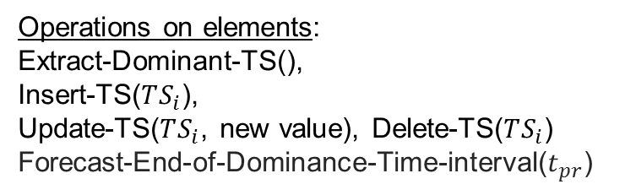
Temporally-Detailed Priority Queues
Traditional
Priority Queues
Temporally-Detailed Priority Queues
Operations on elements:
Extract Min(),
Insert($SV_{i}$),
Decrease Key($SV_{i}$, new value), etc.
Operations on elements:
Extract-Dominant-TS(),
Insert-TS($TS_{i}$),
Update-TS($TS_{i}$, new value), Delete-TS($TS_{i}$)
Forecast-End-of-Dominance-Time-interval($t_{pr}$)
8
9
10
12
17
….
6
3 | 4 | 11 | 12
4 | 5 | 6 | 7
8 | 9 | 15 | 16

Slide 24
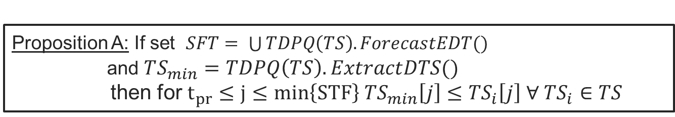
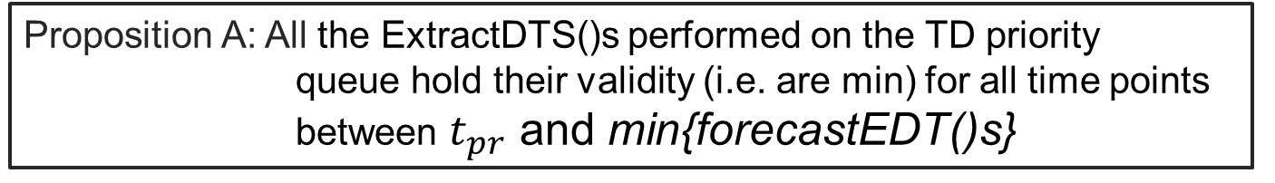
Forecast-End-of-Dominance-Time-Interval() Operation
Called before Extract-Dominant-TS() (or ExtractDTS()) Operation
Returns 1+maximum time for the current Extract-Min holds its validity
Forecast-End-of-Dominance-Time-Interval operation(t_pr) (ForecastEDT() for short)
ExtractDTS() operation
T= 0 1 2 3
3 | 4 | 11 | 12
3 | 4 | 11 | 12
4 | 5 | 6 | 7
4 | 5 | 6 | 7
8 | 9 | 15 | 16
8 | 9 | 15 | 16
→ Returns t=2
Key Properties:
Proposition A: All the ExtractDTS()s performed on the TD priority queue hold their validity (i.e. are min) for all time points between $t_{pr}$ and min{forecastEDT()s}
Proposition A: If set $SFT= \bigcup{TDPQ\left(TS\right).ForecastEDT()}$
and $TS_{min}=TDPQ\left(TS\right). ExtractDTS()$
then for $t_{pr}≤j≤min\left\{STF\right\} TS_{min}\left[j\right]≤TS_{i}\left[j\right] ∀ TS_{i}∈TS$

Slide 25
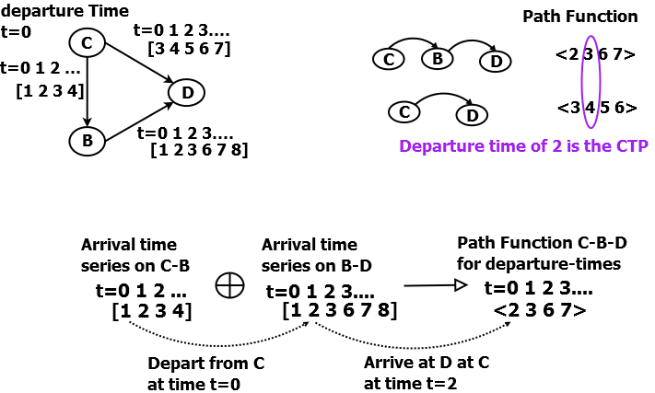
Step 1: Modeling Cost of Paths and Computing Critical-time-points
Journey departing from C at t=0,1,2.. Would reach D at t=3,4,5..
Path functions represent the arrival time at the end-node of path as function of departure-time at the start-node

Slide 26
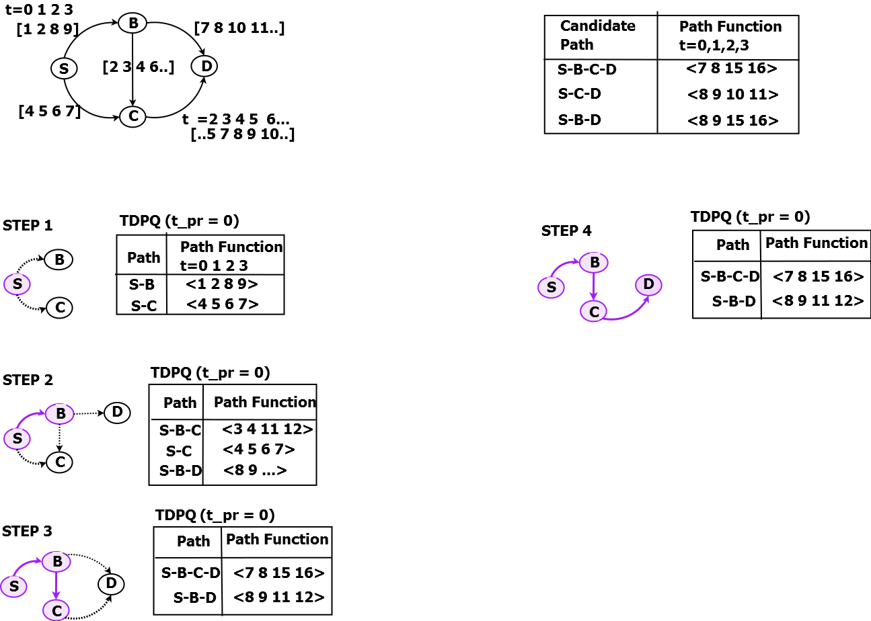
Step 2: Enumerating Candidate paths (1/2)
Source: S
Destination: D
Lambda = {0 ,1, 2, 3}
Put Partial paths in a TDPQ with t_pr = 0
(1) Extract-Min (2) ForecastEDT() returns 2 (B closed)
(3) Insert(S-B-C) and Insert(S-B-D)
Proposition A: We have shortest path from S to B for times t=0,1
(1) ExtractMin (2) ForecastEDT() returns 2 (C closed)
(3) Insert(S-B-C) and Insert(S-B-C-D)
Proposition A: We have shortest path from S to C for times t=0,1

Slide 27
Enumerating Candidate paths (2/2)
Source: S
Destination: D
Lambda = {0 ,1, 2, 3}
Continue until destination is not expanded.
Maintain min of ForecastEDT()s
Using Proposition A we know the path to Destination is optimal for times between current-time and min of “ForecastEDT()s”
Restart exploration for time = min{ForecastEDT()}

Slide 28
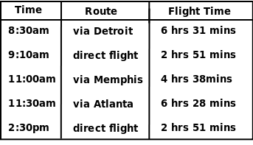
Challenge of Non-FIFO behavior
Waiting can leading to quicker paths!!!
*Flight schedule between Minneapolis and Austin (TX)
Violates the no wait assumption of Dijkstra/A*

Slide 29
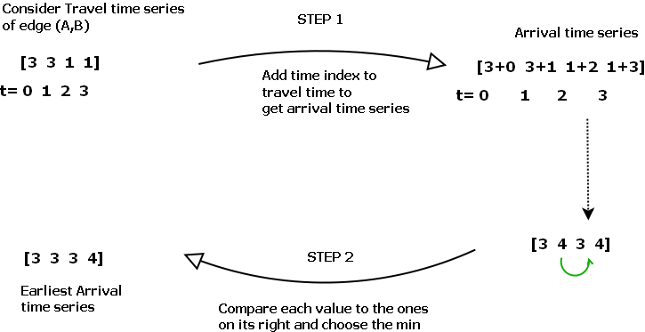
Handling Non-FIFO Behavior (Earliest Arrival Time Series Transformation)
Observation:
Earliest arrival time series is FIFO in nature.

Slide 30
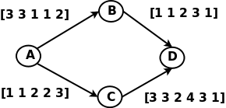
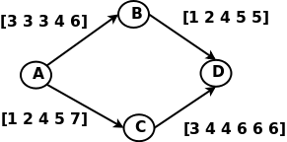
Time aggregated Graph
Time aggregated Graph with Earliest arrival time series
Observation:
Earliest arrival time series is FIFO in nature.

