Slide 1
Introduction to Spatial Computing CSE 555
Fundamental Spatial Concepts
Some slides adapted from Worboys and Duckham (2004) GIS: A Computing Perspective, Second Edition, CRC Press

Slide 2
Set Based Geometry of Space

Slide 3
Sets
The set based model involves:
The constituent objects to be modeled, called elements or members
Collection of elements, called sets
The relationship between the elements and the sets to which they belong, termed membership
We write s $∈$ S to indicate that an element s is a member of the set S

Slide 4
Sets
A large number of modeling tools are constructed:
Equality
Subset: S $∈$ T
Power set: the set of all subsets of a set, P(S)
Empty set $∅$ ;
Cardinality: the number of members in a set #S
Intersection: S $⋂$ T
Union: S $⋃$ T
Difference: S\T
Complement: elements that are not in the set, S’

Slide 5
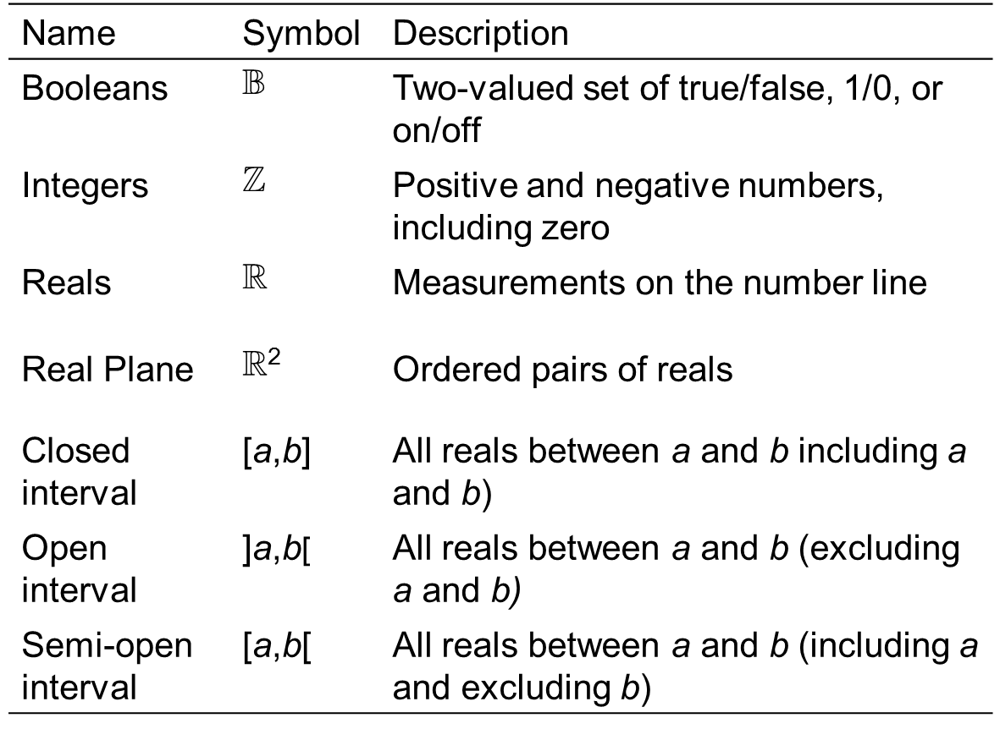
Distinguished sets

Slide 6
Relations
Product: returns the set of ordered pairs, whose first element is a member of the first set and second element is a member of the second set
Binary relation: a subset of the product of two sets, whose ordered pairs show the relationships between members of the first set and members of the second set
Reflexive relations: where every element of the set is related to itself
Symmetric relations: where if x is related to y then y is related to x
Transitive relations: where if x is related to y and y is related to z then x is related to z
Equivalence relation: a binary relation that is reflexive, symmetric and transitive

Slide 7
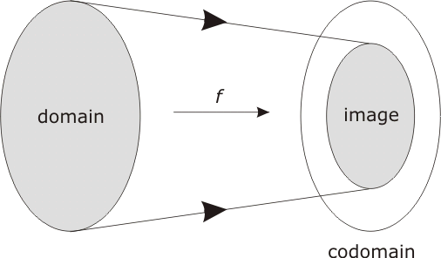
Functions
Function: a type of relation which has the property that each member of the first set relates to exactly one member of the second set
f: S $→$ T

Slide 8
Functions
Injection: any two different points in the domain are transformed to two distinct points in the codomain
Image: the set of all possible outputs
Surjection: when the image equals the codomain
Bijection: a function that is both a surjection and an injection

Slide 9
Inverse Functions
Injective function have inverse functions
Projection
Given a point in the plane that is part of the image of the transformation, it is possible to reconstruct the point on the spheroid from which it came
Example:
A new function whose domain is the image of the UTM maps the image back to the spheroid

Slide 10
Convexity
A set is convex if every point is visible from every other point within the set
Let S be a set of points in the Euclidean plane
Visible:
Point x in S is visible from point y in S if either
x=y or;
it is possible to draw a straight-line segment between x and y that consists entirely of points of S

Slide 11
Convexity
Observation point:
The point x in S is an observation point for S if every point of S is visible from x
Semi-convex:
The set S is semi-convex (star-shaped if S is a polygonal region) if there is some observation point for S
Convex:
The set S is convex if every point of S is an observation point for S

Slide 12
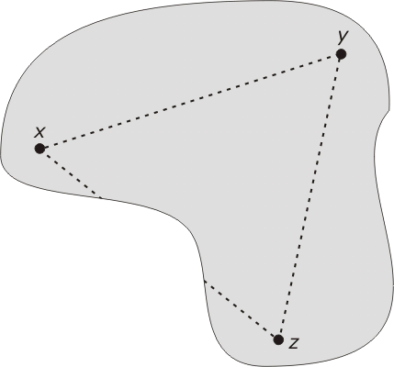
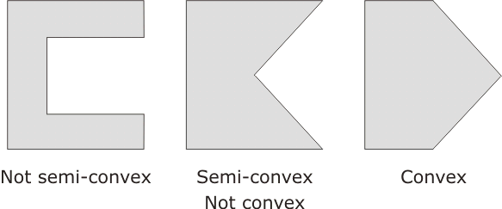
Convexity
Visibility between points x, y, and z

Slide 13
Topology of Space

Slide 14
Topology
Topology: “study of form”; concerns properties that are invariant under topological transformations
Intuitively, topological transformations are rubber sheet transformations
Topological | A point is at an end-point of an arc
 | A point is on the boundary of an area
 | A point is in the interior/exterior of an area
 | An arc is simple
 | An area is open/closed/simple
 | An area is connected
Non-topological | Distance between two points
 | Bearing of one point from another point
 | Length of an arc
 | Perimeter of an area

Slide 15
Brief Introduction to Topology
Basis of a Topology
Let (M ; T) be a topological space. A subset B of the topology
T is called a basis of the topology if T contains exactly those sets which result from arbitrary unions of elements of B.
Generating set of a Topology
A subset E of the power set P(M) is called a generating set on the underlying set M if :
E1: The underlying set M is a union of elements of E.
E2: For every point x of the intersection A of two elements of E there is an element of E which contains x and is a subset of A.
Construction of Topology
A generating set E is a basis for a topological space with the underlying set M. The set T which contains every union of elements of E is therefore a topology on M.

Slide 16
Examples of Generating Sets (1/2)
Euclidean Space: Given a set of M points lying in a Euclidean plane. For each point x $∈$ M we define at least one $ε−ball$ as the set of points D(x, $ε$) of M whose Euclidean distance from x is strictly less than $ε$. We define a set E as the set of these $ε−ball$s. Does E make a candidate generating set for a topology on M?
E1: By definition of set E every point x is contained in an $ε−ball$. Therefore, the union of all the $ε−ball$s would be the set M.
E2: Case 1: Let E_{r} = D(x, r) and E_{s}= D(y, s) be different elements of the set E. If their intersection E_{r} $∩$ E_{s} is empty, then condition (E2) for generating sets is satisfied, since there is no point x in E_{r} $∩$ E_{s}.
Case 2: If E_{r} $∩$ E_{s} is not empty, then without loss of generality assume that there is point z $∈$ E_{r} $∩$ E_{s} .
We can always construct a $ε−ball$ around z by taking the radius $ε$ = min{r - Euclidist(z,x), s – Euclidist(z,y)}/2 which will be inside E_{r} $∩$ E_{s} . Thus, establishing the E2 property.
r
s
x
z
y

Slide 17
Examples of Generating Sets (2/2)
Travel-Time: Given a set of M points lying in a Transportation network (mode: driving). For each point x $∈$ M we define at least one $ε−ball$ as the set of points D(x, $ε$) of M whose travel-time from x is strictly less than $ε$. We define a set T as the set of these $ε−ball$s. Does T make a candidate generating set for a topology on M?
E1: By definition of set T every point x is contained in an $ε−ball$. Therefore, the union of all the $ε−ball$s would be the set M.
E2: Case 1: Let T_{r} = D(x, r) and T_{s}= D(y, s) be different elements of the set T. If their intersection T_{r} $∩$ T_{s} is empty, then condition (E2) for generating sets is satisfied, since there is no point x in T_{r} $∩$ T_{s}.
Case 2: If T_{r} $∩$ T_{s} is not empty, then without loss of generality assume that there is point z $∈$ T_{r} $∩$ T_{s} .
Can we still construct a $ε−ball$ around z which will completely inside the area of intersection?
r
s
x
z
y

Slide 18
Examples of Generating Sets (2/2)
Case 2: If T_{r} $∩$ T_{s} is not empty, then without loss of generality assume that there is point z $∈$ T_{r} $∩$ T_{s} .
r
z
s
x
y
Lets construct a $ε−ball$ around z by taking the radius $ε$ = min{r – traveltime(x,z), s – traveltime(y,z)}/2.
Would it be completely inside the intersection of the $ε−ball$s of x and y?
Without loss of generality assume that $ε$ = (r – traveltime(x,z))/2 and p is a point in $ε−ball$ of z.
We have: traveltime(x,p) $≤$ traveltime(x,z) + $ε$ which is strictly less than r,
And traveltime(y,p) $≤$ traveltime(y,z) + $ε$ (but is this strictly less than s?)
traveltime(y,p) $≤$ traveltime(y,z) + (r – traveltime(x,z))/2 (substituting value of $ε$)
⬅➔ Traveltime(y,p) $≤$ traveltime(y,z) + (s-traveltime(y,z))/2
←→ Traveltime(y,p) $≤$ (s+traveltime(y,z))/2 which is again strictly less than s. (E2 Holds)

Slide 19
Neighborhoods
Once we have topology we define Neighborhoods
A subset A M of the underlying set of a topological space (M;T) is called a neighborhood of a point x ∈ M if there is a subset T_{i} of A which is open (i.e., T_{i} $∈$ T) and contains x.
The set of neighborhoods of a point x is called as neighborhood system of x and it denoted as U(x)

Slide 20
Homeomorphism – Rubber sheet transformations
A homeomorphism (or topological transformation) is a bijection of that transforms each neighborhood in the domain to a neighborhood in the image.

Slide 21
Homeomorphism – Rubber sheet transformations
Any neighborhood in the image must be the result of application of the transformation to a neighborhood in the domain.
i.e., we are not allowed to create or destroy a neighborhood.
If Y is the result of applying a homeomorphism to a set X, then X and Y are topologically equivalent.

Slide 22
Homeomorphism – Rubber sheet transformations
Summary Statement
If you create a map which not topologically equivalent to the original space → It would keep me awake in the nights!!!
Topological equivalence ensures mathematical sanity of our maps.

Slide 23
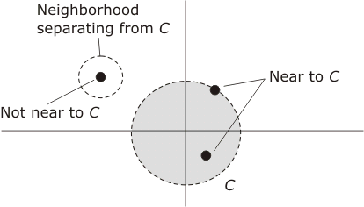
Some Definitions over Topological Space
Nearness
Let S be a topological space.
Then S has a set of neighborhoods associated with it.
Let C be a subset of points in S and c an individual point in S
Define c to be near C if every neighborhood of c contains some point of C

Slide 24
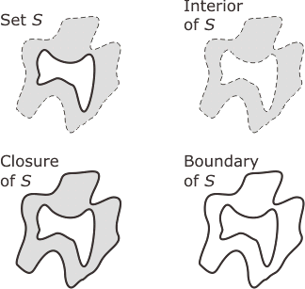
Some Definitions over Topological Space
Let X be a topological space and S be a subset of points of X
The closure of S is the union of S with the set of all its near points
The interior of S consists of all points which belong to S and not near points of compliment of S
denoted S°
Boundary of S: it is the set of points in the closure of S, not belonging to the interior of S. It is denoted by ∂S

Slide 25
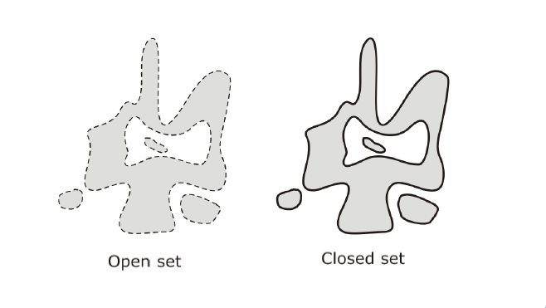
Some Definitions over Topological Space
Let X be a topological space and S be a subset of points of X.
Then S is open if every point of S can be surrounded by a neighborhood that is entirely within S.
Alternatively: a set that does not contain its boundary
Then S is closed if it contains all its near points
Alternatively: a set that does contain its boundary

Slide 26
Metric Spaces

Slide 27
Definition
A point-set S is a metric space if there is a distance function d, which takes ordered pairs (s,t) of elements of S and returns a distance that satisfies the following conditions
For each pair s, t in S, d(s,t) >0 if s and t are distinct points and d(s,t) =0 if s and t are identical
For each pair s,t in S, the distance from s to t is equal to the distance from t to s, d(s,t) = d(t,s)
For each tripe s,t,u in S, the sum of the distances from s to t and from t to u is always at least as large as the distance from s to u

Slide 28
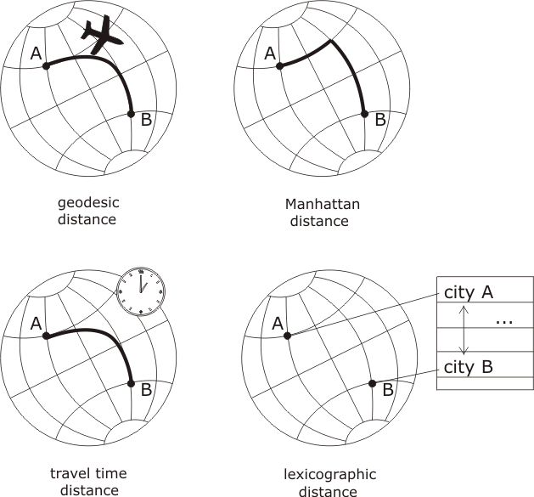
Distances Defined on Globe
Metric space
Metric space
Quasimetric
As travel-time
Not always
symmetric
Metric space

Slide 29
Extra Slides on Topology (Optional Material)

Slide 30
Brief Introduction to Topology
The field of topology generally concerns with the study of geometrical properties and spatial relations unaffected by the continuous change of shape or size of figures.
Definition of Topology
Defined on a family of subsets. Consider a set M, let P(M) be its power set (i.e, set of all of its subsets). A topology T is a subset of P(M) with the following properties:
T1: T contains the empty set $φ$ and the underlying set M
T2: The intersection of any two elements A and B of T is an element of T.
T3: The union of an arbitrary number of elements A,B,… of T is an element of T. (Note that this part of the definition is not limited to the union of a countable number of sets.

Slide 31
Brief Introduction to Topology
Topological Space:
A domain (M ; T) is called a topological space if T is a topology on the underlying set M. Every element of the underlying set M is called a point of the topological space. Every element of the topology T is called an open set of the topological space and is a subset of M.
Open Sets (An example):
Formally, a subset A of points of a topological space (M;T) is called an open set. Alternatively it is a member of T.
Consider the real number set R.
A subset U⊆R is 'open' if for every point x∈U there is some ε>0 such that (x−ε,x+ε)⊆U. Equivalently, if |x−y|<ε then y∈U.
Intuitively, for sets defined using geometric shapes (e.g., circles) the boundary of the shape is not included in the set.

Slide 32
Brief Introduction to Topology
Neighborhoods
A subset A M of the underlying set of a topological space (M;T) is called a neighborhood of a point x ∈ M if there is a subset T_{i} of A which is open (i.e., T_{i} $∈$ T) and contains x.
The set of neighborhoods of a point x is called as neighborhood system of x and it denoted as U(x)

Slide 33
Brief Introduction to Topology
Properties of a neighborhood system
The neighborhood system U(x) is not empty.
The neighborhood system U(x) does not contain the empty set $φ$
If the neighborhood system U(x) contains the neighborhoods U_{i} and U_{k} , then it also contains their intersection U_{m} = U_{j} $∩$ U_{k}
If the neighborhood system U(x) contains the neighborhoods U_{i} and U_{k} , then it also contains their union U_{m} = U_{j} $∪$ U_{k}
If U_{m} is a neighborhood of the point x. Then there is an open subset Ti of U_{m} such that U_{m} is also a neighborhood for every point y of the subset T_{i}

Slide 34
Brief Introduction to Topology
Neighborhood Axioms (alternative definition of topology)
A neighborhood topology on a set X assigns to each x∈X a non empty set U(x) of subsets of X, called neighborhoods of x, with the properties:
U1: Each point belongs to each of its neighborhoods
U2: The union of an arbitrary number of neighborhoods of a point x is also neighborhood of x.
U3: The intersections of two neighborhoods of x is a neighborhood of x.
U4: Every neighborhood U_{m} of a point x contains a neighborhood U_{i} U_{m} of x such that, U_{m} is a neighborhood of every point of U_{i}

