Slide 1
Introduction to Spatial Computing CSE 555
Fundamental Spatial Concepts
Some slides adapted from Worboys and Duckham (2004) GIS: A Computing Perspective, Second Edition, CRC Press

Slide 2
Database Support For Spatial Data

Slide 3
Database Support
What is a Database? a repository of data that is logically related, but possibly physically distributed over several sites
A database is created and maintained using a database management system (DBMS)
For a database to be useful it must be:
Reliable
Correct and consistent
Secure
Fast retrieval

Slide 4
Are relational databases good enough for spatial data??

Slide 5
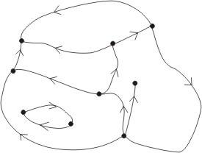
Is rational database sufficient?
Consider a sample vector data illustrated alongside. Each road has following information
Name -- String
Geometry -- sequence of lines.
Line – Start point, End point and length.
Q1: Design a Database schema (atleast 2NF) for this data, reduce redundancy as much as possible.
P0
R1P1
R1P2
R1P3
R1
MG Road

Slide 6
Is rational database sufficient?
Road ID | Road Name
R1 | MG Road
… | …..
P0
R1P1
R1P2
R1P3
Road ID | Line seg | SpointLat | Spoint_Long | Epoint Lat | Epoint Long
R1 | L1 | P0.x | P0.y | R1P1.x | R1P1.y
R1 | L2 | R1P1.x | R1P1.y | …. | …..
…. | …. | ….. | ….. | ….. | ……
R1
MG Road
Q1: Write an SQL query to retrieve all the line segments of MG road in order.

Slide 7
Is rational database sufficient?
Road ID | Road Name
R1 | MG Road
… | …..
Road ID | Line seg | SpointLat | Spoint_Long | Epoint Lat | Epoint Long
R1 | L1 | P0.x | P0.y | R1P1.x | R1P1.y
R1 | L2 | R1P1.x | R1P1.y | …. | …..
…. | …. | ….. | ….. | ….. | ……
Lake ID | Road Name
Lake1 | Calhoun
… | …..
What if we also have data on lakes?
Lake ID | Line seg | SpointLat | Spoint_Long | Epoint Lat | Epoint Long
Lake1 | L1 | P0.x | P0.y | R1P1.x | R1P1.y
Lake1 | L2 | R1P1.x | R1P1.y | …. | …..
…. | …. | ….. | ….. | ….. | ……

Slide 8
Is rational database sufficient?
Road ID | Road Name
R1 | MG Road
… | …..
Road ID | Line seg | SpointLat | Spoint_Long | Epoint Lat | Epoint Long
R1 | L1 | P0.x | P0.y | R1P1.x | R1P1.y
R1 | L2 | R1P1.x | R1P1.y | …. | …..
…. | …. | ….. | ….. | ….. | ……
Lake ID | Road Name
Lake1 | Calhoun
… | …..
Lake ID | Line seg | SpointLat | Spoint_Long | Epoint Lat | Epoint Long
Lake1 | L1 | P0.x | P0.y | R1P1.x | R1P1.y
Lake1 | L2 | R1P1.x | R1P1.y | …. | …..
…. | …. | ….. | ….. | ….. | ……
Query: Write an SQL query to retrieve all roads which are alongside lakes.

Slide 9
Is rational database sufficient?
Road ID | Road Name
R1 | MG Road
… | …..
Road ID | Line seg | SpointLat | Spoint_Long | Epoint Lat | Epoint Long
R1 | L1 | P0.x | P0.y | R1P1.x | R1P1.y
R1 | L2 | R1P1.x | R1P1.y | …. | …..
…. | …. | ….. | ….. | ….. | ……
Spatial data and operations need more than the traditional relational databases
Lake ID | Road Name
Lake1 | Calhoun
… | …..
Lake ID | Line seg | SpointLat | Spoint_Long | Epoint Lat | Epoint Long
Lake1 | L1 | P0.x | P0.y | R1P1.x | R1P1.y
Lake1 | L2 | R1P1.x | R1P1.y | …. | …..
…. | …. | ….. | ….. | ….. | ……
Query: Write an SQL query to retrieve all roads which are alongside lakes.

Slide 10
Some other query examples
Traditional Query
Query 1: Retrieve names and addresses of all opencast coal mines in Staffordshire
Data may be retrieved by a simple look up and match
Query 2: Retrieve names and addresses of all employees of Wedgwood Pottery who earn more than half the sum earned by the managing director
Numerical comparison

Slide 11
Some other query examples
Spatial Query:
Retrieve all the addresses which are not over the underlying water table and do not have direct water connection from municipality.
Retrieve all addresses where the house income is less than 10,000 per month.
Satisfying these queries may require the integration of both spatial and non-spatial information

Slide 12
Spatial Data Vs Relational Data
Spatial data can be notoriously large and often layered.
Considering its spatial semantics is a must.
Specialized modeling concepts (conceptual mode) operators (logical data model), spatial storage structures (physical data model) and access methods (physical data model) are required.

Slide 13
Building a System of Spatial Data
The process of developing a database is essentially a process of model building
Application domain model: describes the core requirements of users in a particular application domain, based on an initial study
Conceptual model: Illustrates the entities, the core concepts and relationships among the entities. Usually consists of conceptual models such as ER diagrams.
Logical model: An abstract layer creating between the conceptual and the physical layers to create independence between the two. Consists of abstract data types and operators defined on data.
Physical model: This is the result of a process of programming and system implementation. Query optimization can also be considered a part of physical model.

Slide 14
Conceptual Modeling of Spatial Data

Slide 15
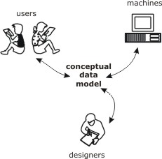
Conceptual data model
A conceptual data model provides a model of the proposed system that is independent of implementation details
An effective conceptual model:
Easy communication between analysts, designers and users
Aids the design of the system
Provides basic reference material for implemented system

Slide 16
Background on Entity relationship model
The entity relationship model is a conceptual data modeling technique where
An entity type represents a collection of similar objects
An entity instance is an occurrence of a particular entity
An attribute type is a property associated with an entity
An attribute type that serves to uniquely identify an entity type is called an identifier
Identifiers are usually underlined
attribute type
entity type
identifier

Slide 17
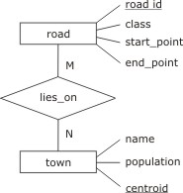
Background on Entity relationship model
Entity types are connected using relationships
A relationship type connects one or more entity types
A relationship occurrence is a particular instance of a relationship
Relationships may have their own attributes independent of entities
Entity, attribute, and relationship types are shown in an entity relationship diagram (E-R diagram)
relationship
type

Slide 18
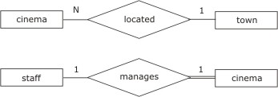
Background on Entity relationship model
Relationship types may be
many-to-many: e.g., a town may have many road, which in turn may pass through many towns
many-to-one: e.g., a town may have many cinemas, but a cinema can be located in at most one town
one-to-one: e.g., a cinema may have one manager who manages only one cinema
These constraints constitute cardinality conditions

Slide 19
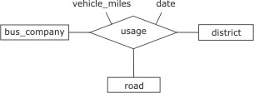
Background on Entity relationship model
In addition to cardinality conditions, relationships may also have participatory conditions:
optional or mandatory (indicated with a double line)
A relationship from an entity to itself is called involutory
A relationship connecting three entities is called a ternary relationship

Slide 20
Extended Entity Relationship model
The extended entity relationship model (EER) adds further features:
An entity type E₁ is a subtype of E₂ if every occurrence of E₁ is also an occurrence of E₂.
In this case, E₂ is a supertype of E₁
The operation of forming subtypes is called specialization;
the inverse operation of forming supertypes is called generalization

Slide 21
Extended Entity Relationship model
For specialization (and conversely for generalization)
A subtype has the same identifying attribute(s) as the supertype
A subtype has all the attributes of the supertype, and possibly some more
A subtype enters into all the relationships in which the supertype is involved, and possibly some more.
Subtypes and supertypes are organized into an inheritance hierarchy

Slide 22
Extended Entity Relationship model
Subtypes may be:
disjoint: where no occurrence of one subtype is an occurrence of another
overlapping: subtypes are not disjoint
EER uses an extended diagrammatic notation to represent specialization/generalization constructs
supertype
disjoint
overlapping
subtype

Slide 23
EER for spatial information #1
E-R or EER can be used to model spatial entities
Most vector-based GIS use a similar structure
Node
area
directed arc

Slide 24
Pop Question
Area needs to be bounded.
Question: What is the minimum number of arcs associated with an area?
(0,1, or many)?
Question: What is the minimum number of nodes in an area?
(0 ,1 or many)?
Node
area
directed arc

Slide 25
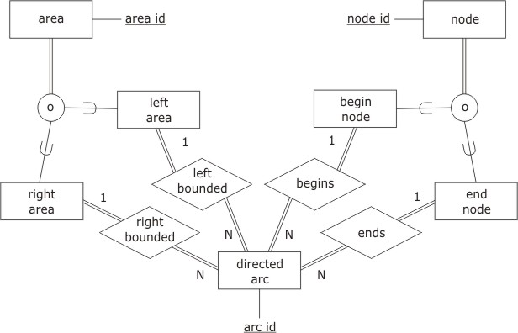
EER for spatial information #2
Question1: What is the minimum number of arcs associated with an area?
(0,1, or many)?
Question2: What is the minimum number of nodes in an area?
(0 ,1 or many)?
Question: Re-consider the implication if “overlapping” is changed to “disjoint” in the EER diagram

Slide 26
Pop question
What should be changed in the ER diagram to model the red dot?
Node
area
directed arc

