Slide 1
Introduction to Spatial Computing CSE 555
Algorithms for Spatial Data
Some slides adapted from Worboys and Duckham (2004) GIS: A Computing Perspective, Second Edition, CRC Press

Slide 2
Algorithms
An algorithm is a specification of a computational process required to perform some operation
For a given algorithm, we are usually interested in how efficient it is. Efficient algorithms require less computing resources when actually implemented
The efficiency of an algorithm is usually measured in terms of the time the algorithm uses, called time complexity or the amount of storage space required, called space complexity
For example, the time required to compute the breadth first search for any graph G = (V, E) is proportional to |V|, the number of input nodes
We use the “big-oh” notation to classify algorithms according to time complexity
O(n) stands for the set of algorithms that have a time complexity that is at most linearly proportional to n

Slide 3
Common Complexity Orders
We all like these
O(1) | Constant time | Very fast
O(log_{e}n) | Logarithmic time | Fast
O(n) | Linear time | Moderate
O(n logn) | Sub-linear time | Moderate
O(n^{k}) | Polynomial time | Slow
O(k^{n}) | Exponential time | Intractable
Not so much!

Slide 4
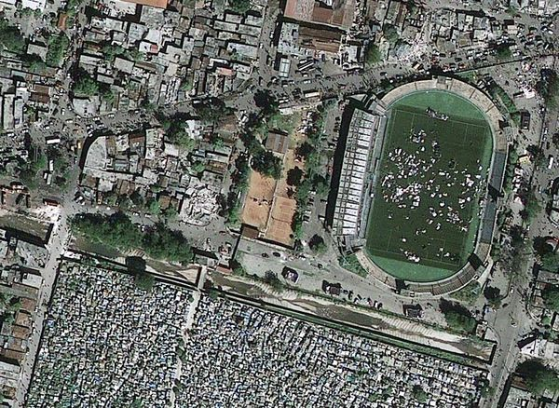
What about the complexity of these tasks? Can even have a correct and complete algorithm?
Examples:
Geo-locate all human settlements e.g. tents (or usable roads) after an earthquake. You are given aerial images.
Given a news article (e.g. those from Google News), photograph, or video-clip, identify the geographic location it is describing.
Given postal addresses of hotels, determine the hotel closest to a specified point of interest (POI). Assume the availability of a geo-coding service to convert postal addresses to geographic point-locations

Slide 5
Geometric domains
Geometric domain is a triple <G,P,S>, where:
G, the domain grid, is a finite connected portion of the discrete Euclidean plane, Z²
P is a set of points in Z²
S is a set of line segments in Z²
Subject to the following closure conditions:
Each point of P is a point in the domain grid G
Any line segment in S must have its end-points as members of P
Any point in P that is incident with a line segment in S must be one of its end-points
If any two line segments in S intersect as a point, then that point must be a member of P

Slide 6
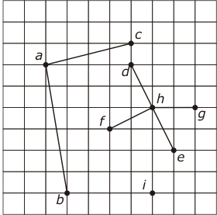
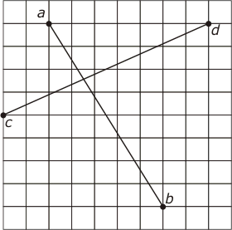
Grid Structures For Geometric Domains
A structure that forms a geometric domain
A structure that does not form a geometric domain

Slide 7
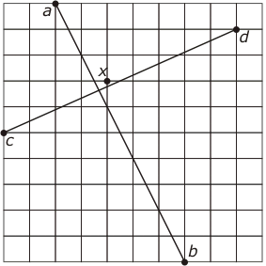
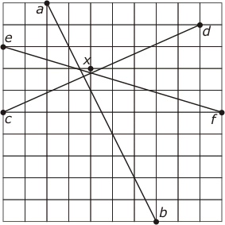
Discretization For Geometric Domain
Discretization: moving data from a continuous to a discrete domain (some precision will be lost)
Can snap the intersection point to a nearest gird point? Point x in this example
May not always work. Here the intersection point change its location with respect to line ef

Slide 8
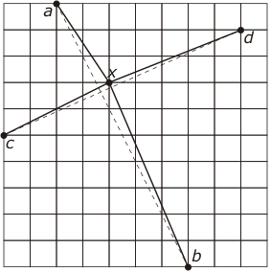
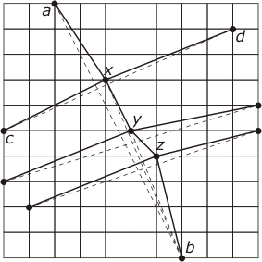
Discretization – Drifting problem
Say we go ahead snapping the intersection point to the grid point x anyways
The chain axyzb has strayed well away from the original line segment ab

Slide 9
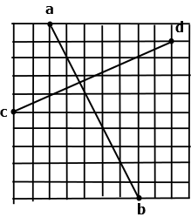
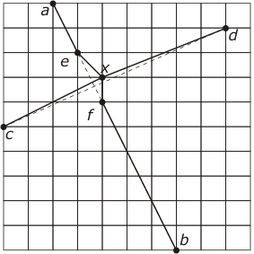
Green Yao Algorithm for Drifting problem
Imagine pegs put on the grid points.
Lines are imagined to be rubber strings
Lines can be stretched to include a point, but not cross a peg.

Slide 10
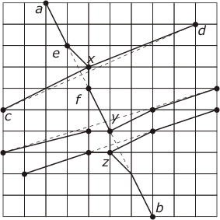
Green Yao Algorithm for Drifting problem
If multiple intersections then the final answer may depend on the order of intersections considered

Slide 11
Discretizing Arcs
Problem: Given an chain of vertices $V=\{v_{1},v_{2},v_{3},..v_{n}\}$ representing an arc, the problem is to find a subsequence of vertices that approximates the chain V.
No self intersections.
Overall Idea (Douglas and Peucker Algorithm):
Approximate $V=\{v_{1},v_{2},v_{3},..v_{n}\}$ by a single line $v_{1}v_{n}$
Determine the farthest point $v_{j}$ from $v_{1},v_{n}.$
If distance $d(v_{j}, v_{1}v_{n}$) is $≤ε (input threshold)$ then stop.
Otherwise break-up $V$ into $\left\{v_{1},..v_{j}\right\} \& \{v_{j}, …, v_{n}\}$ and proceed recursively.

Slide 12
Discretizing Arcs
Douglas and Peucker Algorithm :
Approximate $V=\{v_{1},v_{2},v_{3},..v_{n}\}$ by a single line $v_{1}v_{n}$
Determine the farthest point $v_{j}$ from $v_{1},v_{n}.$
If distance $d(v_{j}, v_{1}v_{n}$) is $≤ε (input threshold)$ then stop.
Otherwise break-up $V$ into $\left\{v_{1},..v_{j}\right\} \& \{v_{j}, …, v_{n}\}$ and proceed recursively.

Slide 13
Discretizing Arcs
Douglas and Peucker Algorithm :
Approximate $V=\{v_{1},v_{2},v_{3},..v_{n}\}$ by a single line $v_{1}v_{n}$
Determine the farthest point $v_{j}$ from $v_{1},v_{n}.$
If distance $d(v_{j}, v_{1}v_{n}$) is $≤ε (input threshold)$ then stop.
Otherwise break-up $V$ into $\left\{v_{1},..v_{j}\right\} \& \{v_{j}, …, v_{n}\}$ and proceed recursively.

Slide 14
Discretizing Arcs
Douglas and Peucker Algorithm :
Approximate $V=\{v_{1},v_{2},v_{3},..v_{n}\}$ by a single line $v_{1}v_{n}$
Determine the farthest point $v_{j}$ from $v_{1},v_{n}.$
If distance $d(v_{j}, v_{1}v_{n}$) is $≤ε (input threshold)$ then stop.
Otherwise break-up $V$ into $\left\{v_{1},..v_{j}\right\} \& \{v_{j}, …, v_{n}\}$ and proceed recursively.

Slide 15
Discretizing Arcs
Douglas and Peucker Algorithm :
Approximate $V=\{v_{1},v_{2},v_{3},..v_{n}\}$ by a single line $v_{1}v_{n}$
Determine the farthest point $v_{j}$ from $v_{1},v_{n}.$
If distance $d(v_{j}, v_{1}v_{n}$) is $≤ε (input threshold)$ then stop.
Otherwise break-up $V$ into $\left\{v_{1},..v_{j}\right\} \& \{v_{j}, …, v_{n}\}$ and proceed recursively.

Slide 16
Discretizing Arcs
Douglas and Peucker Algorithm :
Approximate $V=\{v_{1},v_{2},v_{3},..v_{n}\}$ by a single line $v_{1}v_{n}$
Determine the farthest point $v_{j}$ from $v_{1},v_{n}.$
If distance $d(v_{j}, v_{1}v_{n}$) is $≤ε (input threshold)$ then stop.
Otherwise break-up $V$ into $\left\{v_{1},..v_{j}\right\} \& \{v_{j}, …, v_{n}\}$ and proceed recursively.

Slide 17
Discretizing Arcs
Douglas and Peucker Algorithm :
Approximate $V=\{v_{1},v_{2},v_{3},..v_{n}\}$ by a single line $v_{1}v_{n}$
Determine the farthest point $v_{j}$ from $v_{1},v_{n}.$
If distance $d(v_{j}, v_{1}v_{n}$) is $≤ε (input threshold)$ then stop.
Otherwise break-up $V$ into $\left\{v_{1},..v_{j}\right\} \& \{v_{j}, …, v_{n}\}$ and proceed recursively.

Slide 18
Spatial Algorithms for Point Data

Slide 19
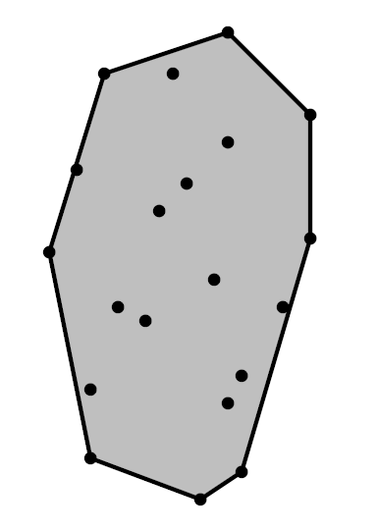
Convex Hull of N points in a plane
Definition: Given set of N points in the Euclidean plane, convex hull is the minimum area convex region that contains every point.
Intuition: points are nails perpendicular to plane, stretch an elastic rubber bound around all points; it will minimize length.
The input: 2N coordinates.
Size of the convex hull O(N)
Sample Convex Hull
Slides Adapted from http://www.cs.uu.nl/docs/vakken/ga/slides1.pdf

Slide 20
Convex Hull of N points in a plane
Definition: Given set of N points in the Euclidean plane, convex hull is the minimum area convex region that contains every point.
Intuition: points are nails perpendicular to plane, stretch an elastic rubber bound around all points; it will minimize length.
The output is returned as a sorted sequence of the points, clockwise (CW) along the boundary.
Sample Convex Hull
Slides Adapted from http://www.cs.uu.nl/docs/vakken/ga/slides1.pdf

Slide 21
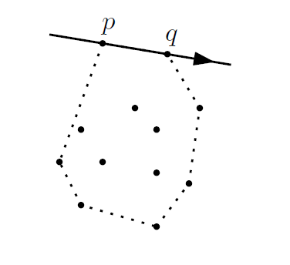
Intuitions used in the Algorithm
Property: The vertices of the convex hull are always points from the input.
Consequently, the edges of the convex hull connect two points of the input
Property: The supporting line of any convex hull edge has all input points to one side
all points lie right of the
directed line from p to q,
if the edge from p to q is
a convex hull edge

Slide 22
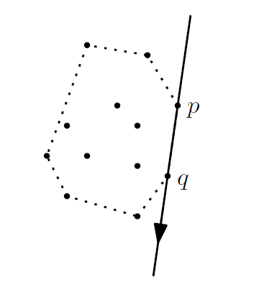
Intuitions used in the Algorithm
Property: The vertices of the convex hull are always points from the input.
Consequently, the edges of the convex hull connect two points of the input
Property: The supporting line of any convex hull edge has all input points to one side
all points lie right of the
directed line from p to q,
if the edge from p to q is
a convex hull edge

Slide 23
Simple Algorithm for Convex Hull
Input: A set of P points in a Plane.
Output: A list containing the vertices of the convex hull CH(P) in clockwise order.
$E←∅ and valid←true$
For all ordered pairs $\left(p,q\right)∈PXP$ with $p≠q$
2.1 Do while $valid is true$
2.2 If all points $r∈P$ ($r≠p and r≠q$) lie on the same side of $pq$
2.2.1 Add $pq$ to set $E$
2.3 Else $valid←false$
From the set $E$ of edges construct a list of vertices $CH(P)$, sorted in clockwise order.

Slide 24
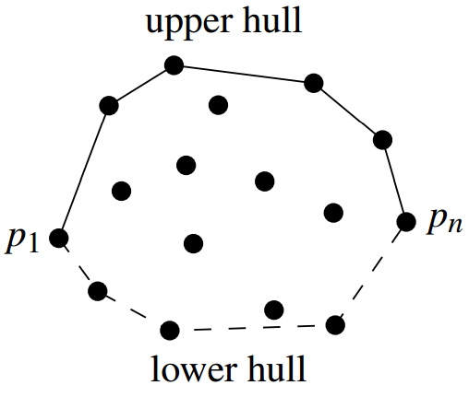
Incremental Algorithm for Convex Hull
Main idea: Sort the points from left to right (= by x-coordinate).
Insert the points in this order, and maintain the upper hull so far
First compute the upper boundary of the convex hull and then the lower part.

Slide 25
Incremental Algorithm for Convex Hull
Right
Turn
Observation: from left to right, there would be only right turns
on the upper hull.

Slide 26
Incremental Algorithm for Convex Hull
Initialize by inserting the leftmost two points

Slide 27
Incremental Algorithm for Convex Hull
P8
If we add the third point there will be a right turn at the previous point, so we add it
P5
P6
P4
P7
P3

Slide 28
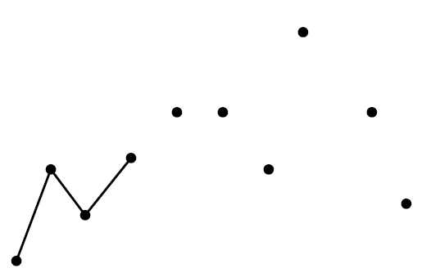
Incremental Algorithm for Convex Hull
P8
If we add the fourth point we get a left turn at the third
point
P5
P6
P4
P7
P3

Slide 29
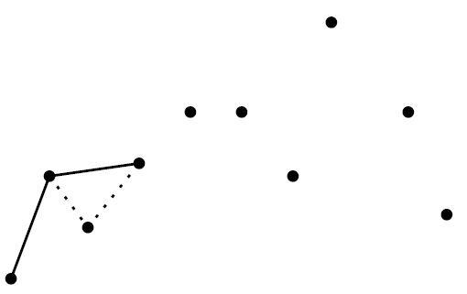
Incremental Algorithm for Convex Hull
P8
…..so we remove the third point from the upper hull when we add the fourth
P5
P6
P4
P7
P3

Slide 30
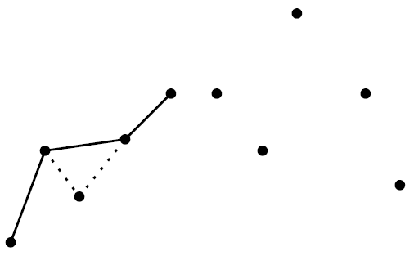
Incremental Algorithm for Convex Hull
P8
If we add the fifth point we get a left turn at the fourth point
P5
P6
P4
P7
P3

Slide 31
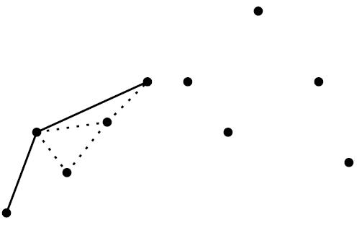
Incremental Algorithm for Convex Hull
P8
….so we remove the fourth point when we add the fifth
P5
P6
P4
P7
P3

Slide 32
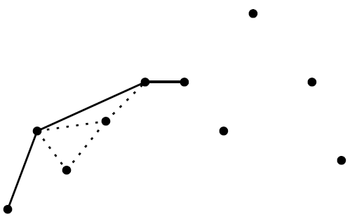
Incremental Algorithm for Convex Hull
P8
If we add the sixth point we get a right turn at the fifth point, so we just add it
P5
P6
P4
P7
P3

Slide 33
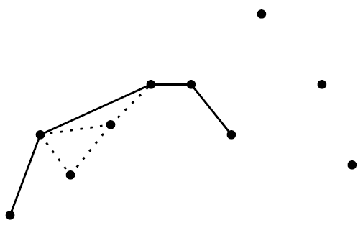
Incremental Algorithm for Convex Hull
P8
We also just add the seventh point as it was also a right turn.
P5
P6
P4
P7
P3

Slide 34
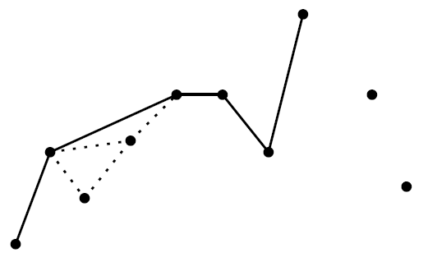
Incremental Algorithm for Convex Hull
P8
When adding the eight point (a left turn) we must remove the seventh point
P5
P6
P4
P7
P3

Slide 35
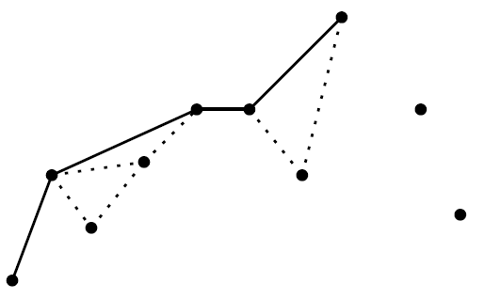
Incremental Algorithm for Convex Hull
P8
….we must also remove the seventh point.
It is also a left turn from current edge.
P5
P6
P4
P7
P3

Slide 36
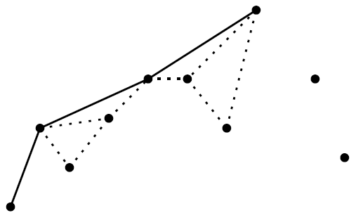
Incremental Algorithm for Convex Hull
P8
…. and also the sixth point.
P5
P6
P4
P7
P3

Slide 37
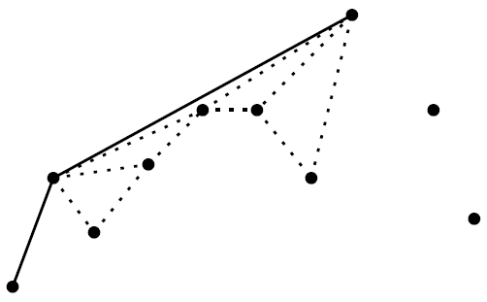
Incremental Algorithm for Convex Hull
P8
…. and also the fifth point.
P5
P6
P4
P7
P3

Slide 38
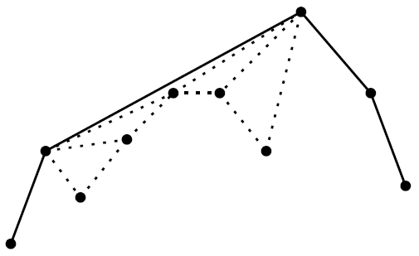
Incremental Algorithm for Convex Hull
After two more steps we get the result.

Slide 39
Pesudo-code for the Incremental algorithm
Input: A set of points P in a Plane.
Upper Part of Convex Hull
Sort the points by x-coordinate, resulting in a sequence$p_{1},…,p_{n}$
Put the points $p_{1}$ and $p_{2}$ in a list $L_{upper}$, with $p_{1}$ as the first point.
For $i←3 to |P|$
3.1 Do append $p_{i} to L_{upper}$
3.2 While $L_{upper }$contains more that two points and the last three points in $L_{upper}$ do not make a right turn.
3.2.1 Delete the middle of the last three points from $L_{upper}$

Slide 40
Pesudo-code for the Incremental algorithm
Input: A set of points P in a Plane.
Lower Part of Convex Hull
Put points$p_{n} and p_{n−1 }$in a list $L_{lower}$, with $p_{n}$ as the first point.
For $i←\left|P\right|−2 downto 1$
5.1 Do append $p_{i} to L_{lower}$
5.2 While $L_{lower }$contains more that two points and the last three points in $L_{lower}$ do not make a right turn.
5.2.1 Delete the middle of the last three points from $L_{lower}$
6. Remove the first and the last point from $L_{lower}$ to avoid duplication of the points where the upper and lower hull meet.
7. Append $L_{lower}$ and $L_{upper}$ and return the result.

Slide 41
Spatial Algorithms for Raster data

Slide 42
Calculating Accumulated Water flow
Given the elevation filed of an geographic region.
Compute the water accumulated
Assume that water flows along the direction of steepest flow
1 | 1 | 1 | 1
1 | 1 | 1 | 1
1 | 1 | 1 | 1
1 | 1 | 1 | 1
90 | 80 | 70 | 35
85 | 75 | 65 | 55
70 | 100 | 50 | 40
60 | 55 | 45 | 30
0 | 0 | 0 | 5
0 | 0 | 0 | 0
0 | 0 | 0 | 0
0 | 0 | 0 | 11
Rainfall Field
Elevation Field
Accumulated water
Is this a local, focal or a zonal operation?

Slide 43
Intuition for Algorithm
Construct a gradient descent graph.
Each node is connected to node with greatest descent.
Reverse the edges.
Perform a depth first search from each node.
Total water at a node = water from its descendants + self water
90 | 80 | 70 | 35
85 | 75 | 65 | 55
70 | 100 | 50 | 40
60 | 55 | 45 | 30
A | B | C | D
E | F | G | H
I | J | K | L
M | N | O | P
A
B
C
D
E
F
G
H
I
J
K
L
M
N
O
P
Elevation Field
Gradient Descent Graph

Slide 44
Intuition for algorithm
Construct a gradient descent graph.
Each node is connected to node with greatest descent.
Reverse the edges.
Perform depth first search from each node
Total water at a node = water from its descendants + self water
90 | 80 | 70 | 35
85 | 75 | 65 | 55
70 | 100 | 50 | 40
60 | 55 | 45 | 30
A | B | C | D
E | F | G | H
I | J | K | L
M | N | O | P
A
B
C
D
E
F
G
H
I
J
K
L
M
N
O
P
Elevation Field
Reverse Gradient Descent Graph

Slide 45
Intuition for algorithm
Construct a gradient descent graph.
Each node is connected to node with greatest descent.
Reverse the edges.
Perform depth first search from each node to get
Total water at a node = water from its descendants + self water
90 | 80 | 70 | 35
85 | 75 | 65 | 55
70 | 100 | 50 | 40
60 | 55 | 45 | 30
A | B | C | D
E | F | G | H
I | J | K | L
M | N | O | P
A
B
C
D
E
F
G
H
I
J
K
L
M
N
O
P
Elevation Field
Reverse Gradient Descent Graph

Slide 46
Intuition for algorithm
Construct a gradient descent graph.
Each node is connected to node with greatest descent.
Reverse the edges.
Perform depth first search from each node to get
Total water at a node = water from its descendants + self water
90 | 80 | 70 | 35
85 | 75 | 65 | 55
70 | 100 | 50 | 40
60 | 55 | 45 | 30
A | B | C | D
E | F | G | H
I | J | K | L
M | N | O | P
A
B
C
D
E
F
G
H
I
J
K
L
M
N
O
P
Elevation Field
Reverse Gradient Descent Graph

Slide 47
Intuition for algorithm
Construct a gradient descent graph.
Each node is connected to node with greatest descent.
Reverse the edges.
Perform depth first search from each node to get
Total water at a node = water from its descendants + self water
90 | 80 | 70 | 35
85 | 75 | 65 | 55
70 | 100 | 50 | 40
60 | 55 | 45 | 30
A | B | C | D
E | F | G | H
I | J | K | L
M | N | O | P
A
B
C
D
E
F
G
H
I
J
K
L
M
N
O
P
Elevation Field
Reverse Gradient Descent Graph

Slide 48
Intuition for algorithm
Construct a gradient descent graph.
Each node is connected to node with greatest descent.
Reverse the edges.
Perform depth first search from each node to get
Total water at a node = water from its descendants + self water
90 | 80 | 70 | 35
85 | 75 | 65 | 55
70 | 100 | 50 | 40
60 | 55 | 45 | 30
A | B | C | D
E | F | G | H
I | J | K | L
M | N | O | P
A
B
C
D
E
F
G
H
I
J
K
L
M
N
O
P
Elevation Field
Reverse Gradient Descent Graph

Slide 49
Intuition for algorithm
Construct a gradient descent graph.
Each node is connected to node with greatest descent.
Reverse the edges.
Perform depth first search from each node to get
Total water at a node = water from its descendants + self water
90 | 80 | 70 | 35
85 | 75 | 65 | 55
70 | 100 | 50 | 40
60 | 55 | 45 | 30
A | B | C | D
E | F | G | H
I | J | K | L
M | N | O | P
A
B
C
D
E
F
G
H
I
J
K
L
M
N
O
P
Elevation Field
Reverse Gradient Descent Graph

Slide 50
Intuition for algorithm
Construct a gradient descent graph.
Each node is connected to node with greatest descent.
Reverse the edges.
Perform depth first search from each node to get
Total water at a node = water from its descendants + self water
90 | 80 | 70 | 35
85 | 75 | 65 | 55
70 | 100 | 50 | 40
60 | 55 | 45 | 30
A | B | C | D
E | F | G | H
I | J | K | L
M | N | O | P
A
B
C
D
E
F
G
H
I
J
K
L
M
N
O
P
Elevation Field
Reverse Gradient Descent Graph

Slide 51
Intuition for algorithm
Construct a gradient descent graph.
Each node is connected to node with greatest descent.
Reverse the edges.
Perform depth first search from each node to get
Total water at a node = water from its descendants + self water
90 | 80 | 70 | 35
85 | 75 | 65 | 55
70 | 100 | 50 | 40
60 | 55 | 45 | 30
A | B | C | D
E | F | G | H
I | J | K | L
M | N | O | P
A
B
C
D
E
F
G
H
I
J
K
L
M
N
O
P
Elevation Field
Reverse Gradient Descent Graph

Slide 52
Intuition for algorithm
Construct a gradient descent graph.
Each node is connected to node with greatest descent.
Reverse the edges.
Perform depth first search from each node to get
Total water at a node = water from its descendants + self water
90 | 80 | 70 | 35
85 | 75 | 65 | 55
70 | 100 | 50 | 40
60 | 55 | 45 | 30
A | B | C | D
E | F | G | H
I | J | K | L
M | N | O | P
A
B
C
D
E
F
G
H
I
J
K
L
M
N
O
P
Elevation Field
Reverse Gradient Descent Graph

Slide 53
Intuition for algorithm
Construct a gradient descent graph.
Each node is connected to node with greatest descent.
Reverse the edges.
Perform depth first search from each node to get
Total water at a node = water from its descendants + self water
90 | 80 | 70 | 35
85 | 75 | 65 | 55
70 | 100 | 50 | 40
60 | 55 | 45 | 30
A | B | C | D
E | F | G | H
I | J | K | L
M | N | O | P
A
B
C
D
E
F
G
H
I
J
K
L
M
N
O
P
Elevation Field
Reverse Gradient Descent Graph

Slide 54
Question
What should be the termination condition for the algorithm?
Does it need to keep track of any other information during the depth first search?
Hint: Think “what operation would get me to the equilibrium stage of accumulation?”
90 | 80 | 70 | 35
85 | 75 | 65 | 55
70 | 100 | 50 | 40
60 | 55 | 45 | 30
A | B | C | D
E | F | G | H
I | J | K | L
M | N | O | P
A
B
C
D
E
F
G
H
I
J
K
L
M
N
O
P
Elevation Field
Reverse Gradient Descent Graph

Slide 55
Pseudo-Code (1/2)
Input: Gradient descent graph with a set of N nodes and E edges. Each node is contains a value (rvalue) which denotes the amount of rainfall it received.
Output: Modified gradient descent graph where each node contains the accumulated rain in its “rvalue” attribute.
Modified-Depth-First (node)
IF node is Null then return -1
Accum_rain $←$ 0
For all children of node do
3.1 If Child’s rvalue $≠$0
3.1.1 Accum_rain $←$ Accum_rain + Modified-Depth-First(child node)
3.1.2 Set Child’s rvalue to 0
Node rvalue $←$ Node rvalue + Accum_rain
Return Node rvalue

Slide 56
Pseudo-Code (2/2)
Input: Gradient descent graph with a set of N nodes and E edges. Each node is contains a value (rvalue) which denotes the amount of rainfall it received.
Output: Modified gradient descent graph where each node contains the accumulated rain in its “rvalue” attribute.
Main Routine
While there exists a node with a child with non-zero “rvalue”
1.1 For all nodes $n∈N$ in the descent graph
1.1.1 If $n$has a child with non-zero “rvalue”
1.1.2 Modified-Depth-First($n$)
2. Return the accumulated rainfall on all nodes.
What is the time complexity of the algorithm?

Slide 57
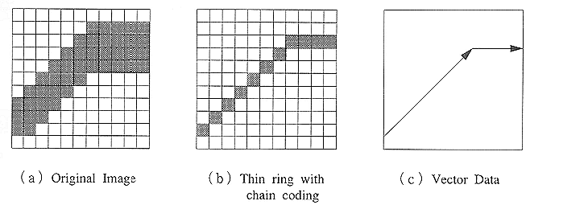
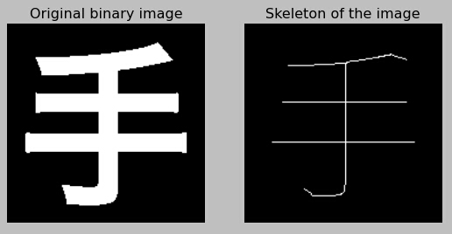
Raster Thinning

Slide 58
Raster Thinning Algorithm
 | P_{N}
P_{W} | P | P_{E}
 | P_{S}
0 – White
1 – Black
N(p) = Sum of neighbors of p
T(p) = Count of number of transitions from 0 to 1
 | p
T(p) = 1

Slide 59
Raster Thinning Algorithm
Input m x n binary raster(0 = white,1=black)
1. repeat
2: for all points p in the raster do
3: if 2 $≤$ N(p) $≤$ 6 and T(p) = 1 and p_{N} $×$ p_{S} $×$ p_{E} =0 and p_{W} $×$ p_{E} $×$ p_{S} =0 then mark p
4: if there are no marked point then halt
5: else set all marked points to value 0
6: for all points p in the raster do
7: if 2 $≤$ N(p) $≤$ 6 and T(p) = 1 and p_{N} $×$ p_{S} $×$ p_{w} =0 and p_{W} $×$ p_{E} $×$ p_{N} =0 then mark p
8: set all marked points to value 0
9: until there are no marked points
10:Output:m x n thinned binary raster (black is thinned)
 | 3 | 4
 | 4 | 6 | 5
 |  | 5 | 6 | 5
 |  |  | 6 | 7 | 5
 |  |  | 5 | 7 | 6 | 6 | 3
 | 3 | 5 | 5 |  | 5 | 7 | 5
 | 3 | 5 | 3 |  |  | 4 | 3

Slide 60
Raster Thinning Algorithm
Input m x n binary raster(0 = white,1=black)
1. repeat
2: for all points p in the raster do
3: if 2 $≤$ N(p) $≤$ 6 and T(p) = 1 and p_{N} $×$ p_{S} $×$ p_{E} =0 and p_{W} $×$ p_{E} $×$ p_{S} =0 then mark p
4: if there are no marked point then halt
5: else set all marked points to value 0
6: for all points p in the raster do
7: if 2 $≤$ N(p) $≤$ 6 and T(p) = 1 and p_{N} $×$ p_{S} $×$ p_{w} =0 and p_{W} $×$ p_{E} $×$ p_{N} =0 then mark p
8: set all marked points to value 0
9: until there are no marked points
10:Output:m x n thinned binary raster (black is thinned)
 | 3 | 4
 | 4 | 6 | 5
 |  | 5 | 6 | 5
 |  |  | 6 | 7 | 5
 |  |  | 5 | 7 | 6 | 6 | 3
 | 3 | 5 | 5 |  | 5 | 7 | 5
 | 3 | 5 | 3 |  |  | 4 | 3

Slide 61
Raster Thinning Algorithm
Input m x n binary raster(0 = white,1=black)
1. repeat
2: for all points p in the raster do
3: if 2 $≤$ N(p) $≤$ 6 and T(p) = 1 and p_{N} $×$ p_{S} $×$ p_{E} =0 and p_{W} $×$ p_{E} $×$ p_{S} =0 then mark p
4: if there are no marked point then halt
5: else set all marked points to value 0
6: for all points p in the raster do
7: if 2 $≤$ N(p) $≤$ 6 and T(p) = 1 and p_{N} $×$ p_{S} $×$ p_{w} =0 and p_{W} $×$ p_{E} $×$ p_{N} =0 then mark p
8: set all marked points to value 0
9: until there are no marked points
10:Output:m x n thinned binary raster (black is thinned)
 | 3 | 4
 | 4 | 6 | 5
 |  | 5 | 6 | 5
 |  |  | 6 | 7 | 5
 |  |  | 5 | 7 | 6 | 6 | 3
 | 3 | 5 | 5 |  | 5 | 7 | 5
 | 3 | 5 | 3 |  |  | 4 | 3

Slide 62
Raster Thinning Algorithm
Input m x n binary raster(0 = white,1=black)
1. repeat
2: for all points p in the raster do
3: if 2 $≤$ N(p) $≤$ 6 and T(p) = 1 and p_{N} $×$ p_{S} $×$ p_{E} =0 and p_{W} $×$ p_{E} $×$ p_{S} =0 then mark p
4: if there are no marked point then halt
5: else set all marked points to value 0
6: for all points p in the raster do
7: if 2 $≤$ N(p) $≤$ 6 and T(p) = 1 and p_{N} $×$ p_{S} $×$ p_{w} =0 and p_{W} $×$ p_{E} $×$ p_{N} =0 then mark p
8: set all marked points to value 0
9: until there are no marked points
10:Output:m x n thinned binary raster (black is thinned)
 | 3 | 4
 | 4 | 6 | 5
 |  | 5 | 6 | 5
 |  |  | 6 | 7 | 5
 |  |  | 5 | 7 | 6 | 6 | 3
 | 3 | 5 | 5 |  | 5 | 7 | 5
 | 3 | 5 | 3 |  |  | 4 | 3

Slide 63
Raster Thinning Algorithm
Input m x n binary raster(0 = white,1=black)
1. repeat
2: for all points p in the raster do
3: if 2 $≤$ N(p) $≤$ 6 and T(p) = 1 and p_{N} $×$ p_{S} $×$ p_{E} =0 and p_{W} $×$ p_{E} $×$ p_{S} =0 then mark p
4: if there are no marked point then halt
5: else set all marked points to value 0
6: for all points p in the raster do
7: if 2 $≤$ N(p) $≤$ 6 and T(p) = 1 and p_{N} $×$ p_{S} $×$ p_{w} =0 and p_{W} $×$ p_{E} $×$ p_{N} =0 then mark p
8: set all marked points to value 0
9: until there are no marked points
10:Output:m x n thinned binary raster (black is thinned)
 |  | 1
 |  |  | 3
 |  |  | 4 | 5
 |  |  | 5 | 5 | 4 | 2
 |  | 2 | 3 |  |  | 2

Slide 64
Raster Thinning Algorithm
Input m x n binary raster(0 = white,1=black)
1. repeat
2: for all points p in the raster do
3: if 2 $≤$ N(p) $≤$ 6 and T(p) = 1 and p_{N} $×$ p_{S} $×$ p_{E} =0 and p_{W} $×$ p_{E} $×$ p_{S} =0 then mark p
4: if there are no marked point then halt
5: else set all marked points to value 0
6: for all points p in the raster do
7: if 2 $≤$ N(p) $≤$ 6 and T(p) = 1 and p_{N} $×$ p_{S} $×$ p_{w} =0 and p_{W} $×$ p_{E} $×$ p_{N} =0 then mark p
8: set all marked points to value 0
9: until there are no marked points
10:Output:m x n thinned binary raster (black is thinned)
 |  | 1
 |  |  | 3
 |  |  | 4 | 5
 |  |  | 5 | 5 | 4 | 2
 |  | 2 | 3 |  |  | 2

Slide 65
Raster Thinning Algorithm
Input m x n binary raster(0 = white,1=black)
1. repeat
2: for all points p in the raster do
3: if 2 $≤$ N(p) $≤$ 6 and T(p) = 1 and p_{N} $×$ p_{S} $×$ p_{E} =0 and p_{W} $×$ p_{E} $×$ p_{S} =0 then mark p
4: if there are no marked point then halt
5: else set all marked points to value 0
6: for all points p in the raster do
7: if 2 $≤$ N(p) $≤$ 6 and T(p) = 1 and p_{N} $×$ p_{S} $×$ p_{w} =0 and p_{W} $×$ p_{E} $×$ p_{N} =0 then mark p
8: set all marked points to value 0
9: until there are no marked points
10:Output:m x n thinned binary raster (black is thinned)
 |  | 1
 |  |  | 3
 |  |  | 4 | 5
 |  |  | 5 | 5 | 4 | 2
 |  | 2 | 3 |  |  | 2

Slide 66
Raster Thinning Algorithm
Input m x n binary raster(0 = white,1=black)
1. repeat
2: for all points p in the raster do
3: if 2 $≤$ N(p) $≤$ 6 and T(p) = 1 and p_{N} $×$ p_{S} $×$ p_{E} =0 and p_{W} $×$ p_{E} $×$ p_{S} =0 then mark p
4: if there are no marked point then halt
5: else set all marked points to value 0
6: for all points p in the raster do
7: if 2 $≤$ N(p) $≤$ 6 and T(p) = 1 and p_{N} $×$ p_{S} $×$ p_{w} =0 and p_{W} $×$ p_{E} $×$ p_{N} =0 then mark p
8: set all marked points to value 0
9: until there are no marked points
10:Output:m x n thinned binary raster (black is thinned)
 |  | 1
 |  |  | 3
 |  |  | 4 | 5
 |  |  | 5 | 5 | 4 | 2
 |  | 2 | 3 |  |  | 2

Slide 67
Raster Thinning Algorithm
Input m x n binary raster(0 = white,1=black)
1. repeat
2: for all points p in the raster do
3: if 2 $≤$ N(p) $≤$ 6 and T(p) = 1 and p_{N} $×$ p_{S} $×$ p_{E} =0 and p_{W} $×$ p_{E} $×$ p_{S} =0 then mark p
4: if there are no marked point then halt
5: else set all marked points to value 0
6: for all points p in the raster do
7: if 2 $≤$ N(p) $≤$ 6 and T(p) = 1 and p_{N} $×$ p_{S} $×$ p_{w} =0 and p_{W} $×$ p_{E} $×$ p_{N} =0 then mark p
8: set all marked points to value 0
9: until there are no marked points
10:Output:m x n thinned binary raster (black is thinned)
 |  | 1
 |  |  | 2
 |  |  | 3
 |  |  | 3 | 4 | 2 | 1
 |  |  | 2

Slide 68
Raster Thinning Algorithm
Input m x n binary raster(0 = white,1=black)
1. repeat
2: for all points p in the raster do
3: if 2 $≤$ N(p) $≤$ 6 and T(p) = 1 and p_{N} $×$ p_{S} $×$ p_{E} =0 and p_{W} $×$ p_{E} $×$ p_{S} =0 then mark p
4: if there are no marked point then halt
5: else set all marked points to value 0
6: for all points p in the raster do
7: if 2 $≤$ N(p) $≤$ 6 and T(p) = 1 and p_{N} $×$ p_{S} $×$ p_{w} =0 and p_{W} $×$ p_{E} $×$ p_{N} =0 then mark p
8: set all marked points to value 0
9: until there are no marked points
10:Output:m x n thinned binary raster (black is thinned)
 |  | 1
 |  |  | 2
 |  |  | 3
 |  |  | 3 | 4 | 2 | 1

Slide 69
Raster Thinning Algorithm
Input m x n binary raster(0 = white,1=black)
1. repeat
2: for all points p in the raster do
3: if 2 $≤$ N(p) $≤$ 6 and T(p) = 1 and p_{N} $×$ p_{S} $×$ p_{E} =0 and p_{W} $×$ p_{E} $×$ p_{S} =0 then mark p
4: if there are no marked point then halt
5: else set all marked points to value 0
6: for all points p in the raster do
7: if 2 $≤$ N(p) $≤$ 6 and T(p) = 1 and p_{N} $×$ p_{S} $×$ p_{w} =0 and p_{W} $×$ p_{E} $×$ p_{N} =0 then mark p
8: set all marked points to value 0
9: until there are no marked points
10:Output:m x n thinned binary raster (black is thinned)
 |  | 1
 |  |  | 2
 |  |  | 3
 |  |  | 2 | 3 | 2 | 1

Slide 70
Raster Thinning Algorithm
Input m x n binary raster(0 = white,1=black)
1. repeat
2: for all points p in the raster do
3: if 2 $≤$ N(p) $≤$ 6 and T(p) = 1 and p_{N} $×$ p_{S} $×$ p_{E} =0 and p_{W} $×$ p_{E} $×$ p_{S} =0 then mark p
4: if there are no marked point then halt
5: else set all marked points to value 0
6: for all points p in the raster do
7: if 2 $≤$ N(p) $≤$ 6 and T(p) = 1 and p_{N} $×$ p_{S} $×$ p_{w} =0 and p_{W} $×$ p_{E} $×$ p_{N} =0 then mark p
8: set all marked points to value 0
9: until there are no marked points
10:Output:m x n thinned binary raster (black is thinned)
 |  | 1
 |  |  | 2
 |  |  | 3
 |  |  | 2 | 3 | 2 | 1

Slide 71
Raster Thinning Algorithm
 | 3 | 4
 | 4 | 6 | 5
 |  | 5 | 6 | 5
 |  |  | 6 | 7 | 5
 |  |  | 5 | 7 | 6 | 6 | 3
 | 3 | 5 | 5 |  | 5 | 7 | 5
 | 3 | 5 | 3 |  |  | 4 | 3
Input m x n binary raster(0 = white,1=black)
1. repeat
2: for all points p in the raster do
3: if 2 $≤$ N(p) $≤$ 6 and T(p) = 1 and p_{N} $×$ p_{S} $×$ p_{E} =0 and p_{W} $×$ p_{E} $×$ p_{S} =0 then mark p
4: if there are no marked point then halt
5: else set all marked points to value 0
6: for all points p in the raster do
7: if 2 $≤$ N(p) $≤$ 6 and T(p) = 1 and p_{N} $×$ p_{S} $×$ p_{w} =0 and p_{W} $×$ p_{E} $×$ p_{N} =0 then mark p
8: set all marked points to value 0
9: until there are no marked points
10:Output:m x n thinned binary raster (black is thinned)
 |  | 1
 |  |  | 2
 |  |  | 3
 |  |  | 2 | 3 | 2 | 1

Slide 72
Perform Thinning on this image
Input m x n binary raster(0 = white,1=black)
1. repeat
2: for all points p in the raster do
3: if 2 $≤$ N(p) $≤$ 6 and T(p) = 1 and p_{N} $×$ p_{S} $×$ p_{E} =0 and p_{W} $×$ p_{E} $×$ p_{S} =0 then mark p
4: if there are no marked point then halt
5: else set all marked points to value 0
6: for all points p in the raster do
7: if 2 $≤$ N(p) $≤$ 6 and T(p) = 1 and p_{N} $×$ p_{S} $×$ p_{w} =0 and p_{W} $×$ p_{E} $×$ p_{N} =0 then mark p
8: set all marked points to value 0
9: until there are no marked points
10:Output:m x n thinned binary raster (black is thinned)

Slide 73
Geometric Data Structures

Slide 74
Range Queries
Range defined by the rectangle
P9
P7
P1
P6
P8
P5
P2
P4
P3
Retrieve all points inside the rectangle

Slide 75
Nearest Neighbor Queries
P9
P7
P1
P6
Query Point
P8
P5
P2
P4
P3
Retrieve closest two points to the query point

Slide 76
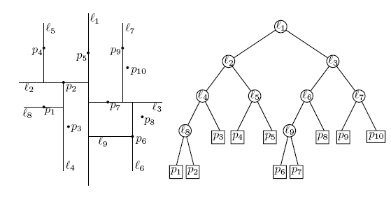
KD Tree
Slide adapted from Dr George Bebis Univ Nevada

Slide 77
KD Tree
Every node (except leaves) represents a hyperplane that divides the space into two parts.
Points to the left (right) of this hyperplane represent the left (right) sub-tree of that node.
P_{left}
P_{right}
Slide adapted from Dr George Bebis Univ Nevada

Slide 78
KD Tree
As we move down the tree, we divide the space along alternating (but not always) axis-aligned hyperplanes:
Split by x-coordinate: split by a vertical line that has (ideally) half the points left or on, and half right.
Split by y-coordinate: split by a horizontal line that has (ideally) half the points below or on and half above.
Slide adapted from Dr George Bebis Univ Nevada

Slide 79
KD Tree Construction
Split by x-coordinate: split by a vertical line that has approximately half the points left or on, and half right.
Points on the line go to the left subtree
x
Slide adapted from Dr George Bebis Univ Nevada

Slide 80
KD Tree Construction
Split by y-coordinate: split by a horizontal line that has approximately half the points left or on, and half right.
Points on the line go to the left subtree
x
Y
Y
Slide adapted from Dr George Bebis Univ Nevada

Slide 81
KD Tree Construction
Split by x-coordinate: split by a vertical line that has approximately half the points left or on, and half right.
Points on the line go to the left subtree
x
Y
Y
x
x
x
x
Slide adapted from Dr George Bebis Univ Nevada

Slide 82
KD Tree Construction
Split by y-coordinate: split by a horizontal line that has approximately half the points left or on, and half right.
Points on the line go to the left subtree
x
Y
Y
x
x
x
x
Y
Y
Slide adapted from Dr George Bebis Univ Nevada

Slide 83
KD Tree Node Structure
A KD-tree node has 5 fields
Splitting axis
Splitting value
Data
Left pointer
Right pointer
Slide adapted from Dr George Bebis Univ Nevada

Slide 84
KD Tree Splitting Strategies
Divide by finding median
Assumes all the points are available ahead of time.
Divide perpendicular to the axis with widest spread
Split axes might not alternate
And many more….
Slide adapted from Dr George Bebis Univ Nevada

Slide 85
Example – using median (data stored at the leaves)
Slide adapted from Dr George Bebis Univ Nevada

Slide 86
Example – using median (data stored at the leaves)
Slide adapted from Dr George Bebis Univ Nevada

Slide 87
Example – using median (data stored at the leaves)
Slide adapted from Dr George Bebis Univ Nevada

Slide 88
Example – using median (data stored at the leaves)
Slide adapted from Dr George Bebis Univ Nevada

Slide 89
Example – using median (data stored at the leaves)
Slide adapted from Dr George Bebis Univ Nevada

Slide 90
Example – using median (data stored at the leaves)
Slide adapted from Dr George Bebis Univ Nevada

Slide 91
Example – using median (data stored at the leaves)
Slide adapted from Dr George Bebis Univ Nevada

Slide 92
Example – using median (data stored at the leaves)
Slide adapted from Dr George Bebis Univ Nevada

Slide 93
Example – using median (data stored at the leaves)
Slide adapted from Dr George Bebis Univ Nevada

Slide 94
Region of node v
Region(v) : the subtree rooted at v stores the points in black dots

Slide 95
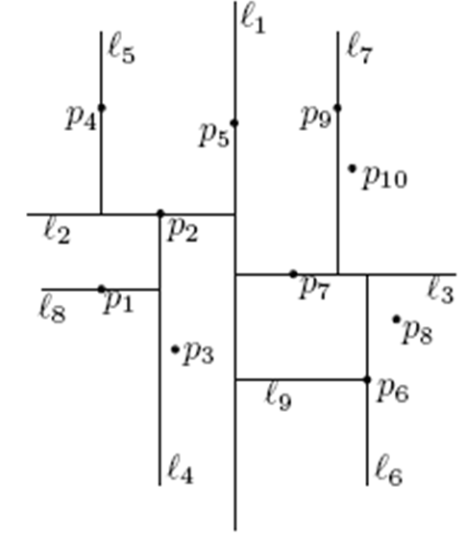
KD Trees – Range Search
query range
Need only search nodes whose region intersects query region.
Report all points in subtrees whose regions are entirely contained in query range.
If a region is partially contained in the query range check points.
Slide adapted from Dr George Bebis Univ Nevada

Slide 96
KD-tree: range queries
Recursive procedure starting from v = root
SearchKDtree (v, query rectangle R)
1. If v is a leaf, then report the points stored in v if it lies in R
2. Else
2.1 if Region(lc(v)) is contained in R, then report all points in the subtree(v).
2.2 Else If Region(lc(v)) intersects with R, then SearchKDtree(lc(v), R)
2.3 If Region(rc(v)) is contained in R, then report all points in the subtree(v). intersects R
2. 4 Else if Region(rc(v)) intersects R, then SearchKDtree(rc(v), R)

Slide 97
KD-tree: Range Query Example
L1, P5
L2, P2
L3, P7
L4, P2
L5, P4
L6, P6
L7, P9
L9,P6

Slide 98
KD-tree: Range Query Example
L1, P5
Query Rectangle
L2, P2
L3, P7
L4, P2
L5, P4
L6, P6
L7, P9
L9,P6

Slide 99
KD-tree: Range Query Example
Intersection with region of P5. Thus proceed
L1, P5
L2, P2
L3, P7
L4, P2
L5, P4
L6, P6
L7, P9
L9,P6

Slide 100
KD-tree: Range Query Example
L1, P5
Region of L2, P2 not in rect but intersect. Thus proceed
L2, P2
L3, P7
L4, P2
L5, P4
L6, P6
L7, P9
L9,P6

Slide 101
KD-tree: Range Query Example
Region of L5, P4 not in rect and not intersect. Will not be traversed further
L1, P5
L2, P2
L3, P7
L4, P2
L5, P4
L6, P6
L7, P9
L9,P6

Slide 102
KD-tree: Range Query Example
Region of L4, P2 not in rect but intersect. Thus proceed down
L1, P5
L2, P2
L3, P7
L4, P2
L5, P4
L6, P6
L7, P9
L9,P6

Slide 103
KD-tree: Range Query Example
Region of L8, P1 not in rect and no intersect. Will not be traversed further down
L1, P5
L2, P2
L3, P7
L4, P2
L5, P4
L6, P6
L7, P9
L9,P6

Slide 104
KD-tree: Range Query Example
Region of rc(L4) not in rect but intersect. Proceed further down
L1, P5
L2, P2
L3, P7
L4, P2
L5, P4
L6, P6
L7, P9
L9,P6

Slide 105
KD-tree: Range Query Example
P3 is a leaf. Check if P3 is inside the query rectangle or not.
L1, P5
L2, P2
L3, P7
L4, P2
L5, P4
L6, P6
L7, P9
L9,P6

Slide 106
KD-tree: Range Query Example
L1, P5
Region of L3, P7 not in rect but intersect. Thus proceed
L2, P2
L3, P7
L4, P2
L5, P4
L6, P6
L7, P9
L9,P6

Slide 107
KD-tree: Range Query Example
L1, P5
Region of L7, P9 not in rect but intersect. Thus proceed
L2, P2
L3, P7
L4, P2
L5, P4
L6, P6
L7, P9
L9,P6

Slide 108
KD-tree: Range Query Example
L1, P5
Region of rc(L7) not in rect but intersect. Thus proceed
L2, P2
L3, P7
L4, P2
L5, P4
L6, P6
L7, P9
L9,P6

Slide 109
KD-tree: Range Query Example
L1, P5
P10 is a leaf. So we check if P10 is in the query rect or not
L2, P2
L3, P7
L4, P2
L5, P4
L6, P6
L7, P9
L9,P6

Slide 110
KD-tree: Range Query Example
L1, P5
P9 is a leaf. So we check if P9 is in the query rect or not
L2, P2
L3, P7
L4, P2
L5, P4
L6, P6
L7, P9
L9,P6

Slide 111
KD-tree: Range Query Example
L1, P5
Region L6,P6 not inside the rect but intersect. So we proceed.
L2, P2
L3, P7
L4, P2
L5, P4
L6, P6
L7, P9
L9,P6

Slide 112
KD-tree: Range Query Example
L1, P5
Region rc(L6) not inside the rect but intersect. So we proceed.
L2, P2
L3, P7
L4, P2
L5, P4
L6, P6
L7, P9
L9,P6

Slide 113
KD-tree: Range Query Example
L1, P5
P8 is a leaf. So we check if it is present inside the query rect or not.
L2, P2
L3, P7
L4, P2
L5, P4
L6, P6
L7, P9
L9,P6

Slide 114
KD-tree: Range Query Example
L1, P5
Region L9,P6 not in rect but intersect. So Proceed.
L2, P2
L3, P7
L4, P2
L5, P4
L6, P6
L7, P9
L9,P6

Slide 115
KD-tree: Range Query Example
L1, P5
Region rc(L9,P6) is completely inside the rect. So return all points.
L2, P2
L3, P7
L4, P2
L5, P4
L6, P6
L7, P9
L9,P6

Slide 116
KD-tree: Range Query Example
L1, P5
Region lc(L9,P6) is not inside the rect but intersect. So proceed.
L2, P2
L3, P7
L4, P2
L5, P4
L6, P6
L7, P9
L9,P6

Slide 117
KD-tree: Range Query Example
L1, P5
P6 is a leaf and is inside the query rect. Return in answer.
L2, P2
L3, P7
L4, P2
L5, P4
L6, P6
L7, P9
L9,P6

Slide 118
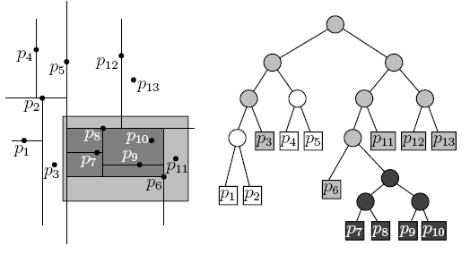
KD-tree: Range Query Another Example

Slide 119
Recall Nearest Neighbor Queries
P9
P7
P1
P6
Query Point
P8
P5
P2
P4
P3
Retrieve closest k points to the query point

Slide 120
KD Trees – Nearest Neighbor Search
query Point
KNN → Find k nearest neighbor of the given query point.
First we will discuss 1-NN and then generalize to K nearest neighbors.
Key Idea: start off with an estimate on nearest neighbor and then keep updating whenever we find a better one.

Slide 121
KD Trees – Nearest Neighbor Search
query Point
Two things to consider for such a approach:
Need a smart way to prune through the data space without actually computing distance to the actual data points
Also if my initial estimate is bad, I would end up doing a lot of replacements.

Slide 122
KD Trees – Nearest Neighbor Search
query Point
Two things to consider for such a approach:
Need a smart way to prune through the data space
Also if my initial estimate is bad, I would end up doing a lot of replacements.
Consider the left child of L3
What is the minimum possible distance between the query point and any point in the region of lc(L3)?

Slide 123
KD Trees – Nearest Neighbor Search
query Point
Two things to consider for such a approach:
Need a smart way to prune through the data space
Also if my initial estimate is bad, I would end up doing a lot of replacements.
Consider the left child of L3
What is the minimum possible distance between the query point and any point in the region of lc(L3)?
If it is less than our current distance best estimate (P2), then what???

Slide 124
KD Trees – Nearest Neighbor Search
Two things to consider for such a approach:
Need a smart way to prune through the data space
if initial estimate is bad → a lot of replacements.
E.g., P9 would be a very bad initial estimate

Slide 125
KD Trees – Nearest Neighbor Search
Two things to consider for such a approach:
Need a smart way to prune through the data space
if initial estimate is bad → a lot of replacements.
E.g., P9 would be a very bad initial estimate
Structure of KD-Tree helps us again.

Slide 126
KD Trees – Nearest Neighbor Search
Two things to consider for such a approach:
Need a smart way to prune through the data space
Need good initial estimates
E.g., P9 would be a very bad
Structure of KD-Tree helps
“Search” of the query point in the query tree and take the leaf where the search terminates.
Works ok in practice

Slide 127
KD Trees – Nearest Neighbor Search
Two things to consider for such a approach:
Need a smart way to prune through the data space
Need good initial estimates
E.g., P9 would be a very bad
Structure of KD-Tree helps
“Search” of the query point in the query tree and take the leaf where the search terminates.
Works ok in practice

Slide 128
KD Trees – Nearest Neighbor Search
Two things to consider for such a approach:
Need a smart way to prune through the data space
Need good initial estimates
E.g., P9 would be a very bad
Structure of KD-Tree helps
“Search” of the query point in the query tree and take the leaf where the search terminates.
Works ok in practice

Slide 129
KD Trees – Nearest Neighbor Search
Two things to consider for such a approach:
Need a smart way to prune through the data space
Need good initial estimates
E.g., P9 would be a very bad
Structure of KD-Tree helps
“Search” of the query point in the query tree and take the leaf where the search terminates.
Works ok in practice

Slide 130
KD Trees – Nearest Neighbor Search
Two things to consider for such a approach:
Need a smart way to prune through the data space
Need good initial estimates
E.g., P9 would be a very bad
Structure of KD-Tree helps
“Search” of the query point in the query tree and take the leaf where the search terminates.
Works ok in practice

Slide 131
KD-tree: 1-Nearest Neighbor Queries
Recursive procedure start SearchNNKDtree(Q, root, NULL, infty)
SearchNNKDtree (query point Q, Node N, Estimate point: P, Est distance: d)
If N is leaf Then
1.1 w’ = Distance(Q, N.datapoint)
1.2 If w’ < d Then d = w’; P = N.datapoint
2. Else
2.1 If (Q is to left of N.line) //Left for Y-axis parallel and below for X-axis parallel
Search = left
2.2 Else
Search = right
3. If (Search == left)
3.1 SearchNNKDtree(Q, N.leftchild, P, d)
3.2 If dist(Q, N.rc.reg) =< d Then SearchNNKDtree(Q, N.rightchild, P, d)
4. If (Search == right)
4.1 SearchNNKDtree(Q, N.rightchild, P, d)
4.2 If dist(Q, N.lc.reg) =< d Then SearchNNKDtree(Q, N.leftchild, P, d)

Slide 132
KD-tree: 1-NN Query Running
query Point
Query point is to the left of the line L1, therefore we take Left Child
L1, P5
L2, P2
L3, P7
L4, P2
L5, P4
L6, P6
L7, P9
L9,P6

Slide 133
KD-tree: 1-NN Query Running
query Point
Query point is to the right of the line L2, therefore we take Right Child
L1, P5
L2, P2
L3, P7
L4, P2
L5, P4
L6, P6
L7, P9
L9,P6

Slide 134
KD-tree: 1-NN Query Running
query Point
Query point is to the right of the line L5, therefore we take Right Child
L1, P5
L2, P2
L3, P7
L4, P2
L5, P4
L6, P6
L7, P9
L9,P6

Slide 135
KD-tree: 1-NN Query Running
query Point
Right child of L5 is a leaf; that becomes the initial estimate
L1, P5
L2, P2
L3, P7
L4, P2
L5, P4
L6, P6
L7, P9
L9,P6

Slide 136
KD-tree: 1-Nearest Neighbor Queries
Recursive procedure start SearchNNKDtree(Q, root, NULL, infty)
SearchNNKDtree (query point Q, Node N, Estimate point: P, Est distance: d)
If N is leaf Then
1.1 w’ = Distance(Q, N.datapoint)
1.2 If w’ < d Then d = w’; P = N.datapoint
2. Else
2.1 If (Q is to left of N.line) //Left for Y-axis parallel and below for X-axis parallel
Search = left
2.2 Else
Search = right
3. If (Search == left)
3.1 SearchNNKDtree(Q, N.leftchild, P, d)
3.2 If dist(Q, N.rc.reg) =< d Then SearchNNKDtree(Q, N.rightchild, P, d)
4. If (Search == right)
4.1 SearchNNKDtree(Q, N.rightchild, P, d)
4.2 If dist(Q, N.lc.reg) =< d Then SearchNNKDtree(Q, N.leftchild, P, d)

Slide 137
KD-tree: 1-NN Query Running
P5 becomes the initial estimate;
d = dist(Query, P5)
L1, P5
L2, P2
L3, P7
L4, P2
L5, P4
L6, P6
L7, P9
L9,P6

Slide 138
KD-tree: 1-NN Query Running
Now winding back the recursion.
d = dist(Query, P5)
L1, P5
L2, P2
L3, P7
L4, P2
L5, P4
L6, P6
L7, P9
L9,P6

Slide 139
KD-tree: 1-Nearest Neighbor Queries
Recursive procedure start SearchNNKDtree(Q, root, NULL, infty)
SearchNNKDtree (query point Q, Node N, Estimate point: P, Est distance: d)
If N is leaf Then
1.1 w’ = Distance(Q, N.datapoint)
1.2 If w’ < d Then d = w’; P = N.datapoint
2. Else
2.1 If (Q is to left of N.line) //Left for Y-axis parallel and below for X-axis parallel
Search = left
2.2 Else
Search = right
3. If (Search == left)
3.1 SearchNNKDtree(Q, N.leftchild, P, d)
3.2 If dist(Q, N.rc.reg) =< d Then SearchNNKDtree(Q, N.rightchild, P, d)
4. If (Search == right)
4.1 SearchNNKDtree(Q, N.rightchild, P, d)
4.2 If dist(Q, N.lc.reg) =< d Then SearchNNKDtree(Q, N.leftchild, P, d)
Executed for Line L5

Slide 140
KD-tree: 1-NN Query Running
Left child of L5 is a leaf
L1, P5
L2, P2
L3, P7
L4, P2
L5, P4
L6, P6
L7, P9
L9,P6

Slide 141
KD-tree: 1-NN Query Running
Left child of L5 is a leaf; no change as it outside the current estimate
L1, P5
L2, P2
L3, P7
L4, P2
L5, P4
L6, P6
L7, P9
L9,P6

Slide 142
KD-tree: 1-NN Query Running
Winding back the recursion; At l2 we now see left child
L1, P5
L2, P2
L3, P7
L4, P2
L5, P4
L6, P6
L7, P9
L9,P6

Slide 143
KD-tree: 1-Nearest Neighbor Queries
Recursive procedure start SearchNNKDtree(Q, root, NULL, infty)
SearchNNKDtree (query point Q, Node N, Estimate point: P, Est distance: d)
If N is leaf Then
1.1 w’ = Distance(Q, N.datapoint)
1.2 If w’ < d Then d = w’; P = N.datapoint
2. Else
2.1 If (Q is to left of N.line) //Left for Y-axis parallel and below for X-axis parallel
Search = left
2.2 Else
Search = right
3. If (Search == left)
3.1 SearchNNKDtree(Q, N.leftchild, P, d)
3.2 If dist(Q, N.rc.reg) =< d Then SearchNNKDtree(Q, N.rightchild, P, d)
4. If (Search == right)
4.1 SearchNNKDtree(Q, N.rightchild, P, d)
4.2 If dist(Q, N.lc.reg) =< d Then SearchNNKDtree(Q, N.leftchild, P, d)
Executed for Line L2

Slide 144
KD-tree: 1-NN Query Running
Winding back the recursion; At l2 we now see left child
L1, P5
L2, P2
L3, P7
L4, P2
L5, P4
L6, P6
L7, P9
L9,P6

Slide 145
KD-tree: 1-Nearest Neighbor Queries
Recursive procedure start SearchNNKDtree(Q, root, NULL, infty)
SearchNNKDtree (query point Q, Node N, Estimate point: P, Est distance: d)
If N is leaf Then
1.1 w’ = Distance(Q, N.datapoint)
1.2 If w’ < d Then d = w’; P = N.datapoint
2. Else
2.1 If (Q is to left of N.line) //Left for Y-axis parallel and below for X-axis parallel
Search = left
2.2 Else
Search = right
3. If (Search == left)
3.1 SearchNNKDtree(Q, N.leftchild, P, d)
3.2 If dist(Q, N.rc.reg) =< d Then SearchNNKDtree(Q, N.rightchild, P, d)
4. If (Search == right)
4.1 SearchNNKDtree(Q, N.rightchild, P, d)
4.2 If dist(Q, N.lc.reg) =< d Then SearchNNKDtree(Q, N.leftchild, P, d)
Executed for Line L4

Slide 146
KD-tree: 1-NN Query Running
At l4 we now see right child
L1, P5
L2, P2
L3, P7
L4, P2
L5, P4
L6, P6
L7, P9
L9,P6

Slide 147
KD-tree: 1-NN Query Running
Right child of L4 is a leaf; w’ = dist(q,P3)
w’ > d so no change
L1, P5
L2, P2
L3, P7
L4, P2
L5, P4
L6, P6
L7, P9
L9,P6

Slide 148
KD-tree: 1-NN Query Running
Going back in recursion;
L1, P5
L2, P2
L3, P7
L4, P2
L5, P4
L6, P6
L7, P9
L9,P6

Slide 149
KD-tree: 1-Nearest Neighbor Queries
Recursive procedure start SearchNNKDtree(Q, root, NULL, infty)
SearchNNKDtree (query point Q, Node N, Estimate point: P, Est distance: d)
If N is leaf Then
1.1 w’ = Distance(Q, N.datapoint)
1.2 If w’ < d Then d = w’; P = N.datapoint
2. Else
2.1 If (Q is to left of N.line) //Left for Y-axis parallel and below for X-axis parallel
Search = left
2.2 Else
Search = right
3. If (Search == left)
3.1 SearchNNKDtree(Q, N.leftchild, P, d)
3.2 If dist(Q, N.rc.reg) =< d Then SearchNNKDtree(Q, N.rightchild, P, d)
4. If (Search == right)
4.1 SearchNNKDtree(Q, N.rightchild, P, d)
4.2 If dist(Q, N.lc.reg) =< d Then SearchNNKDtree(Q, N.leftchild, P, d)
Executed for Line L4

Slide 150
KD-tree: 1-NN Query Running
Dist(query, L8.reg) =< d so proceed
L1, P5
L2, P2
L3, P7
L4, P2
L5, P4
L6, P6
L7, P9
L9,P6

Slide 151
KD-tree: 1-Nearest Neighbor Queries
Recursive procedure start SearchNNKDtree(Q, root, NULL, infty)
SearchNNKDtree (query point Q, Node N, Estimate point: P, Est distance: d)
If N is leaf Then
1.1 w’ = Distance(Q, N.datapoint)
1.2 If w’ < d Then d = w’; P = N.datapoint
2. Else
2.1 If (Q is to left of N.line) //Left for Y-axis parallel and below for X-axis parallel
Search = left
2.2 Else
Search = right
3. If (Search == left)
3.1 SearchNNKDtree(Q, N.leftchild, P, d)
3.2 If dist(Q, N.rc.reg) =< d Then SearchNNKDtree(Q, N.rightchild, P, d)
4. If (Search == right)
4.1 SearchNNKDtree(Q, N.rightchild, P, d)
4.2 If dist(Q, N.lc.reg) =< d Then SearchNNKDtree(Q, N.leftchild, P, d)
Executed for Line L8

Slide 152
KD-tree: 1-NN Query Running
Right child of L8 is leaf
W’ = Dist(query, P2)
W’ < d so replace the estimate
L1, P5
L2, P2
L3, P7
L4, P2
L5, P4
L6, P6
L7, P9
L9,P6

Slide 153
KD-tree: 1-Nearest Neighbor Queries
Recursive procedure start SearchNNKDtree(Q, root, NULL, infty)
SearchNNKDtree (query point Q, Node N, Estimate point: P, Est distance: d)
If N is leaf Then
1.1 w’ = Distance(Q, N.datapoint)
1.2 If w’ < d Then d = w’; P = N.datapoint
2. Else
2.1 If (Q is to left of N.line) //Left for Y-axis parallel and below for X-axis parallel
Search = left
2.2 Else
Search = right
3. If (Search == left)
3.1 SearchNNKDtree(Q, N.leftchild, P, d)
3.2 If dist(Q, N.rc.reg) =< d Then SearchNNKDtree(Q, N.rightchild, P, d)
4. If (Search == right)
4.1 SearchNNKDtree(Q, N.rightchild, P, d)
4.2 If dist(Q, N.lc.reg) =< d Then SearchNNKDtree(Q, N.leftchild, P, d)
Executed for point P2

Slide 154
KD-tree: 1-NN Query Running
Right child of L8 is leaf
W’ = Dist(query, P2)
W’ < d so replace the estimate
L1, P5
L2, P2
L3, P7
L4, P2
L5, P4
L6, P6
L7, P9
L9,P6

Slide 155
KD-tree: 1-NN Query Running
Right child of L8 is leaf
W’ = Dist(query, P2)
W’ < d so replace the estimate d = W’
L1, P5
L2, P2
L3, P7
L4, P2
L5, P4
L6, P6
L7, P9
L9,P6

Slide 156
KD-tree: 1-NN Query Running
While going back; left child of L8 is leaf
W’ = Dist(query, P1)
W’ > d so no change
L1, P5
L2, P2
L3, P7
L4, P2
L5, P4
L6, P6
L7, P9
L9,P6

Slide 157
KD-tree: 1-NN Query Running
L1, P5
Going back in recursion.
L2, P2
L3, P7
L4, P2
L5, P4
L6, P6
L7, P9
L9,P6

Slide 158
KD-tree: 1-NN Query Running
L1, P5
Going back in recursion. Right child of L1
L2, P2
L3, P7
L4, P2
L5, P4
L6, P6
L7, P9
L9,P6

Slide 159
KD-tree: 1-NN Query Running
Would any sub-tree be pruned in this recursion?
L1, P5
L2, P2
L3, P7
L4, P2
L5, P4
L6, P6
L7, P9
L9,P6

Slide 160
KD Trees – K-Nearest Neighbor Search
query Point for 2-NN
Similar approach for K-nearest neighbors
Three key ideas:
Bounded Priority Queue:
“d” thing is defined a distance from q to current farthest point.
First we fill up k points in our bounded priority then begin searching the remaining tree while pruning.

Slide 161
KD-tree: 2-NN Query Running
Initial estimates would be P4 and P5
L1, P5
Current PQ
P4 | P5
L2, P2
L3, P7
L4, P2
L5, P4
L6, P6
L7, P9
L9,P6

Slide 162
KD-tree: 2-NN Query Running
After few steps
L1, P5
Current PQ
P2 | P4
L2, P2
L3, P7
L4, P2
L5, P4
L6, P6
L7, P9
L9,P6

Slide 163
KD-tree: 2-NN Query Running
What will happen on the right subtree of L1?
Current PQ
L1, P5
P2 | P4
L2, P2
L3, P7
L4, P2
L5, P4
L6, P6
L7, P9
L9,P6

Slide 164
Region Quadtrees
Quadtree is a tree structure where every non-leaf node has exactly four descendents
Region quadtrees recursively subdivide non-homogenous square arrays of cells into four equal sized quadrants
Decomposition continues until all squares bound homogenous regions
Some slides borrowed from “GIS a computational perspective: second edition” by M. Worboys CRC press 2004.

Slide 165
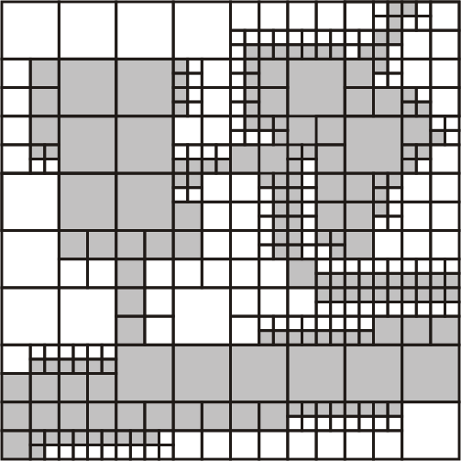
Region Quadtrees
Input Data (Raster form)
Quad Tree
Some slides borrowed from “GIS a computational perspective: second edition” by M. Worboys CRC press 2004.

Slide 166
Region Quadtrees
Quadtrees take full advantage of the spatial structure, adapt to variable spatial detail
Inefficient for highly inhomogeneous rasters
Very sensitive to changes in the embedding space (e.g., translation, rotation)
Some slides borrowed from “GIS a computational perspective: second edition” by M. Worboys CRC press 2004.

Slide 167
Region Quadtrees
Quadtrees take full advantage of the spatial structure, adapt to variable spatial detail
Inefficient for highly inhomogeneous rasters
Very sensitive to changes in the embedding space (e.g., translation, rotation)
More useful for representing/compressing raster data.
Some slides borrowed from “GIS a computational perspective: second edition” by M. Worboys CRC press 2004.

Slide 168
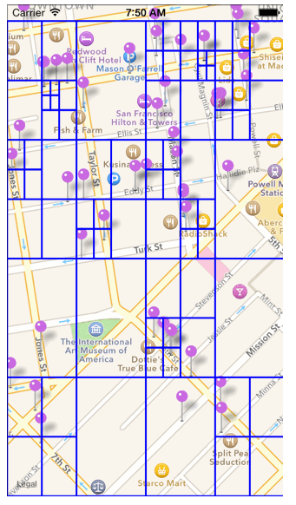
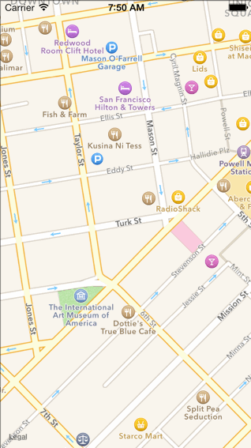
Region Quadtrees for points Insertion Animation
Animation available at this link: https://robots.thoughtbot.com/how-to-handle-large-amounts-of-data-on-maps

Slide 169
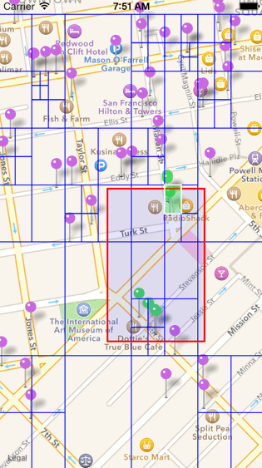
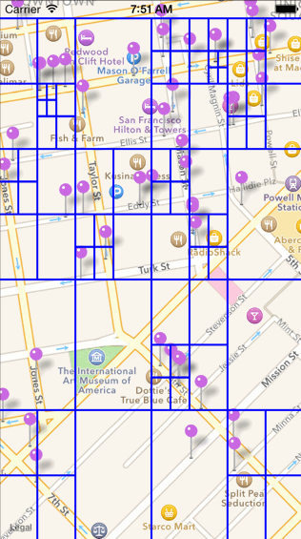
Region Quadtrees for points Range Query Example
Animation available at this link: https://robots.thoughtbot.com/how-to-handle-large-amounts-of-data-on-maps

Slide 170
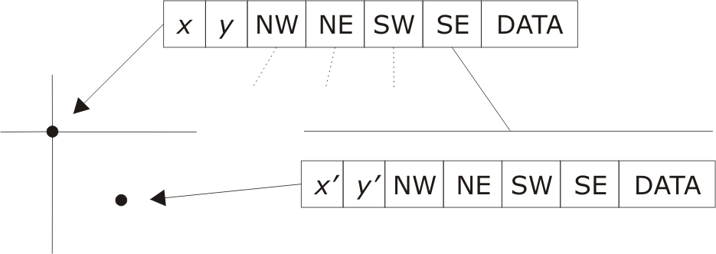
Point Quadtrees
Combination of grid approach with multidimensional binary search tree
Each non-leaf node has four descendents
Each quadrant partition is centered on a data point
Quadtree build time is O(n log n); search time is O(log n)
Some slides borrowed from “GIS a computational perspective: second edition” by M. Worboys CRC press 2004.

Slide 171
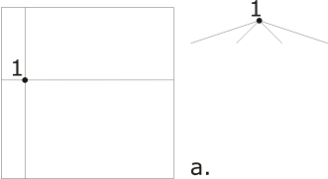
Point Quadtrees
Some slides borrowed from “GIS a computational perspective: second edition” by M. Worboys CRC press 2004.

Slide 172
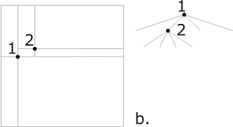
Point Quadtrees
Some slides borrowed from “GIS a computational perspective: second edition” by M. Worboys CRC press 2004.

Slide 173
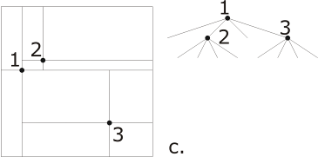
Point Quadtrees
Some slides borrowed from “GIS a computational perspective: second edition” by M. Worboys CRC press 2004.

Slide 174
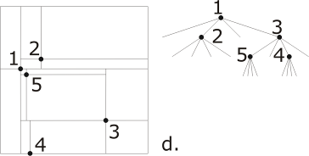
Point Quadtrees
Some slides borrowed from “GIS a computational perspective: second edition” by M. Worboys CRC press 2004.

Slide 175
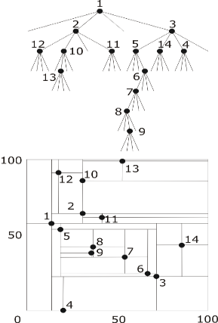
Point Quadtrees
Some slides borrowed from “GIS a computational perspective: second edition” by M. Worboys CRC press 2004.

Slide 176
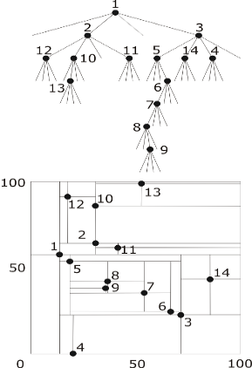
Point Quadtrees: Range Query
Some slides borrowed from “GIS a computational perspective: second edition” by M. Worboys CRC press 2004.

Slide 177
PM Quadtrees
C
Partiton: (512,512)
A
NW
Point A
Edge AB
NE
Point C
Edge CB
SW
Point B
Edge AB
Edge CB
SE
Edge CB
B

Slide 178
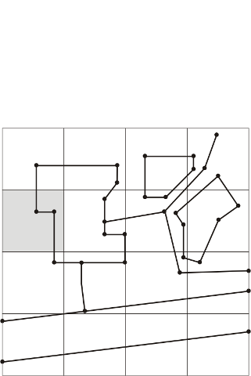
PM1 Quadtrees
Divides region into quadtree, such that all edges and vertices are separated into distinct leaf nodes
Each leaf node contains at most one vertex
Leaves containing a vertex contain only edges incident with that vertex
Leaves not containing a vertex contain only one edge
Some slides borrowed from “GIS a computational perspective: second edition” by M. Worboys CRC press 2004.

Slide 179
PM1 Quadtrees
Divides region into quadtree, such that all edges and vertices are separated into distinct leaf nodes
Each leaf node contains at most one vertex
Leaves containing a vertex contain only edges incident with that vertex
Leaves not containing a vertex contain only one edge
Some slides borrowed from “GIS a computational perspective: second edition” by M. Worboys CRC press 2004.

Slide 180
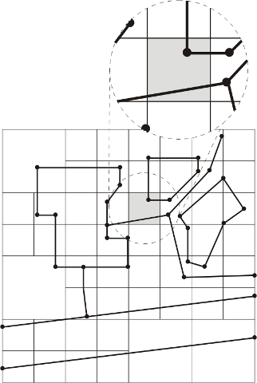
PM1 Quadtrees
Divides region into quadtree, such that all edges and vertices are separated into distinct leaf nodes
Each leaf node contains at most one vertex
Leaves containing a vertex contain only edges incident with that vertex
Leaves not containing a vertex contain only one edge
Some slides borrowed from “GIS a computational perspective: second edition” by M. Worboys CRC press 2004.

Slide 181
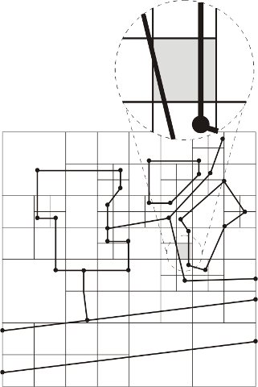
PM1 Quadtrees
Divides region into quadtree, such that all edges and vertices are separated into distinct leaf nodes
Each leaf node contains at most one vertex
Leaves containing a vertex contain only edges incident with that vertex
Leaves not containing a vertex contain only one edge
Some slides borrowed from “GIS a computational perspective: second edition” by M. Worboys CRC press 2004.

Slide 182
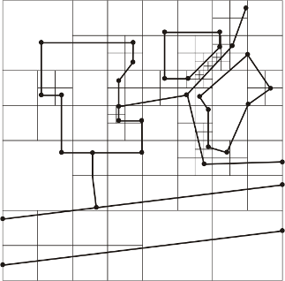
PM1 Quadtrees
Divides region into quadtree, such that all edges and vertices are separated into distinct leaf nodes
Each leaf node contains at most one vertex
Leaves containing a vertex contain only edges incident with that vertex
Leaves not containing a vertex contain only one edge
Final Quadtree following all constraints.
Some slides borrowed from “GIS a computational perspective: second edition” by M. Worboys CRC press 2004.

