Slide 1
Introduction to Spatial Computing CSE 5ISC
Fundamental Spatial Concepts and Algorithms
Some slides adapted from Worboys and Duckham (2004) GIS: A Computing Perspective, Second Edition, CRC Press

Slide 2
Representation Models for Object Data

Slide 3
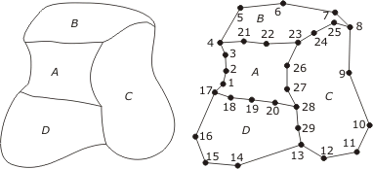
Spaghetti Model
Spaghetti data structure represents a planar configuration of points, arcs, and areas
Geometry is represented as a set of lists of straight-line segments
There is NO explicit representation of the topological interrelationships of the configuration, such as adjacency

Slide 4
Spaghetti Model - Example
Each polygonal area is represented by its boundary loop
Each loop is discretized as a closed polyline
Each polyline is represented as a list of points
A:[1,2,3,4,21,22,23,26,27,28,20,19,18,17]
B:[4,5,6,7,8,25,24,23,22,21]
C:[8,9,10,11,12,13,29,28,27,26,23,24,25]
D:[17,18,19,20,28,29,13,14,15,16]
Any comments on its space requirements?
Using Spaghetti data model, can we can determine the neighbors of an Area?

Slide 5
NAA : Node Arc Area
Each directed arc has exactly one start and one end node.
Each node must be the start node or end node (maybe both) of at least one directed arc.
Directed arcs may intersect only at their end nodes.
Each directed arc has exactly one area on its right and one area on its left.
Each area must be the left area or right area (maybe both) of at least one directed arc.

Slide 6
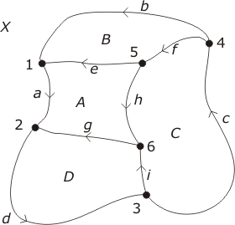
NAA : Example
Arc | Begin | End | Left | Right
a | 1 | 2 | A | X
b | 4 | 1 | B | X
c | 3 | 4 | C | X
d | 2 | 3 | D | X
e | 5 | 1 | A | B
f | 4 | 5 | C | B
g | 6 | 2 | D | A
h | 5 | 6 | C | A
i | 3 | 6 | D | C

Slide 7
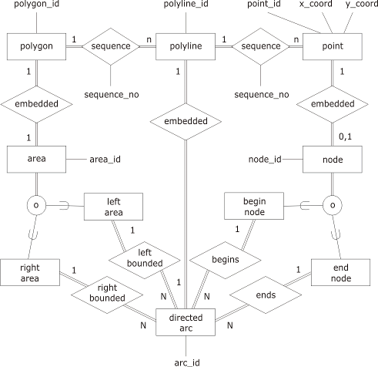
NAA : Example
ARC(ARC ID, BEGIN_NODE, END_NODE, LEFT_AREA, RIGHT_AREA)
POLYGON(AREA ID, ARC ID, SEQUENCE_NO)
POLYLINE(ARC ID, POINT ID, SEQUENCE_NO)
POINT(POINT ID, X_COORD,Y_COORD)
NODE(NODE ID, POINT_ID)

Slide 8
Double Connected Edge List (DCEL)
Omits details of the actual embedding
Focuses on the topological relationships embodied in the entities node, arc (edge), and area (face)
One table provides the information to construct:
The sequence (cycle) of arcs around the node for each node in the configuration; and
The sequence (cycle) of arcs around the area for each node in the configuration
Every arc has a unique next arc and a unique previous arc

Slide 9
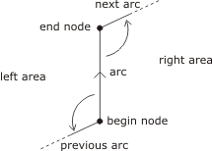
Double Connected Edge List-- Example
Arc ID | BEGIN NODE | END NODE | LEFT AREA | RIGHT AREA | PREVIOUS ARC | NEXT ARC
a | 1 | 2 | A | X | e | d
b | 4 | 1 | B | X | f | a
c | 3 | 4 | C | X | I | b
d | 2 | 3 | D | X | g | c
e | 5 | 1 | A | B | h | b
f | 4 | 5 | C | B | c | e
g | 6 | 2 | D | A | I | a
h | 5 | 6 | C | A | f | g
i | 3 | 6 | D | C | d | h

Slide 10
Double Connected Edge List-- Algorithms
Query: Clockwise sequence of arcs surrounding area X
Input: Area X
1: find some arc x which bounds X
2: arc $←$ x
3: repeat
4: store arc in sequence s
5: if left_area(arc) = X then
6: arc $←$ previous_arc (arc)
7: else
8: arc $←$ next_arc(arc)
9: until arc is not x
Output: Clockwise sequence of arcs s

Slide 11
Double Connected Edge List-- Algorithms
Query: Counterclockwise sequence of arcs surrounding node n
Input: Node n
1: find some arc x which is incident with n
2: arc $←$ x
3: repeat
4: store arc in sequence s
5: if begin_node(arc) = n then
6: arc $←$ previous_arc (arc)
7: else
8: arc $←$ next_arc(arc)
9: until arc is not x
Output: Counterclockwise sequence of arcs s

Slide 12
Voronoi Diagrams

Slide 13
Definition of Voronoi Diagrams
Let P be a set of n distinct points (sites) in the plane.
The Voronoi diagram of P is the subdivision of the plane into n cells (also called proximal polygons), one for each site.
A point q lies in the cell corresponding to a site p_{i} ∈ P
if and only if
Euclidean_Dist( q, p_{i} ) < Euclidean_dist( q, p_{j} ), for each p_{i} ∈ P, j ≠ i.
Slide adapted from Allen Miu CSAIL MIT

Slide 14
Voronoi Diagrams- Example
p_{i} : site points, e.g., post offices, hospitals
e : Voronoi edge
v : Voronoi vertex
e
v
p_{i}
Slide adapted from Allen Miu CSAIL MIT

Slide 15
Voronoi Diagrams Terminology
Voronoi Edge
v
Bounded Cell
Unbounded Cell
Slide adapted from Allen Miu CSAIL MIT

Slide 16
Intuition for Constructing Voronoi Diagrams
P₁
Trivial Case:
One Site
Trivially all points are close to P₁

Slide 17
Intuition for Constructing Voronoi Diagrams
P₁
P₂
Two Sites:
What would be voronoi edge?
Perpendicular bisector would “define” the voronoi edge.

Slide 18
Intuition for Constructing Voronoi Diagrams
P₁
P₂
Two Sites:
What would be voronoi edge?
Perpendicular bisector would “define” the voronoi edge.

Slide 19
Intuition for Constructing Voronoi Diagrams
P₁
P₂
P₃
P₄
P₅
P₆
Collinear sets of sites:
What would be voronoi edges?

Slide 20
Intuition for Constructing Voronoi Diagrams
P₁
P₂
P₃
P₄
P₅
P₆
Collinear sets of sites:
What would be voronoi edges?
A set of perpendicular bisectors
One between each consecutive pair of nodes.

Slide 21
Intuition for Constructing Voronoi Diagrams
P₃
P₁
P₂
Non-Collinear sets of sites:
What would be voronoi edges?
Again perpendicular bisectors, but need to consider their intersections as well
These become voronoi vertices
Slide adapted from Allen Miu CSAIL MIT

Slide 22
Intuition for Constructing Voronoi Diagrams
$$v_{i}$$
$v_{i}:$Voronoi Vertex
P₃
P₁
P₂
Non-Collinear sets of sites:
What would be voronoi edges?
Again perpendicular bisectors, but need to consider their intersections as well
These become voronoi vertices
Slide adapted from Allen Miu CSAIL MIT

Slide 23
Not all bisectors form edges in Voronoi Diagrams
p_{i} : site points
e : Voronoi edge
p_{i}
e

Slide 24
So which Bisectors form the Voronoi Diagram?
Given a point q
Let C(q) be the largest empty circle with q as its center
And it does not contain any site of P in its interior
The bisector between p_{i} and p_{j} define an voronoi edge iff
There exists a point q on the bisector of p_{i} and p_{j} such that C(q) contains both p_{i} and p_{j} on its boundary and no other site.
v
p_{i}
e

Slide 25
Voronoi Diagrams Properties
A point q is a voronoi vertex if and only if the largest empty circle centered at q touches at least 3 sites on its boundary.
A Voronoi vertex is an intersection of 3 more segments, each equidistant from a pair of sites
p_{i} : site points
e : Voronoi edge
v : Voronoi vertex
v
p_{i}
e
Slide adapted from Allen Miu CSAIL MIT

Slide 26
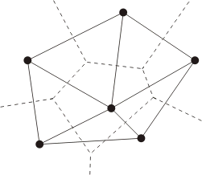
Relation between Voronoi and Triangulation
Dual of Voronoi diagram → Delaunay triangulation
Make each site a vertex
Add an edge between two vertices if they share an voronoi edge.

Slide 27
Some Properties of Delaunay Triangulation
Given an initial point set P for which no sets of three points are collinear (to avoid degenerate cases)
The Delaunay triangulation is unique
The external edges of the triangulation from the convex hull of P (i.e., the smallest convex set containing P)
The circumcircles of the triangles contain no members of P in their interior
The triangles in a Delaunay triangulation are best-possible with respect to regularity (closest to equilateral)

Slide 28
Algorithms for Voronoi Diagrams

Slide 29
A Naïve Algorithm for Voronoi Diagrams
Input: A set P of sites whose voronoi diagram has to be constructed.
For all sites $p_{i}∈P$ do
1.1 Initialize a data structure ${Vor(p_{i})}_{}$(doubly linked list) to store the boundary of voronoi cell of $p_{i}$
1.2 For all sites $p_{j}≠p_{i}$ do
1.2.1 Construct the half plane ${h(p}_{j},p_{i})$ corresponding to the perpendicular bisector of the line segment $p_{j}p_{i}$
1.2.2 Determine the intersection of ${h(p}_{j},p_{i})$ with $Vor(p_{i})$ and update $Vor(p_{i})$

Slide 30
A Naïve Algorithm for Voronoi Diagrams
For all sites $p_{i}∈P$ do
1.1 Initialize a data structure ${Vor(p_{i})}_{}$(doubly linked list) to store the boundary of voronoi cell of $p_{i}$
1.2 For sites $p_{j}≠p_{i}$ do
1.2.1 Construct the half plane ${h(p}_{j},p_{i})$ corresponding to the perpendicular bisector of the line segment $p_{j}p_{i}$
1.2.2 Determine the intersection of ${h(p}_{j},p_{i})$ with $Vor(p_{i})$ and update $Vor(p_{i})$

Slide 31
Naïve Algorithm Examples
For all sites $p_{i}∈P$ do
1.1 Initialize a data structure ${Vor(p_{i})}_{}$(doubly linked list) to store the boundary of voronoi cell of $p_{i}$
1.2 For sites $p_{j}≠p_{i}$ do
1.2.1 Construct the half plane ${h(p}_{j},p_{i})$ corresponding to the perpendicular bisector of the line segment $p_{j}p_{i}$
1.2.2 Determine the intersection of ${h(p}_{j},p_{i})$ with $Vor(p_{i})$ and update $Vor(p_{i})$

Slide 32
Naïve Algorithm Examples
For all sites $p_{i}∈P$ do
1.1 Initialize a data structure ${Vor(p_{i})}_{}$(doubly linked list) to store the boundary of voronoi cell of $p_{i}$
1.2 For sites $p_{j}≠p_{i}$ do
1.2.1 Construct the half plane ${h(p}_{j},p_{i})$ corresponding to the perpendicular bisector of the line segment $p_{j}p_{i}$
1.2.2 Determine the intersection of ${h(p}_{j},p_{i})$ with $Vor(p_{i})$ and update $Vor(p_{i})$

Slide 33
A Naïve Algorithm for Voronoi Diagrams
Input: A set P of sites whose voronoi diagram has to be constructed.
For all sites $p_{i}∈P$ do
1.1 Initialize a data structure ${Vor(p_{i})}_{}$(doubly linked list) to store the boundary of voronoi cell of $p_{i}$
1.2 For all sites $p_{j}≠p_{i}$ do
1.2.1 Construct the half plane ${h(p}_{j},p_{i})$ corresponding to the perpendicular bisector of the line segment $p_{j}p_{i}$
1.2.2 Determine the intersection of ${h(p}_{j},p_{i})$ with $Vor(p_{i})$ and update $Vor(p_{i})$
Effects of some $p_{j}$ on $p_{i}$ might be completely absorbed from some other $p_{j}$. In other words, some bisectors would not contribute to the voronoi cell of $p_{i}$

Slide 34
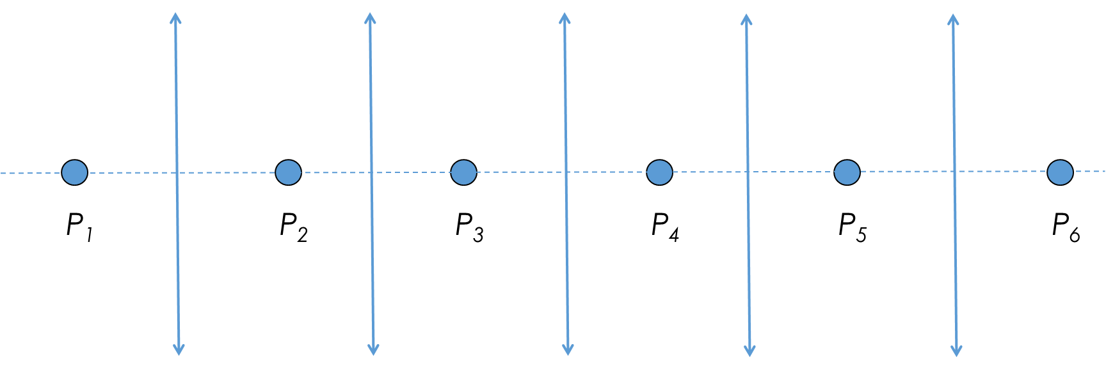
A Naïve Algorithm for Voronoi Diagrams
Effects of some $p_{j}$ on $p_{i}$ might be completely absorbed from some other $p_{j}$. In the below example, while processing P3, effects of P1 would be completely absorbed by P2.
Input: A set P of sites whose voronoi diagram has to be constructed.
For all sites $p_{i}∈P$ do
1.1 Initialize a data structure ${Vor(p_{i})}_{}$(doubly linked list) to store the boundary of voronoi cell of $p_{i}$
1.2 For all sites $p_{j}≠p_{i}$ do
1.2.1 Construct the half plane ${h(p}_{j},p_{i})$ corresponding to the perpendicular bisector of the line segment $p_{j}p_{i}$
1.2.2 Determine the intersection of ${h(p}_{j},p_{i})$ with $Vor(p_{i})$ and update $Vor(p_{i})$

Slide 35
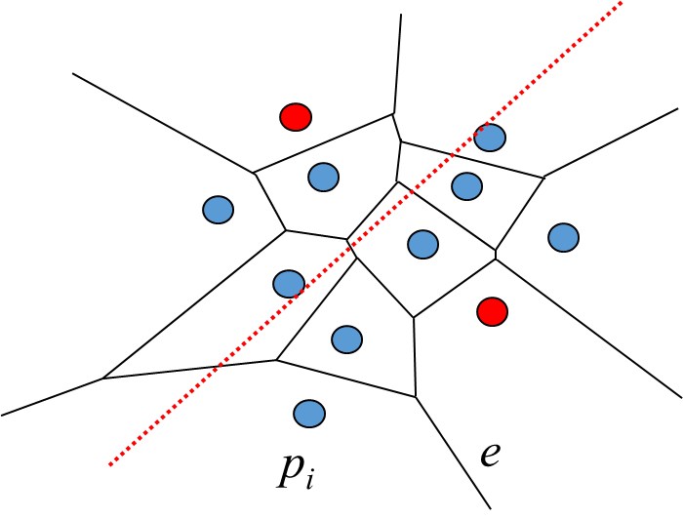
A Naïve Algorithm for Voronoi Diagrams
Input: A set P of sites whose voronoi diagram has to be constructed.
For all sites $p_{i}∈P$ do
1.1 Initialize a data structure ${Vor(p_{i})}_{}$(doubly linked list) to store the boundary of voronoi cell of $p_{i}$
1.2 For all sites $p_{j}≠p_{i}$ do
1.2.1 Construct the half plane ${h(p}_{j},p_{i})$ corresponding to the perpendicular bisector of the line segment $p_{j}p_{i}$
1.2.2 Determine the intersection of ${h(p}_{j},p_{i})$ with $Vor(p_{i})$ and update $Vor(p_{i})$
Effects of some $p_{j}$ on $p_{i}$ might be completely absorbed from some other $p_{j}$. In the below example, while processing P3, effects of P4 would be completely absorbed by the sites along the green arc.
P₄
P₃

Slide 36
A Naïve Algorithm for Voronoi Diagrams
For all sites $p_{i}∈P$ do
1.1 Initialize a data structure ${Vor(p_{i})}_{}$(doubly linked list) to store the boundary of voronoi cell of $p_{i}$
1.2 For sites $p_{j}≠p_{i}$ do
1.2.1 Construct the half plane ${h(p}_{j},p_{i})$ corresponding to the perpendicular bisector of the line segment $p_{j}p_{i}$
1.2.2 Determine the intersection of ${h(p}_{j},p_{i})$ with $Vor(p_{i})$ and update $Vor(p_{i})$
Time Complexity:
Each Voronoi cell is a intersection of n-1 half planes
Cost of half plane intersection: O(n log n)
Result from Comp Geometry
We repeat this for all sites
Thus, total cost O(n²log n)

Slide 37
Sweep Line Algorithm for Voronoi Diagrams
Goal is to construct the voronoi diagram as a horizontal line sweeps the set of sites from top to bottom
q
Challenges for Sweep Approach
Part of Vor(p_{i}) that lies above sweep line depends on things which are below the sweep line
When the sweep lines reaches the topmost voronoi vertex of cell, we don’t have all the information required to compute the cell.
Sweep Line
p_{i}
v
e

Slide 38
Fortune’s Algorithm for Voronoi Diagrams
Loop Invariant (key Idea)
At any stage during the course of the algorithm we have a representation of the locus of points q that are closer to some site p_{i} above the sweep line than to the line itself (and thus to any site below the line).
Slide adapted from Allen Miu CSAIL MIT

Slide 39
Fortune’s Algorithm for Voronoi Diagrams
At any stage during the course of the algorithm we have a representation of the locus of points q that are closer to some site p_{i} above the sweep line than to the line itself.
q
p_{i}
Equidistance
Sweep Line
Beach Line
Slide adapted from Allen Miu CSAIL MIT

Slide 40
Fortune’s Algorithm for Voronoi Diagrams
Sweep Line
Break Points
Slide adapted from Allen Miu CSAIL MIT

Slide 41
Fortune’s Algorithm for Voronoi Diagrams
Break Points trace out Voronoi edges.
q
p_{i}
Sweep Line
Equidistance

Slide 42
Fortune’s Algorithm for Voronoi Diagrams
As algorithm proceeds it maintains a list of events which need to be processed.
These events have the potential to effect the final diagram.
Correctness Claim: It is sufficient to process just these events
Two Main events to keep track of:
Circle event
Site event

Slide 43
Fortune’s Algorithm: Site Event
A new arc appears in the beach line when a new site appears
l
Slide adapted from Allen Miu CSAIL MIT

Slide 44
Fortune’s Algorithm: Site Event
A new arc appears in the beach line when a new site appears
l
Slide adapted from Allen Miu CSAIL MIT

Slide 45
Fortune’s Algorithm: Site Event
A new arc appears in the beach line when a new site appears
l
Slide adapted from Allen Miu CSAIL MIT

Slide 46
Fortune’s Algorithm: Circle Event
Arcs flatten out as sweep line moves down, even lead to a voronoi vertex
q
p_{i}
Sweep Line

Slide 47
Fortune’s Algorithm: Circle event
Arcs flatten out as sweep line moves down, even lead to a voronoi vertex
q
p_{i}
Sweep Line
Voronoi vertex!

Slide 48
Fortune’s Algorithm Data Structures
Current state of the Voronoi diagram
Doubly linked list of half-edge, vertex, cell records
Current state of the beach line
Keep track of break points
Keep track of arcs currently on beach line
Current state of the sweep line
Priority event queue sorted on decreasing y-coordinate
Slide adapted from Allen Miu CSAIL MIT

Slide 49
Doubly Linked List (D)
Goal: a simple data structure that allows an algorithm to traverse a Voronoi diagram’s edges, cells and vertices.
Divide voronoi edges into uni-directional half-edges
A chain of counter-clockwise half-edges forms a cell
Define a half-edge’s “twin” to be its opposite half-edge of the same segment
Cell(p_{i})
Cell(p_{i})
v
v
e
e

Slide 50
Doubly Linked List (D)
Cell Table
Cell(p_{i}) : pointer to any incident half-edge
Vertex Table
v_{i} : list of pointers to all incident half-edges
Doubly Linked-List of half-edges; each has:
Pointer to Cell Table entry
Pointers to start/end vertices of half-edge
Pointers to previous/next half-edges in the CCW chain
Pointer to twin half-edge

Slide 51
Balanced Binary Tree
Internal nodes represent break points between two arcs
Also contains a pointer to the record of the voronoi edge being traced
Leaf nodes represent arcs.
Each arc is in turn represented by the site that generated it
Also contains a pointer to a potential circle event
< p_{j}, p_{k}>
p_{j}
p_{i}
p_{k}
p_{l}
< p_{i}, p_{j}>
< p_{k}, p_{l}>
l
p_{i}
p_{j}
p_{k}
p_{l}

Slide 52
Event Queue (Q)
An event is an interesting point encountered by the sweep line as it sweeps from top to bottom
Sweep line makes discrete stops, rather than a continuous sweep
Event Queue consists of:
Site Events (when the sweep line encounters a new site point)
Circle Events (when the sweep line encounters the bottom of an empty circle touching 3 or more sites).
Events are prioritized based on y-coordinate

Slide 53
Summarizing Data Structures
Current state of the Voronoi diagram
Doubly linked list of half-edge, vertex, cell records
Current state of the beach line
Keep track of break points
Inner nodes of binary search tree; represented by a tuple
Keep track of arcs currently on beach line
Leaf nodes of the tree; represented by a site that generated the arc
Current state of the sweep line
Priority event queue sorted on decreasing y-coordinate

Slide 54
Algorithm
Initialize
Event queue Q ← all site events
Binary search tree T ← ∅
Doubly linked list D ← ∅
While Q not ∅,
Remove event (e) from Q with largest y-coordinate
HandleEvent(e, T, D)

Slide 55
Handling Site Events
Locate the existing arc (if any) that is above the new site. If this is pointing to a circle event then delete it as that is not going to happen.
Break the arc by replacing the leaf node with a sub tree representing the new arc and its break points. Rebalance if necessary.
Add two half-edge records in the doubly linked list
Check for potential circle event(s), add them to event queue if they don’t exist. Here, we check the new triples created by the arc corresponding to the new site.

Slide 56
Handling Site Events
The x coordinate of the new site is used for the binary search
The x coordinate of each breakpoint along the root to leaf path is computed on the fly
< p_{j}, p_{k}>
p_{j}
p_{i}
p_{k}
p_{l}
< p_{i}, p_{j}>
< p_{k}, p_{l}>
p_{m}
l
p_{i}
p_{j}
p_{k}
p_{l}

Slide 57
Handling Site Events
Corresponding leaf replaced by a new sub-tree.
Now P_{k} P_{l} and P_{m} would have a new circle event. Put that into Q
< p_{j}, p_{k}>
< p_{i}, p_{j}>
< p_{k}, p_{l}>
< p_{l}, p_{m}>
p_{j}
p_{i}
p_{j}
p_{k}
p_{i}
p_{k}
p_{l}
< p_{m}, p_{l}>
p_{m}
l
p_{l}
p_{m}
p_{l}
Slide adapted from Allen Miu CSAIL MIT

Slide 58
Handling Circle Events
Delete from T the leaf node of the disappearing arc and its associated circle events in the event queue. Note an arc (a portion of beach line) can technically be involved in multiple circle events.
Add vertex to corresponding edge record in doubly linked list
Create new edge record in doubly linked list
Check the new triplets formed by the former neighboring arcs for potential circle events

Slide 59
Handling Circle Events
< p_{j}, p_{k}>
< p_{i}, p_{j}>
< p_{k}, p_{l}>
< p_{l}, p_{m}>
p_{i}
p_{j}
p_{k}
p_{i}
p_{k}
p_{l}
p_{j}
< p_{m}, p_{l}>
p_{m}
l
p_{l}
p_{m}
p_{l}
Slide adapted from Allen Miu CSAIL MIT

Slide 60
Handling Circle Events: Adding vertex to edge record
Link!
< p_{j}, p_{k}>
Half Edge Record
Endpoints.add(x, y)
Half Edge Record
Endpoints.add(x, y)
< p_{i}, p_{j}>
< p_{k}, p_{l}>
< p_{l}, p_{m}>
p_{i}
p_{i}
p_{j}
p_{k}
p_{k}
p_{l}
p_{j}
< p_{m}, p_{l}>
p_{m}
l
p_{l}
p_{m}
p_{l}
Slide adapted from Allen Miu CSAIL MIT

Slide 61
Handling Circle Events: Delete disappearing arc
< p_{j}, p_{k}>
< p_{i}, p_{j}>
p_{i}
p_{i}
p_{j}
p_{k}
p_{k}
p_{l}
p_{j}
< p_{m}, p_{l}>
p_{m}
l
p_{m}
p_{l}
Slide adapted from Allen Miu CSAIL MIT

Slide 62
Handling Circle Events: Delete disappearing arc
< p_{j}, p_{k}>
< p_{i}, p_{j}>
< p_{k}, p_{m}>
< p_{m}, p_{l}>
p_{i}
p_{i}
p_{j}
p_{k}
p_{k}
p_{l}
p_{j}
p_{m}
p_{m}
p_{l}
l
Slide adapted from Allen Miu CSAIL MIT

Slide 63
Handling Circle Events: Create new edge record
< p_{j}, p_{k}>
New Half Edge Record
Endpoints.add(x, y)
< p_{i}, p_{j}>
< p_{k}, p_{m}>
< p_{m}, p_{l}>
p_{i}
p_{i}
p_{j}
p_{k}
p_{k}
p_{l}
p_{j}
p_{m}
p_{m}
p_{l}
l
A new edge is traced out by the new break point < p_{k}, p_{m}>
Slide adapted from Allen Miu CSAIL MIT

Slide 64
Handling Circle Events: Check new triplets
< p_{j}, p_{k}>
< p_{i}, p_{j}>
< p_{k}, p_{m}>
< p_{m}, p_{l}>
p_{i}
p_{i}
p_{j}
p_{k}
p_{k}
p_{l}
p_{j}
p_{m}
p_{m}
p_{l}
l
Q
…
y
new circle event
Slide adapted from Allen Miu CSAIL MIT

Slide 65
Note on Algorithm Termination
Algorithm terminates when Q = ∅.
However, the beach line and its break points continue to trace the Voronoi edge.
Terminate these “half-infinite” edges via a bounding box.

Slide 66
Note on Algorithm Termination
< p_{j}, p_{k}>
< p_{i}, p_{j}>
< p_{k}, p_{m}>
< p_{m}, p_{l}>
p_{i}
p_{i}
p_{j}
p_{k}
p_{k}
p_{l}
p_{j}
p_{m}
p_{m}
p_{l}
Q
∅
l
Slide adapted from Allen Miu CSAIL MIT

Slide 67
Note on Algorithm Termination
< p_{j}, p_{m}>
< p_{m}, p_{l}>
< p_{i}, p_{j}>
p_{i}
p_{i}
p_{j}
p_{k}
p_{l}
p_{m}
p_{l}
p_{j}
p_{m}
Q
∅
l
Slide adapted from Allen Miu CSAIL MIT

Slide 68
Note on Algorithm Termination
< p_{j}, p_{m}>
< p_{m}, p_{l}>
< p_{i}, p_{j}>
p_{i}
p_{i}
p_{j}
p_{k}
p_{l}
p_{m}
p_{l}
p_{j}
p_{m}
Terminate half-lines with a bounding box!
Q
∅
l
Slide adapted from Allen Miu CSAIL MIT

Slide 69
Voronoi Diagrams: Space Complexity
Claim: For n ≥ 3, |v| ≤ 2n − 5 and |e| ≤ 3n − 6
Proof: (General Case)
Euler’s Formula: for connected, planar graphs, |v| – |e| + f = 2
Where:
|v| is the number of vertices
|e| is the number of edges
f is the number of faces
f_{i}
v_{i}
p_{i}
e_{i}
Slide adapted from Allen Miu CSAIL MIT

Slide 70
Voronoi Diagrams: Space Complexity
Claim: For n ≥ 3, |v| ≤ 2n − 5 and |e| ≤ 3n − 6
Proof: (General Case)
For our case, we need to construct a planner graph by adding a virtual vertex and connecting it all voronoi edges of unbounded cells.
p∞
p_{i}
e
Slide adapted from Allen Miu CSAIL MIT

Slide 71
Voronoi Diagrams: Space Complexity
Claim: For n ≥ 3, |v| ≤ 2n − 5 and |e| ≤ 3n − 6
Proof: (General Case)
Euler's formula becomes: (|v| +1) – |e| + n = 2
p∞
p_{i}
e

Slide 72
Voronoi Diagrams: Space Complexity
Claim: For n ≥ 3, |v| ≤ 2n − 5 and |e| ≤ 3n − 6
Proof: (General Case)
Euler's formula becomes: (|v| +1) – |e| + n = 2
We have:
and
Therefore,
Combined with
we get, for n ≥ 3

