Slide 1
Introduction to Spatial Computing CSE 555
Spatial Indexing Techniques for Secondary Memory
Some slides adapted from Spatial Databases: A Tour by Shashi Shekhar Prentice Hall (2003)

Slide 2
Scenario for Designing Spatial Indexes
Goal: Store spatial objects A,B and C in storage system such that following queries can be executed efficiently.
Point Queries:
Range Queries:
Nearest Neighbor Queries
Spatial Joins:
B
A
0 1 2 3
C
0 1 2 3

Slide 3
Scenario for Designing Spatial Indexes
Goal: Store spatial objects A,B and C in storage system such that following queries can be executed efficiently.
Point Queries:
  Given an object search if it exists in the database or not
  Example: Return the spatial object located at (3,2)
Range Queries:
Nearest Neighbor Queries
Spatial Joins:
B
A
0 1 2 3
C
0 1 2 3

Slide 4
Scenario for Designing Spatial Indexes
Goal: Store spatial objects A,B and C in storage system such that following queries can be executed efficiently.
Point Queries:
Range Queries:
  Return the objects which lie within the defined range of x and y
  Example: return objects which lie in the rectangle defined by 0<x<2 and 0<y<2
Nearest Neighbor Queries
Spatial Joins:
B
A
0 1 2 3
C
0 1 2 3

Slide 5
Scenario for Designing Spatial Indexes
Goal: Store spatial objects A,B and C in storage system such that following queries can be executed efficiently.
Point Queries:
Range Queries:
Nearest Neighbor Queries
  Find the nearest spatial object (or k nearest spatial objects) of the point (2,1)
Spatial Joins:
B
A
0 1 2 3
C
0 1 2 3

Slide 6
Scenario for Designing Spatial Indexes
Goal: Store spatial objects A,B and C in storage system such that following queries can be executed efficiently.
Point Queries:
Range Queries:
Nearest Neighbor Queries
Spatial Joins:
  Find the spatial objects which intersect the object R1
B
R1
A
0 1 2 3
C
0 1 2 3

Slide 7
Scenario for Designing Spatial Indexes
Had these objects been a 1-dimensional in nature, e.g., real numbers, strings etc.
A simple B+ tree would be constructed over these.
Can easily get O(log n) complexity for all the queries (except the join query) mentioned in the previous slides.
B
R1
A
0 1 2 3
C
0 1 2 3

Slide 8
Scenario for Designing Spatial Indexes
How to get ordering in 2-Dimensions?
Once we get ordering we can try B+ tree again for spatial objects.
B
R1
A
0 1 2 3
C
0 1 2 3

Slide 9
Towards Getting an Order Basics
Approximate objects with cells.
Helps in getting a continuous space to work with easer to handle.
Would have to map back whenever necessary (for the queries and results).
B
A
0 1 2 3
C
0 1 2 3

Slide 10
Towards Getting an Order
First Attempt
  Order on Y then X: (0,0) (1,0) (2,0) (3,0) (0,1) (1,1) (2,1) (3,1) (0,2) (1,2) (2,2) (3,2) (0,3) (1,3) (2,3) (3,3)
B
A
0 1 2 3
C
0 1 2 3

Slide 11
Towards Getting an Order
First Attempt
Order on Y then X: (0,0) (1,0) (2,0) (3,0) (0,1) (1,1) (2,1) (3,1) (0,2) (1,2) (2,2) (3,2) (0,3) (1,3) (2,3) (3,3)
Insert tuples <(0,0),C>; <(0,1),C>; <(2,1),A>; <(3,1),A>; <(2,2),A>; <(3,2),A>; <(0,3),B>; <(3,3),A>; in a B+ tree.
These would be order of leaves in the B+ tree
B
A
0 1 2 3
C
0 1 2 3

Slide 12
Towards Getting an Order
First Attempt (Y then X)
Insert tuples <(0,0),C>; <(0,1),C>; <(2,1),A>; <(3,1),A>; <(2,2),A>; <(3,2),A>; <(0,3),B>; <(3,3),A>; in a B+ tree.
Range Query: Retrieve the objects whose 2=<x=<3 and 2=<y=<3
B
Q
A
0 1 2 3
C
0 1 2 3

Slide 13
Towards Getting an Order
First Attempt (Y then X)
  Insert tuples <(0,0),C>; <(0,1),C>; <(2,1),A>; <(3,1),A>; <(2,2),A>; <(3,2),A>; <(0,3),B>; <(3,3),A>; in a B+ tree.
  Range Query: Retrieve the objects whose 2=<x=<3 and 2=<y=<3
B
Q
A
0 1 2 3
C
0 1 2 3
Not really in the range but still got in

Slide 14
Towards Getting an Order
Second Attempt (X then Y)
Order on X then Y:
(0,0) (0,1) (0,2) (0,3) (1,0) (1,1) (1,2) (1,3) (2,0) (2,1) (2,2) (2,3) (3,0) (3,1) (3,2) (3,3)
B
A
0 1 2 3
C
0 1 2 3

Slide 15
Towards Getting an Order
Second Attempt (X then Y)
Order on X then Y:
(0,0) (0,1) (0,2) (0,3) (1,0) (1,1) (1,2) (1,3) (2,0) (2,1) (2,2) (2,3) (3,0) (3,1) (3,2) (3,3)
B
Q
A
0 1 2 3
C
0 1 2 3
  Range Query 2<x<3 & 2<y<3: Little better this time

Slide 16
How about in this scenario?
B
Q
C
A
0 1 2 3
0 1 2 3
  Range Query: Retrieve all objects in this range 1=<x=<2 & y=3 ?

Slide 17
Towards Getting an Order
Problem with these orderings: Cells which are close to each other might get spread out and occupy places quite far from each other.
Need a ordering which can preserve spatial locality in both x and y directions as much as possible!
Cannot get 100%
Neighboring Cells but far apart in the ordering
B
A
0 1 2 3
C
0 1 2 3

Slide 18
Z-Order curve
(0,3) | (1,3) | (2,3) | (3,3)
(0,2) | (1,2) | (2,2) | (3,2)
(0,1) | (1,1) | (2,1) | (3,1)
(0,0) | (1,0) | (2,0) | (3,0)
B
A
0 1 2 3
0 1 2 3
C
0 1 2 3
0 1 2 3

Slide 19
Z-Order curve
00 11 | 01 11 | 10 11 | 11 11
00 10 | 01 10 | 10 10 | 11 10
00 01 | 01 01 | 10 01 | 11 01
00 00 | 01 00 | 10 00 | 11 00
B
A
0 1 2 3
0 1 2 3
C
0 1 2 3
0 1 2 3
Write the X and Y coordinates in Binary Form

Slide 20
Z-Order curve
0101 | 0111 | 1101 | 1111
0100 | 0110 | 1100 | 1110
0001 | 0011 | 1001 | 1011
0000 | 0010 | 1000 | 1010
B
A
0 1 2 3
0 1 2 3
C
0 1 2 3
0 1 2 3
Interleave them to create one string

Slide 21
Z-Order curve
5 | 7 | 13 | 15
4 | 6 | 12 | 14
1 | 3 | 9 | 11
0 | 2 | 8 | 10
B
A
0 1 2 3
0 1 2 3
C
0 1 2 3
0 1 2 3
Convert the bit strings to its corresponding decimal

Slide 22
Z-Order curve
5 | 7 | 13 | 15
4 | 6 | 12 | 14
1 | 3 | 9 | 11
0 | 2 | 8 | 10
B
A
0 1 2 3
0 1 2 3
C
0 1 2 3
0 1 2 3
This is the order of cells from this process

Slide 23
Z-Order curve
5 | 7 | 13 | 15
4 | 6 | 12 | 14
1 | 3 | 9 | 11
0 | 2 | 8 | 10
B
A
0 1 2 3
0 1 2 3
C
0 1 2 3
0 1 2 3
This is the order of cells from this process

Slide 24
Z-Order curve
5 | 7 | 13 | 15
4 | 6 | 12 | 14
1 | 3 | 9 | 11
0 | 2 | 8 | 10
B
A
0 1 2 3
0 1 2 3
C
0 1 2 3
0 1 2 3
Visually its looks like we have Zs on our map.
Hence the name Z-order curve!!

Slide 25
Z-Order curve
Many neighboring cells thrown far apart in the ordering
Fewer neighboring cells are far in the ordering
5 | 7 | 13 | 15
4 | 6 | 12 | 14
1 | 3 | 9 | 11
0 | 2 | 8 | 10
B
A
0 1 2 3
0 1 2 3
C
0 1 2 3
0 1 2 3
Z-ordering
Ordering:
X followed by Y

Slide 26
Z-Order curve: Range Query
B
A
5 | 7 | 13 | 15
4 | 6 | 12 | 14
1 | 3 | 9 | 11
0 | 2 | 8 | 10
0 1 2 3
Q
0 1 2 3
C
0 1 2 3
C
0 1 2 3
Z-order: (0,0) (0,1) (1,0) (1,1) (0,2) (0,3) (1,2) (1,3) (2,0) (2,1) (3,0) (3,1) (2,2) (2,3) (3,2) (3,3)
B
A
A
A

Slide 27
Z-Order curve: Range Query
5 | 7 | 13 | 15
4 | 6 | 12 | 14
1 | 3 | 9 | 11
0 | 2 | 8 | 10
B
A
Q
0 1 2 3
0 1 2 3
C
0 1 2 3
0 1 2 3
C
Z-order: (0,0) (0,1) (1,0) (1,1) (0,2) (0,3) (1,2) (1,3) (2,0) (2,1) (3,0) (3,1) (2,2) (2,3) (3,2) (3,3)
B
A
A
A
Will this Approach of executing Range Query always give correct answer??

Slide 28
Z-Order curve: Range Query
5 | 7 | 13 | 15
4 | 6 | 12 | 14
1 | 3 | 9 | 11
0 | 2 | 8 | 10
B
A
Q
0 1 2 3
0 1 2 3
C
0 1 2 3
0 1 2 3
C
Z-order: (0,0) (0,1) (1,0) (1,1) (0,2) (0,3) (1,2) (1,3) (2,0) (2,1) (3,0) (3,1) (2,2) (2,3) (3,2) (3,3)
B
A
A
A
It may also include some objects which are not part of answer. Need a second step to clean those out.

Slide 29
Correctness of Range Query on Z-Order curves
  Consider again our previous example:
5 | 7 | 13 | 15
4 | 6 | 12 | 14
1 | 3 | 9 | 11
0 | 2 | 8 | 10
B
A
Q
0 1 2 3
0 1 2 3
C
0 1 2 3
0 1 2 3
Z-order: (0,0) (0,1) (1,0) (1,1) (0,2) (0,3) (1,2) (1,3) (2,0) (2,1) (3,0) (3,1) (2,2) (2,3) (3,2) (3,3)
Retrieved all records within this range and cross checked the result.

Slide 30
Correctness of Range Query on Z-Order curves
  Consider again our previous example:
5 | 7 | 13 | 15
4 | 6 | 12 | 14
1 | 3 | 9 | 11
0 | 2 | 8 | 10
B
What do we mean by Correctness?
Right answer would certainly be in the result. But it may contain some other information also which need to cleaned
A
Q
0 1 2 3
0 1 2 3
C
0 1 2 3
0 1 2 3
Z-order: (0,0) (0,1) (1,0) (1,1) (0,2) (0,3) (1,2) (1,3) (2,0) (2,1) (3,0) (3,1) (2,2) (2,3) (3,2) (3,3)
Retrieved all records within this range and cross checked the result.

Slide 31
Correctness of Range Query on Z-Order curves
  Proof Sketch:
Z-order: (0,0) (0,1) (1,0) (1,1) (0,2) (0,3) (1,2) (1,3) (2,0) (2,1) (3,0) (3,1) (2,2) (2,3) (3,2) (3,3)
Retrieved all records within this range and cross checked the result.
For this approach to be correct we need to prove that all the cells which are in the query rectangle of (1,1) and (2,2) are between 4 and 9.

Slide 32
Correctness of Range Query on Z-Order curves
  Proof Sketch:
Without loss of generalization let:
  LL = (xmin, ymin) is the lower left of the query rectangle
  UR = (xmax, ymax) is the upper right of the query rectangle.
  Then we need to prove that all the cells with (xmin < x < xmax) and ( ymin < y < ymax) will have their Z-values between z-values of LL and UR.

Slide 33
Correctness of Range Query on Z-Order curves
  Proof Sketch:
Take two cell coordinates numbers: (x1,y1) and (x2, y2)
Case I: x2 > x1 and y1 = y2
  If x2 is greater than x1 that it will have “1” in at least one higher position in binary form
  Which means it will get “1” in at least one higher position in its z-value.
  Implies that it will have a higher z-value.

Slide 34
Correctness of Range Query on Z-Order curves
  Proof Sketch:
Case II: y2 > y1 and x1 = x2
  If y2 is greater than y1 that it will have “1” in at least one higher position in binary form
  Which means it will get “1” in at least one higher position in its z-value
  Implies it will have a higher z-value.

Slide 35
Correctness of Range Query on Z-Order curves
  Proof Sketch:
Case III: x2 > x1 and y2 > y1
  Similar argument of getting “1” in at least one higher position in its z-value
  Implies it will have a higher z-value

Slide 36
Correctness of Range Query on Z-Order curves
  Proof Sketch:
Now take any cell (x, y) inside the query rectangle defined by LL and UU
Using our previous argument z-value of (x,y) would be greater than z-value of LL and smaller that z-value of UR
Basically we switch (x1,y1) and (x2, y2) with (x,y), LL, and UR to make a argument.

Slide 37
Z-Order curve: K-Nearest Neighbor Query
5 | 7 | 13 | 15
4 | 6 | 12 | 14
1 | 3 | 9 | 11
0 | 2 | 8 | 10
B
A
0 1 2 3
0 1 2 3
C
Q
0 1 2 3
0 1 2 3
0 1 2 3
0 1 2 3
C
Z-order: (0,0) (0,1) (1,0) (1,1) (0,2) (0,3) (1,2) (1,3) (2,0) (2,1) (3,0) (3,1) (2,2) (2,3) (3,2) (3,3)
B
A
A
A
Query: What are the two closest neighbors of query point Q?

Slide 38
Z-Order curve: K-Nearest Neighbor Query
5 | 7 | 13 | 15
4 | 6 | 12 | 14
1 | 3 | 9 | 11
0 | 2 | 8 | 10
B
A
0 1 2 3
0 1 2 3
C
Q
0 1 2 3
0 1 2 3
0 1 2 3
0 1 2 3
C
Z-order: (0,0) (0,1) (1,0) (1,1) (0,2) (0,3) (1,2) (1,3) (2,0) (2,1) (3,0) (3,1) (2,2) (2,3) (3,2) (3,3)
Q
B
A
A
A
Nearest to Q we have object B and C in the Z-Order
Relative distances in Z-order don’t match up real ones

Slide 39
Z-Order curve: KNN Query for K=1
B
A
5 | 7 | 13 | 15
4 | 6 | 12 | 14
1 | 3 | 9 | 11
0 | 2 | 8 | 10
0 1 2 3
C
0 1 2 3
0 1 2 3
C
0 1 2 3
Z-order: (0,0) (0,1) (1,0) (1,1) (0,2) (0,3) (1,2) (1,3) (2,0) (2,1) (3,0) (3,1) (2,2) (2,3) (3,2) (3,3)
B
A
A
A
What about 1-nearest neighbor? Any Luck?

Slide 40
Z-Order curve: KNN Query for K=1
B
A
5 | 7 | 13 | 15
4 | 6 | 12 | 14
1 | 3 | 9 | 11
0 | 2 | 8 | 10
0 1 2 3
C
0 1 2 3
0 1 2 3
C
0 1 2 3
Z-order: (0,0) (0,1) (1,0) (1,1) (0,2) (0,3) (1,2) (1,3) (2,0) (2,1) (3,0) (3,1) (2,2) (2,3) (3,2) (3,3)
B
A
A
A
Get the NN from the z-values and issue a range query where range is a circle, query point as the center and radius is the distance to closest Z-value

Slide 41
Z-Order curve: Algorithm for Spatial Join?
B
R1
5 | 7 | 13 | 15
4 | 6 | 12 | 14
1 | 3 | 9 | 11
0 | 2 | 8 | 10
A
0 1 2 3
0 1 2 3
C
0 1 2 3
C
0 1 2 3
Z-order: (0,0) (0,1) (1,0) (1,1) (0,2) (0,3) (1,2) (1,3) (2,0) (2,1) (3,0) (3,1) (2,2) (2,3) (3,2) (3,3)
B
A
A
A
Which Spatial Object overlaps with river R1?

Slide 42
Z-Order curve: Algorithm for Spatial Join?
B
R1
5 | 7 | 13 | 15
4 | 6 | 12 | 14
1 | 3 | 9 | 11
0 | 2 | 8 | 10
A
0 1 2 3
0 1 2 3
C
0 1 2 3
0 1 2 3
C
Z-order: (0,0) (0,1) (1,0) (1,1) (0,2) (0,3) (1,2) (1,3) (2,0) (2,1) (3,0) (3,1) (2,2) (2,3) (3,2) (3,3)
B
A
A
A
Sorted Z-order values of R1: (2,0) (2,1) (2,2) (3,2) (3,3)
Can be posed as a range query with end points as (2,0) (3,3)

Slide 43
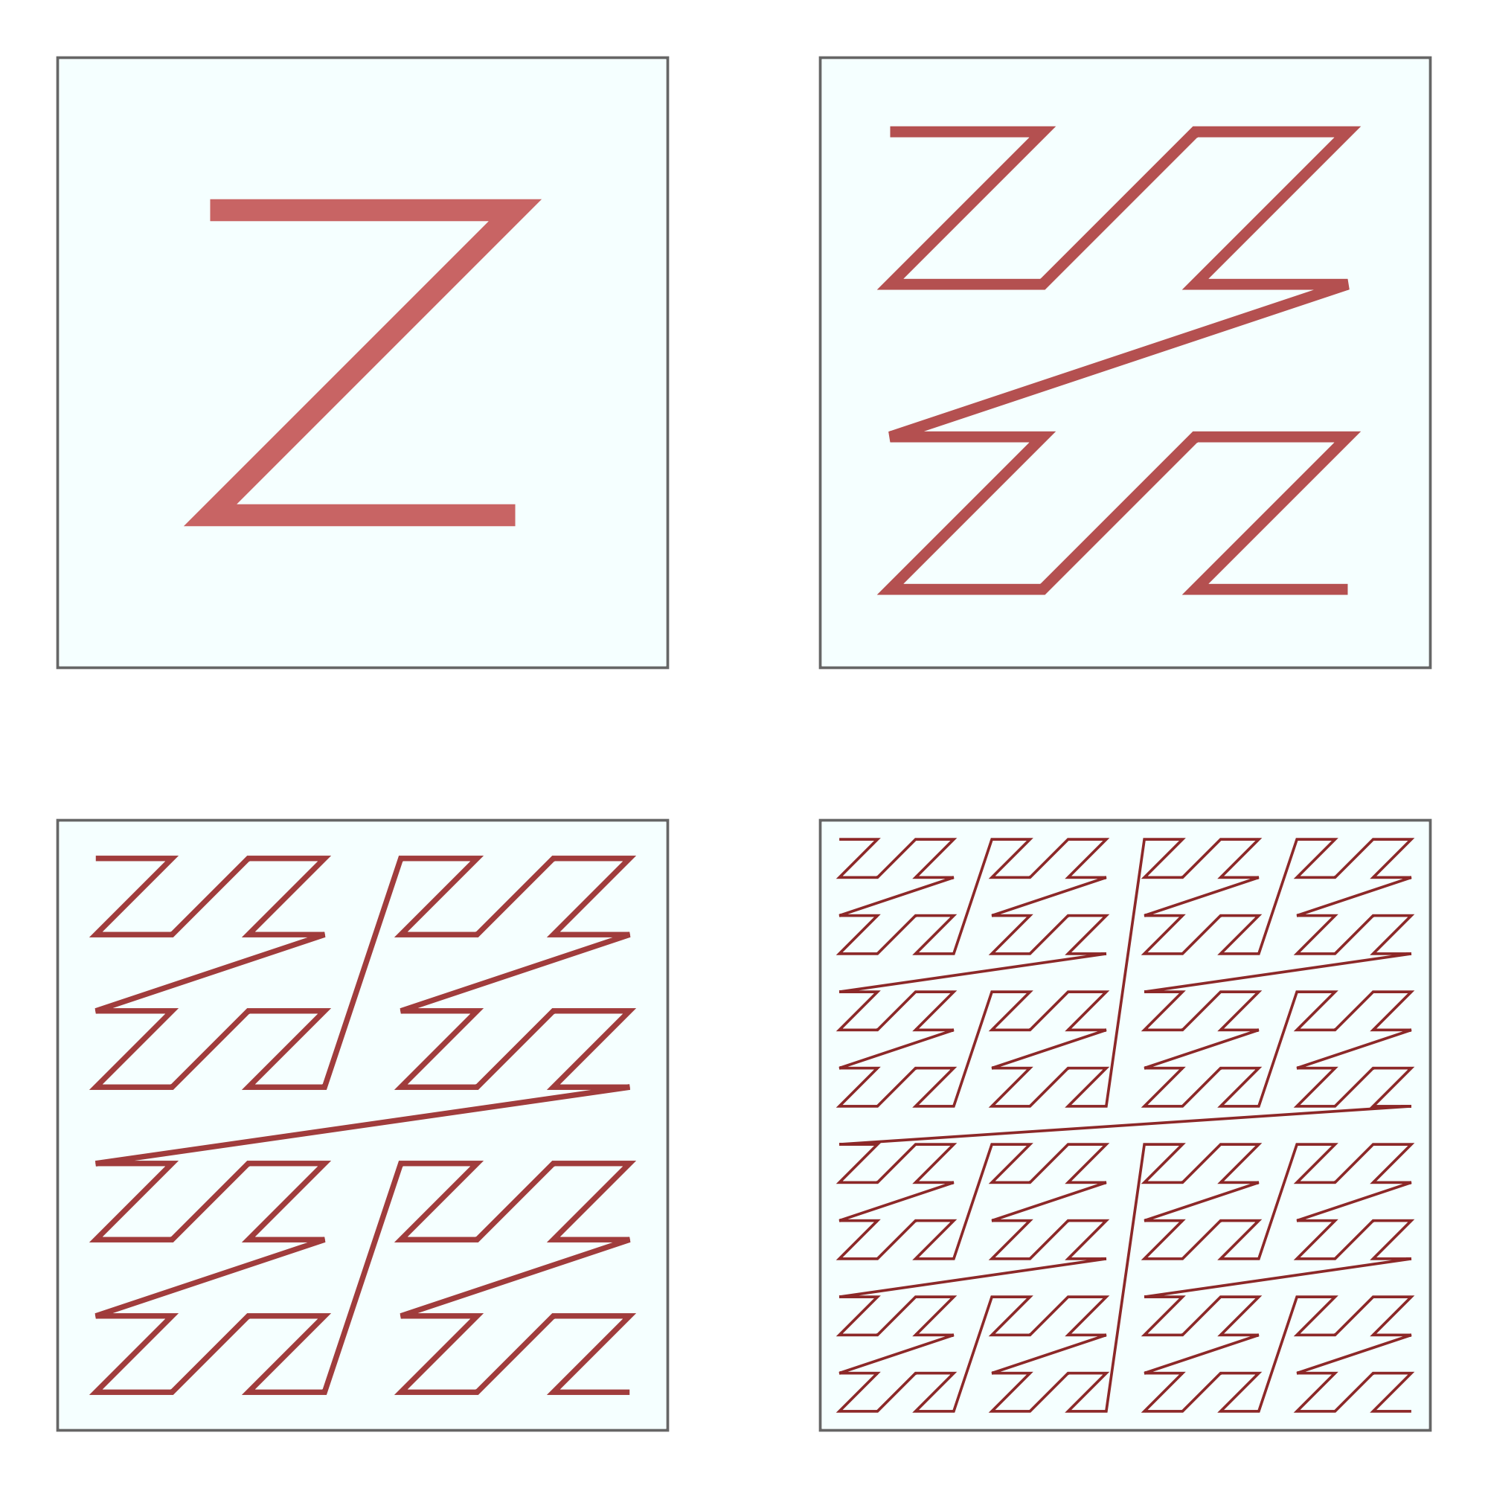
Z-Curves in larger spaces
Image source: wikipedia

Slide 44

Analytical Analysis of Z-Order curves
Confusion Matrix:
Precision:
$Precision =\frac{True Positive}{True Positive+False Positive}$
Recall:
$Recall =\frac{True Positive}{True Positive+False Negative}$
True Condition
Pos Neg
True Positive | False Positive
False Negative | True Negative
Predicted Condition
Neg Pos

Slide 45

Analytical Analysis of Z-Order curves
Confusion Matrix:
Precision:
$Precision =\frac{True Positive}{True Positive+False Positive}$
Recall:
$Recall =\frac{True Positive}{True Positive+False Negative}$
True Condition
Pos Neg
Thoughts on Precision and Recall of the initial step of previous range query algorithm?
True Positive | False Positive
False Negative | True Negative
Predicted Condition
Neg Pos

Slide 46
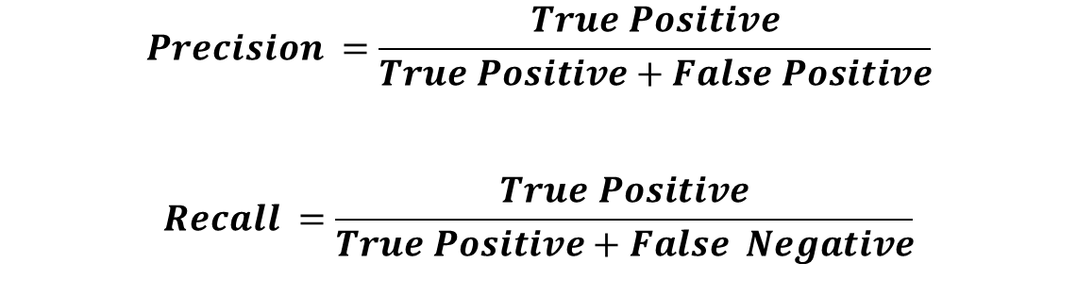
Analytical Analysis of Z-Order curves
$$Precision =\frac{True Positive}{True Positive+False Positive}$$
$$Recall =\frac{True Positive}{True Positive+False Negative}$$
B
A
Q
0 1 2 3
Thoughts on Precision and Recall of the first step of the range query algorithm?
C
0 1 2 3
Z-order: (0,0) (0,1) (1,0) (1,1) (0,2) (0,3) (1,2) (1,3) (2,0) (2,1) (3,0) (3,1) (2,2) (2,3) (3,2) (3,3)

Slide 47
Hilbert Curves
Step1: Read in the n-bit binary representation of the x and y coordinates.
Step 2: Interleave bits of the two binary numbers into one string
Step3: Divide the string into from left to right into 2-bit strings
Step4: Assign decimal values: “00” as 0; “01” as 1; “10” as 3; “11” as 2 and put into an array is the same order as the strings occurred.
Step5: For each number j in the array
  If j==0 then switch every following occurrence of 1 to 3 and vice-versa
  If j==3 then switch every following occurrence of 0 to 2 and vice-versa
Step6: Convert each number in the array to its binary representation (2-bit strings), concatenate from left to right and convert to decimal.

Slide 48
Hilbert Curves
(0,3) | (1,3) | (2,3) | (3,3)
(0,2) | (1,2) | (2,2) | (3,2)
(0,1) | (1,1) | (2,1) | (3,1)
(0,0) | (1,0) | (2,0) | (3,0)
B
A
0 1 2 3
C
0 1 2 3
0 1 2 3

Slide 49
Hilbert Curves (Step 1)
00 11 | 01 11 | 10 11 | 11 11
00 10 | 01 10 | 10 10 | 11 10
00 01 | 01 01 | 10 01 | 11 01
00 00 | 01 00 | 10 00 | 11 00
B
A
0 1 2 3
C
0 1 2 3
0 1 2 3
Write the X and Y coordinates in Binary Form

Slide 50
Hilbert Curves (Step 2)
00 11 | 01 11 | 10 11 | 11 11
00 10 | 01 10 | 10 10 | 11 10
00 01 | 01 01 | 10 01 | 11 01
00 00 | 01 00 | 10 00 | 11 00
0101 | 0111 | 1101 | 1111
0100 | 0110 | 1100 | 1110
0001 | 0011 | 1001 | 1011
0000 | 0010 | 1000 | 1010
0 1 2 3
0 1 2 3
0 1 2 3
0 1 2 3
Interleave them to create one string

Slide 51
Hilbert Curves (Step 3)
0101 | 0111 | 1101 | 1111
0100 | 0110 | 1100 | 1110
0001 | 0011 | 1001 | 1011
0000 | 0010 | 1000 | 1010
01 01 | 01 11 | 11 01 | 11 11
01 00 | 01 10 | 11 00 | 11 10
00 01 | 00 11 | 10 01 | 10 11
00 00 | 00 10 | 10 00 | 10 10
0 1 2 3
0 1 2 3
0 1 2 3
0 1 2 3
Divide the string into from left to right into 2-bit strings

Slide 52
Hilbert Curves (Step 4)
01 01 | 01 11 | 11 01 | 11 11
01 00 | 01 10 | 11 00 | 11 10
00 01 | 00 11 | 10 01 | 10 11
00 00 | 00 10 | 10 00 | 10 10
11 | 12 | 21 | 22
10 | 13 | 20 | 23
01 | 02 | 31 | 32
00 | 03 | 30 | 33
0 1 2 3
0 1 2 3
0 1 2 3
0 1 2 3
Assign decimal values: “00” as 0; “01” as 1; “10” as 3; “11” as 2

Slide 53
Hilbert Curves (Step 5)
11 | 12 | 21 | 22
10 | 13 | 20 | 23
01 | 02 | 31 | 32
00 | 03 | 30 | 33
11 | 12 | 21 | 22
10 | 13 | 20 | 23
03 | 02 | 31 | 30
00 | 01 | 32 | 33
0 1 2 3
0 1 2 3
0 1 2 3
0 1 2 3
  If j==0 then switch every following occurrence of 1 to 3 and vice-versa
  If j==3 then switch every following occurrence of 0 to 2 and vice-versa

Slide 54
Hilbert Curves (Step 6)
11 | 12 | 21 | 22
10 | 13 | 20 | 23
03 | 02 | 31 | 30
00 | 01 | 32 | 33
0101 | 0110 | 1001 | 1010
0100 | 0111 | 1000 | 1011
0011 | 0010 | 1101 | 1100
0000 | 0001 | 1110 | 1111
0 1 2 3
0 1 2 3
0 1 2 3
0 1 2 3
  Concatenate and Convert to Binary

Slide 55
Hilbert Curves (Step 6)
0101 | 0110 | 1001 | 1010
0100 | 0111 | 1000 | 1011
0011 | 0010 | 1101 | 1100
0000 | 0001 | 1110 | 1111
5 | 6 | 9 | 10
4 | 7 | 8 | 11
3 | 2 | 13 | 12
0 | 1 | 14 | 15
0 1 2 3
0 1 2 3
0 1 2 3
0 1 2 3
  Concatenate and Convert to Binary

Slide 56
Hilbert Curves (Step 6)
5 | 6 | 9 | 10
4 | 7 | 8 | 11
3 | 2 | 13 | 12
0 | 1 | 14 | 15
B
A
0 1 2 3
0 1 2 3
C
0 1 2 3
0 1 2 3
Hilbert-curve: (0,0) (1,0) (1,1) (0,1) (0,2) (0,3) (1,3) (1,2) (2,2) (2,3) (3,3) (3,2) (3,1) (2,1) (2,0) (3,0)

Slide 57
Hilbert Curves (Step 6)
5 | 6 | 9 | 10
4 | 7 | 8 | 11
3 | 2 | 13 | 12
0 | 1 | 14 | 15
B
A
0 1 2 3
0 1 2 3
C
0 1 2 3
0 1 2 3
Hilbert-curve: (0,0) (1,0) (1,1) (0,1) (0,2) (0,3) (1,3) (1,2) (2,2) (2,3) (3,3) (3,2) (3,1) (2,1) (2,0) (3,0)

Slide 58
Hilbert Curves Vs Z-Curves
5 | 6 | 9 | 10
4 | 7 | 8 | 11
3 | 2 | 13 | 12
0 | 1 | 14 | 15
5 | 7 | 13 | 15
4 | 6 | 12 | 14
1 | 3 | 9 | 11
0 | 2 | 8 | 10
0 1 2 3
0 1 2 3
0 1 2 3
0 1 2 3
Hilbert Curve
Z-ordering

Slide 59
Hilbert- curve: Range Query
B
5 | 6 | 9 | 10
4 | 7 | 8 | 11
3 | 2 | 13 | 12
0 | 1 | 14 | 15
A
Q
0 1 2 3
0 1 2 3
C
0 1 2 3
0 1 2 3
C
Hilbert-curver: (0,0) (1,0) (1,1) (0,1) (0,2) (0,3) (1,3) (1,2) (2,2) (2,3) (3,3) (3,2) (3,1) (2,1) (2,0) (3,0)
B
A
A
Need to pic min and max Hilbert curve values for this range !

Slide 60
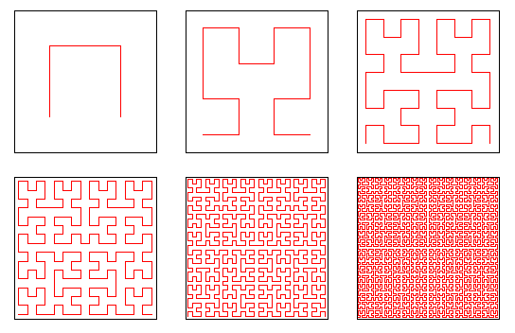
Hilbert Curves in larger spaces
Image source and more details at: http://www.bic.mni.mcgill.ca/~mallar/CS-644B/hilbert.html

Slide 61
Contemplating the Hilbert Curve Algo
Step1: Read in the n-bit binary representation of the x and y coordinates.
Step 2: Interleave bits of the two binary numbers into one string
Step3: Divide the string into from left to right into 2-bit strings
Step4: Assign decimal values: “00” as 0; “01” as 1; “10” as 3; “11” as 2 and put into an array is the same order as the strings occurred.
Step5: For each number j in the array
  If j==0 then switch every following occurrence of 1 to 3 and vice-versa
  If j==3 then switch every following occurrence of 0 to 2 and vice-versa
Step6: Convert each number in the array to its binary representation (2-bit strings), concatenate from left to right and convert to decimal.

Slide 62
Contemplating the Hilbert Curve Algo
01 01 | 01 11 | 11 01 | 11 11
01 00 | 01 10 | 11 00 | 11 10
00 01 | 00 11 | 10 01 | 10 11
00 00 | 00 10 | 10 00 | 10 10
11 | 12 | 21 | 22
10 | 13 | 20 | 23
01 | 02 | 31 | 32
00 | 03 | 30 | 33
0 1 2 3
0 1 2 3
0 1 2 3
0 1 2 3
Output after Step 4

Slide 63
Contemplating the Hilbert Curve Algo
Say we Skip Step 5 and Jump to step 6
01 01 | 01 10 | 10 01 | 10 10
01 00 | 01 11 | 10 00 | 10 11
00 01 | 00 10 | 11 01 | 11 10
00 00 | 00 11 | 11 00 | 11 11
11 | 12 | 21 | 22
10 | 13 | 20 | 23
01 | 02 | 31 | 32
00 | 03 | 30 | 33
0 1 2 3
0 1 2 3
0 1 2 3
0 1 2 3
Step 6: We convert nums to binary,
concatenate and then convert to decimal

Slide 64
Contemplating the Hilbert Curve Algo
Say we Skip Step 5 and Jump to step 6
01 01 | 01 10 | 10 01 | 10 10
01 00 | 01 11 | 10 00 | 10 11
00 01 | 00 10 | 11 01 | 11 10
00 00 | 00 11 | 11 00 | 11 11
5 | 6 | 9 | 10
4 | 7 | 8 | 11
1 | 2 | 13 | 14
0 | 3 | 12 | 15
0 1 2 3
0 1 2 3
0 1 2 3
0 1 2 3
Step 6: We convert nums to binary,
concatenate and then convert to decimal

Slide 65
Contemplating the Hilbert Curve Algo
Say we Skip Step 5 and Jump to step 6
01 01 | 01 10 | 10 01 | 10 10
01 00 | 01 11 | 10 00 | 10 11
00 01 | 00 10 | 11 01 | 11 10
00 00 | 00 11 | 11 00 | 11 11
5 | 6 | 9 | 10
4 | 7 | 8 | 11
1 | 2 | 13 | 14
0 | 3 | 12 | 15
0 1 2 3
0 1 2 3
0 1 2 3
0 1 2 3
Step 6: We convert nums to binary,
concatenate and then convert to decimal

Slide 66
Contemplating the Hilbert Curve Algo
5 | 6 | 9 | 10
4 | 7 | 8 | 11
3 | 2 | 13 | 12
0 | 1 | 14 | 15
5 | 6 | 9 | 10
4 | 7 | 8 | 11
1 | 2 | 13 | 14
0 | 3 | 12 | 15
0 1 2 3
0 1 2 3
0 1 2 3
0 1 2 3
Step 5 seems to be taking care of the rotation and the reflection of the basic shape inverted cup!!!

Slide 67
Addressing challenges of
2-Dimenions more directly

Slide 68
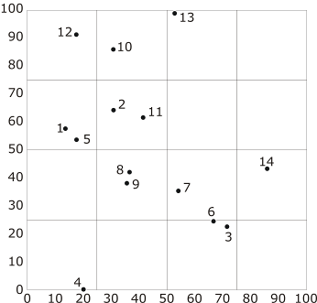
Grid Files
Basic idea- Divide space into cells by a grid
Store data in each cell in distinct disk page
A directory structure needed
Efficient for find, insert, range and nearest neighbor
May have wastage of disk storage space
Non-uniform data distribution over space ??

Slide 69
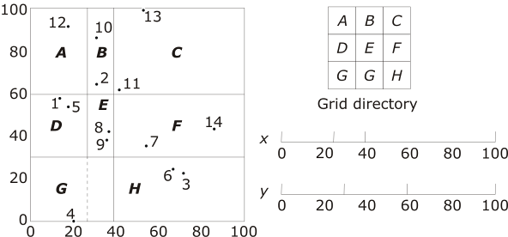
Grid Files
Refinement of basic idea into Grid Files
  Use non-uniform grids
  Linear scale store row and column boundaries
  Allow sharing of disk pages across grid cells

Slide 70
Grid Files (insertion example)
Capacity of bucket = 3
J. Nievergelt and H. Hinterberger. The Grid File: An Adaptable, Symmetric Multikey File Structure. ACM Transactions on Database Systems, Vol. 9, No. 1, March 1994

Slide 71
Grid Files (insertion example)
When the bucket overflows we split it.
A new bucket is made.
Records that lie in one half of the space are moved to the new bucket.
J. Nievergelt and H. Hinterberger. The Grid File: An Adaptable, Symmetric Multikey File Structure. ACM Transactions on Database Systems, Vol. 9, No. 1, March 1994

Slide 72
Grid Files (insertion example)
Bucket A overflows again.
J. Nievergelt and H. Hinterberger. The Grid File: An Adaptable, Symmetric Multikey File Structure. ACM Transactions on Database Systems, Vol. 9, No. 1, March 1994

Slide 73
Grid Files (insertion example)
Bucket A overflows again.
Very Imp: Splitting of A is full horizontal split, i.e., region of B is also split. But B was not overflowing, so both buckets still point to B only
J. Nievergelt and H. Hinterberger. The Grid File: An Adaptable, Symmetric Multikey File Structure. ACM Transactions on Database Systems, Vol. 9, No. 1, March 1994

Slide 74
Grid Files (insertion example)
Bucket A overflows again.
In Grid files, data space which are the buckets is different from the geographic spread of the data.
J. Nievergelt and H. Hinterberger. The Grid File: An Adaptable, Symmetric Multikey File Structure. ACM Transactions on Database Systems, Vol. 9, No. 1, March 1994

Slide 75
Grid Files (insertion example)
Bucket A overflows again.
Splits in any dimension are made through and trough out. This makes the task of maintain linear scales easy
J. Nievergelt and H. Hinterberger. The Grid File: An Adaptable, Symmetric Multikey File Structure. ACM Transactions on Database Systems, Vol. 9, No. 1, March 1994

Slide 76
Grid Files (insertion example)
One more split.
J. Nievergelt and H. Hinterberger. The Grid File: An Adaptable, Symmetric Multikey File Structure. ACM Transactions on Database Systems, Vol. 9, No. 1, March 1994

Slide 77
Grid Files (insertion example)
One more split.
Note that splits in any dimension are made through and trough.
J. Nievergelt and H. Hinterberger. The Grid File: An Adaptable, Symmetric Multikey File Structure. ACM Transactions on Database Systems, Vol. 9, No. 1, March 1994

Slide 78
Grid Files (Another example)
Assume Bucket size = 3
Y-axis
Bucket A
X-axis

Slide 79
Grid Files (Another example)
Assume Bucket size = 3
Y-axis
Bucket A
X-axis

Slide 80
Grid Files (Another example)
Assume Bucket size = 3
Overflow! Create a new bucket; Split both scales and the bucket
Y-axis
Bucket A
X-axis

Slide 81
Grid Files (Another example)
Assume Bucket size = 3
Bucket B
Y-axis
Bucket A
X-axis

Slide 82
Grid Files (Another example)
Assume Bucket size = 3
Bucket B
Y-axis
Bucket A
X-axis

Slide 83
Grid Files (Another example)
Assume Bucket size = 3
Overflow! Create a new bucket; Split both scales and the bucket.
Bucket B
Y-axis
Bucket A
X-axis

Slide 84
Grid Files (Another example)
Assume Bucket size = 3
Bucket C
Bucket B
Y-axis
Bucket A
X-axis

Slide 85
Grid Files (Another example)
Assume Bucket size = 3
Bucket C
Bucket B
Y-axis
Bucket A
X-axis

Slide 86
Grid Files (Another example)
Assume Bucket size = 3
Overflow! Create a new bucket. Split bucket A.
Bucket C
Bucket B
Y-axis
Bucket A
X-axis

Slide 87
Grid Files (Another example)
Assume Bucket size = 3
Bucket C
Bucket B
Y-axis
Bucket A
Bucket D
X-axis

Slide 88
Grid Files (Another example)
Assume Bucket size = 3
Overflow! Create a new bucket; Split both scales and the bucket.
Bucket C
Bucket B
Y-axis
Bucket A
Bucket D
X-axis

Slide 89
Grid Files (Another example)
Assume Bucket size = 3
Bucket C
Bucket B
Y-axis
Bucket A
Bucket D
X-axis
Bucket E

Slide 90
Grid Files (Splitting Policies)
Splits:
  Can happen during insertion.
  Overflow of a bucket corresponding to a grid partition leads to a split.
  Can also happen if bucket containing records from several grid partition fills up.
  Splitting dimension can be changed alternatively.
  Splitting point may not always be the middle point, other algorithms are also possible.
J. Nievergelt and H. Hinterberger. The Grid File: An Adaptable, Symmetric Multikey File Structure. ACM Transactions on Database Systems, Vol. 9, No. 1, March 1994

Slide 91
Grid Files (Querying example)
X-partitions (0,1000,1500,1750,1875,2000)
Y-partitions (a, f, k, p, z).
Query
1 bucket
J. Nievergelt and H. Hinterberger. The Grid File: An Adaptable, Symmetric Multikey File Structure. ACM Transactions on Database Systems, Vol. 9, No. 1, March 1994

Slide 92
Grid Files (Querying example)
X-partitions (0,1000,1500,1750,1875,2000)
Y-partitions (a, f, k, p, z).
Query
Say this is one bucket
J. Nievergelt and H. Hinterberger. The Grid File: An Adaptable, Symmetric Multikey File Structure. ACM Transactions on Database Systems, Vol. 9, No. 1, March 1994

Slide 93
Grid Files (Querying example)
Thoughts on Precision and Recall of the initial step of this algorithm?
X-partitions (0,1000,1500,1750,1875,2000)
Y-partitions (a, f, k, p, z).
Query
Say this is one bucket
J. Nievergelt and H. Hinterberger. The Grid File: An Adaptable, Symmetric Multikey File Structure. ACM Transactions on Database Systems, Vol. 9, No. 1, March 1994

Slide 94
Grid Files (Merging Policies)
Merging:
  Happens when data is being deleted.
  Buckets may be merged in case of underflow.
  Multiple policies can be developed for merging.
  Details beyond the scope of this course.
  Interested readers can refer the paper for details.
J. Nievergelt and H. Hinterberger. The Grid File: An Adaptable, Symmetric Multikey File Structure. ACM Transactions on Database Systems, Vol. 9, No. 1, March 1994

