Slide 1
Introduction to Spatial Computing CSE 555
Spatial Indexing Techniques for Secondary Memory
Some slides adapted from Spatial Databases: A Tour by Shashi Shekhar Prentice Hall (2003)

Slide 2
R-Trees and its Variants

Slide 3
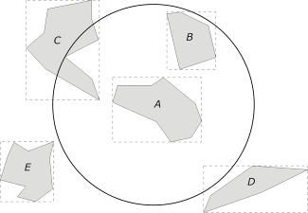
Rectangles and Minimum Bounding Boxes
Minimum bounding box (MBB/MBR): the smallest rectangle bounding a shape with its axes parallel to the sides of the Cartesian frame
Using MBB, some queries may be answered without retrieving the geometry of an object.
Some slides borrowed from “GIS a computational perspective: second edition” by M. Worboys CRC press 2004.

Slide 4
R-tree Properties and Invariants
Balanced (similar to B+ tree)
I is an n-dimensional rectangle of the form (I₀, I₁, ... , I_{n-1}) where I_{i} is a range [a,b] ∈[-∞,∞]
Leaf node index entries: (I, tuple_id)
Non-leaf node entry: (I, child_ptr)
M is maximum entries per node.
m ≤ M/2 is the minimum entries per node.
Antonin Guttman. 1984. R-trees: a dynamic index structure for spatial searching. In Proceedings of the 1984 ACM SIGMOD international conference on Management of data (SIGMOD '84)

Slide 5
R-tree Properties and Invariants
Every leaf (non-leaf) has between m and M records (children) except for the root.
Root has at least two children unless it is a leaf.
For each leaf (non-leaf) entry, I is the smallest rectangle that contains the data objects (children).
All leaves appear at the same level.
Antonin Guttman. 1984. R-trees: a dynamic index structure for spatial searching. In Proceedings of the 1984 ACM SIGMOD international conference on Management of data (SIGMOD '84)

Slide 6
R-tree – Searching Algorithm
Given a search rectangle S (or a geometry).
Start at root and locate all child nodes whose rectangle I intersects S (via linear search).
Search the subtrees of those child nodes.
When you get to the leaves, return entries whose rectangles intersect S.
Searches may require inspecting several paths.
Worst case running time is not so good.

Slide 7
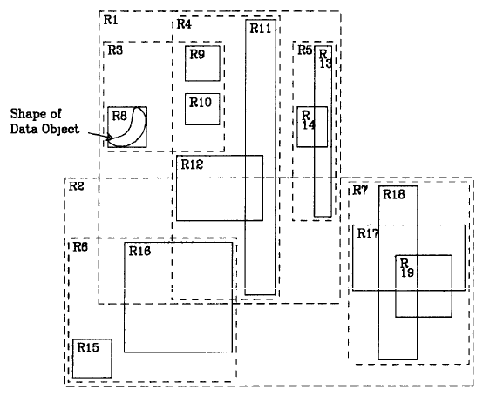
R-tree – Example (1/2)
Find all rectangles which contains this query point
Antonin Guttman. 1984. R-trees: a dynamic index structure for spatial searching. In Proceedings of the 1984 ACM SIGMOD international conference on Management of data (SIGMOD '84)

Slide 8
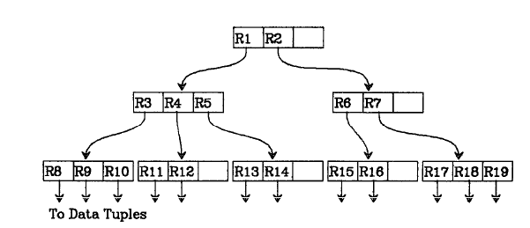
R-tree – Example (2/2)
The query point sits in rectangles R11 and R14
Antonin Guttman. 1984. R-trees: a dynamic index structure for spatial searching. In Proceedings of the 1984 ACM SIGMOD international conference on Management of data (SIGMOD '84)

Slide 9
R-tree – Insertion Algorithm (1/2)
Traverse the tree top down, starting from the root.
At each level:
If there is a node whose directory rectangle contains the MBB to be inserted, then search the subtree.
Else choose a node such that enlargement of its directory rectangle is minimal, then search the subtree.
If more than one node satisfy this, then choose the one with the smallest area.
Repeat until a leaf node is reached.

Slide 10
R-tree – Insertion Algorithm (2/2)
At leaf level:
If the leaf node is not full then an entry [MBB, object-id] is inserted.
Else //the leaf node is full
Split the leaf node.
Update the directory rectangles of the ancestor nodes if necessary.

Slide 11
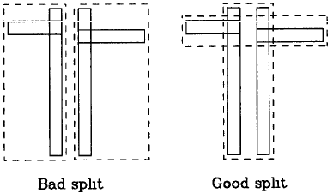
R-tree – Node Splitting
Problem: Divide M+1 entries among two nodes so that it is unlikely that the nodes are needlessly examined during a search.
Objective: Minimize total area of the covering rectangles for both nodes.
Exponential algorithm.
Quadratic algorithm.
Linear time algorithm.

Slide 12
R-tree – Node Splitting: Exponential Algorithm
Problem: Divide M+1 entries among two nodes so that it is unlikely that the nodes are needlessly examined during a search.
Solution: Minimize total area of the covering rectangles for both nodes.
Exponential algorithm
Try all possible combinations.
Optimal results!
Bad running time!

Slide 13
R-tree – Node Splitting: Quadratic Algorithm
Problem: Divide M+1 entries among two nodes so that it is unlikely that the nodes are needlessly examined during a search.
Solution: Minimize total area of the covering rectangles for both nodes.
Quadratic algorithm
Find pair of entries E₁ and E₂ that maximizes area(J) - area(E₁) - area(E₂) where J is covering rectangle. J is the MBR containing only E1 and E2
Put E₁ in one group, E₂ in the other.
If one group has M-m+1 entries, put the remaining entries into the other group and stop. If all entries have been distributed then stop.
For each entry E, calculate d₁ and d₂ where d_{i} is the minimum area increase in covering rectangle of the group when E is added.
Find E with maximum |d₁ - d₂| and add E to the group whose area will increase the least. If tied: (a) choose smaller area, (b) choose smaller group
Repeat starting with step 3.

Slide 14
R-tree – Tree Adjustment during overflow
N = leaf node. If there was a split, then NN is the other node.
If N is root, stop. Otherwise P = N’s parent and E_{N} is its entry for N. Adjust the rectangle for E_{N} to tightly enclose new N.
If NN exists (i.e., N was split and NN is its second MBB from split), add entry E_{NN} (MBB corresponding to NN) to P. E_{NN} points to NN and its MBB rectangle tightly encloses NN.
If necessary, split P
Set N=P and go to step 2.
Antonin Guttman. 1984. R-trees: a dynamic index structure for spatial searching. In Proceedings of the 1984 ACM SIGMOD international conference on Management of data (SIGMOD '84)

Slide 15
R-tree – Example (1/2)
Antonin Guttman. 1984. R-trees: a dynamic index structure for spatial searching. In Proceedings of the 1984 ACM SIGMOD international conference on Management of data (SIGMOD '84)

Slide 16
R-tree – Example (2/2)
Antonin Guttman. 1984. R-trees: a dynamic index structure for spatial searching. In Proceedings of the 1984 ACM SIGMOD international conference on Management of data (SIGMOD '84)

Slide 17
R-tree – Insertion Example
Nw
Insert the new data point Nw into the R-tree shown
Antonin Guttman. 1984. R-trees: a dynamic index structure for spatial searching. In Proceedings of the 1984 ACM SIGMOD international conference on Management of data (SIGMOD '84)

Slide 18
R-tree – Insertion Example
Nw
Nw goes here creating an overflow
Antonin Guttman. 1984. R-trees: a dynamic index structure for spatial searching. In Proceedings of the 1984 ACM SIGMOD international conference on Management of data (SIGMOD '84)

Slide 19
R-tree – Insertion Example
Nw
Nw goes here creating an overflow

Slide 20
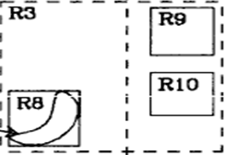
R-tree – Example Splitting R3
Nw

Slide 21
R-tree – Example Splitting R3: Step 1
Nw

Slide 22
R-tree – Example Splitting R3: Step 2
Nw

Slide 23
R-tree – Example Splitting R3: Step 3
Nw

Slide 24
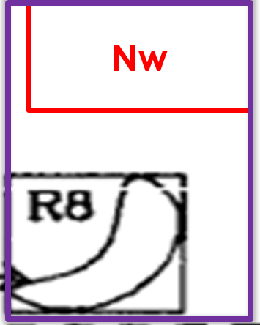
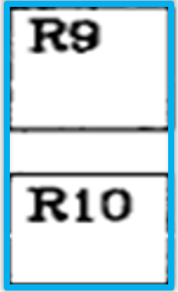
R-tree – Example Splitting R3
R3
R3’’

Slide 25
R-tree – Example Adjusting the tree
M =3 m =2
R3
R4
R5
Nw
R8
R9
R10

Slide 26
R-tree – Example Adjusting the tree
M =3 m =2
R3
R4
R5
R3’’ should go into this
Nw
R8
R9
R10

Slide 27
R-tree – Example Adjusting the tree
M =3 m =2
Overflow: This should be split
R3
R3’’
R4
R5
Nw
R8
R9
R10

Slide 28
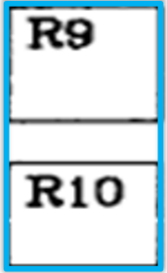
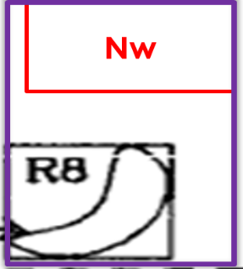
R-tree – Example Splitting R3 R3’’ R4 and R5
R3
R3’’

Slide 29
R-tree – Example Splitting R3 R3’’ R4 and R5
R3’’
R4
R3
R5

Slide 30
R-tree – Example Splitting R3 R3’’ R4 and R5
R4
R3
R3’’
R5

Slide 31
R-tree – Example Splitting R3 R3’’ R4 and R5
R3’’
R4
R3
R5

Slide 32
R-tree – Example Splitting R3 R3’’ R4 and R5
R1’
R4
R1
R5
R3
R3’’

Slide 33
R-tree – Example Adjusting the tree
M =3 m =2
R1
R2
R3
R3’’
R4
R5
Overflow: This was split
Nw
R8
R9
R10

Slide 34
R-tree – Example Adjusting the tree
M =3 m =2
R1
R1’
R2
R3
R3’’
R4
R5

Slide 35
R-tree – Node Splitting: Quadratic Algorithm Example
P3
P2
P6
M = 6
m = 3
P7
P4
P1
P5
Node to be Split

Slide 36
R-tree – Node Splitting: Quadratic Algorithm Step 1
P3
P2
P6
M = 6
m = 3
P7
P4
P1
P5
Node to be Split

Slide 37
R-tree – Node Splitting: Quadratic Algorithm Step 2
P3
P2
P6
M = 6
m = 3
P7
P4
P1
P5
Node to be Split

Slide 38
R-tree – Node Splitting: Quadratic Algorithm Step 3
P3
P2
P6
M = 6
m = 3
P7
P4
P1
P5
Node to be Split

Slide 39
R-tree – Node Splitting: Quadratic Algorithm Step 4
P3
P2
P6
M = 6
m = 3
P7
P4
P1
P5
Node to be Split

Slide 40
R-tree – Node Splitting: Quadratic Algorithm Step 5
P3
P2
P6
M = 6
m = 3
P7
P4
P1
P5
Node to be Split

Slide 41
R-tree – Node Splitting: Quadratic Algorithm Step 6
P3
P2
P6
M = 6
m = 3
P7
P4
P1
P5
Node to be Split

