Slide 1
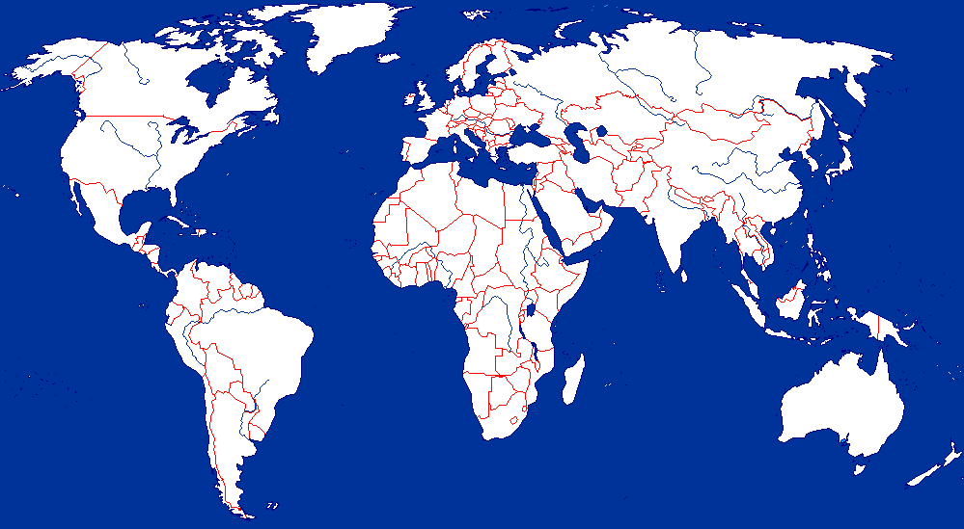
Strategies for Spatial Joins
Recall Spatial Join Example:
List all pairs of overlapping rivers and countries.
Return pairs from “rivers” table and “countries” table satisfying the “overlap” predicate.

Slide 2
Strategies for Spatial Joins - Continued
List of strategies
Nested loop:
Test all possible pairs for spatial predicate
All rivers are paired with all countries
Space Partitioning:
Test pairs of objects from common spatial regions only
Rivers in Africa are tested with countries in Africa only
Tree Matching
Hierarchical pairing of object groups from each table
Other, e.g. spatial-join-index based, external plane-sweep, …

Slide 3
Spatial Join – Running Examples
Fire station map
House map
Overlay & spatial join
B
c
c
B
a
d
a
d
A
f
A
f
b
e
b
e
C
C
h
i
k
h
i
k
D
g
j
l
g
D
j
l
Fire-stations
Houses
Results:
Query:
For each fire station, find all the houses within a distance <= 1
Fire-stations | Houses
A | a
B | f
D | h
D | j

Slide 4
Nested loop
Query:
For each fire station, find all the houses within a distance <= 1
B
Suppose: 1) each data block has 2 points
A
2) the size of memory buffer is 3 blocks
(i.e., 1 for fire-stations, 1 for houses, 1 for results)
C
Algorithm:
For each block B_{fs} of fire stations
D
For each block B_{h} of houses
Data block 0
Data block 1
Scan all pairs of fire stats in B_{fs} and houses in B_{h}
Fire-stations
Houses
c
a
d
f
b
e
h
i
k
g
j
l
Data block 2
Data block 3
Data block 4
3
Data block 5
Data block 6
Data block 7

Slide 5
Nested loop
Query:
For each fire station, find all the houses within a distance <= 1
B
Suppose: 1) each data block has 2 points
A
2) the size of memory buffer is 3 blocks
(i.e., 1 for fire-stations, 1 for houses, 1 for results)
C
Algorithm:
For each block B_{fs} of fire stations
D
For each block B_{h} of houses
Data block 0
Data block 1
Scan all pairs of fire stats in B_{fs} and houses in B_{h}
Fire-stations
Houses
For Block 0, traverse through Blocks 2-7
For Block 1, traverse through Blocks 2-7
c
Cost:
a
# blocks for fire stations * # blocks for houses = 2*6 = 12
d
f
b
e
Fire stations
h
i
k
Houses
g
j
l
Data block 2
Data block 3
Data block 4
3
Data block 5
Data block 6
Data block 7

Slide 6
Nested loop with Index for Inner Loop
Query:
For each fire station, find all the houses within a distance <= 1
B
A
C
Suppose an R-tree (primary index) is available for the houses.
D
Data block 0
Data block 1
X
c
X | Y
a
d
f
b
e
h
i
k
a | b
c | e
d | f
g | h
i | j
k | l
Y
g
j
l
Data block 2
Data block 3
Data block 4
3
Data block 5
Data block 6
Data block 7

Slide 7
Nested loop with Index for Inner Loop
Query:
For each fire station, find all the houses within a distance <= 1
B
A
C
For each block of fire stations, create MOBR with length of 1.
D
Data block 0
Data block 1
X
c
a
d
f
b
e
h
i
k
Y
g
j
l
Data block 2
Data block 3
Data block 4
3
Data block 5
Data block 6
Data block 7

Slide 8
Nested loop with Index for Inner Loop
Query:
For each fire station, find all the houses within a distance <= 1
B
A
C
For each block of fire stations, create MBR with length of 1.
D
Data block 0
Data block 1
Algorithm:
For each MBR M_{fs} of fire-station blocks
X
c
Find overlapped blocks in the R-tree
a
d
f
b
e
h
i
k
Y
g
j
l
Data block 2
Data block 3
Data block 4
3
Data block 5
Data block 6
Data block 7

Slide 9
Nested loop with Index for Inner Loop
Query:
For each fire station, find all the houses within a distance <= 1
B
A
C
Algorithm:
For each MBR M_{fs} of fire-station blocks
Find overlapped blocks in the R-tree
D
Data block 0
Data block 1
Block 0:
Root -> X -> , -> leaf objs
-> Y -> , -> leaf objs
X
c
a
d
f
b
e
X | Y
h
i
k
Y
g
j
l
Data block 2
Data block 3
Data block 4
a | b
c | e
d | f
g | h
i | j
k | l
3
Data block 5
Data block 6
Data block 7

Slide 10
Nested loop with Index for Inner Loop
Query:
For each fire station, find all the houses within a distance <= 1
B
A
C
Algorithm:
For each MBR M_{fs} of fire-station blocks
Find overlapped blocks in the R-tree
D
Data block 0
Data block 1
Block 1:
Root -> X -> -> leaf objs
-> Y -> , -> leaf objs
X
c
a
d
f
b
e
X | Y
h
i
k
Y
g
j
l
Data block 2
Data block 3
Data block 4
a | b
c | e
d | f
g | h
i | j
k | l
3
Data block 5
Data block 6
Data block 7

Slide 11
Tree Matching strategy
Query:
For each fire station, find all the houses within a distance <= 1
B
A
Suppose an R-tree (primary index) is available for fire stations and houses, respectively.
C
D
Data block 0
Data block 1
A | D
B | C
X
c
a
d
f
b
e
X | Y
h
i
k
Y
g
j
l
Data block 2
Data block 3
Data block 4
a | b
c | e
d | f
g | h
i | j
k | l
3
Data block 5
Data block 6
Data block 7

Slide 12
Tree Matching strategy
Query:
For each fire station, find all the houses within a distance <= 1
B
A
Suppose an R-tree (primary index) is available for fire stations and houses, respectively.
C
Algorithm:
D
Tree Match(Rtree1 node1, Rtree2 node2)
Data block 0
Data block 1
For all MBR M2 of R-tree2 node2
For all MBR M1 of R-tree1 node1
IF (if mindist(M2,M1) =< 1)
If (node1 and node2 are leaves)
<perform the join>
Else if (node1 is leaf page)
Read child of M2
Tree Match (node1, M2.child)
Else if(node2 is a leaf page)
………..
X
c
a
d
f
b
e
h
i
k
Y
g
j
l
Data block 2
Data block 3
Data block 4
3
Data block 5
Data block 6
Data block 7

Slide 13
Tree Matching strategy
Query:
For each fire station, find all the houses within a distance <= 1
B
A
Suppose an R-tree (primary index) is available for fire stations and houses, respectively.
C
D
Data block 0
Data block 1
A | D
B | C
X
c
a
d
f
b
e
X | Y
h
i
k
Y
g
j
l
Data block 2
Data block 3
Data block 4
a | b
c | e
d | f
g | h
i | j
k | l
3
Data block 5
Data block 6
Data block 7

Slide 14
Partitioning based strategy
P₀
P₁
Partition the study area into 2 * 2 = 4 partitions, P₀, P₁, P₂, P₃
B
A
For fire station, create MBR with length of 1.
C
Partitioning results:
D
P₂
P₃
Partition | Fire-Stations | Houses
P₀ | A | a, b, c, e
P₁ | B, C | d, f
P₂ | D | g, h, j
P₃ | C | i, k, l
Data block 0
Data block 1
P₀
P₁
c
a
d
f
b
e
MBR of C in both P₁ and P₃ since it overlaps both partitions.
h
i
k
g
j
l
Data block 2
Data block 3
Data block 4
3
P₂
P₃
Data block 5
Data block 6
Data block 7

Slide 15
Partitioning based strategy
Query:
For each fire station, find all the houses within a distance <= 1
P₀
P₁
B
A
Algorithm:
For each partition P_{i}
For each MOBR M_{fs} of fire-station in P_{i}
Find all the houses in P_{i} that are overlapped with M_{fs}
C
D
P₂
P₃
Data block 0
Fire-stations
P₀
P₁
c
B
Results from filter phase:
A
Partition | MOBR | Houses overlapped
a
d
f
e
P₀
A a, b, c, e
b
C
B f
C d, f
P₁
h
i
k
g
D
P₂
D h, j
j
l
P₃
Data block 2
Data block 4
C i, k
3
Data block 3
P₂
P₃
Data block 5
Data block 6
Data block 7

Slide 16
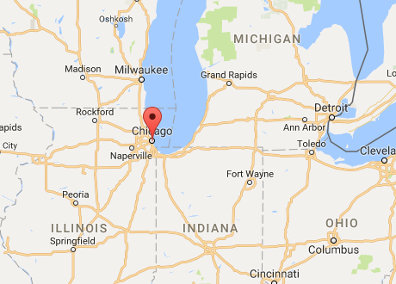
Strategies for 1-Nearest Neighbor Queries
Sector
Recall Nearest Neighbor Example
Find the city closest to Chicago.
Return one spatial object from datafile C
List of strategies
Two phase approach
Fetch C’s disk sector(s) containing the location Chicago
M = minimum distance(Chicago, cities in fetched sectors)
Test all cities within distance M of Chicago (Range Query)
Single phase approach
Recursive algorithm for R-tree
First get the closest data point
Then eliminate objects based on mindist to MBRs
Similar to K-NN algorithm on KD-trees

Slide 17
Two Phase Approach
X
c
Given the location of a user p, find the nearest restaurant.
(If more than one nearest neighbors, return all results)
a
d
f
b
e
h
i
k
Y
j
l
Suppose R-tree (primary index) is available on this dataset
g
p
3
Restaurants
User
X | Y
a | b
c | e
d | f
g | h
i | j
k | l

Slide 18
Two Phase Approach
Given the location of a user p, find the nearest restaurant.
(If more than one nearest neighbors, return all results)
X
c
a
d
Algorithm:
f
b
e
Find the index leaf containing the query point p
Point g, h are the closest points to p,
h
i
k
Y
j
l
g
p
3
Restaurants
User
X | Y
a | b
c | e
d | f
g | h
i | j
k | l

Slide 19
Two Phase Approach
Given the location of a user p, find the nearest restaurant.
(If more than one nearest neighbors, return all results)
X
c
a
d
Algorithm:
f
b
e
Find the index leaf containing the query point p
Point g, h are the closest points to p at distance d_{B}
h
i
k
Create a circle Circle_{p} whose center is p, and radius = d_{B}
Y
j
l
Create the MOBR of Circle_{p} : M_{p}
g
p
Range query: M_{p}, and test all points in M_{p}
Root -> Y -> leaves containing <g,h> and <j,i>
3
Since dist(p, j) = 1.41 < D_{B}, point j is nearest neighbor of p
Restaurants
User
X | Y
a | b
c | e
d | f
g | h
i | j
k | l

Slide 20
One Phase Approach – Recursive search on R-tree
Given the location of a user p, find the nearest restaurant.
(If more than one nearest neighbors, return all results)
X
c
a
d
f
Algorithm:
Node | MinDist | MaxDist
b
e
First level:
X 3 7.47
Nothing X eliminated
h
i
k
Y 0 4.47
Nothing eliminated
Y
j
l
Second level:
3.16 4.12
g
p
3.16 5.10
3
4.47
Node eliminated
0 2.83
1.41 2.83
3.16
Node eliminated
In the first part of the algorithm we get that
Point g, h are the closest points to p, distance = 2

