Slide 1
Introduction to Spatial Computing CSE 5ISC
Spatial Networks
Some slides adapted from Shashi Shekhar, University of Minnesota

Slide 2
Evacuation Route Planning

Slide 3
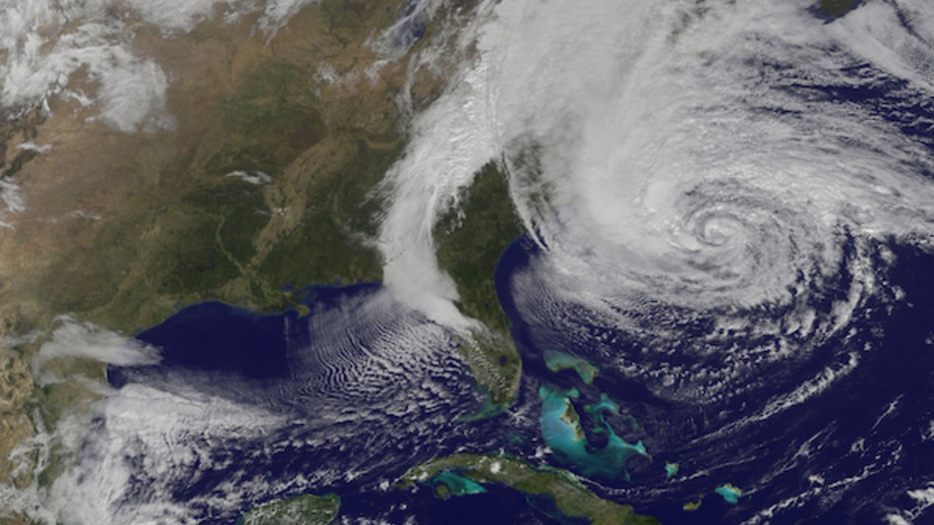
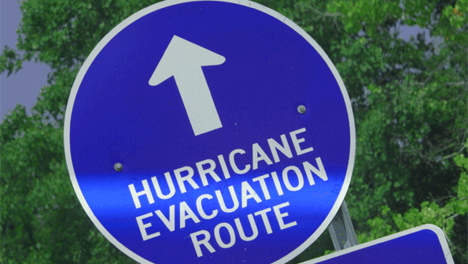
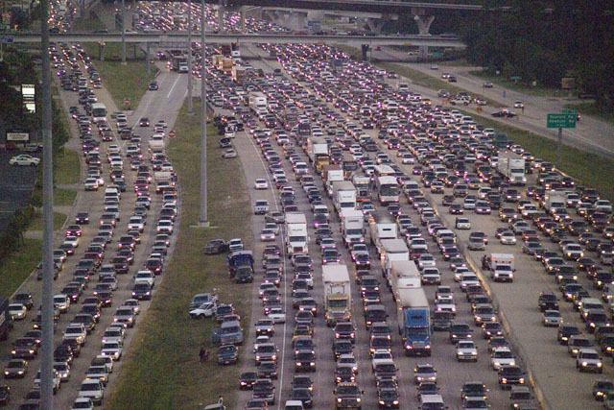
Motivational Scenarios
Large Scale evacuation due to Natural Events
    E.g., hurricane evacuations
Evacuation scenarios for cities with nuclear power plants
Other scenarios
  E.g., Building evacuations and other places of large gatherings e.g., Hajj
Hurricane Sandy New York 2012

Slide 4
Problem Definition
Given
  A transportation network represented as a spatial network (G= (N,E)) with
  Capacity constraint for each edge and node
  Travel time for each edge
  Number of evacuees and their initial locations
  Evacuation destinations
Output
  Evacuation plan consisting of a set of origin-destination routes
  and a scheduling of evacuees on each route.
Objective
  Minimize evacuation egress time
  Which is time from start of evacuation to last evacuee reaching a destination
Constraints
  Route scheduling should observe capacity constraints of network
  Reasonable computation time despite limited computer memory
  Capacity constraints and travel times are non-negative integers
  Evacuees start from and end up at nodes

Slide 5
A Note on Objective Function
Why minimize evacuation time?
  Reduce exposure time to evacuees
  Since harm due to many hazards increase with exposure time!
Why minimize computation time ?
  During Evacuation
    Unanticipated events
      Bridge Failure due to Katrina, 100-mile traffic jams due to Rita
    Plan new evacuation routes to respond to events
    Contra-flow based plans, i.e., reverse lane directions based on needs
  During Planning
    Explore a large number of scenarios Based on
    Transportation Modes
    Event location and time

Slide 6
Interpreting the notion of Capacity
Capacity of an edge can be interpreted in two ways.
The algorithm still holds in applicability,
But of course the final answer (evacuation schedules) would be different.
Following are two ways to interpret capacity:
  (1) Capacity as “number of lanes in the road”
    Here capacity denotes the number of people who can start off a particular point at the same time.
    You also need a “lag parameter” which denotes the lag after which next batch of people can be sent out. In these slides lag param is 1 time unit.
  (2) Total number of people that are going to occupy the road for a certain duration
    If capacity is 10 and stated duration is 5 mins.
    Then it means that if we send out 10 people at t=0, we cannot send more people until t=5.
    This is interpretation can be derived from (1) though integration and some assumptions.

Slide 7
Sample Input
N1, 50 (10)
(7,1)
N4, 8
(3,3)
N3, 30
(3,3)
N5, 6
(7,1)
(5,4)
N2, 50 (5)
(3,4)
N6, 10
N7, 8
N9, 25
(5,5)
(6,4)
(3,5)
N13
N10, 30
(14,4)
(6,4)
N11, 8
(8,1)
N8, 65
(15)
(6,3)
(3,3)
(3,2)
N14
(6,4)
N12, 18
(3,3)

Slide 8
Evacuation Plan for Input on Previous Slide
Image Courtesy: Shashi Shekhar, UMN

Slide 9
N1, 50 (10)
(7,1)
N4, 8
(3,3)
N3, 30
(3,3)
N5, 6
(7,1)
(5,4)
N2, 50 (5)
(3,4)
N6, 10
N7, 8
N9, 25
(5,5)
(6,4)
(3,5)
N13
N10, 30
(14,4)
(6,4)
N11, 8
(8,1)
N8, 65
(15)
(6,3)
(3,3)
(3,2)
N14
(6,4)
N12, 18
(3,3)

Slide 10
N1, 50 (10)
Start At T=0
(7,1)
N4, 8
(3,3)
N3, 30
(3,3)
N5, 6
(7,1)
(5,4)
N2, 50 (5)
(3,4)
N6, 10
N7, 8
N9, 25
(5,5)
(6,4)
(3,5)
N13
(14,4)
(6,4)
N10, 30
N8, 25
(9) A 6
N11, 8
(8,1)
(6,3)
(3,3)
(3,2)
N14
(6,4)
N12, 18
(3,3)

Slide 11
N1, 50 (10)
Curr time = 3
(7,1)
N4, 8
(3,3)
N3, 30
(3,3)
N5, 6
(7,1)
(5,4)
N2, 50 (5)
(3,4)
N6, 10
N7, 8
N9, 25
(5,5)
(6,4)
(3,5)
N13
(14,4)
N10, 30
A 6
(6,4)
N11, 8
(8,1)
N8, 65
(11)
(6,3)
(3,3)
(3,2)
N14
(6,4)
N12, 18
(3,3)

Slide 12
N1, 50 (10)
Curr time = 4
(7,1)
N4, 8
(3,3)
N3, 30
(3,3)
N5, 6
(7,1)
(5,4)
N2, 50 (5)
(3,4)
N6, 10
N7, 8
N9, 25
(5,5)
(6,4)
(3,5)
N13
A 6
(14,4)
N10, 30
(6,4)
N11, 8
(8,1)
N8, 65
(11)
(6,3)
(3,3)
(3,2)
N14
(6,4)
N12, 18
(3,3)

Slide 13
Limitations of Previous Works
A. Capacity-ignorant Approach
- Simple shortest path computation, e.g. A*, Dijktra’s, etc.
- e.g. EXIT89 (National Fire Protection Association)
Limitation: Poor solution quality as evacuee population grows
B. Operations Research: Time-Expanded Graph + Linear Programming
- Optimal solution, e.g. EVACNET (U. FL), Hoppe and Tardos (Cornell U).
Limitation: - High computational complexity => Does not scale to large problems
- Users need to guess an upper bound on evacuation time
Inaccurate guess => either no solution or increased computation cost!
C. Transportation Science: Dynamic Traffic Assignment
- Game Theory: Wardrop Equilibrium, e.g. DYNASMART (FHWA), DYNAMIT(MIT)
Limitation: Extremely high compute time
- Is Evacuation an equilibrium phenomena?

Slide 14
Capacity Constrained Route Planer (CCRP)
Key Ideas for CCRP
Time-series attributes
  Available_Node_Capacity (Ni , t)
  = #additional evacuees that can stay at node Ni at time t
  Available_Edge_Capacity (Ni -Nj , t)
  = #additional evacuess that may travel via edge Ni -Nj at time t
Generalize shortest path algorithms to
  ■ Honor capacity constraints
  ■ Spread people over space and time

Slide 15
Capacity Constrained Route Planer (CCRP)
While (any source node has evacuees) do
Step 1: Find nearest pair (Source S, Destination D), based on current available capacity of nodes and edges. Note that this is the path with the earliest arrival time at a destination (starting from t=0). Also it may happen that people may have to wait at source to get the path with earliest arrival at destination.
Step 2: Compute available flow on shortest route R (S,D)
flow = min { number of current evacuees at S ,
Available_Edge_Capacity( any edges on R ),
Available_Node_Capacity( any nodes on R ) }
Step 3: Make reservation of capacity on route R
Available capacity of each edge on R reduced by flow
Available capacity of each incoming nodes on R reduced by flow

Slide 16
CCRP: Example Input
N1, 50 (10)
(7,1)
N4, 8
N3, 30
N5, 6
(3,3)
(3,3)
(5,4)
(7,1)
N2, 50 (5)
(3,4)
N6, 10
N7, 8
N9, 25
(5,5)
(6,4)
(3,5)
N13
(14,4)
N10, 30
(6,4)
N11, 8
(8,1)
N8, 65
(15)
(6,3)
(3,3)
(3,2)
N14
(6,4)
N12, 18
(3,3)

Slide 17
CCRP: Example Input : Iteration 1
Quickest route between Source and Destination
N8
N10
N13
#Evacuees = 6
N1, 50 (10)
(7,1)
N4, 8
N3, 30
N5, 6
(3,3)
(3,3)
(5,4)
(7,1)
N2, 50 (5)
(3,4)
N6, 10
N7, 8
N9, 25
(5,5)
(6,4)
(3,5)
N13
(14,4)
N10, 30
(6,4)
(6,3)
N11, 8
(8,1)
N8, 65
(15)
(3,3)
(3,2)
N14
(6,4)
N12, 18
(3,3)

Slide 18
CCRP: Example Input : Iteration 1
Quickest route between Source and Destination
N8
N10
N13
#Evacuees = 6
N1, 50 (10)
(7,1)
N4, 8
N3, 30
N5, 6
(3,3)
(3,3)
(5,4)
(7,1)
N2, 50 (5)
(3,4)
8 | 8 | 8 | 8
8 | 8 | 8 | 8
8 | 8 | 8 | 8
8 | 8 | 8 | 8
N6, 10
N7, 8
N9, 25
(5,5)
(6,4)
(3,5)
N13
(14,4)
N10, 30
(6,4)
(6,3)
N11, 8
(8,1)
6 | 6 | 6 | 6
6 | 6 | 6 | 6
6 | 6 | 6 | 6
6 | 6 | 6 | 6
N8, 65
(15)
(3,3)
(3,2)
(6,4)
N14
N12, 18
(3,3)

Slide 19
CCRP: Example Input : Iteration 1
Quickest route between Source and Destination
N8
N10
N13
N1, 50 (10)
(7,1)
Reserve for 6 evacuees and update edge reservation table
N4, 8
N3, 30
N5, 6
(3,3)
(3,3)
(5,4)
(7,1)
N2, 50 (5)
(3,4)
8 | 8 | 8 | 2
8 | 8 | 8 | 8
8 | 8 | 8 | 8
8 | 8 | 8 | 8
N6, 10
N7, 8
N9, 25
(5,5)
(6,4)
(3,5)
N13
(14,4)
N10, 30
(6,4)
(6,3)
N11, 8
(8,1)
0 | 6 | 6 | 6
6 | 6 | 6 | 6
6 | 6 | 6 | 6
6 | 6 | 6 | 6
N8, 65
(15)
(3,3)
(3,2)
(6,4)
N14
N12, 18
(3,3)

Slide 20
CCRP: Example Input : Iteration 1
Quickest route between Source and Destination
N8
N10
N13
#Evacuees = 6
N1, 50 (10)
(7,1)
N4, 8
N3, 30
N5, 6
(3,3)
(3,3)
(5,4)
(7,1)
N2, 50 (5)
(3,4)
N6, 10
N7, 8
N9, 25
(5,5)
(6,4)
(3,5)
N13
6
(14,4)
N10, 30
(6,4)
(6,3)
N11, 8
(8,1)
N8, 65
(9)
(3,3)
(3,2)
(6,4)
N14
N12, 18
(3,3)

Slide 21
CCRP: Example Input : Iteration 2
Quickest route between Source and Destination
N8
N10
N13
#Evacuees = 6
N1, 50 (10)
(7,1)
N4, 8
N3, 30
N5, 6
(3,3)
(3,3)
(5,4)
(7,1)
N2, 50 (5)
(3,4)
N6, 10
N7, 8
N9, 25
(5,5)
(6,4)
(3,5)
N13
(14,4)
N10, 30
(6,4)
(6,3)
N11, 8
(8,1)
N8, 65
(9)
(3,3)
(3,2)
N14
(6,4)
N12, 18
(3,3)

Slide 22
CCRP: Example Input : Iteration 2
Quickest route between Source and Destination
N8
N10
N13
N1, 50 (10)
(7,1)
N4, 8
N3, 30
N5, 6
(3,3)
(3,3)
(5,4)
(7,1)
N2, 50 (5)
(3,4)
8 | 8 | 8 | 2
8 | 8 | 8 | 8
8 | 8 | 8 | 8
8 | 8 | 8 | 8
N6, 10
N7, 8
N9, 25
(5,5)
(6,4)
(3,5)
N13
(14,4)
N10, 30
(6,4)
(6,3)
N11, 8
(8,1)
0 | 6 | 6 | 6
6 | 6 | 6 | 6
6 | 6 | 6 | 6
6 | 6 | 6 | 6
N8, 65
(9)
(3,3)
(3,2)
(6,4)
N14
N12, 18
(3,3)

Slide 23
CCRP: Example Input : Iteration 2
Quickest route between Source and Destination
N8
N10
N13
#Evacuees = 6
N1, 50 (10)
(7,1)
Reserve for 6 evacuees and update edge reservation table
N4, 8
N3, 30
N5, 6
(3,3)
(3,3)
(5,4)
(7,1)
N2, 50 (5)
(3,4)
8 | 8 | 8 | 2
2 | 8 | 8 | 8
8 | 8 | 8 | 8
8 | 8 | 8 | 8
N6, 10
N7, 8
N9, 25
(5,5)
(6,4)
(3,5)
N13
(14,4)
N10, 30
(6,4)
(6,3)
N11, 8
(8,1)
0 | 0 | 6 | 6
6 | 6 | 6 | 6
6 | 6 | 6 | 6
6 | 6 | 6 | 6
N8, 65
(9)
(3,3)
(3,2)
(6,4)
N14
N12, 18
(3,3)

Slide 24
CCRP: Example Input : Iteration 3
Quickest route between Source and Destination
N8
N11
N14
#Evacuees = 3
N1, 50 (10)
(7,1)
N4, 8
N3, 30
N5, 6
(3,3)
(3,3)
(5,4)
(7,1)
N2, 50 (5)
(3,4)
N6, 10
N7, 8
N9, 25
(5,5)
(6,4)
(3,5)
N13
6 + 6
(14,4)
N10, 30
(6,4)
(6,3)
N11, 8
(8,1)
N8, 65
(3)
(3,3)
(3,2)
(6,4)
N14
N12, 18
(3,3)

Slide 25
CCRP: Example Input : Iteration 3
Quickest route between Source and Destination
N8
N11
N14
N1, 50 (10)
(7,1)
N4, 8
N3, 30
N5, 6
(3,3)
(3,3)
(5,4)
(7,1)
N2, 50 (5)
(3,4)
N6, 10
N7, 8
N9, 25
3 | 3 | 3 | 3
3 | 3 | 3 | 3
3 | 3 | 3 | 3
3 | 3 | 3 | 3
(5,5)
(6,4)
(3,5)
N13
6 + 6
(14,4)
N10, 30
(6,4)
3 | 3 | 3 | 3
3 | 3 | 3 | 3
3 | 3 | 3 | 3
3 | 3 | 3 | 3
(6,3)
N11, 8
(8,1)
N8, 65
(3)
(3,3)
(3,2)
(6,4)
N14
N12, 18
(3,3)

Slide 26
CCRP: Example Input : Iteration 3
Quickest route between Source and Destination
N8
N11
N14
#Evacuees = 3
N1, 50 (10)
(7,1)
N4, 8
N3, 30
N5, 6
(3,3)
(3,3)
Reserve for 3 evacuees and update edge reservation table
(5,4)
(7,1)
N2, 50 (5)
(3,4)
N6, 10
N7, 8
N9, 25
3 | 3 | 3 | 0
3 | 3 | 3 | 3
3 | 3 | 3 | 3
3 | 3 | 3 | 3
(5,5)
(6,4)
(3,5)
N13
6 + 6
(14,4)
N10, 30
(6,4)
0 | 3 | 3 | 3
3 | 3 | 3 | 3
3 | 3 | 3 | 3
3 | 3 | 3 | 3
(6,3)
N11, 8
(8,1)
N8, 65
(3)
(3,3)
(3,2)
(6,4)
N14
N12, 18
(3,3)

Slide 27
CCRP: Example Input : Iteration 4
N1
N3
N4
N1, 50 (10)
N13
N10
N6
7 | 7 | 7 | 7
7 | 7 | 7 | 7
7 | 7 | 7 | 7
7 | 7 | 7 | 7
(7,1)
#Evacuees = 3
Edge reservation tables for (N3,N4) (N4,N6) and (N6, N10) are not shown
N4, 8
N5, 6
N3, 30
(3,3)
(3,3)
(5,4)
(7,1)
N2, 50 (5)
(3,4)
N6, 10
N7, 8
N13
6 + 6
N9, 25
(8,1)
(5,5)
(6,4)
(3,5)
(14,4)
(6,4)
8 | 8 | 8 | 2
2 | 8 | 8 | 8
8 | 8 | 8 | 8
8 | 8 | 8 | 8
N10, 30
(6,3)
N11, 8
N8, 65
(0)
(3,3)
(3,2)
(6,4)
N14
3
N12, 18
(3,3)

Slide 28
CCRP: Example Input : Iteration 4
N1
N3
N4
N1, 50 (10)
N13
N10
N6
3 | 7 | 7 | 7
7 | 7 | 7 | 7
7 | 7 | 7 | 7
7 | 7 | 7 | 7
(7,1)
#Evacuees = 3
Edge reservation tables for (N3,N4) (N4,N6) and (N6, N10) are not shown
N4, 8
N5, 6
N3, 30
(3,3)
(3,3)
(5,4)
(7,1)
N2, 50 (5)
(3,4)
N6, 10
N7, 8
N13
6 + 6
N9, 25
(8,1)
(5,5)
(6,4)
(3,5)
(14,4)
(6,4)
8 | 8 | 8 | 2
2 | 8 | 8 | 8
8 | 8 | 8 | 8
8 | 5 | 8 | 8
N10, 30
(6,3)
N11, 8
N8, 65
(0)
(3,3)
(3,2)
(6,4)
N14
3
N12, 18
(3,3)

Slide 29
CCRP: Example Input : Iteration 4
N1
N3
N4
N1, 50 (7)
N13
N10
N6
(7,1)
#Evacuees = 3
Edge reservation tables for (N3,N4) (N4,N6) and (N6, N10) are not shown
N4, 8
N5, 6
N3, 30
(3,3)
(3,3)
(5,4)
(7,1)
N2, 50 (5)
(3,4)
N6, 10
N7, 8
N13
6 + 6 + 3
N9, 25
(8,1)
(5,5)
(6,4)
(3,5)
(14,4)
(6,4)
N10, 30
(6,3)
N11, 8
N8, 65
(0)
(3,3)
(3,2)
(6,4)
N14
3
N12, 18
(3,3)

Slide 30
Sample Evacuation Scenarios
Evacuation Zone for Montecello, MN, USA

Slide 31
Old Evacuation Plan

Slide 32
Plan Generated by CCRP

Slide 33
Capacity Constrained Route Planer (CCRP)
Summary of CCRP:
  • Each iteration generate route and schedule for one group of evacuee.
  • Destination capacity constrains can be accommodated if needed
  • Solution evacuation plan observes capacity constraints of network
  • Wait at intermediate nodes not considered in this algorithm.
References:
Shekhar et. al.: Experiences with evacuation route planning algorithms. International Journal of Geographical Information Science 26(12): 2253-2265 (2012)
Lu et. al.: Evacuation Route Planning: a Case Study in Semantic Computing. Int. J. Semantic Computing 1(2): 249-303 (2007)
Lu et. al.: Capacity Constrained Routing Algorithms for Evacuation Planning: A Summary of Results. SSTD 2005: 291-307

