Slide 1

Spatial Data Mining

Slide 2
Outline
Motivation, Spatial Pattern Families
Limitations of Traditional Statistics
Colocations and Co-occurrences
Spatial outliers
Summary: What is special about mining spatial data?

Slide 3
Why Data Mining?
Holy Grail - Informed Decision Making
Sensors & Databases increased rate of Data Collection
  Transactions, Web logs, GPS-track, Remote sensing, …
Challenges:
  Volume (data) >> number of human analysts
  Some automation needed
Approaches
  Database Querying, e.g., SQL3/OGIS
  Data Mining for Patterns
  …

Slide 4
Data Mining vs. Database Querying
Recall Database Querying (e.g., SQL3/OGIS)
  Can not answer questions about items not in the database!
    Ex. Predict tomorrow’s weather or credit-worthiness of a new customer
  Can not efficiently answer complex questions beyond joins
    Ex. What are natural groups of customers?
    Ex. Which subsets of items are bought together?
Data Mining may help with above questions!
  Prediction Models
  Clustering, Associations, …

Slide 5
Spatial Data Mining (SDM)
The process of discovering
  interesting, useful, non-trivial patterns from large spatial datasets
Spatial pattern families
  Hotspots, Spatial clusters
  Spatial outlier, discontinuities
  Co-locations, co-occurrences
  Location prediction models
  …

Slide 6
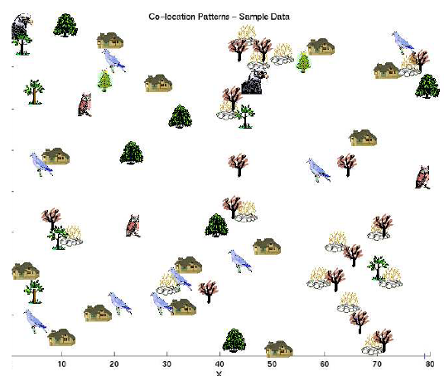

Pattern Family 1: Co-locations/Co-occurrence
Given: A collection of different types of spatial events
Find: Co-located subsets of event types
Source: Discovering Spatial Co-location Patterns: A General Approach, IEEE Transactions
on Knowledge and Data Eng., 16(12), December 2004 (w/ H.Yan, H.Xiong).

Slide 7
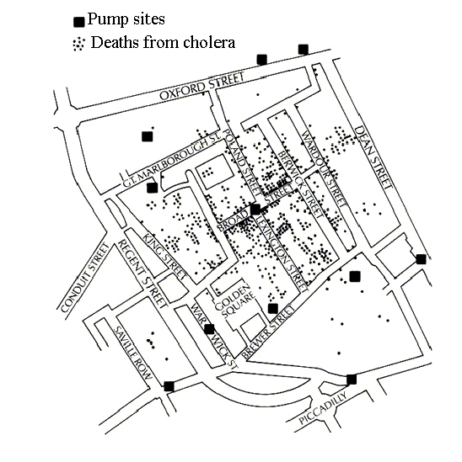

Pattern Family 2: Hotspots, Spatial Cluster
The 1854 Asiatic Cholera in London
  Near Broad St. water pump except a brewery

Slide 8
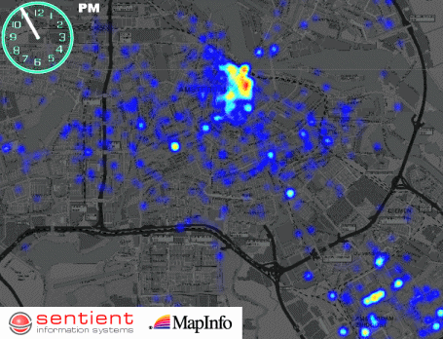
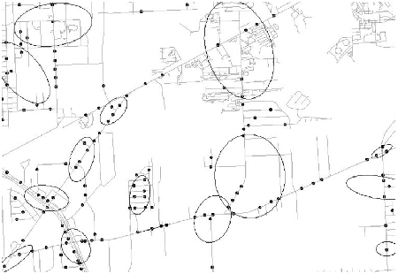
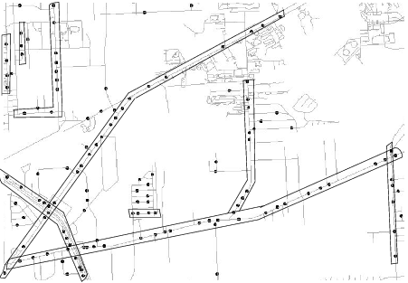
Complicated Hotspots
Complication Dimensions
  Time
  Spatial Networks
Challenges: Trade-off b/w
  Semantic richness and
  Scalable algorithms

Slide 9
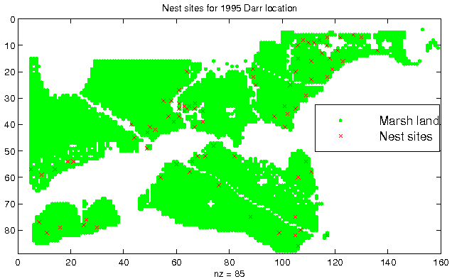
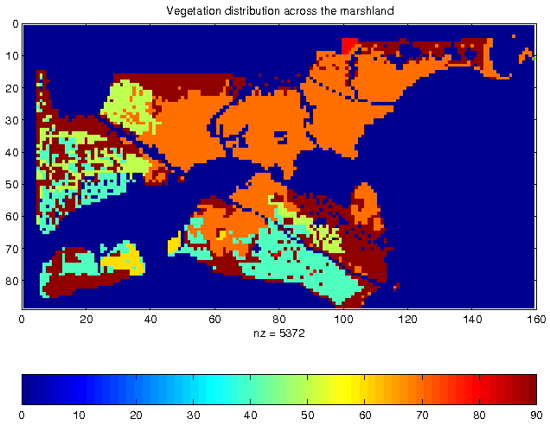
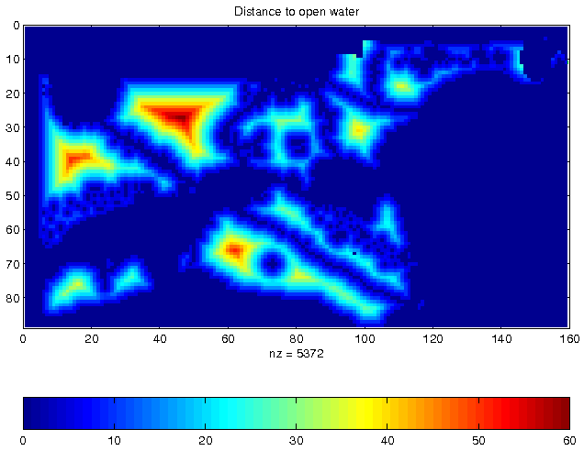
Pattern Family 3: Predictive Models
Location Prediction:
  Predict Bird Habitat Prediction
  Using environmental variables
    E.g., distance to open water
    Vegetation durability etc.

Slide 10
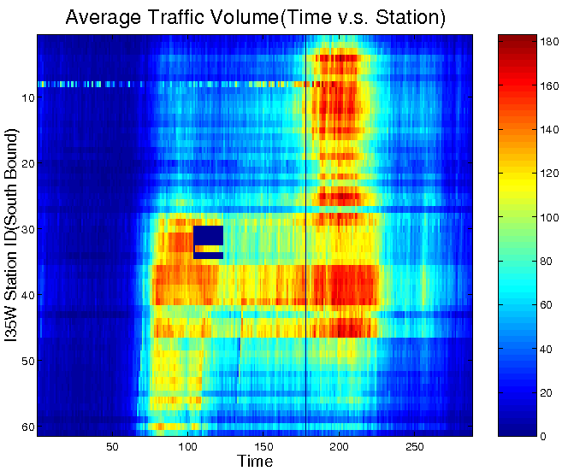
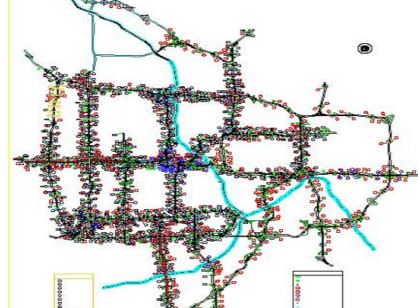
Pattern Family 4: Spatial Outliers
Spatial Outliers, Anomalies, Discontinuities
  Traffic Data in Twin Cities
  Abnormal Sensor Detections
  Spatial and Temporal Outliers
Source: A Unified Approach to Detecting Spatial Outliers, GeoInformatica, 7(2), Springer, June 2003.
(A Summary in Proc. ACM SIGKDD 2001) with C.-T. Lu, P. Zhang.

Slide 11
What’s NOT Spatial Data Mining (SDM)
Simple Querying of Spatial Data
  Find neighbors of Canada, or shortest path from Boston to Houston
Testing a hypothesis via a primary data analysis
  Ex. Is cancer rate inside Hinkley, CA higher than outside ?
  SDM: Which places have significantly higher cancer rates?
Uninteresting, obvious or well-known patterns
  Ex. (Warmer winter in St. Paul, MN) => (warmer winter in Minneapolis, MN)
  SDM: (Pacific warming, e.g. El Nino) => (warmer winter in Minneapolis, MN)
Non-spatial data or pattern
  Ex. Diaper and beer sales are correlated
  SDM: Diaper and beer sales are correlated in blue-collar areas (weekday evening)

Slide 12
Quiz
Categorize following into queries, hotspots, spatial outlier, colocation, location prediction:
  (a) Which countries are very different from their neighbors?
  (b) Which highway-stretches have abnormally high accident rates ?
  (c) Forecast landfall location for a Hurricane brewing over an ocean?
  (d) Which retail-store-types often co-locate in shopping malls?
  (e) What is the distance between Beijing and Chicago?

Slide 13
Limitations of Traditional Statistics
Classical Statistics
  Data samples: independent and identically distributed (i.i.d)
  Simplifies mathematics underlying statistical methods, e.g., Linear Regression
Certain amount of “clustering” of spatial events
Spatial data samples are not independent
  Spatial Autocorrelation metrics
    Global and local Moran’s I
Spatial Heterogeneity
  Spatial data samples may not be identically distributed!
  No two places on Earth are exactly alike!

Slide 14
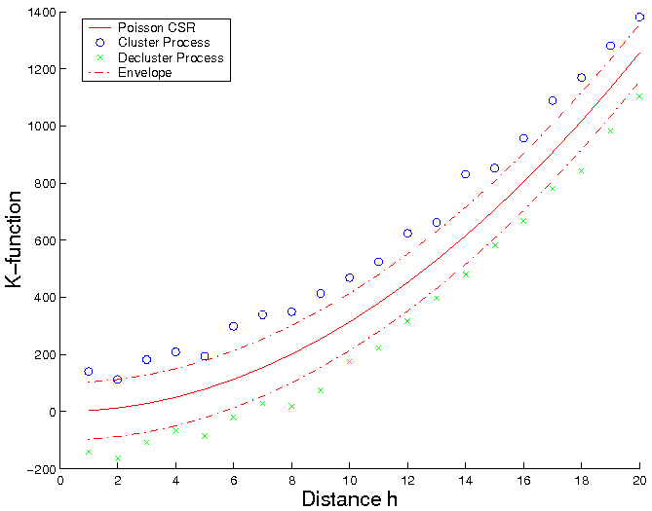
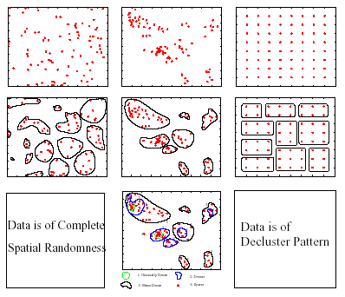
“Degree of Clustering”: K-Function
  Purpose: Compare a point dataset with a complete spatial random (CSR) data
  Input: A set of points
  where λ is intensity of event
Interpretation: Compare k(h, data) with K(h, CSR)
  K(h, data) = k(h, CSR): Points are CSR
      > means Points are clustered
      < means Points are de-clustered
[number of events within distance h of an arbitrary event]
CSR
Clustered
De-clustered

Slide 15
Cross K-Function
  Cross K-Function Definition
  Cross K-function of some pair of spatial feature types
  Example
    Which pairs are frequently co-located
    Statistical significance
[number of type j event within distance h
of a randomly chosen type i event]

Slide 16
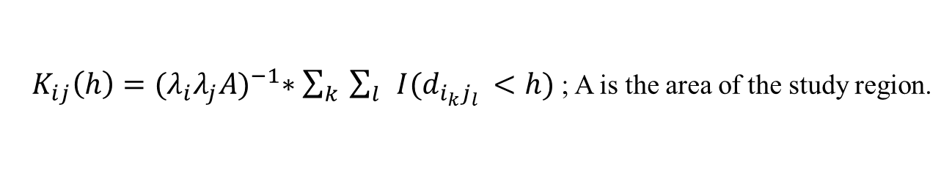
Estimating K-Function
[number of events within distance h of an arbitrary event]
$K\left(h\right)=λ^{−1}∗\sum_{i}{\sum_{j≠i}{I\left(d_{ij}<h\right)}};$ $λ=\frac{\#events}{Area of the study region}$
[number of type j event within distance h
of a randomly chosen type i event]
$K_{ij}\left(h\right)={(λ_{i}λ_{j}A)}^{−1}∗\sum_{k}{\sum_{l}{I(d_{i_{k}j_{l} }<h) }}$; A is the area of the study region.

Slide 17
Recall Pattern Family 2: Co-locations
Given: A collection of different types of spatial events
Find: Co-located subsets of event types
Source: Discovering Spatial Co-location Patterns: A General Approach, IEEE Transactions
on Knowledge and Data Eng., 16(12), December 2004 (w/ H.Yan, H.Xiong).

Slide 18
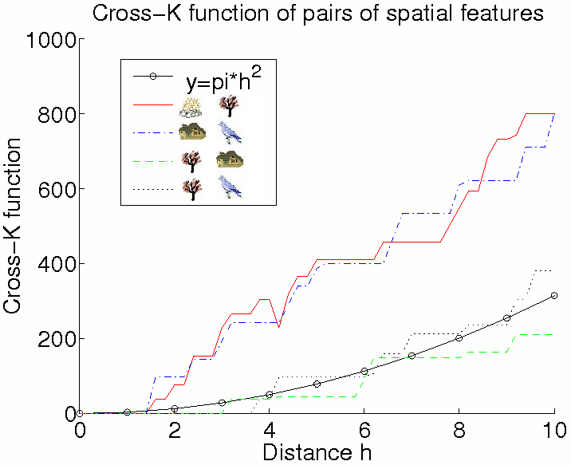
Illustration of Cross-Correlation
  Illustration of Cross K-function for Example Data
Cross-K Function for Example Data

Slide 19
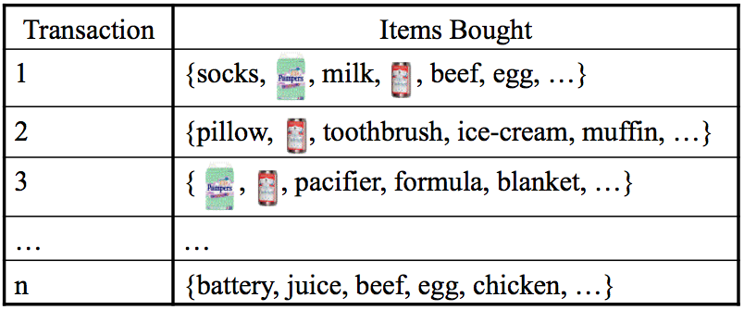
Background: Association Rules
  Association rule e.g. (Diaper in T => Beer in T)
    Support: probability (Diaper and Beer in T) = 2/5
    Confidence: probability (Beer in T | Diaper in T) = 2/2
  Apriori Algorithm
    Support based pruning using monotonicity

Slide 20
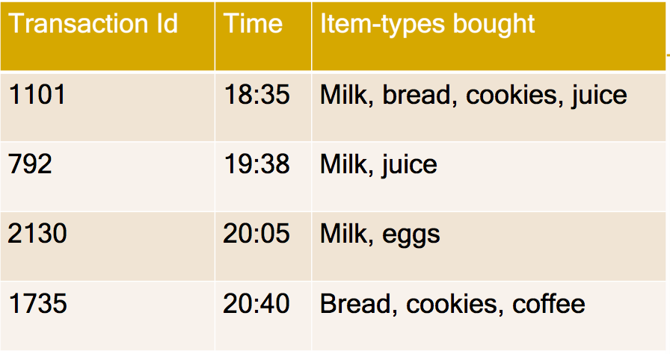
Apriori Algorithm
How to eliminate infrequent item-sets as soon as possible?
Support threshold >= 0.5

Slide 21
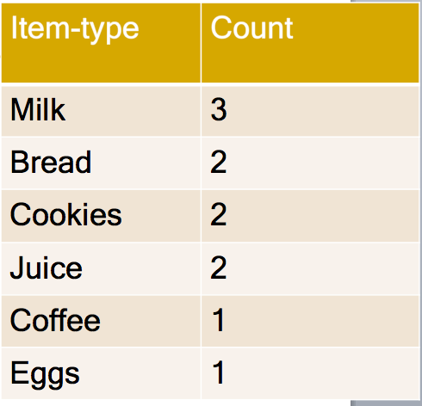
Apriori Algorithm
Eliminate infrequent singleton sets
Support threshold >= 0.5
Milk
Bread
Cookies
Juice
Coffee
Eggs

Slide 22
Apriori Algorithm
Make pairs from frequent items & prune infrequent pairs!
Item type | Count
Milk, Juice | 2
Bread, Cookies | 2
Milk, cookies | 1
Milk, bread | 1
Bread, Juice | 1
Cookies, Juice | 1
Support threshold >= 0.5
MB
MC
MJ
BC
BJ
CJ
Milk
Bread
Cookies
Juice
Coffee
Eggs
81

Slide 23
Apriori Algorithm
Make triples from frequent pairs & Prune infrequent triples!
Item type | Count
Milk, Juice | 2
Bread, Cookies | 2
Milk, Cookies | 1
Milk, bread | 1
Bread, Juice | 1
Cookies, Juice | 1
Support threshold >= 0.5
MBCJ
MBC
MBJ
MCJ
BCJ
No triples generated due to monotonicity!
How??
MB
MC
MJ
BC
BJ
CJ
Apriori algorithm
examined only
12 subsets
instead of 64!
Milk
Bread
Cookies
Juice
Coffee
Eggs

Slide 24
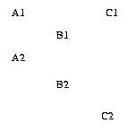
Association Rules Limitations
  Transaction is a core concept!
    Support is defined using transactions
    Apriori algorithm uses transaction based Support for pruning
  However, spatial data is embedded in continuous space
    Transactionizing continuous space is non-trivial !

Slide 25
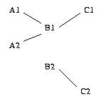
Spatial Association (Han 95) vs. Cross-K Function
  Spatial Association Rule (Han 95)
  Output = (B,C) with threshold 0.5
  Transactions by Reference feature, e.g. C
  Transactions: (C1, B1), (C2, B2)
  Support (A,B) = Ǿ
  Support(B,C)=2 / 2 = 1
Input = Feature A,B, and, C, & instances A1, A2, B1, B2, C1, C2

Slide 26
Spatial Association (Han 95) vs. Cross-K Function
  Spatial Association Rule (Han 95)
  Output = (B,C) with threshold 0.5
  Transactions by Reference feature, e.g. C
  Transactions: (C1, B1), (C2, B2)
  Support (A,B) = Ǿ
  Support(B,C)=2 / 2 = 1
  Cross-K Function
    Cross-K (A, B) = 2/4 * (area)
    Cross-K(B, C) = 2/4 * (area)
    Cross-K(A, C) = 0
Input = Feature A,B, and, C, & instances A1, A2, B1, B2, C1, C2
  Output = (A,B), (B, C) with appropriate threshold

Slide 27
Spatial Colocation (Shekhar 2001)
Features: A. B. C
Feature Instances: A1, A2, B1, B2, C1, C2
Feature Subsets: (A,B), (A,C), (B,C), (A,B,C)
Participation ratio (pr):
pr(A, (A,B)) = fraction of A instances neighboring feature {B} = 2/2 = 1
pr(B, (A,B)) = ½ = 0.5
Participation index (A,B) = pi(A,B) = min{ pr(A, (A,B)), pr(B, (A,B)) } = min (1, ½ ) = 0.5
pi(B, C) = min{ pr(B, (B,C)), pr(C, (B,C)) } = min (1,1) = 1
Participation Index Properties:
(1) Computational: Non-monotonically decreasing like support measure
(2) Statistical: Upper bound on Ripley’s Cross-K function

Slide 28
Participation Index >= Cross-K Function
B.1
A.1
B.1
A.1
B.1
A.1
A.3
A.3
A.3
B.2
A.2
B.2
A.2
B.2
A.2
Cross-K (A,B) | 2/6 = 0.33 | 3/6 = 0.5 | 6/6 = 1
PI (A,B) | 2/3 = 0.66 | 1 | 1

Slide 29
Association Vs. Colocation
 | Associations | Colocations
underlying space | Discrete market baskets | Continuous geography
event-types | item-types, e.g., Beer | Boolean spatial event-types
collections | Transaction (T) | Neighborhood N(L) of location L
prevalence measure | Support, e.g., Pr.[ Beer in T] | Participation index, a lower bound on Pr.[ A in N(L) | B at L ]
conditional probability measure | Pr.[ Beer in T | Diaper in T ] | Participation Ratio(A, (A,B)) = Pr.[ A in N(L) | B at L ]

Slide 30
Spatial Association Rule vs. Colocation
  Spatial Association Rule (Han 95)
  Output = (B,C)
  Transactions by Reference feature C
  Transactions: (C1, B1), (C2, B2)
  Support (A,B) = Ǿ, Support(B,C)=2 / 2 = 1
  Cross-K Function
    Cross-K (A, B) = 2/4 * (area)
    Cross-K(B, C) = 2/4 * (area)
Input = Spatial feature A,B, C, & their instances
  Output = (A,B), (B, C)
  Colocation - Neighborhood graph
  Output = (A,B), (B, C)
  PI(A,B) = min(2/2,1/2) = 0.5
  PI(B,C) = min(2/2,2/2) = 1

Slide 31
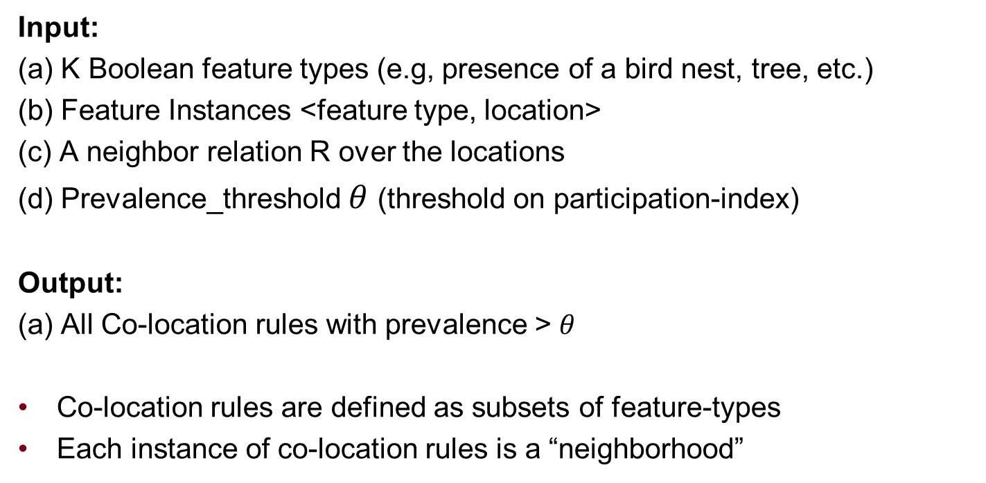
Mining Colocations: Problem Definition
Input:
(a) K Boolean feature types (e.g, presence of a bird nest, tree, etc.)
(b) Feature Instances <feature type, location>
(c) A neighbor relation R over the locations
(d) Prevalence_threshold $θ$ (threshold on participation-index)
Output:
(a) All Co-location rules with prevalence > $θ$
Co-location rules are defined as subsets of feature-types
Each instance of co-location rules is a “neighborhood”

Slide 32
Mining Colocations: Basic Concepts

Slide 33
Key Concepts: Neigborhood

Slide 34
Key Concepts: Co-location rules

Slide 35
Some more Key Concepts

Slide 36
Mining Colocations: Algorithm Trace

Slide 37
Mining Colocations: Algorithm Trace (1/6)

Slide 38
Mining Colocations: Algorithm Trace (2/6)

Slide 39
Mining Colocations: Algorithm Trace (3/6)

Slide 40
Mining Colocations: Algorithm Trace (5/6)

Slide 41
Mining Colocations: Algorithm Trace (6/6)

Slide 42
Quiz
Which is false about concepts underlying association rules?
a) Apriori algorithm is used for pruning infrequent item-sets
b) Support(diaper, beer) cannot exceed support(diaper)
c) Transactions are not natural for spatial data due to continuity of
geographic space
d) Support(diaper) cannot exceed support(diaper, beer)

Slide 43
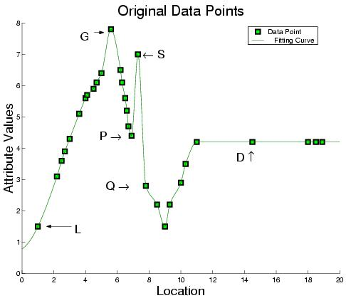
Outliers: Global (G) vs. Spatial (S)

Slide 44
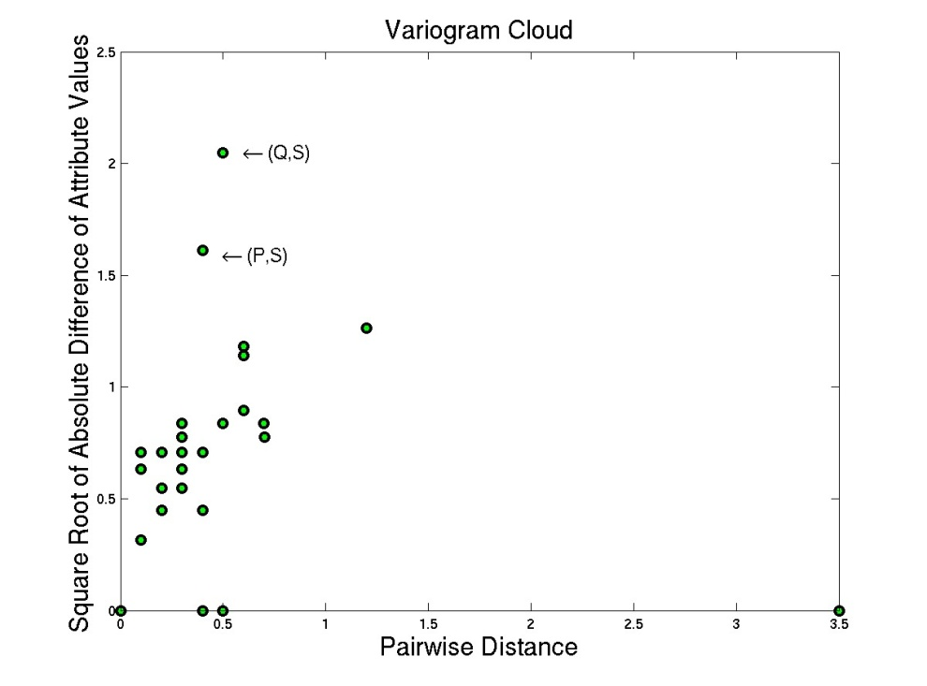
Outlier Detection Tests: Variogram Cloud
  Graphical Test: Variogram Cloud

Slide 45
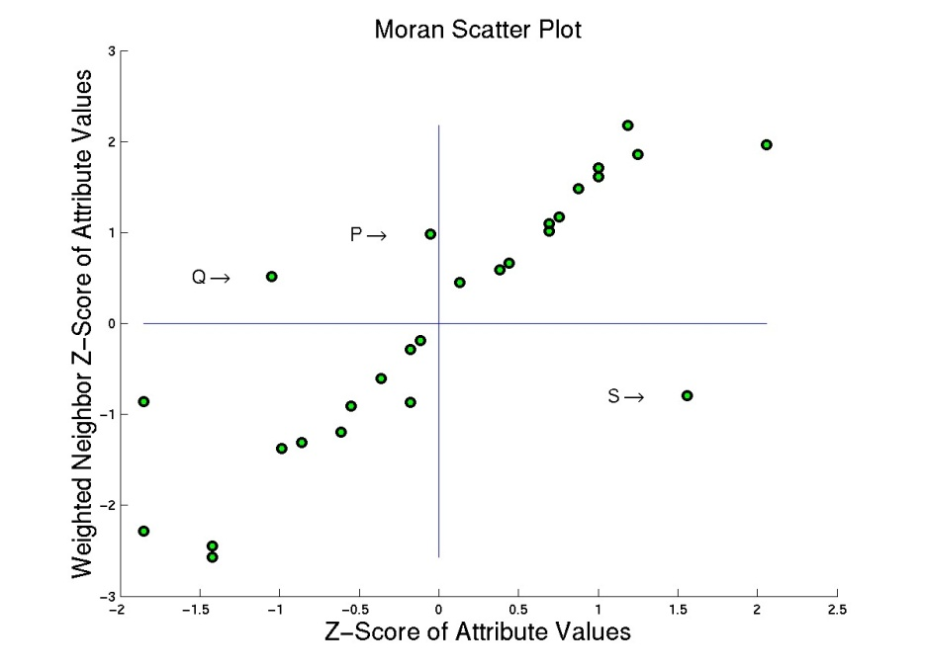
Outlier Detection Test: Moran Scatterplot
  Graphical Test: Moran Scatter Plot

Slide 46
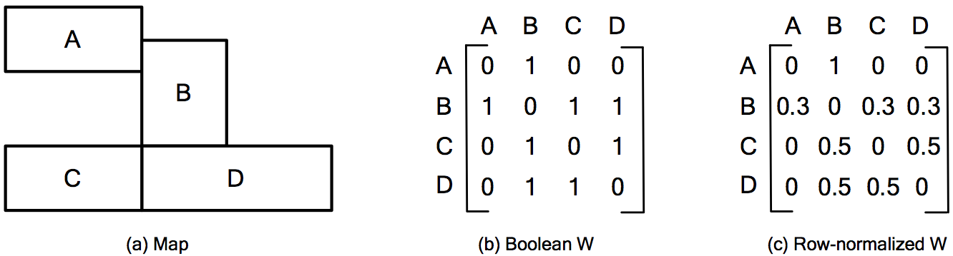
Neighbor Relationship: W Matrix

Slide 47
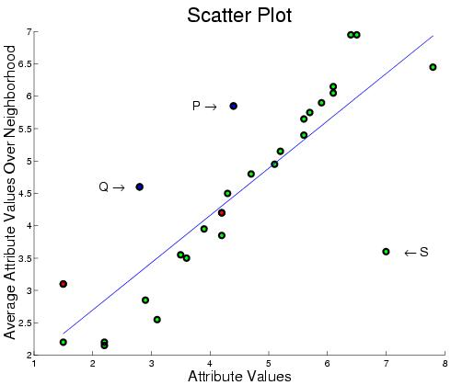
Outlier Detection – Scatterplot
  Quantitative Tests: Scatter Plot

Slide 48
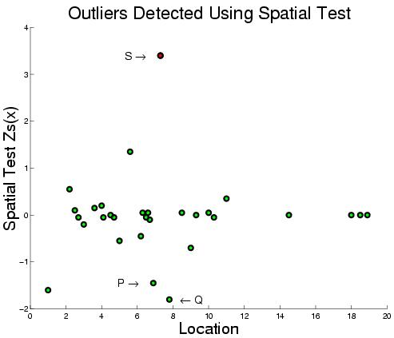
Outlier Detection Tests: Spatial Z-test
  Quantitative Tests: Spatial Z-test
    Algorithmic Structure: Spatial Join on neighbor relation

Slide 49
Quiz
Which of the following is false about spatial outliers?
a) Oasis (isolated area of vegetation) is a spatial outlier area in a desert
b) They may detect discontinuities and abrupt changes
c) They are significantly different from their spatial neighbors
d) They are significantly different from entire population

Slide 50
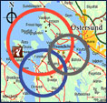
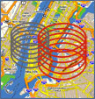

Statistically Significant Clusters
  K-Means does not test Statistical Significance
    Finds chance clusters in complete spatial randomness (CSR)
Classical
Clustering
Spatial
Clustering

Slide 51
Spatial Scan Statistics (SatScan)
  Goal: Omit chance clusters
  Ideas: Likelihood Ratio, Statistical Significance
  Steps
    Enumerate candidate zones & choose zone X with highest likelihood ratio (LR)
      LR(X) = p(H1|data) / p(H0|data)
      H0: points in zone X show complete spatial randomness (CSR)
      H1: points in zone X are clustered
    If LR(Z) >> 1 then test statistical significance
      Check how often is LR( CSR ) > LR(Z)
        using 1000 Monte Carlo simulations

Slide 52
SatScan Examples
Test 1: Complete Spatial Randomness
SatScan Output: No hotspots !
Highest LR circle is a chance cluster!
p-value = 0.128
Test 2: Data with a hotspot
SatScan Output: One significant hotspot!
p-value = 0.001 (low p-value is good)

Slide 53
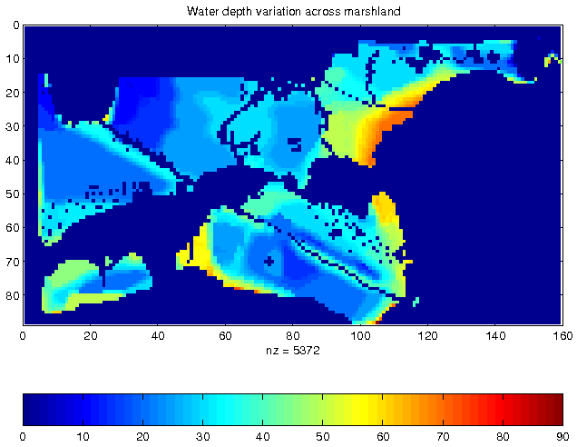
Location Prediction Problem
Target Variable: Nest Locations
Vegetation Index
Water Depth
Distance to Open Water

Slide 54
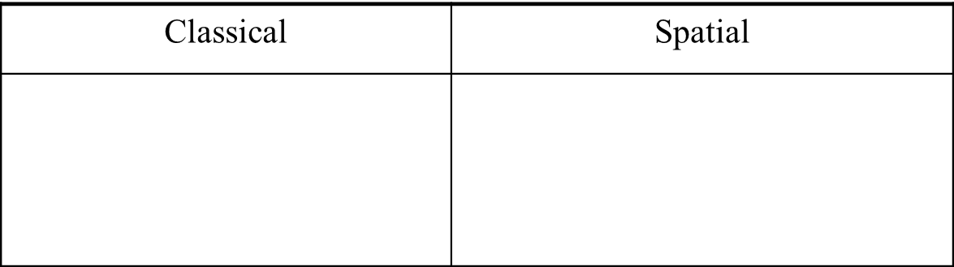
Location Prediction Models
  Traditional Models, e.g., Regression (with Logit or Probit),
    Bayes Classifier, …
Spatial Models
  Spatial autoregressive model (SAR)
  Markov random field (MRF) based Bayesian Classifier

