Slide 1
Introduction to Spatial Computing CSE 5ISC
Introduction
Some slides adapted from Worboys and Duckham (2004) GIS: A Computing Perspective, Second Edition, CRC Press

Slide 2
Course Logistics
Office hours:
  Tuesday and Thursday 11:30am – 12:30pm
  For other times, please send a email to fix an appointment.
  Please use “CSE 5ISC” in the email subject.
Course Web page:
  http://faculty.iiitd.ac.in/~gunturi/courses/mon16/cse5isc/index.html
Course Textbook:
  Worboys and Duckham (2004) GIS: A Computing Perspective, Second Edition, CRC Press
  Shashi Shekhar and Sanjay Chawla (2003): Spatial Databases: A Tour, Prentice Hall

Slide 3
Course Structure
4 homework assignments (12% each) to be done in a team
  Can contain both textbook and programming parts
  Teams of size 1, 2, or 3.
  Teams of size 1 and 2 same work for same deadline.
  Teams of size 3, extra work for same deadline.
Mid-term Exam 17%
Final Exam 22%
One quiz 13% (Oct 6 2016)
Academic Dishonesty policy of IIIT Delhi does apply

Slide 4




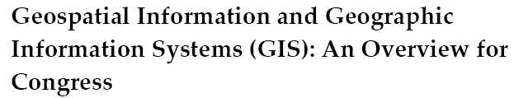


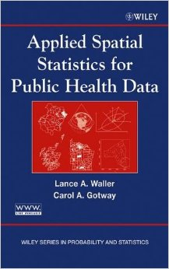

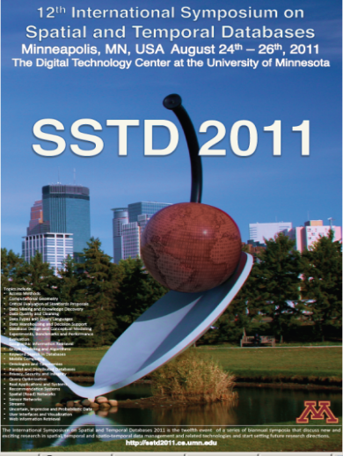


Spatial Computing
Broadly defined as composed of computing activities which focus on data which either spatially or spatio-temporally oriented.

Slide 5


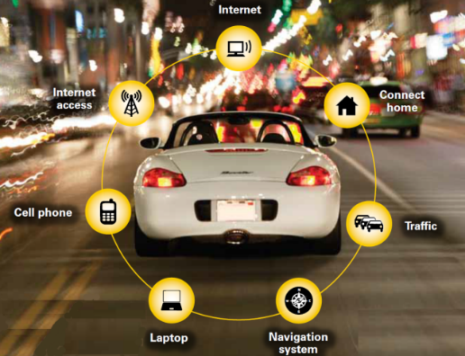
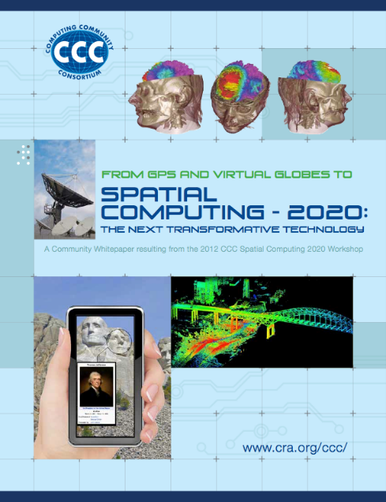



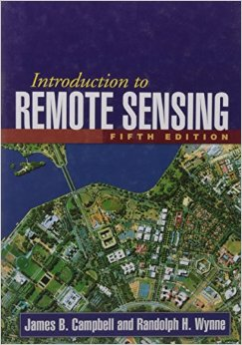
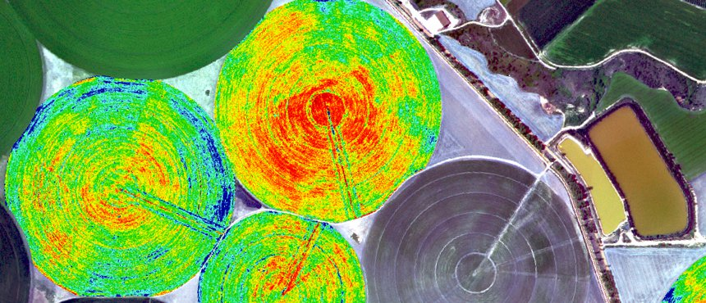
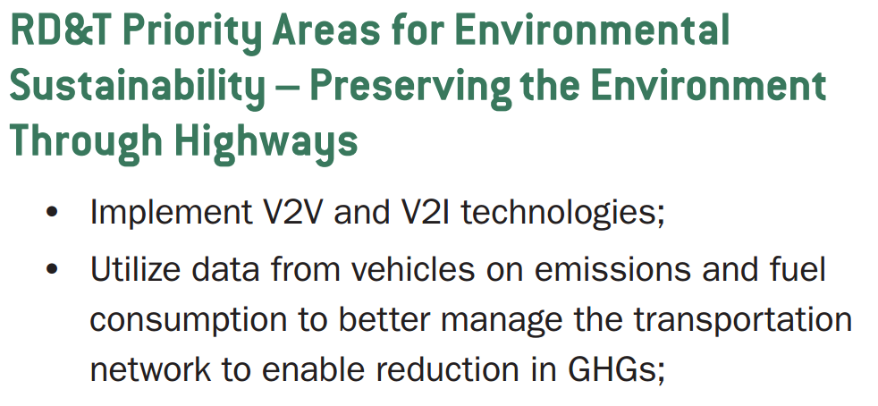


Spatial Computing: Emerging Trend
Penetration of Internet (Internet of Things)
Several platforms are location aware (e.g., smartphones)
Many more travel phenomena are observable
Smarter
Planet

Slide 6
Topics planned…
Conceptual Modeling
  Fundamental Spatial Concepts, localization, etc.
  Models of Geo-spatial information
Algorithms for Spatial Data
  Triangulation, Vornoi diagrams etc.
Spatial index structures
  R-tree, quad tree etc.
Query processing on spatial index structures
  KNN and nearest neighbors etc.
Spatial Networks
Spatial Data Mining
Check schedule on the class homepage.

Slide 7
Topics planned…
Conceptual Modeling
  Fundamental Spatial Concepts, localization, etc.
  Models of Geo-spatial information
Algorithms for Spatial Data
  Triangulation, Voronoi diagrams etc.
Spatial index structures
  R-tree, quad tree etc.
Query processing on spatial index structures
  KNN and nearest neighbors etc.
Spatial Networks
Spatial Data Mining
Check schedule on the class homepage.
Focus is on bringing out the uniqueness of spatial data.
Evaluate feasibility of traditional techs.
Data Eng. for Spatial

Slide 8
Spatial Computing Vs Geographic Information Systems/Science
GIS is the application software to store, retrieve, visualize and analyze geo-spatial data.
Spatial Computing is the core “Computer Science” inside a GIS.
Spatial Computing can go beyond geo-spatial.
Typically Encompasses:
  Spatial and spatio-temporal databases
  Spatial and spatial-temporal data mining
  ……….

Slide 9
Sample Functionalities of GIS
Or
Problems considered in Spatial Computing

Slide 10
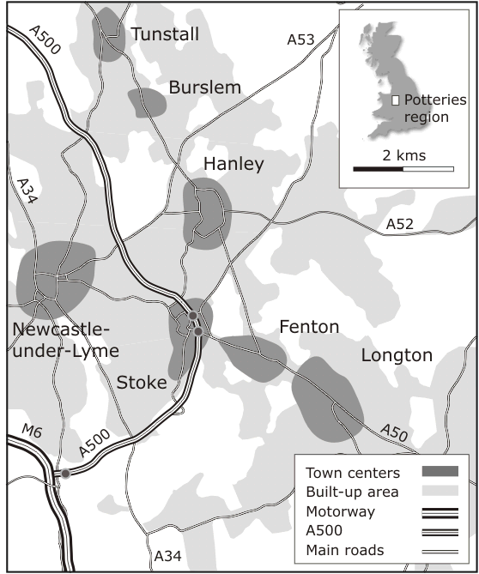
Sample Geographic Locations
Example: “The Potteries”
The Potteries comprise six pottery towns
The region developed during the English industrial revolution
Local communities produced high quality ware from conditions of poverty

Slide 11
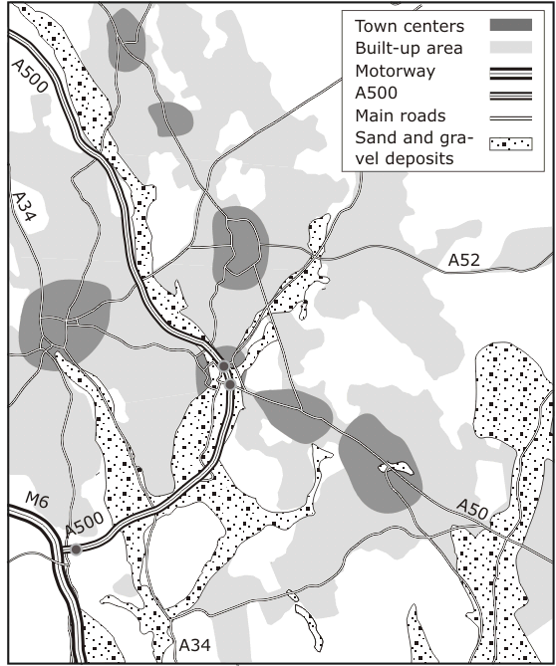
Functionality: layer-based analysis
Determining the potential of different locations for sand and gravel extraction
Drawing together and analyzing data from variety of sources
    Geological data,
    urban structure,
    transportation network,
    …..
Locations of sand and gravel deposits in the Potteries region

Slide 12


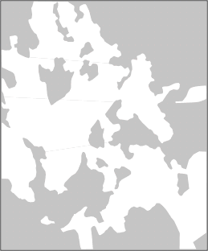

Functionality: layer-based analysis
Query: find all locations that are within 0.5 km of a major road, not in a built-up area, and on a sand/gravel deposit
0.5 km buffer of major roads (not including the motorway
Known sand and gravel deposits
Shaded areas indicate locations that are not built up
Overlay of the three other layers giving area that satisfies the query

Slide 13
Functionality: Visibility analysis
Sometimes it is important to study the visual impact of proposed new buildings, routes, etc.
Visibility analysis can be used to evaluate visual impact
E.g, it the building in the line of sight of the new building.
Is the route visible from enemy posts, etc.
Usually based upon data sets of topographic elevation at point locations

Slide 14
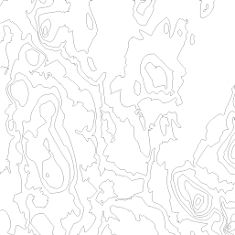
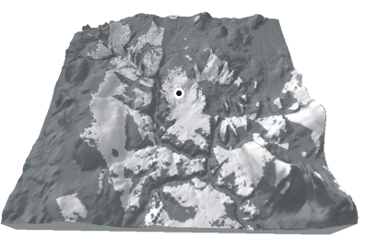
Functionality: Visibility analysis
Contour map
Perspective projection
Darker shaded regions give the area from which the marked point would not be visible

Slide 15
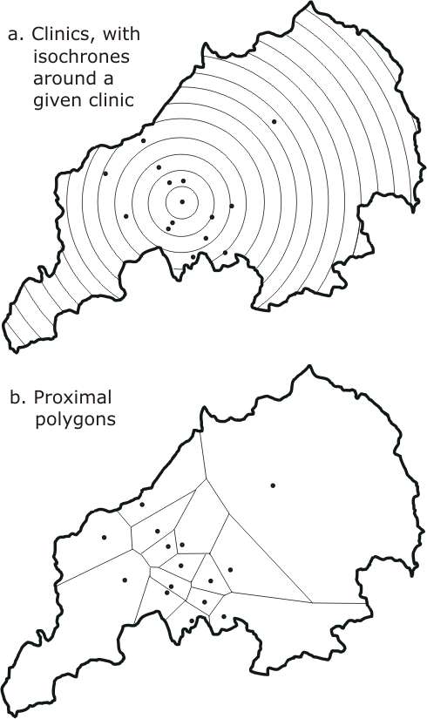
Functionality: location analysis
Locating/planning a clinic (or any public facility) in the Potteries
  Construct the “neighborhood” of clinics, based upon positions of nearby clinics and travel times
  We can then support decisions to relocate, close, or create a new clinic

Slide 16
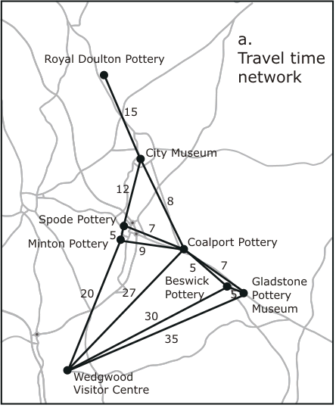
Functionality: network analysis
Find a route using the major road network, visiting each pottery (and the City Museum) only once, while minimizing the traveling time
A travel-time network between potteries is the required data set
Derived from average times on the main roads shown on the map

Slide 17
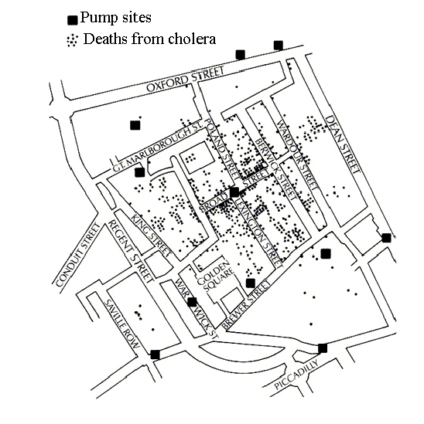
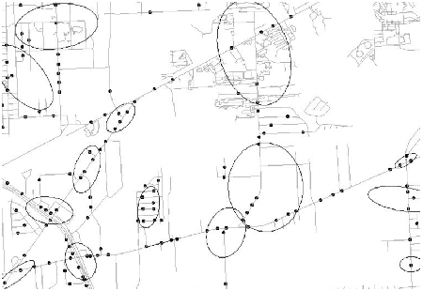
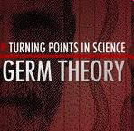
Functionality: Spatial Hotspot
The 1854 Asiatic Cholera in London
  Near Broad St. water pump except a brewery
Traffic accident hotspots

Slide 18
Introduction to Spatial Data

Slide 19
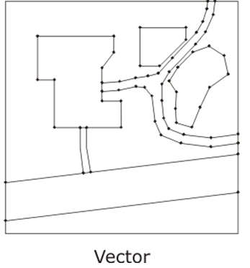
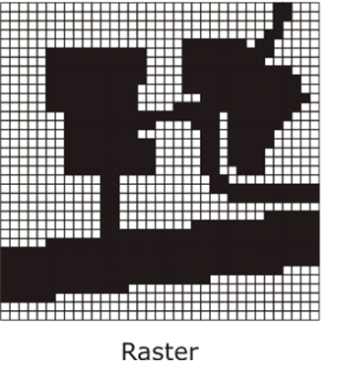
Types of Spatial Data
Vector is a finite straight line segment defined by its end points.
The locations of end-points are given.
Raster data is structured as an array or grid of cells, referred to as pixels

Slide 20
Types of Spatial Data
Raster
  Natural structures to use in computers
  Most programming languages commonly support array handling and operations
  Inefficient in terms of usage of computer storage
Vector
  More efficient in its use of computer storage
  Only points of interest need be stored
  Assume a hard edged boundary model of the world

Slide 21
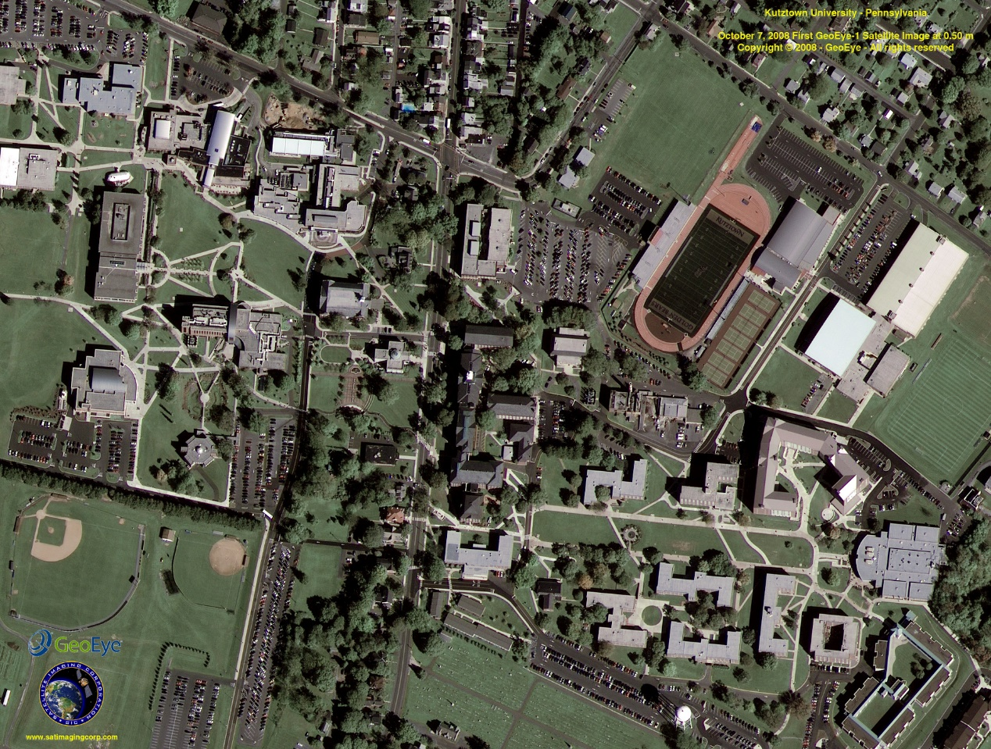
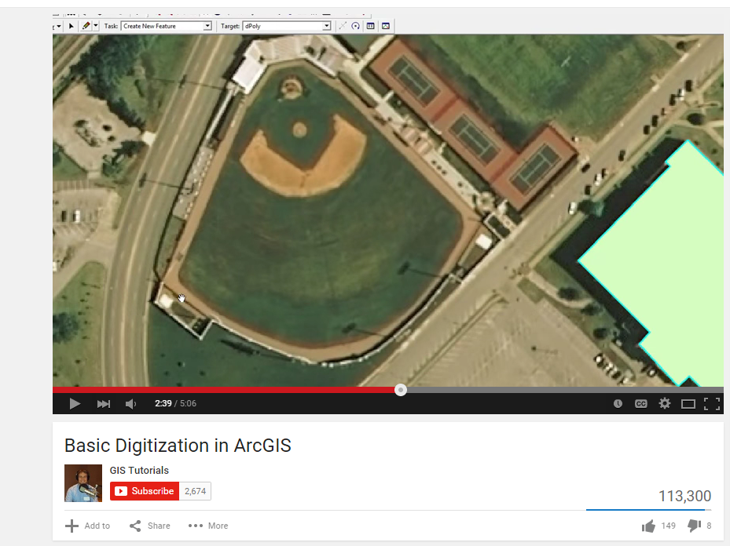
Data Capturing: Remote sensing
Aerial images of the Earth surface which are digitized to get maps.
Youtube video on digitization

Slide 22

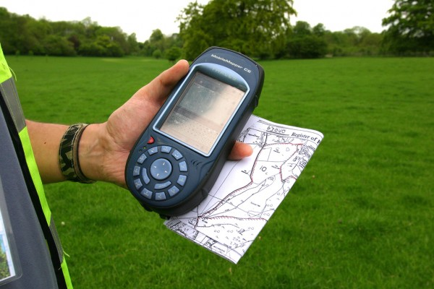
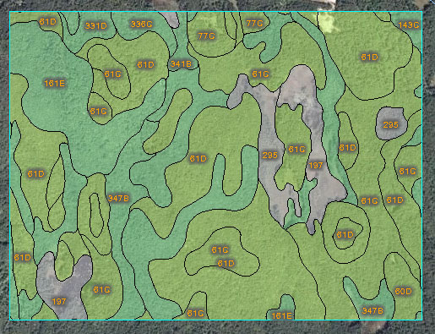
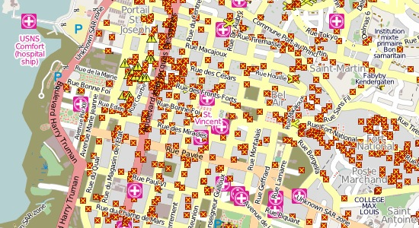
Data Capturing
Sensors are a primary source of data for a GIS and are used to measure some feature of the geographic environment
Volunteered Geographic Information
Land Surveying using GPS devices

Slide 23
Basics on Geometry

Slide 24
Geometry and Invariance
Geometry: provides a formal representation of the abstract properties and structures within a space
Invariance: a group of transformations of space under which propositions remain true
  Distance- translations and rotations
  Angle and parallelism- translations rotations, and scaling

Slide 25
Euclidean Space
Euclidean Space: coordinatized model of space
  Transforms spatial properties into properties of tuples of real numbers
  Coordinate frame consists of a fixed, distinguished point (origin) and a pair of orthogonal lines (axes), intersecting in the origin
Point objects
Line objects
Polygonal objects

Slide 26
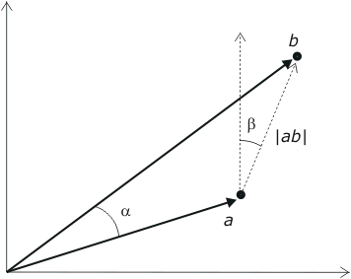


Points
A point in the Cartesian plane R² is associated with a unique pair of real number a = (x,y) measuring distance from the origin in the x and y directions. It is sometimes convenient to think of the point a as a vector.
  Scalar: Addition, subtraction, and multiplication, e.g.,
  (x₁, y₁) − (x₂, y₂) =
  (x₁ − x₂, y₁ − y₂)
  Norm:
  Distance: |ab| = ||a-b||
  Angle between vectors:

Slide 27
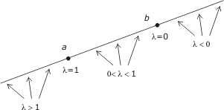

Lines
The line incident with a and b is defined as the point set
{λa + (1 −λ )b | λ is a real number }
The line segment between a and b is defined as the point set {λa + (1 −λ )b | λ $∈$ [0, 1]}
The half line radiating from b and passing through a is defined as the point set {λa + (1 − λ)b | λ $≥$ 0}

Slide 28
Polygon Objects
A polyline in R² is a finite set of line segments (called edges) such that each edge end-point is shared by exactly two edges, except possibly for two points, called the extremes of the polyline.
If no two edges intersect at any place other than possibly at their end-points, the polyline is simple.
A polyline is closed if it has no extreme points.

Slide 29
Polygon Objects
A (simple) polygon is the area enclosed by a simple closed polyline.
This polyline forms the boundary of the polygon. Each end-point of an edge of the polyline is called a vertex of the polygon.
A convex polygon has every point intervisible
A star-shaped or semi-convex polygon has at least one point that is intervisible.

Slide 30
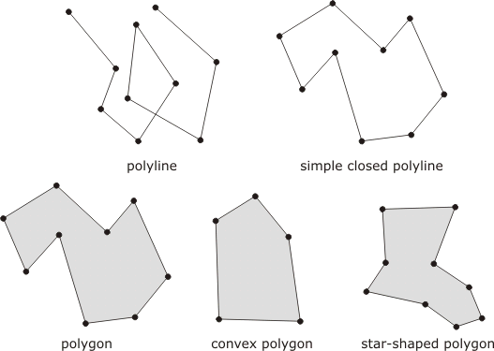
Polygon Objects

Slide 31
Polygonal Objects
Monotone chain: there is some line in the Euclidean plane such that the projection of the vertices onto the line preserves the ordering of the list of points in the chain
Monotone polygon: if the boundary can be split into two polylines, such that the chain of vertices of each polyline is a monotone chain
Triangulation: partitioning of the polygon into triangles that intersect only at their mutual boundaries

Slide 32
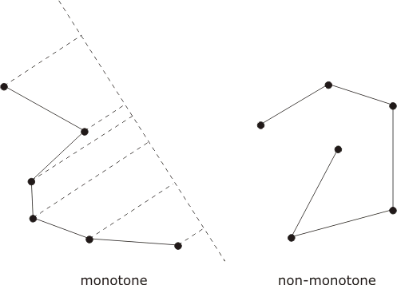
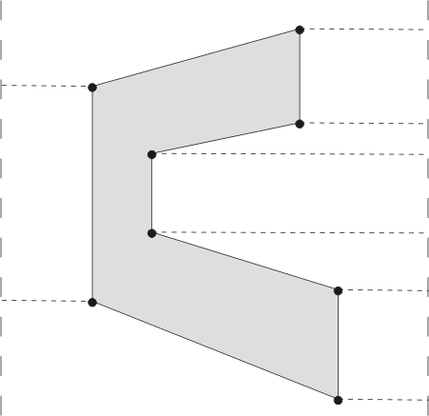
Polygonal Objects
monotone polyline

Slide 33
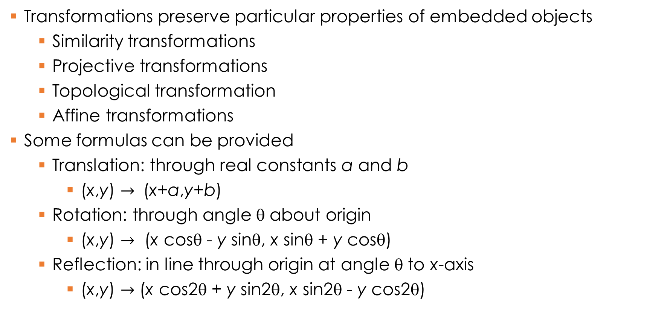
Transformations
Transformations preserve particular properties of embedded objects
  Similarity transformations
  Projective transformations
  Topological transformation
  Affine transformations
Some formulas can be provided
  Translation: through real constants a and b
    (x,y) $→$ (x+a,y+b)
  Rotation: through angle θ about origin
    (x,y) $→$ (x cosθ - y sinθ, x sinθ + y cosθ)
  Reflection: in line through origin at angle θ to x-axis
    (x,y) $→$ (x cos2θ + y sin2θ, x sin2θ - y cos2θ)

Slide 34
Coordinate systems for Earth

Slide 35
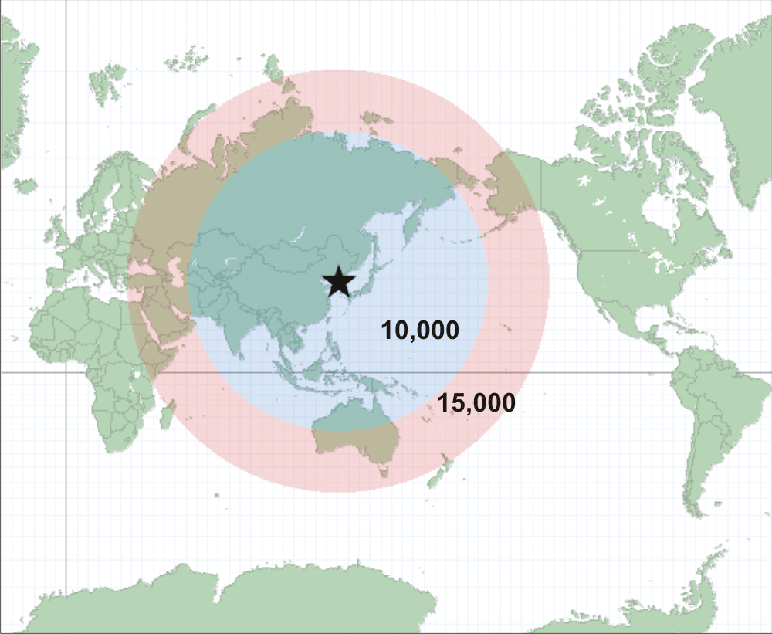
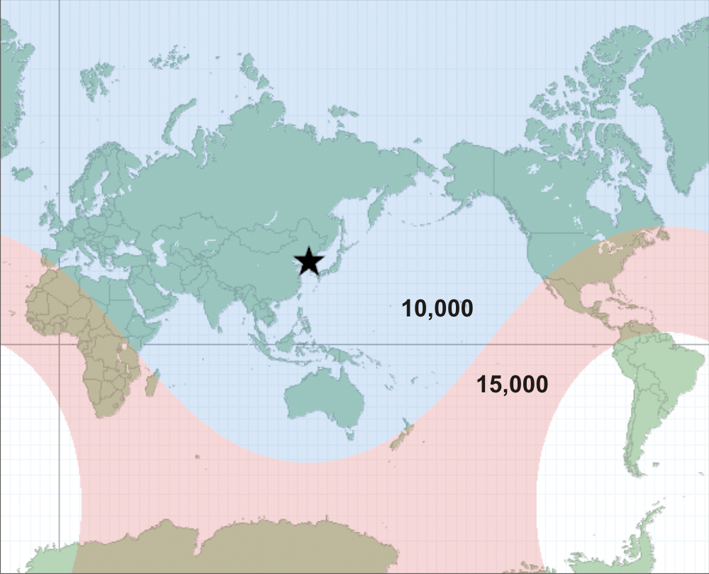
Euclidean space for Earth??
Original map showing regions with 10,000 and 15,000 km from North Korea
Corrected map using Geodesic distances.
More info on http://www.esri.com/news/arcuser/0111/geodesic.html

Slide 36
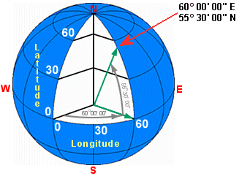
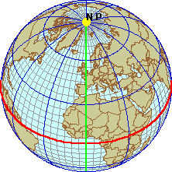
Geographic Coordinates: spherical model
Latitude
  Angle between the equatorial plane and line joining the point to the center of the ellipsoid
Longitude
  Angle east or west from a reference meridian to another meridian that passes through that point
Prime Meridian

Slide 37
Geodetic Coordinates –Ellipsoid model
Another coordinate system which uses a different set of reference points (Datums) for locating places.
A Datum defines a reference point (or a reference frame) for localizing.
Datum uses an ellipsoid to defines latitude, longitude and altitude coordinates.
  Horizontal Datum: For latitude and Longitude
  Vertical Datum: For elevation
Multiple standards exist.
  WGS 84, AD83 and ETRS89
Refer https://en.wikipedia.org/wiki/Geodetic_datum

Slide 38
Geodetic Coordinates –Lat ($φ)$ and Long ($λ)$
The geoid is a representation of the surface of the earth that it would assume if the sea covered the earth

Slide 39
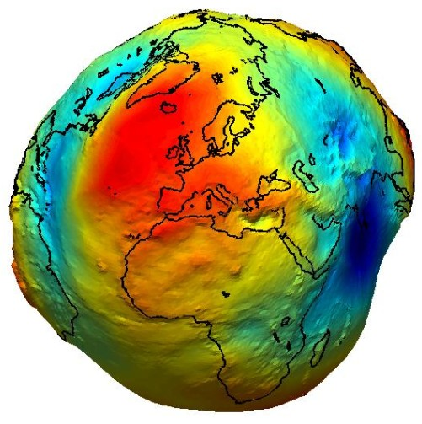
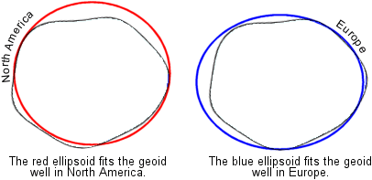
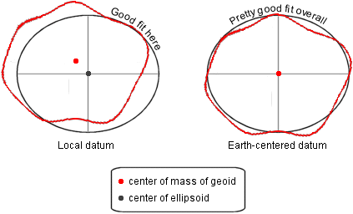
Multiple datums
The geoid is equipotential surface with respect to gravity
Defines the zero elevation.
Refer http://support.esri.com/technical-article/000006398
www.esri.com/news/arcuser/0703/geoid1of3.html

Slide 40

Projected Coordinates
Flattening the Earth

Slide 41
Projected Coordinates
A map project can distort one or several of the following properties
  Shape
  Area
  Distance
  Direction
Some projections specialize in preserving one or several of these features, but none preserve all.
Many types are available. For more details refer: https://en.wikipedia.org/wiki/List_of_map_projections
Refer: http://www.progonos.com/furuti/MapProj/Normal/TOC/cartTOC.html

Slide 42
Map-Projection Distortion: Shape
Projection can distort the shape of a feature.
Conformal Map: Any two lines in the map follow the same angle as the corresponding original lines on the Earth.
Conformal maps preserve the shape of smaller, local geographic features, while general shapes of larger features are distorted.
In other words, they map infinitesimal circles of constant size anywhere on the Earth to infinitesimal circles of varying sizes on the map.
Other projections distort them into ellipses.
Conformal maps also preserve constant scale locally.
http://www.progonos.com/furuti/MapProj/Normal/TOC/cartTOC.html

Slide 43
Map-Projection Distortion: Area
Projection can distort the property of equal area (or equivalent),
Meaning that features have the correct area relative to one another.
Map projections that maintain this property are often called equal area map projections.
For instance, if S America is 8x larger than Greenland on the globe, it will be 8x larger on map as well
No map projection can have both conformality and equal area; sacrifice shape to preserve area and vice versa
http://www.progonos.com/furuti/MapProj/Normal/TOC/cartTOC.html

Slide 44
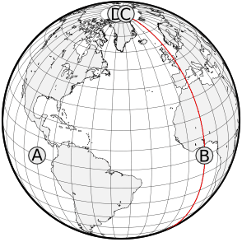
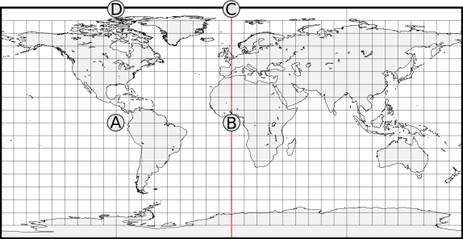
Map-Projection Distortion: Distance
If a line from a to b on a map is the same distance (accounting for scale) that it is on the earth, then the map line has true scale.
No map has true scale everywhere, but most maps have at least one or two lines of true scale.
An equidistant map is one that preserves true scale for all straight lines passing through a single, specified point.
A is equidistant from B and C.
Distance between D and C is actually zero (they are at pole)

Slide 45
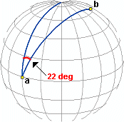
Map-Projection Distortion: Direction
Direction, or azimuth, is measured in degrees of angle from north.
On the earth, this means that the direction from a to b is the angle between the meridian on which a lies and the great circle arc connecting a to b.
If the azimuth value from a to b is the same on a map as on the earth, then the map preserves direction from a to b.
An azimuthal projection is one that preserves direction for all straight lines passing through a single, specified point. No map has true direction everywhere.

Slide 46
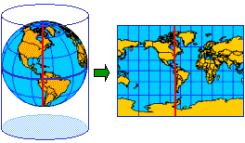
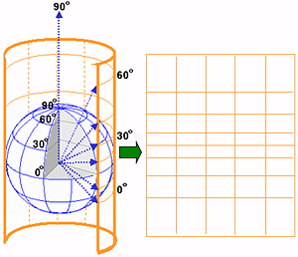
Cylindrical Map Projection
Created by wrapping a cylinder around a globe
The meridians in cylindrical projections are equally spaced.
The spacing between parallel lines of latitude increases toward the poles
meridians never converge so poles can’t be shown.
Source: ESRI

Slide 47
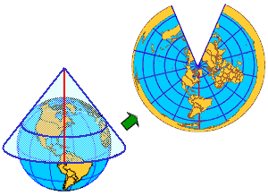
Conical Projection
Projects a globe onto a cone
In simplest case, globe touches cone along a single latitude line, or tangent, called standard parallel
Other latitude lines are projected onto cone
To flatten the cone, it must be cut along a line of longitude (see image)
The opposite line of longitude called the central meridian
Source: ESRI
Source: ESRI
Standard Parallel
Central Meridian

Slide 48
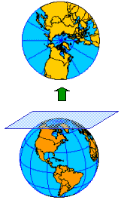
Azimuthal Projection
Planar or Azimuthal Projections: simply project a globe onto a flat plane
Any point of contact may be used but the poles are most commonly used
When another location is used, it is generally to make a small map of a specific area
When the poles are used, longitude lines look like hub and spokes
Source: ESRI

Slide 49
Pop Question
Consider the following classes of transformations for Euclidean spaces
  Translation – Move all objects linearly in same direction by same amount
  Similarity – Either rotate all objects in same direction around an axis OR Perform rotation followed by uniform scaling
  Projective – Using a light source and a mapping plane. For this question assume that all objects are on a plane and there is light source outside the plane.
  Topological – For this question assume that all objects are on a plane. You can perform elastic deformation of the plane without tear.
… Contd on next slide

Slide 50
Pop Question
Which of the following are preserved by each of the previous mentioned transformations:
Shape → Circle should stay as circle and not change to ellipse.
Size → Relative sizes are maintained.
Distance → All distances expand or shrink by the same factor.
Direction → If an object is 45 N of object B it remains so.
Occlusion (in front of) → If the only way to reach object C from A is through C, then it remains so. Further assume that you can move only in straight lines.

Slide 51
Mathematical Definitions of transformations
Translation (e.g., moving an object linearly)
  Moves every point of a figure or a space by the same amount in a given direction.
  Refer: https://en.wikipedia.org/wiki/Translation_(geometry)
Similarity (e.g., rotation, rotation & scaling)
  A circle should stay circle and not change to ellipse.
  Refer: https://en.wikipedia.org/wiki/Similarity_(geometry)
  https://en.wikipedia.org/wiki/Scaling_(geometry)
Projective (e.g., slide projectors)
  Project objects onto a plane; we have a light source and a mapping plane
  http://www.geom.uiuc.edu/docs/reference/CRC-formulas/node16.html
Topological (e.g., elastic deformation without tear)

Slide 52
Pop Question
Consider the following classes of transformations for Euclidean spaces
  Translation (e.g., moving an object linearly)
  Similarity (e.g., rotation, rotation & scaling)
  Projective (e.g., slide projectors)
  Topological (e.g., elastic deformation without tear)
Which of the above transformations are closest to following map projections
(a) Cylindrical, (b) Azimuthal projection

Slide 53
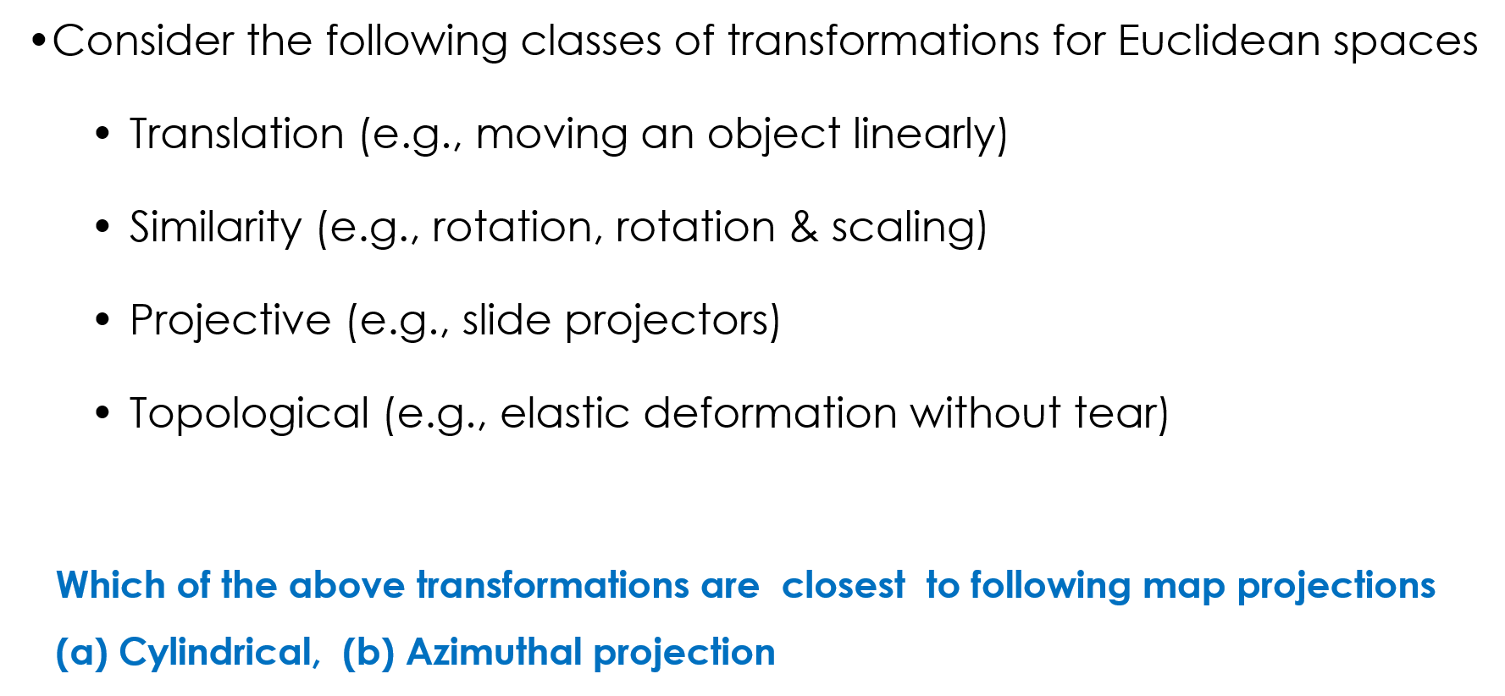
Pop Question
Term “Closest” should be stressed here. In reality all projections are functions which map a geodetic coordinate to an (X,Y) on a plane. This question should be seen only as a thought provoking exercise rather than a mathematical fact
Closest

Slide 54
Pop Question – Answers Cylindrical Proj
Projective (e.g., slide projectors) – YES
  But depends a whole lot of the position of the light source.
  Point source vs Straight line source.
Topological (e.g., elastic deformation without tear) – YES
  Assume a rubber sheet is covered on earth surface to take an imprint and then open up
  Depends on the area of the rubber sheet taken.

Slide 55
Pop Question – Answers Azimuthal Proj
Projective (e.g., slide projectors) – YES
  Can assume a light source at the center of the earth and a mapping plane.
  Depends a whole lot of the position of the light source.
  Refer https://en.wikipedia.org/wiki/Azimuthal_equidistant_projection
Topological (e.g., elastic deformation without tear) – YES

