Slide 1
Database System Implementation CSE 507
Introduction and File Structures
Some slides adapted from R. Elmasri and S. Navathe, Fundamentals of Database Systems, Sixth Edition, Pearson.
And Silberschatz, Korth and Sudarshan Database System Concepts – 6th Edition.

Slide 2
Course Logistics
Two classes per week
  Monday and Thursday 10:00am – 11:30am
People Involved
Course Textbook:
  R. Elmasri and S. Navathe, Fundamentals of Database Systems, 6th edition, Pearson.
  H. Garcia-Molina, J. Ullman and J. Widom. Database System. 6th edition, Pearson.
Dr. Viswanath Gunturi | Instructor
Ashish Bandil | Teaching Assistant
Sachin Negi | Teaching Assistant
Manisha Dubey | Teaching Assistant
Shivangi Yadav | Teaching Assistant

Slide 3
Deliverables
4 homework assignments (10% each) to be done in a team (2 students only)
  containing both textbook and programming parts
2 Exams (15% and 20%)
2 Quizzes (9% each)
A teaser presentation 7% to be done in a team of 2 students.

Slide 4
Policies
Academic Dishonesty policy of IIIT Delhi does apply
http://www.iiitd.ac.in/education/resources/academic-dishonesty
Makeup Exam or Quiz Policy
Late submission policy on homeworks
Policies from TAs and TFs
Course Web page:
  http://faculty.iiitd.ac.in/~gunturi/courses/win16/cse507/index.html
  Please check the course page for updates

Slide 5
Overview of the Course

Slide 6
Schematic of a Database System
Conceptual Models
Logical Model
Physical Model
A Database System

Slide 7
Schematic of a Database System
Conceptual Models
Goal: Capture the real world concepts to be modeled in the application
E.g., ER diagrams
Logical Model
Physical Model
A Database System

Slide 8
Schematic of a Database System
Conceptual Models
Goal: Mathematical representation of the application related concepts.
E.g., relational operators, select project, join, normal forms, SQL queries.
Logical Model
Physical Model
A Database System

Slide 9
Schematic of a Database System
Conceptual Models
Logical Model
Goal: Implement the mathematical concepts into a scalable system code which works for a variety of datasets.
Physical Model
A Database System

Slide 10
Schematic of a Database System
Conceptual Models
Logical Model
Physical Model
Focus of this course!
A Database System

Slide 11
Why is this a part of Data Engineering Stream?
“Rules” governing the scalability go beyond the traditional big-O asymptotic analysis
They dependent on the nature of data.
No clear dominance among query processing algorithms
  For e.g., a O(n²) algorithm may be better than O(nlog n)
The system needs to take decisions depending on input data.
Take away skill: Ability to think from a system’s perspective.
  Under what conditions (properties of data) would this work better?
  What parameters define this dominance zone?

Slide 12
Topics Covered
Introduction and File Structures
Index Structures
Query processing techniques
Query Optimization
Transactions
Concurrency Control
Recovery
Database Security
Object-Relational Databases
Distributed Databases
XML Databases
Introduction to Data Mining

Slide 13
Topics Covered
Introduction and File Structures
Index Structures
Query processing techniques
Query Optimization
Transactions
Concurrency Control
Recovery
Database Security
Object-Relational Databases
Distributed Databases
XML Databases
Introduction to Data Mining
Post Condition 1: Define and Interpret the basic terminologies across these topics.

Slide 14
Topics Covered
Introduction and File Structures
Index Structures
Query processing techniques
Query Optimization
Transactions
Concurrency Control
Recovery
Database Security
Object-Relational Databases
Distributed Databases
XML Databases
Introduction to Data Mining
Post Condition 2: Apply the common algorithms for these topics and analyze the results

Slide 15
Topics Covered
Introduction and File Structures
Index Structures
Query processing techniques
Query Optimization
Transactions
Concurrency Control
Recovery
Database Security
Object-Relational Databases
Distributed Databases
XML Databases
Introduction to Data Mining
Post Condition 3: Evaluate alternative query processing strategies and recommend the best one.
For both traditional relational databases and some new ones

Slide 16
Basics on Disk Storage

Slide 17
Memory Hierarchies and Storage Devices
Computer storage media forms a storage hierarchy that includes:
Primary Storage
  CPU cache (static RAM).
  Main memory (dynamic RAM).
  Fast but more expensive.
  Both are volatile in nature.
Secondary Storage
  Magnetic disks
  Optical disks, e.g., CD-ROMs, DVDs etc.
  Not-so expensive, slower that primary storage
  Non-volatile in nature.

Slide 18
Memory Hierarchies and Storage Devices
Newly emerging Flash memory
  Non-volatile
  Speed-wise somewhat between DRAM and magnetic disks
  Based on “Electronically erasable programmable Read-Only memory”
  Disadvantage: an entire block must be erased and written over.
  Also it can have only a finite number of erases.

Slide 19
Storage of Databases
They are usually too large to fit in main memory.
Also they need to store data that must persist over time.
We prefer secondary storage devices, e.g., magnetic disks.
Why do we need to be smart about storing databases?
Databases typically large amounts of data are important.
A poor design may lead to increase in query, insert, delete and recovery times.
Imagine requirements for systems like airline reservations, and VISA transactions.

Slide 20
Storage of Databases
Primary File Organization
How file records are physically stored on the disk?
Heap file
Sorted file
Hashed file.
Secondary File Organization
An auxiliary access structure
Allows efficient access to file records based on alternate fields.
They mostly exist as indexes.

Slide 21
Secondary Storage Devices: Magnetic Disk
Data stored as magnetized areas on magnetic disk surfaces.
Disks are divided into concentric circular tracks on each disk surface.
A track is divided into smaller blocks or sectors
  because it usually contains a large amount of information
The division of a track into sectors is hard-coded on the disk surface
  A portion of a track that subtends a fixed angle at the center as a sector.
  This angle can be fixed or decrease as we move outward.

Slide 22
Secondary Storage Devices: Magnetic Disk

Slide 23
Secondary Storage Devices: Magnetic Disk
Division of a track into equal-sized disk blocks (or pages)
Done by the operating system during formatting.
Typical disk block range from 512 – 8192 bytes.
Whole blocks are transferred between disk and main memory for processing.

Slide 24
Secondary Storage Devices: Magnetic Disk

Slide 25
Accessing a Magnetic Disk
A disk is a random access addressable device.
Transfer between main memory and disk takes place in units of disk blocks.
Hardware address of a block is a combination of
  Cylinder number
  Track number
  Sector/block number within the track.

Slide 26
Accessing a Magnetic Disk
Step 1: Mechanically position the read/write head to correct track/cylinder.
  Time required to do → Seek time.
Step 2: Beginning of the desired block rotates into position under the read/write head.
  Time required to do so → Rotational delay or latency.
Step 3: A block worth of data is transferred
  Time required to do so → Block transfer time.
Total time required = Seek time + Rotational delay + Block transfer time.
Seek time and rotational delay are much larger than the block transfer time.

Slide 27
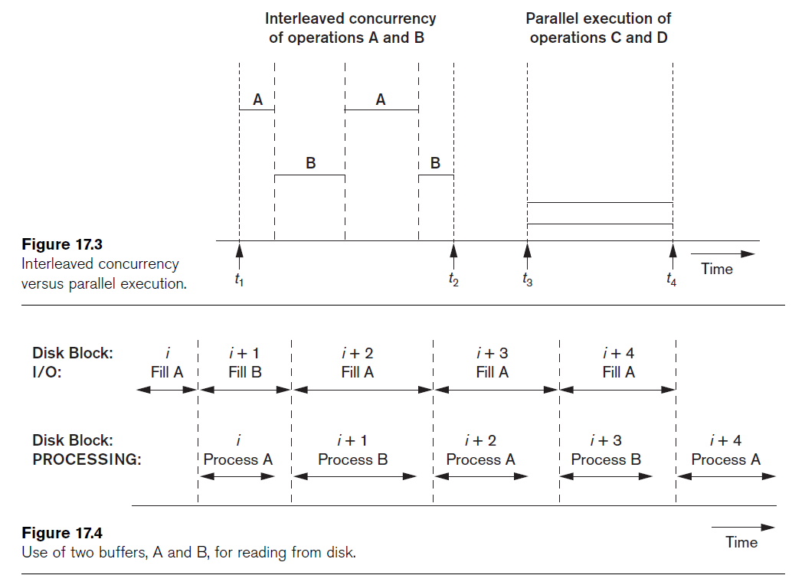
Double Buffering
A technique used for processes running concurrently in an interleaved fashion.
Made possible as we typically have an independent I/O processor.

Slide 28
Placing Files Records on Disk

Slide 29
Types of Records
Records contain fields which have values of a particular type
  E.g., amount, date, time, age
Records may be of fixed length or of variable length.
Variable Length Records can be due to:
  Variable length fields (e.g, varchar).
  Some fields may have multiple values.
  Some fields may be optional.
  We can have different kind of records.

Slide 30
How to put these on a disk?
Fixed length records → Each field can be easily identified from first byte.
Handling Variable Length Records :
  Variable length fields (e.g, varchar).
  Some fields may have multiple values.
  Some fields may be optional.
  We can have different kind of records.

Slide 31
How to put these on a disk?
Fixed length records → Each field can be easily identified from first byte.
Handling Variable Length Records :
  Variable length fields (e.g, varchar) → Separator character after the field
  Some fields may have multiple values.
  Some fields may be optional.
  Different kinds of records.

Slide 32
How to put these on a disk?
Fixed length records → Each field can be easily identified from first byte.
Handling Variable Length Records :
  Variable length fields (e.g, varchar).
  Fields may have multiple values. → Two separator characters
  Some fields may be optional.
  Different kinds of records.

Slide 33
How to put these on a disk?
Fixed length records → Each field can be easily identified from first byte.
Handling Variable Length Records :
  Variable length fields (e.g, varchar).
  Fields may have multiple values.
  Some fields may be optional. → Store <field-name , field-value>
  Different kinds of records.

Slide 34
How to put these on a disk?
Fixed length records → Each field can be easily identified from first byte.
Handling Variable Length Records :
  Variable length fields (e.g, varchar).
  Fields may have multiple values.
  Some fields may be optional.
  Different kinds of records → Include a record-type character.

Slide 35
Blocking
Blocking:
  Refers to storing a number of records in one block on the disk.
Blocking factor (bfr) refers to the number of records per block.
There may be empty space in a block if an integral number of records do not fit in one block.
Spanned Records:
  Refers to records that exceed the size of one or more blocks and hence span a number of blocks.
Variable vs Fixed length records.

Slide 36
Files of Records
File records can be unspanned or spanned
  Unspanned: no record can span two blocks
  Spanned: a record can be stored in more than one block
The physical disk blocks that are allocated to hold the records of a file can be contiguous, linked, or indexed.
In a file of fixed-length records, all records have the same format. Usually, unspanned blocking is used with such files.
Files of variable-length records require additional information to be stored in each record, such as separator characters and field types.
  Usually spanned blocking is used with such files.

Slide 37
Files of Unordered Records
Also called a heap or a pile file.
New records are inserted at the end of the file.
A linear search through the file records is necessary to search for a record.
  This requires reading and searching half the file blocks on the average, and is hence quite expensive.
Record insertion is quite efficient.
Reading the records in order of a particular field requires sorting the file records.
What about deletion? How can we make it little bit more efficient?

Slide 38
Files of Ordered Records
File records are kept sorted by the values of an ordering field.
Insertion is expensive: records must be inserted in the correct order.
  It is common to keep a separate unordered overflow (or transaction) file for new records to improve insertion efficiency; this is periodically merged with the main ordered file.
A binary search can be used to search for a record on its ordering field value.
Reading the records in order of the ordering field is quite efficient.
Deletion handled through deletion markers and re-organization
Updating a field ? Key vs Non-Key attribute.

Slide 39
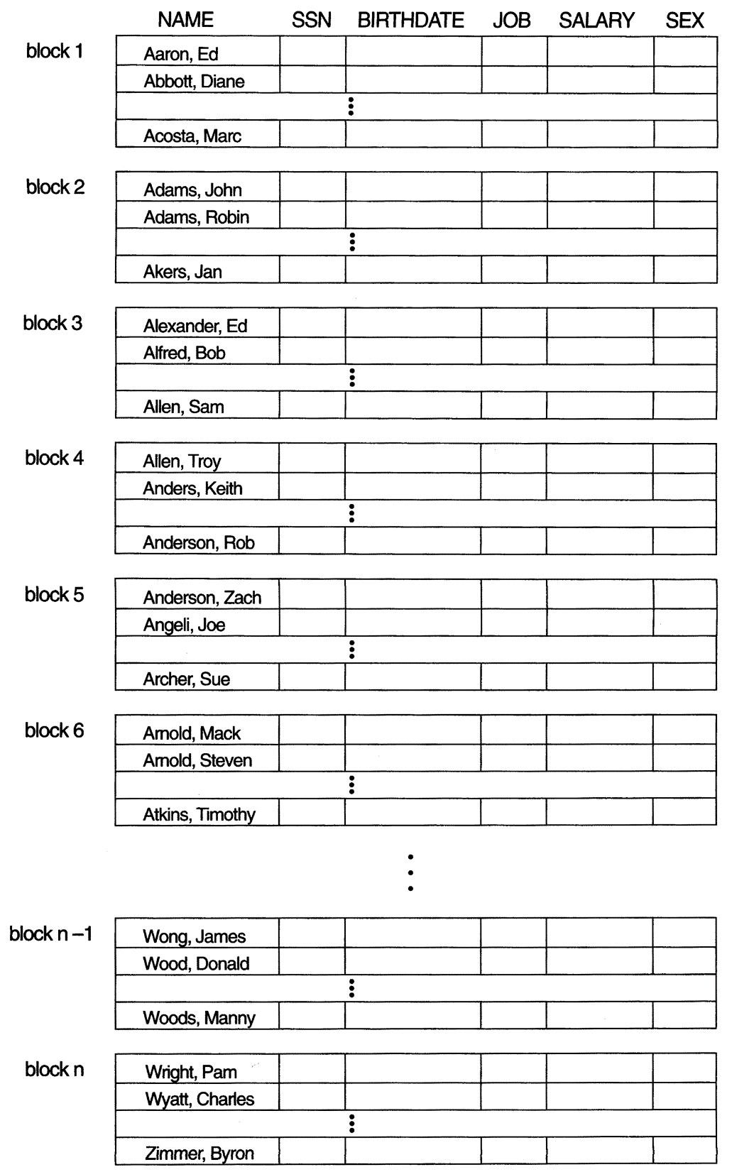
Files of Ordered Records

Slide 40
Hashing Techniques

Slide 41
Introduction to Hashing
Each data-item with hash key value K is stored in location i, where i=h(K), and h is the hashing function.
Search is very efficient on the hash key.
Collisions occur when a new record hashes to a address that is already full
  An overflow file is kept for storing such records.

Slide 42
Static Hashing
A bucket is a unit of storage containing one or more records (a bucket is typically a disk block).
In a hash file organization we obtain the bucket of a record directly from its search-key value using a hash function.
Hash function h is a function from the set of all search-key values K to the set of all bucket addresses B.
Hash function is used to locate records for access, insertion as well as deletion.
Records with different search-key values may be mapped to the same bucket; thus entire bucket has to be searched sequentially to locate a record.

Slide 43
Example File organization with Hashing
Hash file organization of instructor file, using dept_name as key
(See figure in next slide.)
There are 10 buckets,
The binary representation of the ith character is assumed to be the integer i.
The hash function returns the sum of the binary representations of the characters modulo 10
  E.g. h(Music) = 1 h(History) = 2
  h(Physics) = 3 h(Elec. Eng.) = 3

Slide 44

Example File organization with Hashing
Hash file organization of instructor file, using dept_name as key (see previous slide for details).

Slide 45
Mapping to Secondary Memory

Slide 46
Desirable properties of a Hash Function
Worst hash function maps all search-key values to the same bucket;
An ideal hash function is uniform, i.e., each bucket is assigned the same number of search-key values from the set of all possible values.
Ideal hash function is random, so each bucket will have the same number of records assigned to it irrespective of the actual distribution of search-key values in the file.
Typical hash functions perform computation on the internal binary representation of the search-key.
  For example, for a string search-key, the binary representations of all the characters in the string could be added and the sum modulo the number of buckets could be returned. .

Slide 47
Handling Collisions Hashing
Bucket overflow can occur because of
  Insufficient buckets
  Skew in distribution of records. This can occur due to two reasons:
    multiple records have same search-key value
    chosen hash function produces non-uniform distribution of key values

Slide 48
Handling Collisions Hashing
There are numerous methods for collision resolution:
  Open addressing: Proceeding from the occupied position specified by the hash address, the program checks the subsequent positions in order until an unused (empty) position is found.
  Chaining: For this method, various overflow locations are kept, usually by extending the array with a number of overflow positions.
Which of these are suitable for Databases?

Slide 49
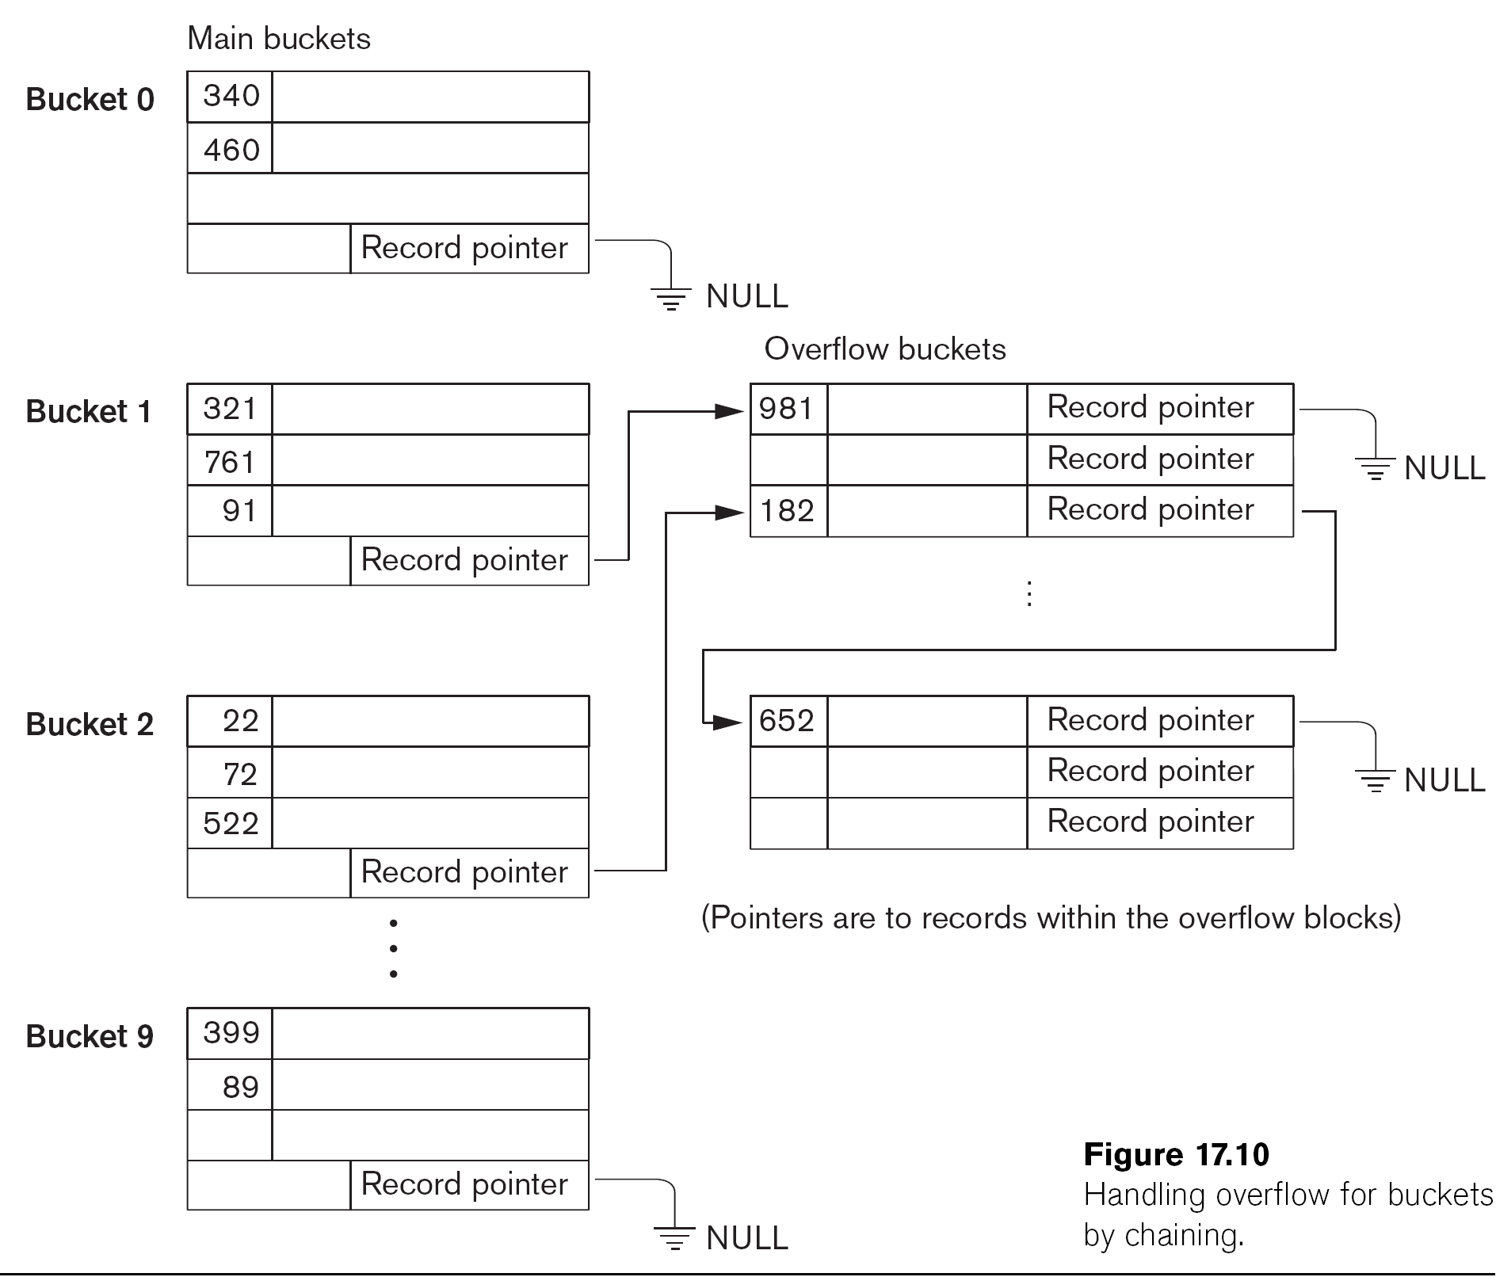
Handling Collisions in Hashing

Slide 50
Lets Evaluate Static Hashing
Think in following terms:
Time required for search and insert.
Space utilization

Slide 51
Lets Evaluate Static Hashing
In static hashing, function h maps search-key values to a fixed set of B of bucket addresses. Databases grow or shrink with time.
  If initial number of buckets is too small, and file grows, performance will degrade due to too much overflows.
  If space is allocated for anticipated growth, a significant amount of space will be wasted initially (and buckets will be underfull).
  If database shrinks, again space will be wasted.
One solution: periodic re-organization of the file with a new hash function
  Expensive, disrupts normal operations

Slide 52
Hashing For Dynamic File Extension
Allows the hash function to be modified dynamically
Extendible hashing – one form of dynamic hashing
  Hash function generates values over a large range — typically b-bit integers, with b = 32.
  At any time use only a prefix of the hash function to index into a table of bucket addresses.
  Let the length of the prefix be i bits, 0 ≤ i ≤ 32.
    Bucket address table size = 2^{i.} Initially i = 0
    Value of i grows and shrinks as the size of the database grows and shrinks.
  Multiple entries in the bucket address table may point to a bucket (why?)

Slide 53
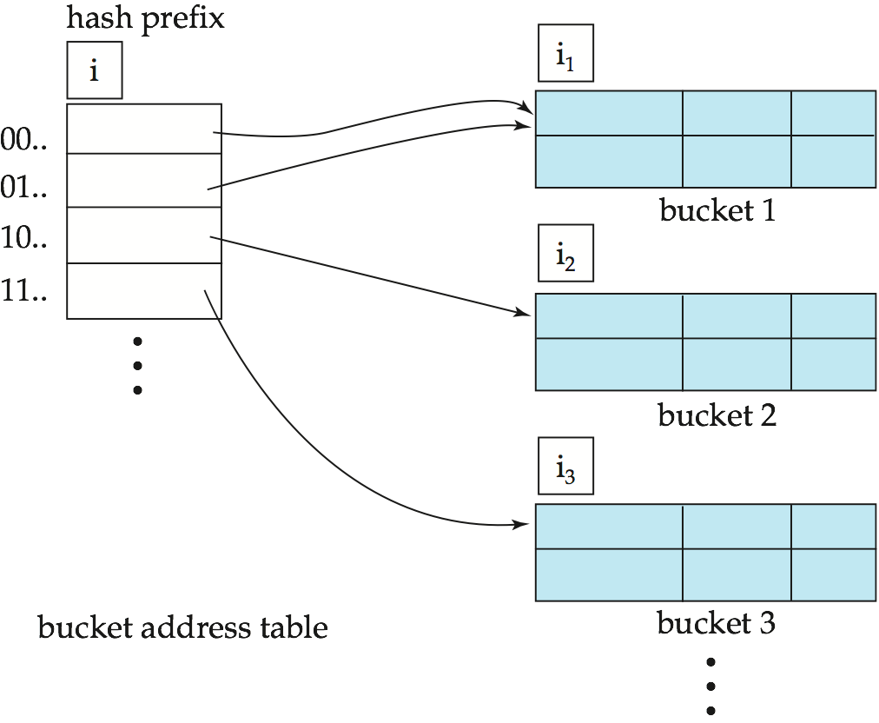
Extendible Hashing
Global Depth
Local Depth
Local Depth
Local Depth

Slide 54
Extendible Hashing
Local Depth: Each bucket j stores a value i_{j}
  All the entries that point to the same bucket have the same values on the first i_{j} bits.
To locate the bucket containing search-key K:
  1. Compute h(K) = X
  Use the first i high order bits of X as a displacement into bucket address table, and follow the pointer to appropriate bucket
To insert a record with search-key value K
  follow same procedure as look-up and locate the bucket, say j.
  If there is room in the bucket j insert record in the bucket.
  Else the bucket must be split and insertion re-attempted.

Slide 55
Splitting a bucket in Extendible Hash
If Global Depth > Local Depth i > i_{j} (more than one pointer to bucket j)
  Allocate a new bucket z, and set i_{j} = i_{z} = (i_{j} + 1)
  Update the second half of the bucket address table entries originally pointing to j, to point to z
  Remove each record in bucket j and reinsert (in j or z)
  Recompute new bucket for K and insert record in the bucket (further splitting is required if the bucket is still full)

Slide 56
Splitting a bucket in Extendible Hash
If Global Depth = Local Depth (only one pointer to bucket j)
  If i reaches some limit b, or too many splits have happened in this insertion, create an overflow bucket
  Else
    increment i and double the size of the bucket address table.
    replace each entry in the table by two entries that point to the same bucket.
    recompute new bucket address table entry for K
    Now i > i_{j} so use the first case above.

Slide 57
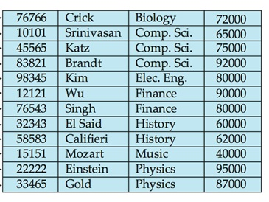
Illustrating an Extendible Hash: Dataset

Slide 58
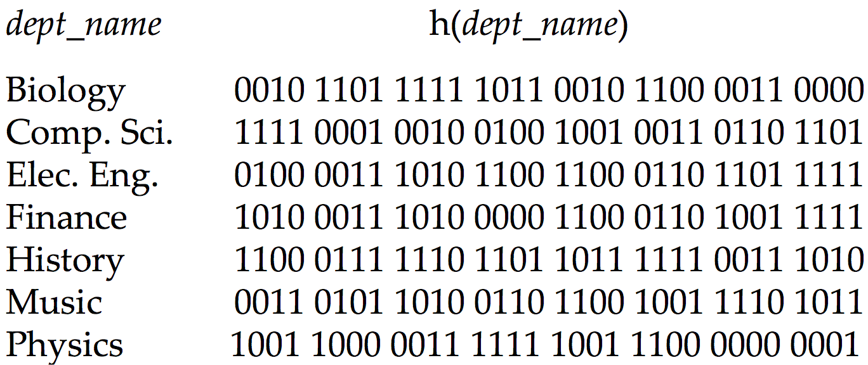
Illustrating an Extendible Hash

Slide 59
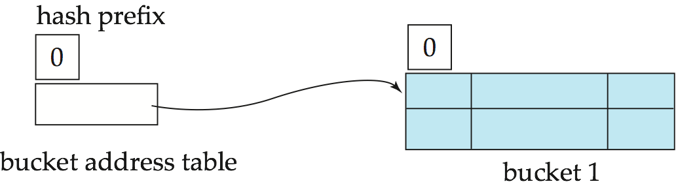
Illustrating an Extendible Hash
Initial Hash structure; bucket size = 2

Slide 60
Illustrating an Extendible Hash
Initial Hash structure; bucket size = 2
Global Depth
Local Depth
Insert this
Record

Slide 61
Illustrating an Extendible Hash
Initial Hash structure; bucket size = 2
Global Depth
Local Depth
10101
Srinivasan
Comp Sci
Insert this
Record

Slide 62
Illustrating an Extendible Hash
Initial Hash structure; bucket size = 2
Global Depth
Local Depth
10101
Srinivasan
Comp Sci
Insert this
Record

Slide 63
Illustrating an Extendible Hash
Initial Hash structure; bucket size = 2
Global Depth
Local Depth
10101
Srinivasan
Comp
15151
Mozart
Music
Insert this
Record

Slide 64
Illustrating an Extendible Hash
Initial Hash structure; bucket size = 2
Global Depth
Local Depth
10101
Srinivasan
Comp
15151
Mozart
Music
Insert this
Record

Slide 65
Illustrating an Extendible Hash
Initial Hash structure; bucket size = 2
Local Depth == Global Depth
Directory size needs to increase
Global Depth
Local Depth
10101
Srinivasan
Comp
15151
Mozart
Music
Insert this
Record

Slide 66
Illustrating an Extendible Hash
Step 1: Increase the directory size
Local Depth == Global Depth
Directory size needs to increase
Global Depth
1
Hash Prefix
0
1

Slide 67
Illustrating an Extendible Hash
Step 2: Re-hash all the old records
Re-Hash all the old Records + the new record
Global Depth
1
Hash Prefix
0
1

Slide 68
Illustrating an Extendible Hash
Step 2: Re-hash all the old records
Re-Hash all the old Records + the new record
Global Depth
1
Hash Prefix
15151
Mozart
Music
4000
0
1

Slide 69
Illustrating an Extendible Hash
Step 2: Re-hash all the old records
Re-Hash all the old Records + the new record
Global Depth
1
Hash Prefix
15151
Mozart
Music
4000
0
1

Slide 70
Illustrating an Extendible Hash
Step 2: Re-hash all the old records
Re-Hash all the old Records + the new record
Global Depth
1
Hash Prefix
15151
Mozart
Music
4000
0
1
10101
Srinivasan
Comp
65000

Slide 71
Illustrating an Extendible Hash
Step 2: Re-hash all the old records
Re-Hash all the old Records + the new record
Global Depth
1
Hash Prefix
15151
Mozart
Music
4000
0
1
10101
Srinivasan
Comp
65000

Slide 72
Illustrating an Extendible Hash
Step 2: Re-hash all the old records
Re-Hash all the old Records + the new record
Global Depth
1
Hash Prefix
15151
Mozart
Music
4000
0
1
10101
Srinivasan
Comp
65000
12121
Wu
Finance
90000

Slide 73
Illustrating an Extendible Hash
Step 2: Re-hash all the old records
Global Depth
1
Local Depth
1
Hash Prefix
15151
Mozart
Music
4000
0
1
1
10101
Srinivasan
Comp
65000
12121
Wu
Finance
90000

Slide 74
Illustrating an Extendible Hash
Global Depth
1
Local Depth
1
Hash Prefix
15151
Mozart
Music
4000
0
1
1
10101
Srinivasan
Comp
65000
12121
Wu
Finance
90000
Insert this
Record

Slide 75
Illustrating an Extendible Hash
Where will this record go?
Global Depth
1
Local Depth
1
Hash Prefix
15151
Mozart
Music
4000
0
1
1
10101
Srinivasan
Comp
65000
12121
Wu
Finance
90000
Insert this
Record

Slide 76
Illustrating an Extendible Hash
One more directory split
Global Depth
1
Local Depth
1
Hash Prefix
15151
Mozart
Music
4000
0
1
1
10101
Srinivasan
Comp
65000
12121
Wu
Finance
90000
Insert this
Record

Slide 77
Illustrating an Extendible Hash
Now splitting the bucket
Global Depth
2
Hash Prefix
15151
Mozart
Music
4000
00
01
10
10101
Srinivasan
Comp
65000
12121
Wu
Finance
90000
11

Slide 78
Illustrating an Extendible Hash
Re-inserting the old records
Global Depth
2
Hash Prefix
15151
Mozart
Music
4000
00
01
10
12121
Wu
Finance
90000
11
10101
Srinivasan
Comp
65000

Slide 79
Illustrating an Extendible Hash
Insert the new record
Global Depth
2
Hash Prefix
15151
Mozart
Music
4000
00
01
10
12121
Wu
Finance
90000
11
22222
Einstein
Physics
95000
10101
Srinivasan
Comp
65000

Slide 80
Illustrating an Extendible Hash
Global Depth
2
Hash Prefix
15151
Mozart
Music
4000
00
01
10
12121
Wu
Finance
90000
11
22222
Einstein
Physics
95000
10101
Srinivasan
Comp
65000

Slide 81
Illustrating an Extendible Hash
What will be the local depth of these buckets?
Global Depth
2
Hash Prefix
15151
Mozart
Music
4000
00
01
10
12121
Wu
Finance
90000
11
22222
Einstein
Physics
95000
10101
Srinivasan
Comp
65000

Slide 82
Illustrating an Extendible Hash
Global Depth
2
1
Local Depth
Hash Prefix
15151
Mozart
Music
4000
00
01
Local Depth
10
2
12121
Wu
Finance
90000
11
22222
Einstein
Physics
95000
10101
Srinivasan
Comp
65000

Slide 83
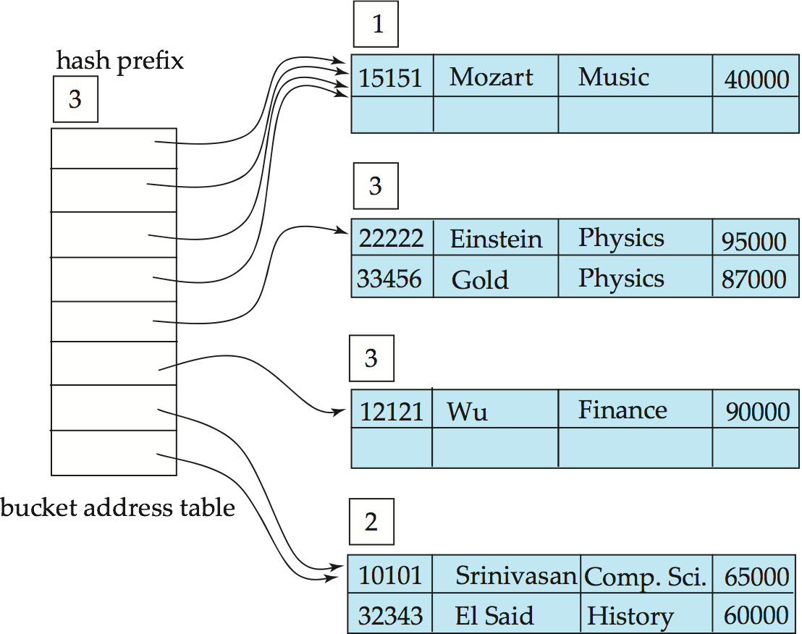
Illustrating an Extendible Hash
Assume two more records come to this bucket

Slide 84
Comments on Extendible Hash
Benefits of extendable hashing:
  Hash performance does not degrade with growth of file
  Minimal space overhead
Disadvantages of extendable hashing
  Extra level of indirection to find desired record
  Bucket address table may itself become very big
    Cannot allocate very large contiguous areas on disk either
  Changing size of directory (aka bucket address table) is expensive
Linear hashing is an alternative mechanism

Slide 85
Comments on Extendible Hash
Expected type of queries:
  Hashing is generally better at retrieving records having a specified value of the key.
  If range queries are common, ordered indices are to be preferred

Slide 86
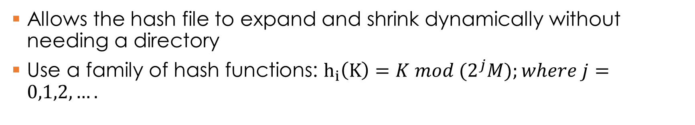
Linear Hashing
Allows the hash file to expand and shrink dynamically without needing a directory
Use a family of hash functions: $h_{i}\left(K\right)=K mod (2^{j}M);where j=0,1,2,….$
File grows linearly
-> No bucket directory needed

