Slide 1
Database System Implementation CSE 507
Indexing Structures
Some slides adapted from Silberschatz, Korth and Sudarshan Database System Concepts – 6th Edition.
And O’Neil et. Al., “Improved Query Performance with Variant Indexes,” ACM SIGMOD 1997.

Slide 2
Duplicates in a B+ tree
 | Mens*
Leaf Node
 | MensFormals |  | MensJeans
R200 | Hugo Boss 2PC | $600
R190 | Levis- Medium | $50
R150 | Gap - Large | $45
… | … | …
RID
Sales Table indexed on the Department column

Slide 3
Bitmaps– A better way to index duplicates
A bitmap is simply an array of bits
Records in a relation are numbered sequentially from 0 to n.
Applicable on attributes that take on a relatively small number of distinct values
E.g. gender, country, state, …
E.g. income-level (income broken up into a small number of levels such as 0-9999, 10000-19999, 20000-50000, 50000- infinity)
Material adapted from Silberchatz, Korth and Sudarshan

Slide 4
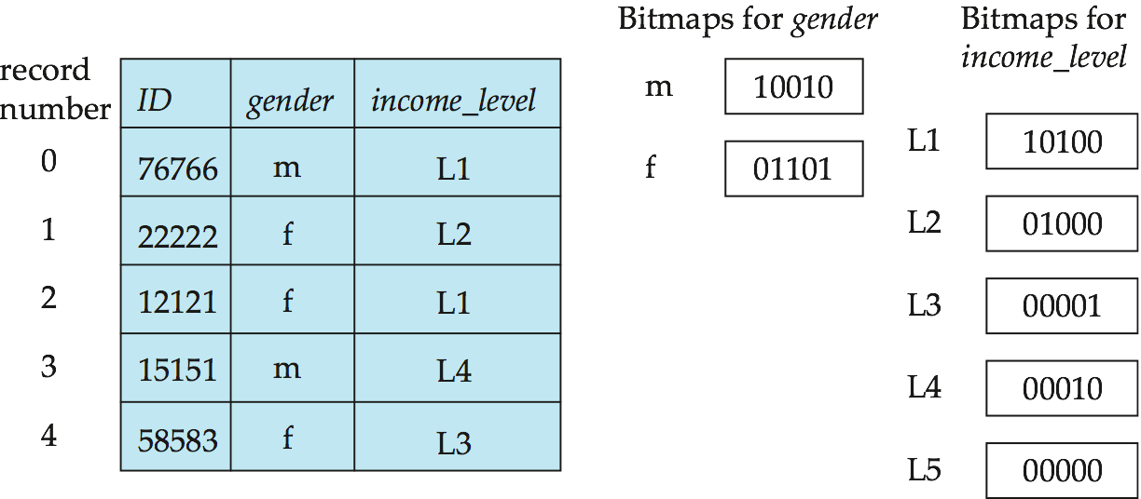
Bitmap Indices
A bitmap index on an attribute has a bitmap for each value of the attribute
Bitmap has as many bits as records
In a bitmap for value v, the bit for a record is 1 if the record has the value v for the attribute, and is 0 otherwise.
Material adapted from Silberchatz, Korth and Sudarshan

Slide 5
Queries on Bitmap Indices
Queries are answered using bitmap operations
Intersection (and)
Union (or)
Complementation (not)
Material adapted from Silberchatz, Korth and Sudarshan

Slide 6
Queries on Bitmaps
Each operation takes two bitmaps of the same size and applies the operation on corresponding bits to get the result bitmap
E.g. 100110 AND 110011 = 100010
100110 OR 110011 = 110111 NOT 100110 = 011001
Males with income level L1: 10010 AND 10100 = 10000
Can then retrieve required tuples.
Counting number of matching tuples is also fast.
Material adapted from Silberchatz, Korth and Sudarshan

Slide 7
Queries on Bitmaps
Bitmaps need to be updated after insert operations.
Deletion needs to be handled properly.
Renumbering rows and shifting bits in bitmaps becomes expensive.
Existence bitmap to note if there is a valid record at a record location
Needed for complementation
not(A=v): (NOT bitmap-A-v) AND ExistenceBitmap
Material adapted from Silberchatz, Korth and Sudarshan

Slide 8
Some Implementation Details
Bitmap indices generally very small compared with relation size.
Density of a bitmap index:
Said to be dense if number of 1-bits are large.
For a column with 32 values → avg density = 1/32
Typically we would have millions of RowIDs in a bitmap.
In such a case bitmaps can be broken into fragments of equal size.
Each fragment fits into a single disk page/block.
If bitmaps are sparse, then convert into a RowID list representation.
If a column has many unique values then put a B+ tree on top of bitmaps for a column.

Slide 9
Some Implementation Details
A series of bitmap fragments making up the entry for “department = sports” for a bitmap index on the “department” column of a sales table.

Slide 10
Some Implementation Details
Bitmap and RowID-list representations are interchangeable.
When Bitmaps are dense, then prefer bitmap representation
Else switch to a RowID representation.
Indeed a Bitmap index can part RowID lists and part Bitmaps.
Authors call this hybrid form as Value-List Index.

Slide 11
Projection Indexes
Reminiscent of vertical partitioning of a table.
A projection index for column duplicates all column values for lookup by ordinal number .
Col1 | Col2 v1 v2 . . . v_{k} | Col3 | Col4
Col2 v1 v2 . . . v_{k}
projection index for col2

Slide 12
Projection Indexes
If Column length = 4Bytes; Page size = 4000 Bytes then index blocking factor = 1000
Given a row number r, page p = r/1000 ; slot s = r%1000.
Projection index Vs Plain layout:
If the selectivity of result set of a join = 1/50
We can expect to pick 1000*(1/50) = 20 values per page of the projection index (Assuming uniform dist)
Alternatively, a plain layout can pick only <file blocking factor>*(1/50)
File blocking factor < index blocking factor (records in a file are of larger size than records in index)
Col2 v1 v2 . . . v_{k}
projection index for col2

Slide 13
Bit-Sliced Indexes
A bitmap index on the “bit-level representation” of the column values.
Consider a SALES table which contains rows for all sales made in last month.
We will build a bit sliced index on the “Rupees_amount”
Interpret each amount in term of N+1 bits.
A function D(n,i) is defined for a row number n in the table:
D(n, 0) = 1 if the 1st (LSB) bit for “Rupees_amount” in row number n is on.
D(n, 1) = 1 if the 2nd bit for “Rupees_amount” in row number n is on.
…
D(n, i) = 1 if the i^{th} bit for “Rupees_amount” in row number n is on.

Slide 14
Bit-Sliced Indexes
B₅
0 1 0 1 0 1 0 1
1 1 1 1 0 0 0 1
0 0 0 1 1 0 0 0
1 1 1 1 0 0 0 0
0 0 0 1 1 1 0 0
0 0 0 0 0 0 1 1
bit-slice
B₄
B₃
B₂
B₁
B₀
Col2: 20 52 20 62 10 34 1 49
B_{nn}: bitmap representing set of rows non null values
in the indexed column;
We can have a different Existence Bitmap in addition to B_{nn}

Slide 15
Bit-Sliced Indexes
Now for each value of i = 0, 1,…. N.
Such that D(n, i) > 0 for some row in the SALES table.
We define Bitmap B_{i} whose n^{th} bit would contain D(n, i)
If we consider each bit to be 1 Paisa;
Then for just N = 25, we can represent up to Rs 3.35 Lakhs
Much more than a typical transaction in a departmental stores.

Slide 16
Question: Compare bit-sliced against a traditional bitmap index for “Rupees_amount”

Slide 17
Using Indexes for Aggregation
SALES table: 100 Million rows; Each row 200 bytes;
File blocking factor = 20; Size of Page/disk block = 4000 Bytes
Query: Select SUM(Rupee_amount) From SALES Where condition
Assume the following:
The Where condition returns 2,000,000 rows.
These are uniformly distributed and have already been determined.
B_{f} denotes a bitmap of this result set. We can assume it to be in Main Mem (about 12 Mb in size)

Slide 18
Direct Access for Aggregation
Query Plan 1:
Direct access to the table to calculate the SUM
Each disk page contains 20 rows
Total number of pages in the file = 5,000,000
Result set is about 1/50 of the rows in the table.
We will loop through the B_{f} and retrieve “Rupees_amount” from all the rows spread across 5,000,000 pages.
Under uniform distribution, we can expect to get about 0.4 records per page, in other words need to read about 2,000,000 pages.

Slide 19
Projection Index for Aggregation
Query Plan 2:
Use a Projection on “Rupees_Amount”; Column width = 4Bytes.
Each disk page contains 4000/4 = 1000 values of the “Rupees_Amount”
Total number of pages in the index file = 100,000
Result set is about 1/50 of the rows in the SALES table.
We will loop through the B_{f} and retrieve “Rupees_amount” from all the rows spread across 100,000 pages.
Under uniform distribution, we can expect to get 20 records in each page. Need to read all the 100,000 pages.

Slide 20
Value-List Index for Aggregation
Query Plan 3:
Use a Value-List index (Bitmap) on “Rupees_Amount”;
IF (COUNT(B_{f} AND B_{nn}) == 0) /*All rows in the result set have NULL for rupees*/
Return NULL;
SUM = 0.0
For each non-null value v in the bitmap index of “Rupees_Amount”{
Designate the set of rows with the value v as B_{v}
SUM += v* COUNT(B_{f} AND B_{v});
}
Return SUM

Slide 21
Value-List Index for Aggregation (1/3)
IF (COUNT(B_{f} AND B_{nn}) == 0)
Return NULL;
SUM = 0.0
For each non-null value v in the index of “Rupees_Amount”{
Designate the set of rows with the value v as B_{v}
SUM += v* COUNT(B_{f} AND B_{v});
}
Values in “Rupees_Amount” are counted in Paisa with 20 bits each,
we can have about 10,000 distinct values
10,001 COUNTs and 10,001 ANDs
If B_{v} is in RowIDs of 4 bytes each.
Under uniform dist → each B_{v} 10,000 RowIDs; or 1000 per page over 10pages;

Slide 22
Value-List Index for Aggregation (2/3)
IF (COUNT(B_{f} AND B_{nn}) == 0)
Return NULL;
SUM = 0.0
For each non-null value v in the index of “Rupees_Amount”{
Designate the set of rows with the value v as B_{v}
SUM += v* COUNT(B_{f} AND B_{v}); }
If B_{v} is in RowIDs of 4 bytes each.
Under uniform dist → each B_{v} 10,000 RowIDs; or 1000 per page over 10pages;
Loop over Bf for AND and COUNT; would bring in 10 pages
Total cost = 10,000 * 10 + leaf scan of B+ over 10,000 distinct values of “Rupees_Amount” + cost of 1 AND and 1 COUNT
If Bf is also in secondary memory then additional 3125 pages for first time

Slide 23
Value-List Index for Aggregation (3/3)
IF (COUNT(B_{f} AND B_{nn}) == 0)
Return NULL;
SUM = 0.0
For each non-null value v in the index of “Rupees_Amount”{
Designate the set of rows with the value v as B_{v}
SUM += v* COUNT(B_{f} AND B_{v}); }
If B_{v} is in Bitmap form.
Each B_{v} is 100 Million bits; or 12,500,000 bytes; 3125 pages.
Loop over Bf for AND and COUNT; would bring in 3125 pages
Total cost = 10,000 * 3125 + leaf scan of B+ over 10,000 distinct values of “Rupees_Amount” + cost of 1 AND and 1 Count

Slide 24
Bit-Sliced Index for Aggregation (1/2)
IF (COUNT(B_{f} AND B_{nn}) == 0) /*All rows in the result set have NULL for rupees*/
Return NULL;
SUM = 0.0
For I = 0 to 19 {
SUM += 2^I * COUNT(B_{f} AND B_{i});
}
Return SUM;
Adds bit-­‐slice by bit-­‐slice.
First counts the number of 1s in the 2^0 slice then multiplies by 2^0
Then, counts the number of 1s in the 2^1 slice then multiplies by 2^1
…..

Slide 25
Bit-Sliced Index for Aggregation (2/2)
IF (COUNT(B_{f} AND B_{nn}) == 0)
Return NULL;
SUM = 0.0
For I = 0 to 19 {
SUM += 2^I * COUNT(B_{f} AND B_{v});
}
Return SUM;
21 ANDs and 21 COUNTS
Assuming B_{f} in main memory:
B_{v} is 100 Million Bits; or 12,500,000 bytes; or 3125 pages
Total cost = 21 * 3125 pages.

Slide 26
Using Indexes for Range Predicates
SALES table: 100 Million rows; Each row 200 bytes;
File blocking factor = 20; Size of Page/disk block = 4000 Bytes
Query: Select Target-List From SALES Where C-Range and <Condition>
Assume the following:
C is a column in SALES
<condition> is a general condition based on “equality”
C-range is a range-predicate C> c1, C between c1 and c2,…, etc.

Slide 27
Value-List Index for Range Predicates
B_{r} = Empty Set
For each entry v in the index for C that satisfies the range C {
Designate the set of rows with the value v as B_{v}
B_{r} = B_{r} OR B_{v}
}
B_{F} = B_{f} AND B_{r} /* B_{f} is the result of the <condition> */

Slide 28
Bit-Sliced Index for Range Predicates
B_{GT} = B_{LT} = the empty set; B_{EQ} = B_{NN}
For each Bit-Slice B_{i} for C in decreasing significance{
If bit i is on in the constant c1
B_{LT} = B_{LT} OR (B_{EQ} AND NOT(B_{i}))
B_{EQ} = B_{EQ} AND B_{i}
else
B_{GT} = B_{GT} OR (B_{EQ} AND B_{i})
B_{EQ} = B_{EQ} AND (NOT B_{i})
}
B_{EQ} = B_{EQ} AND B_{f};
…. (similarly for B_{GT}, B_{LT}, …)
B_{LE} = B_{LT} OR B_{EQ}; B_{GE} = B_{GT} OR B_{EQ}
> → B_{GT}
< → B_{LT}
== → B_{EQ}
=< → B_{LE}
>= → B_{GE}
Not Null → B_{NN}

