Slide 1
Database System Implementation CSE 507
Introduction to Transactions
Some slides adapted from Navathe et. Al. and Silberchatz et. Al.

Slide 2
Transaction Concept
A transaction is a unit of program execution that accesses and possibly updates various data items.
E.g., transaction to transfer $50 from account A to account B:
  1. read(A)
  2. A := A – 50
  3. write(A)
  4. read(B)
  5. B := B + 50
  6. write(B)

Slide 3
Required Properties of a Transaction
Transaction to transfer $50 from account A to account B:
  1. read(A)
  2. A := A – 50
  3. write(A)
  4. read(B)
  5. B := B + 50
  write(B)
Atomicity requirement
  If the transaction fails after step 3 and before step 6, money will be “lost” leading to an inconsistent database state
  Updates of a partially executed transaction are not reflected in DB.

Slide 4
Required Properties of a Transaction
Durability requirement —
Once the transaction has been completed, the updates to the database by the transaction must persist even if there are software or hardware failures.

Slide 5
Required Properties of a Transaction
Consistency requirement
consistency requirements include
    Implicit integrity constraints
      e.g., sum of balances of all accounts.
Start of a transaction → must see a consistent database.
During execution the database may be temporarily inconsistent.
At completion the database must be consistent
  Erroneous transaction logic can lead to inconsistency

Slide 6
Required Properties of a Transaction
Isolation requirement — if between steps 3 and 6, another transaction T2 is allowed to access the partially updated database, it will see an inconsistent database
T1 T2
  1. read(A)
  2. A := A – 50
  3. write(A)
  read(A), read(B), print(A+B)
  4. read(B)
  5. B := B + 50
  6. write(B
Isolation can be ensured trivially by running transactions serially
  That is, one after the other.
Would that be desirable?

Slide 7
Required Properties of a Transaction
Atomicity. Either all operations of the transaction are properly reflected in the database or none are.
Consistency. Execution of a transaction in isolation preserves the consistency of the database.
Isolation. Although multiple transactions may execute concurrently, each transaction must be unaware of other concurrently executing transactions. Intermediate transaction results must be hidden from other concurrently executed transactions.
  That is, for every pair of transactions T_{i} and T_{j}, it appears to T_{i} that either T_{j}, finished execution before T_{i} started, or T_{j} started execution after T_{i} finished.
Durability. After a transaction completes successfully, the changes it has made to the database persist, even if there are system failures.

Slide 8
Transaction Concept
Two main issues to deal with:
Concurrent execution of multiple transactions → Concurrency Control Techniques
Hardware failures and system crashes → Recovery System

Slide 9
Why Concurrency Control?

Slide 10
Why Concurrency Control?
The Lost Update Problem
  This occurs when two transactions that access the same database items have their operations interleaved in a way that makes the value of some database item incorrect.
The Temporary Update (or Dirty Read) Problem
  This occurs when one transaction updates a database item and then the transaction fails for some reason.
  The updated item is accessed by another transaction before it is changed back to its original value.

Slide 11
Why Concurrency Control?
The Incorrect Summary Problem
  If one transaction is calculating an aggregate summary function on a number of records while other transactions are updating some of these records,
  the aggregate function may calculate some values before they are updated and others after they are updated.

Slide 12
Why Concurrency Control? -- Examples

Slide 13
Why Concurrency Control? -- Examples

Slide 14
Why Concurrency Control? -- Examples

Slide 15
Why Recovery is needed?
1. A computer failure (system crash):
  A hardware or software error occurs in the computer system.
  If the hardware crashes, the contents of the computer’s internal memory may be lost.
2. A transaction or system error:
  Due to an operation in the transaction e.g., division by zero.
  Erroneous parameter values or because of a logical programming error.
  the user may interrupt the transaction during its execution.

Slide 16
Why Recovery is needed?
3. Local errors detected by the transaction:
  Certain conditions necessitate cancellation of the transaction. For example, data for the transaction may not be found
4. Concurrency control enforcement:
  The concurrency control method may decide to abort the transaction, to be restarted later, because it violates “serializability.”

Slide 17
Why Recovery is needed?
5. Disk failure:
  Some disk blocks may lose their data because of a read or write malfunction.
6. Physical problems and catastrophes:
  ....

Slide 18
System Logs – For recovery
The System Log
  Log or Journal: The log keeps track of all transaction operations that affect the values of database items.
    This information may be needed to permit recovery from transaction failures.
    The log is kept on disk, so it is not affected by any type of failure except for disk or catastrophic failure.
    In addition, the log is periodically backed up to archival storage (tape).

Slide 19
Terminology on Transactions
Transaction states:
  Active state
  Partially committed state
  Committed state
  Failed state
  Terminated State

Slide 20
Quick Intro to Recovery Techniques

Slide 21
System Logs – For recovery
System Log:
Types of log record:
  [start_transaction,T]: Records that transaction T has started execution.
  [write_item,T,X,old_value,new_value]: Records that transaction T has changed the value of database item X from old_value to new_value.
  [read_item,T,X]: Records that transaction T has read the value of database item X.
  [commit,T]: Records that transaction T has completed successfully, and affirms that its effect can be committed (recorded permanently) to the database.
  [abort,T]: Records that transaction T has been aborted.

Slide 22
System Logs – For recovery
Recovery techniques use the following operators:
  Undo Operation:
  Similar to rollback except that it applies to a single operation rather than to a whole transaction.
  Redo Operation:
  This specifies that certain operations must be redone to ensure that all the operations of a committed transaction have been applied successfully to the database.

Slide 23
Basic Concepts on Recovery
Recovery using log records:
If the system crashes, we can recover to a consistent database state by examining the log.
  Undo the effects of these write operations of an uncommitted transaction T by tracing backward through the log.
  Redo the effect of the write operations of a transaction T by tracing forward through the log.

Slide 24
Basic Concepts on Recovery
Definition a Commit Point:
  When all operations T have been executed successfully and the effect of all the transaction operations has been recorded in the log.
  Beyond the commit point, the transaction is said to be committed.
  The transaction then writes an entry [commit,T] into the log.

Slide 25
Basic Concepts on Recovery
Roll Back of transactions:
  Needed for transactions that have a [start_transaction,T] entry into the log but no commit entry [commit,T] into the log.

Slide 26
Basic Concepts on Recovery
Redoing transactions:
  Transactions that have their commit entry in the log can be redone from the log entries.
  In case of a system crash, only the log entries that have been to disk are considered in the recovery process (obviously).

Slide 27
Basic Concepts on Recovery
Force writing a log:
  Before a transaction reaches its commit point, any portion of the log that has not been written to the disk yet must now be written to the disk.
  This process is called force-writing the log file before committing a transaction.
  More details on recovery algorithms later!

Slide 28
Focus on “Isolation Property”
--- Concurrency Control Tech

Slide 29
Concurrent Executions
Concurrency control schemes –
Set of mechanisms to achieve isolation:
Control the interaction among the concurrent transactions in order to prevent them from destroying the consistency of the database.

Slide 30
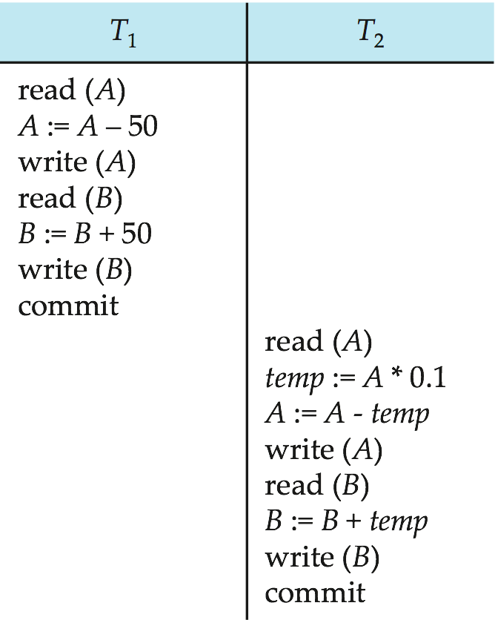
Concurrent Execution example
Let T₁ transfer $50 from A to B, and T₂ transfer 10% of the balance from A to B.
An example of a serial schedule in which T₁ is followed by T₂ :
Increasing Time

Slide 31
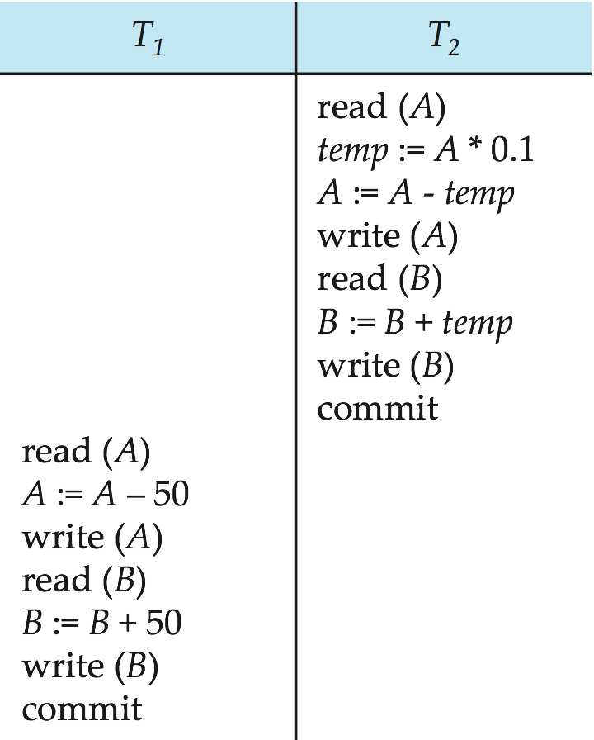
Concurrent Execution example
A serial schedule in which T₂ is followed by T₁ :
Increasing Time

Slide 32
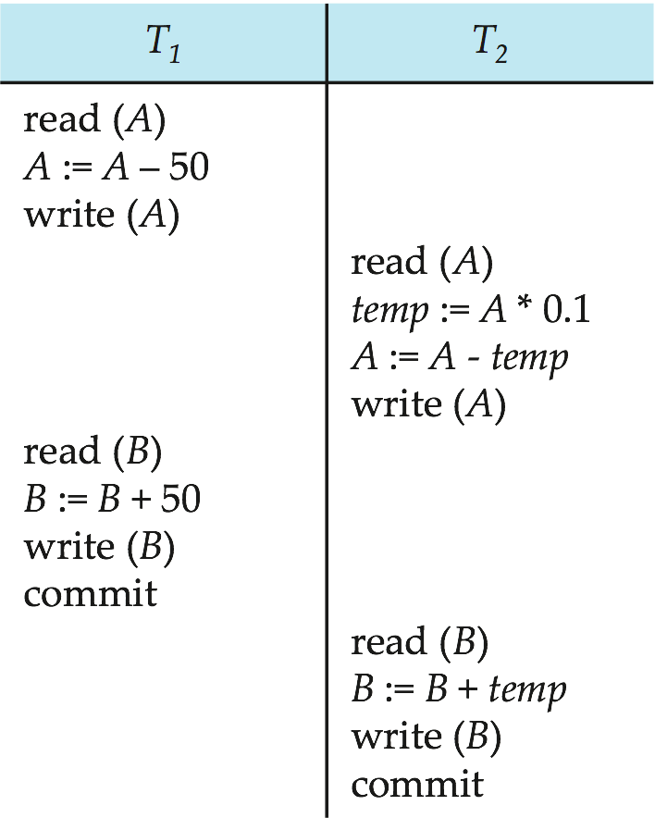
Concurrent Execution example
Let T₁ and T₂ be the transactions defined previously. The following schedule is not a serial schedule, but it is equivalent to Schedule 1.
Increasing Time

Slide 33
Characterizing Schedules on Recoverability
A schedule (or history) S of n transactions T1, T2, …, Tn:
  It is an ordering of the operations of the transactions subject to the constraint that, for each transaction Ti that participates in S, the operations of T1 in S must appear in the same order in which they occur in T1.
  Note, however, that operations from other transactions Tj can be interleaved with the operations of Ti in S.

Slide 34
Characterizing Schedules on Recoverability
Recoverable schedule:
  One where no committed transaction needs to be rolled back.
  A schedule S is recoverable if no transaction T in S commits until all transactions T’ that have written an item that T reads have committed.
Cascadeless schedule:
  One where every transaction reads only the items that are written by committed transactions.

Slide 35
Characterizing Schedules on Recoverability
Schedule(a): r1(x); r2(x); w1(x); r1(y); w2(x); c2; w1(y);c1;
Schedule(b): r1(X); w1(X); r2(X); r1(Y); w2(X); c2; a1;
Schedule(c): r1(X); w1(X); r2(X); r1(Y); w2(X); w1(Y); c1; c2;
Schedule(d): r1(X); w1(X); r2(X); r1(Y); w2(X); w1(Y); a1;
Classify them as recoverable or non-recoverable.

Slide 36
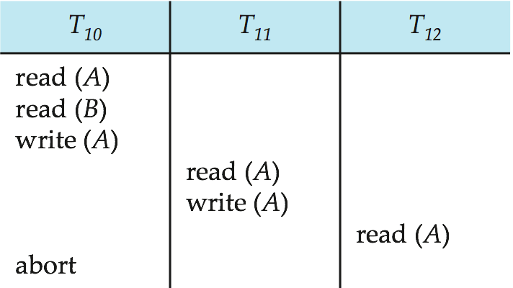
Characterizing Schedules on Recoverability
Schedules requiring cascaded rollback:
  A schedule in which uncommitted transactions that read an item from a failed transaction must be rolled back.

Slide 37
Characterizing Schedules on Recoverability
Strict Schedules:
  A schedule in which a transaction can neither read or write an item X until the last transaction that wrote X has committed.

Slide 38
Characterizing Schedules on Serializability
Serial schedule:
  A schedule S is serial if, for every transaction T participating in the schedule, all the operations of T are executed consecutively in the schedule.
    Otherwise, the schedule is called nonserial schedule.
Serializable schedule:
  A schedule S is serializable if it is equivalent to some serial schedule of the same n transactions.

Slide 39
Characterizing Schedules on Serializability
Let l_{i} and l_{j} be two Instructions of transactions T_{i} and T_{j} respectively.
Instructions l_{i} and l_{j} conflict if and only if there exists some item Q accessed by both l_{i} and l_{j}, and at least one of these instructions wrote Q.
1. l_{i} = read(Q), l_{j} = read(Q). l_{i} and l_{j} don’t conflict.
2. l_{i} = read(Q), l_{j} = write(Q). They conflict.
3. l_{i} = write(Q), l_{j} = read(Q). They conflict
4. l_{i} = write(Q), l_{j} = write(Q). They conflict

Slide 40
Characterizing Schedules on Serializability
Intuitively, a conflict between l_{i} and l_{j} forces a (logical) temporal order between them.
If l_{i} and l_{j} do not conflict, their results would remain the same even if they had been interchanged in the schedule.

Slide 41
Characterizing Schedules on Serializability
Result equivalent:
  Two schedules are called result equivalent if they produce the same final state of the database.
Conflict equivalent:
  Two schedules are said to be conflict equivalent if the order of any two conflicting operations is the same in both schedules.
Conflict serializable:
  A schedule S is said to be conflict serializable if it is conflict equivalent to some serial schedule S’.

Slide 42
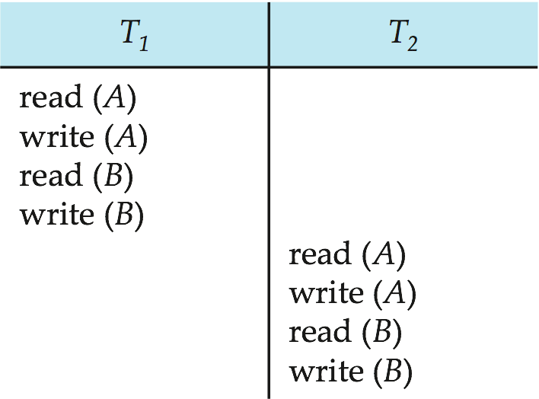
Serializability
Can be transformed into this by moving non-conflicting operations

Slide 43
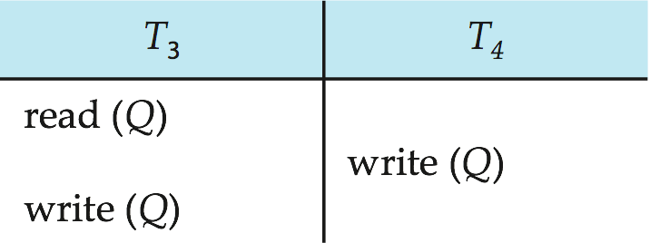
Serializability
Example of a schedule that is not conflict serializable:
We are unable to swap instructions in the above schedule to obtain either the serial schedule < T₃, T₄ >, or the serial schedule < T₄, T₃ >.

Slide 44
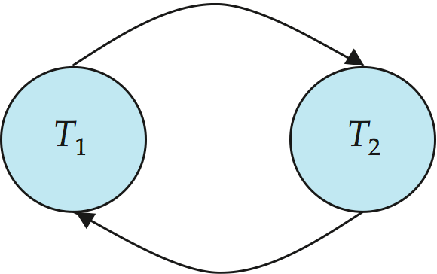
Testing Serializability --- Precedence Graph
Consider some schedule of a set of transactions T₁, T₂, ..., T_{n}
Precedence graph — a direct graph where the vertices are the transactions (names).
We draw an arc from T_{i} to T_{j} if the two transaction conflict, and T_{i} accessed the data item on which the conflict arose earlier.
We may label the arc by the item that was accessed.
Example

Slide 45
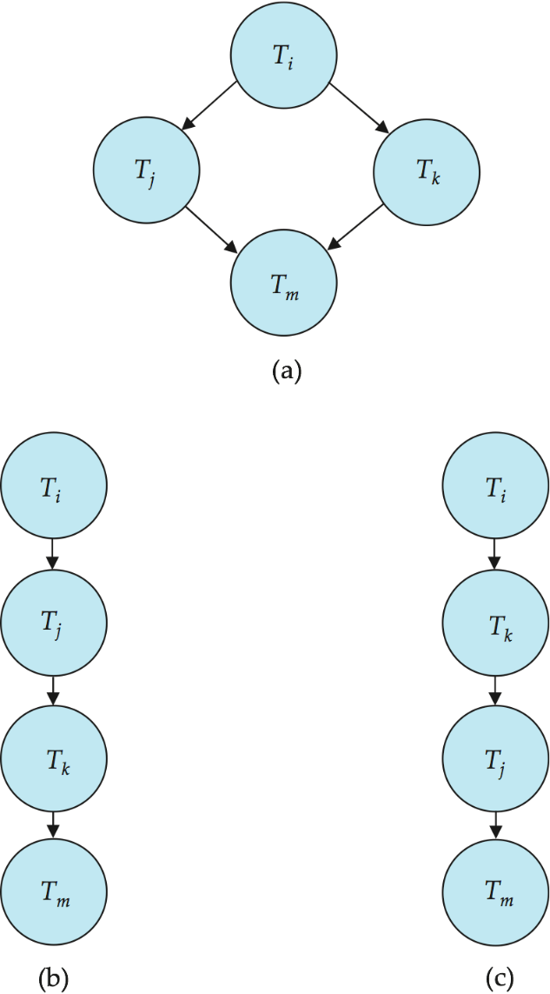
Testing Serializability
A schedule is conflict serializable if and only if its precedence graph is acyclic.
If precedence graph is acyclic, the serializability order can be obtained by a topological sorting of the graph.
  That is, a linear order consistent with the partial order of the graph.
  For example, a serializability order for the schedule (a) would be one of either (b) or (c)

Slide 46
General Note
A database must provide a mechanism that will ensure that all possible schedules are both:
  Conflict serializable.
  Recoverable and preferably cascadeless
A policy in which only one transaction can execute at a time generates serial schedules,
but provides a poor degree of concurrency

Slide 47
General Note
Concurrency-control schemes tradeoff between the amount of concurrency they allow and the amount of overhead that they incur
Testing a schedule for serializability after it has executed is a little too late!
Goal – to develop concurrency control protocols that will assure serializability.

