Slide 1
Database System Implementation CSE 507
Database Recovery
Some slides adapted from Navathe et. Al. , Silberchatz et. Al and Hector Garcia-Molina, Dr Hao-Hua Chu from NTU

Slide 2
Introduction and Basic Concepts
Purpose of Database Recovery
To bring the database into the last consistent state, which existed prior to the failure.
To preserve transaction properties (Atomicity and Durability).
Example:
If the system crashes before a fund transfer transaction completes
then either one or both accounts may have incorrect value.
Thus, the database must be restored to the state before the transaction modified any of the accounts.

Slide 3
Introduction and Basic Concepts
Types of Failure
The database may become unavailable for use due to
Transaction failure: Transactions may fail because of incorrect input, deadlock, etc.
System failure: System may fail because of operating system fault, RAM failure, etc.
Media failure: Disk head crash, power disruption, etc.

Slide 4
Introduction and Basic Concepts
Transaction Log
For recovery from any type of failure data values prior to modification (BFIM - BeFore Image) and the new value after modification (AFIM – AFter Image) are required.
These values and other information is stored in a sequential file called Transaction log.

Slide 5
Introduction and Basic Concepts
When to Update the Data?
Immediate Update: As soon as a data item is modified in cache, the disk copy is updated.
Deferred Update: Modified data items are written either after a transaction ends or after a fixed number of transactions have completed.
If there are heavy conflicts (e.g., 100 transactions accessing only 5 pages for read/write) the resulting schedule would be pretty much serial.
Then both deferred and immediate would be just about the much the same (assuming no deadlocks).
Advantages of Immediate update come out when there is a possibility of high concurrency.

Slide 6
Introduction and Basic Concepts
How to Update the Data?
Shadow update: The modified version of a data item does not overwrite its disk copy but is written at a separate disk location (inefficient).
In-place update: The disk version of the data item is overwritten by the cache version (more popular).

Slide 7
Introduction and Basic Concepts
Transaction Roll-back (Undo) and Roll-Forward (Redo)
To maintain atomicity, a transaction’s operations are redone or undone.
Undo: Restore all BFIMs on to disk (Remove all AFIMs).
Redo: Restore all AFIMs on to disk.
Database recovery is achieved either by performing only Undos or only Redos or by a combination of the two.

Slide 8
Introduction and Basic Concepts
When in-place update (immediate or deferred) is used then log is necessary for recovery.
Write-Ahead Logging (WAL) protocol ensures it is available:
WAL states that
For Undo: Before a data item’s AFIM is flushed to the database disk its BFIM must be written to the log and the log must be saved on a stable store.
For Redo: Before a transaction executes its commit operation, all its AFIMs must be written to the log and the log must be saved on a stable store.

Slide 9
Checkpointing
From time to time the database flushes its buffer to database disk to minimize the task of recovery.
Following steps defines a checkpoint operation:
Suspend execution of transactions temporarily.
Force write modified buffer data to disk (unless a no-UNDO).
Write a [checkpoint] record to the log, save the log to disk.
Resume normal transaction execution.
During recovery redo or undo is required to transactions appearing after [checkpoint] record.

Slide 10
Checkpointing Contd..
T_{c}
T_{f}
T₁
T₂
T₃
T₄
checkpoint
system failure
T₁ can be ignored (updates already output to disk due to checkpoint)
T₂ and T₃ redone (assuming UNDO/REDO procedure) .
T₄ undone (assuming UNDO/REDO procedure).

Slide 11
Introduction and Basic Concepts
Steal/No-Steal and Force/No-Force
Possible ways for flushing database cache to database disk:
Steal: Cache can be flushed before transaction commits.
No-Steal: Cache cannot be flushed before transaction commit.
Force: Cache is immediately flushed (forced) to disk before commit.
No-Force: Otherwise

Slide 12
Introduction and Basic Concepts
Steal/No-Steal and Force/No-Force
These give rise to four different ways for handling recovery:
Steal/No-Force (Undo/Redo)
Steal/Force (Undo/No-redo)
No-Steal/No-Force (Redo/No-undo)
No-Steal/Force (No-undo/No-redo).

Slide 13
Introduction and Basic Concepts
With concurrent transactions, all transactions share a single disk buffer and a single log
We assume:
if a transaction T_{i} has modified an item, no other transaction can modify the same item until T_{i} has committed or aborted
i.e. we need strict schedules.
E.g., Strict 2PL.

Slide 14
Some Basic Recovery Algorithms

Slide 15
Deferred Update (No Undo/Redo)
Deferred Update Protocol:
A transaction cannot change the database on disk until it reaches its commit point.
A transaction does not reach its commit point until all its REDO-type log entries are recorded in the log.
And the log buffer is force written to the disk.

Slide 16
Deferred Update (No Undo/Redo)
Two tables are required for implementing this protocol.
Active table: All active transactions are entered in this table.
Commit table: Transactions to be committed are entered in this table.
These tables are filled by scanning through the log from the last checkpoint during recovery.

Slide 17
Deferred Update (No Undo/Redo)
During recovery:
All transactions of the commit table are redone in the order they were written to log, and
All transactions of active tables are ignored. Why?
It is possible that a commit table transaction may be redone twice but this does not create any inconsistency because of a redone is “idempotent”,
that is, one redone for an AFIM is equivalent to multiple redone for the same AFIM.

Slide 18
Deferred Update (No Undo/Redo)
During recovery:
All transactions of the commit table are redone in the order they were written to log, and
All transactions of active tables are ignored. Why?
Any comments on its efficiency?
In terms of required buffer space

Slide 19
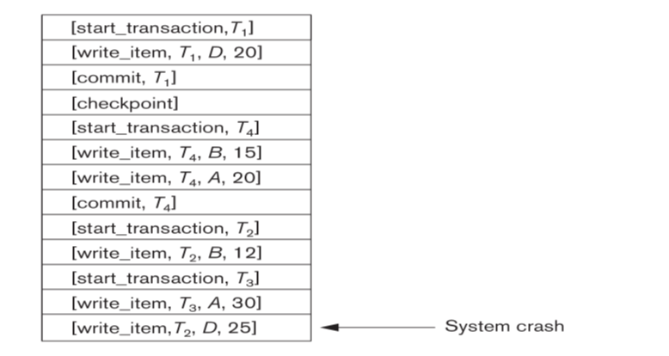
Deferred Update (No Undo/Redo) Example
What is the output of No-UNDO/ REDO algorithm on this system log?
Which transactions are redone and which are ignored?
Assume strict 2PL being followed

Slide 20
Immediate Update Based Technique
In this AFIMs of a transaction can be flushed to the database disk before it commits.
For this reason the recovery manager undoes all transactions during recovery.
If all updates of a transaction are recorded on disk before it commits then no need for REDO
Else REDO is required.
UNDO/REDO is most common type of recovery technique.

Slide 21
Immediate Update Based Technique
Recovery Algorithm
Use two list of transactions: the committed transactions and the active transactions since last check point.
Undo all the write_item operations active transactions. Done in reverse order of the log.
Redo all the write_item operations of the committed transactions. Done in the order they were written in log.

Slide 22
Immediate Update -- Example
[Start_transaction, T1]
[read_item, T1, A]
[read_item, T1,D]
[write_item, T1, D, 20,25]
[checkpoint]
[start_transaction, T2]
[read_item, T2, B]
[write_item, T2, B, 12, 18]
[Commit, T1]
[start_transaction, T4]
[read_item, T4, D]
[write_item, T4, D, 25, 15]
[read_item, T4, A]
[write_item, T4, A, 30, 20]
[read_item,T2, B]
[write_item, T2, B, 15, 35]
[Commit T4]
What is the output of UNDO/ REDO algorithm on this system log?
Which transactions are redone and which are undone?
Assume strict 2PL being followed
System Crash!

Slide 23
Repeating History and Logging during Undo
Transaction rollback (also valid during normal operation)
Let T_{i} be the transaction to be rolled back
Scan log backwards from the end, and for each log record of T_{i} of the form <write_item, T_{i}, X_{j}, V₁, V₂>
perform the undo by writing V₁ to X_{j},
write a log record <write_item, T_{i} , X_{j}, V₁>
such log records are called compensation log records
Once the record <Start_trans, T_{i} > is found stop the scan and write the log record <Abort, T_{i}>

Slide 24
Repeating History and Logging during Undo
Recovery from failure: Two phases
Redo phase: replay updates of all transactions, whether they committed, aborted, or are incomplete
Undo phase: undo all incomplete transactions

Slide 25
Repeating History and Logging during Undo
Redo phase (also called repeating history)
Find last <checkpoint L> record, and set undo-list to L.
Scan forward from above <checkpoint L> record
Whenever a record <write_item, T_{i}, X_{j}, V₁, V₂> is found, redo it by writing V₂ to X_{j}
If a log record <start, T_{i} > is found, add T_{i} to undo-list
Whenever a log record <Commit, T_{i} > or <Abort, T_{i} > is found, remove T_{i} from undo-list

Slide 26
Repeating History and Logging during Undo
Undo phase (Logging during Undo):
Scan log backwards from end
If record <write_item, T_{i}, X_{j}, V₁, V₂> is found where T_{i} is in undo-list perform same actions as for trans rollback:
perform undo by writing V₁ to X_{j}.
write a log record < write_item, T_{i} , X_{j}, V₁>
Whenever a record <start, T_{i} > is found where T_{i} is in undo-list,
Write a log record <Abort, T_{i} >
Remove T_{i} from undo-list
Stop when undo-list is empty.

Slide 27
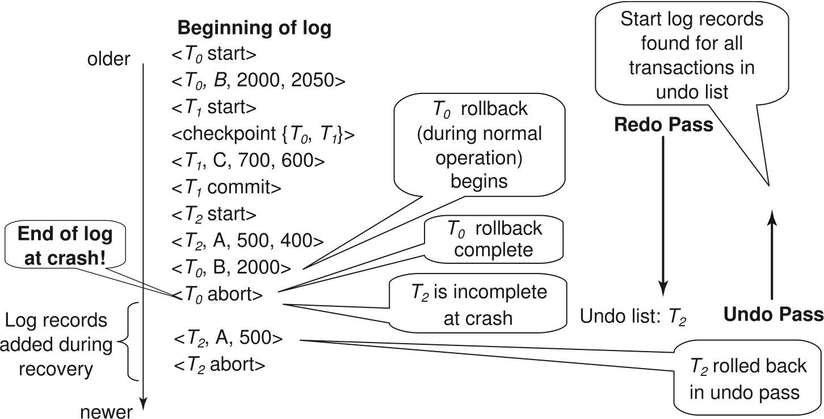
Repeating History and Logging during Undo

Slide 28
ARIES Recovery Algorithm

Slide 29
Introduction to ARIES
ARIES is a state of the art recovery method.
It Incorporates numerous optimizations to speed up recovery
Unlike the recovery algorithm described earlier, ARIES
Uses log sequence number (LSN) to identify log records.
Stores LSNs in pages to identify what updates have already been applied to a database page
Uses Dirty page table to avoid unnecessary redos during recovery
Uses Fuzzy checkpointing that only records information about dirty pages, and does not require dirty pages to be written out at checkpoint time.

Slide 30
ARIES Book Keeping
Log sequence number (LSN) identifies each log record
Must be sequentially increasing
Typically an offset from beginning of log file to allow fast access
Easily extended to handle multiple log files
Concept of PageLSN and RecLSN
Log records of several different types
Dirty page table

Slide 31
ARIES Book Keeping – PageLSN
Each page contains a PageLSN which is the LSN of the last log record whose effects are reflected on the page
To update a page:
Exclusive lock on the page, and write the log record
Update the page
Record the LSN of the log record in PageLSN
Unlock page
PageLSN is used during recovery to prevent repeated redo.

Slide 32
ARIES Book Keeping – PageLSN
PageLSN: the LSN of the most recent log record that made a change to this page.
Every page in the DB must have a pageLSN.
What is P3’s pageLSN?
60 or 20
It is used in the Redo phase of the algorithm.
LSN | LOG
10 | Update: T1 writes P5
20 | Update: T2 writes P3
30 | T2 commits
40 | T2 ends
50 | Update: T3 writes P1
60 | Update: T3 writes P3

Slide 33
ARIES Book Keeping -- Logs
Each log record contains LSN of previous log record of the same transaction.
prevLSN | transID | Type | PageID | Before-image | After-image
Fields common to all log records |  |  | Additional fields for update log records
 | T1000 | update | P500 | ABC | DEF
 | T2000 | update | P600 | HIJ | KLM
 | T1000 | update | P500 | GDE | QRS
 | T1000 | update | P505 | TUV | WXY
PrevLSN: LSN of the previous log record in the same transaction. It forms a single linked list of log records going back in time.

Slide 34
ARIES Book Keeping -- Logs
Special redo-only log record called compensation log record (CLR)
They are used to log actions taken during recovery that never need to be undone

Slide 35
ARIES Book Keeping – CLR Records
Has a field UndoNextLSN to note next (earlier) record to be undone
Records in between would have already been undone
Required to avoid repeated undo of already undone actions
1
2
3
4
4'
3'
2'
1'

Slide 36
ARIES Book Keeping – CLR Records
prevLSN | LSN | transID | Type | PageID | Before-image | After-image
 | 00 | T1000 | update | P500 | ABC | DEF
 | 10 | T2000 | update | P600 | HIJ | KLM
 | 20 | T2000 | update | P500 | GDE | QRS
 | 30 | T1000 | update | P505 | TUV | WXY
 | 40 | T1000 | abort
 | 50 | T1000 | CLR / undo 30 | P505 | TUV
CLR is written when undoing an update (T1000 30) after an abort (or during crash recovery).
CLR records undoNextLSN, which is the LSN of the next log record that is to be undone for T1000, which is the prevLSN of log record #30.
undoNextLSN is used for undoing actions in the reverse order.

Slide 37
ARIES Crash– No need to Undo an Undo Action
prevLSN | LSN | transID | Type | PageID | Before-image | After-image
- | 00 | T1000 | update | P500 | ABC | DEF
00 | 10 | T1000 | update | P505 | TUV | WXY
System Crash
 | 20 | T1000 | CLR/undo 10 | P505 | TUV
System Crash
 | 30 | T1000 | CLR/undo 00 | P500 | ABC
No need to Undo this operation!

Slide 38
ARIES Book Keeping – Dirty Page Table
DirtyPageTable
List of pages in the buffer that have been updated
Contains, for each such page
PageLSN of the page
RecLSN is an LSN such that log records before this LSN have already been applied to the page version on disk
Set to current end of log when a page is inserted into dirty page table (just before being updated)
Recorded in checkpoints, helps to minimize redo work

Slide 39
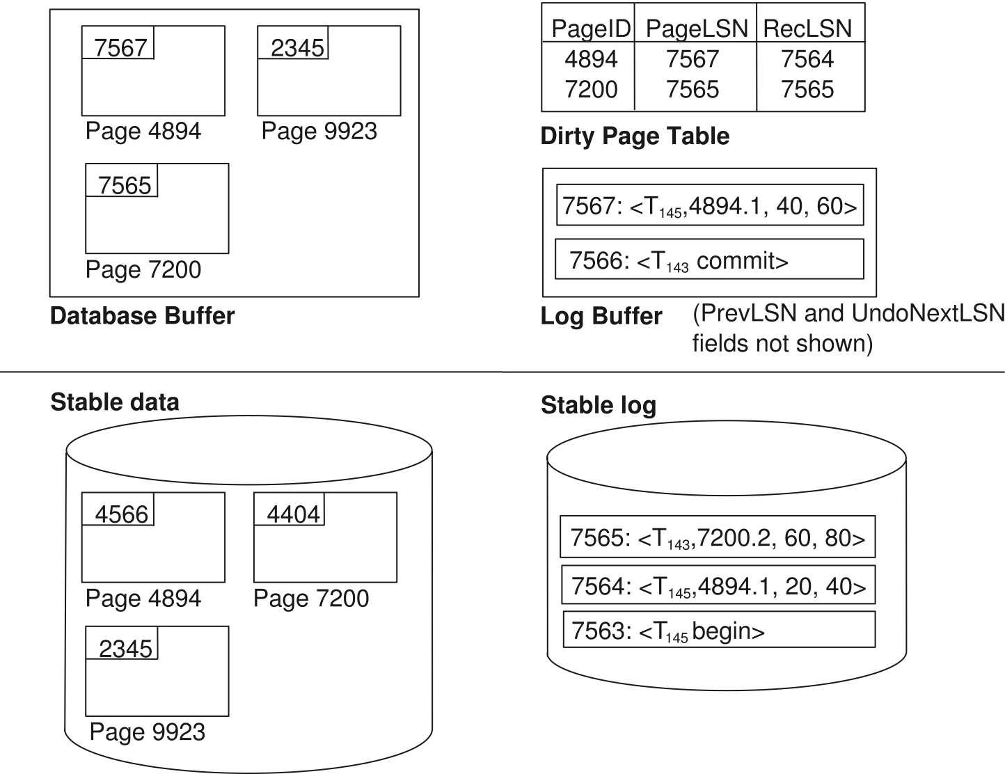
ARIES Book Keeping – A snapshot

Slide 40
ARIES Book Keeping – Checkpoint
Checkpoint log record
Contains:
DirtyPageTable and list of active transactions
For each active transaction, LastLSN, the LSN of the last log record written by the transaction
A fixed position on disk notes LSN of last completed checkpoint log record

Slide 41
ARIES Book Keeping – Checkpoint
Checkpoint log record
Dirty pages are not written out at checkpoint time
Instead, they are flushed out continuously, in the background
Checkpoint is thus very low overhead
can be done frequently

Slide 42
ARIES Algorithm Summary
ARIES recovery involves three passes
Analysis pass: Determines
Which transactions to undo
Which pages were dirty (disk version not up to date) at time of crash
RedoLSN: LSN from which redo should start
Redo pass:
Repeats history, redoing all actions from RedoLSN
RecLSN and PageLSNs are used to avoid redoing actions already reflected on page
Undo pass:
Rolls back all incomplete transactions
Transactions whose abort was complete earlier are not undone

Slide 43
ARIES Algorithm Analysis Phase
Analysis, redo and undo passes
Analysis determines where redo should start
Undo has to go back till start of earliest incomplete transaction
Last checkpoint
End of Log
Time
Log
Analysis pass
Redo pass
Undo pass

Slide 44
ARIES Algorithm Analysis Phase
Starts from last complete checkpoint log record
Reads DirtyPageTable from log record
Sets RedoLSN = min of RecLSNs of all pages in DirtyPageTable
In case no pages are dirty, RedoLSN = checkpoint record’s LSN + 1
Sets undo-list = list of transactions in checkpoint log record
Reads LSN of last log record for each transaction in undo-list from checkpoint log record
Scans forward from checkpoint.. Contd….

Slide 45
ARIES Algorithm Analysis Phase Contd…
Scans forward from checkpoint
If any log record found for transaction not in undo-list, adds transaction to undo-list
Whenever an update log record is found
If page not in DirtyPageTable, then added with RecLSN set to LSN of the update log record
If transaction end log record found, delete transaction from undo-list
Keeps track of last log record for each transaction in undo-list
May be needed for later undo

Slide 46
ARIES Algorithm Analysis Phase Contd…
Analysis pass (cont.)
At end of analysis pass:
RedoLSN determines where to start redo pass
RecLSN for each page in DirtyPageTable used to minimize redo work
All transactions in undo-list need to be rolled back

Slide 47
ARIES Algorithm Analysis Phase Example
pageID | RecLSN | PageLSN
LSN | TransID | Type | PageID
00 | T1000 | update | P500
10 | T2000 | update | P600
20 | T2000 | update | P500
30 | T1000 | update | P505
40 | T2000 | commit
System Crash
Dirty Page Table
transID | lastLSN
Undo List
Assume no previous checkpointing for simplicity.
Initialize Dirty page table and transaction table to empty.

Slide 48
ARIES Algorithm Analysis Phase Example
pageID | RecLSN | PageLSN
P500 | 00
LSN | TransID | Type | PageID
00 | T1000 | update | P500
10 | T2000 | update | P600
20 | T2000 | update | P500
30 | T1000 | update | P505
40 | T2000 | commit
System Crash
Dirty Page Table
transID | lastLSN
T1000 | 00
Undo List
Assume no previous checkpointing for simplicity.
Initialize Dirty page table and transaction table to empty.

Slide 49
ARIES Algorithm Analysis Phase Example
pageID | RecLSN | PageLSN
P500 | 00
P600 | 10
LSN | TransID | Type | PageID
00 | T1000 | update | P500
10 | T2000 | update | P600
20 | T2000 | update | P500
30 | T1000 | update | P505
40 | T2000 | commit
System Crash
Dirty Page Table
transID | lastLSN
T1000 | 00
T2000 | 10
Undo List
Assume no previous checkpointing for simplicity.
Initialize Dirty page table and transaction table to empty.

Slide 50
ARIES Algorithm Analysis Phase Example
pageID | RecLSN | PageLSN
P500 | 00 | 20
P600 | 10
LSN | TransID | Type | PageID
00 | T1000 | update | P500
10 | T2000 | update | P600
20 | T2000 | update | P500
30 | T1000 | update | P505
40 | T2000 | commit
System Crash
Dirty Page Table
transID | lastLSN
T1000 | 00
T2000 | 20
Undo List
Assume no previous checkpointing for simplicity.
Initialize Dirty page table and transaction table to empty.

Slide 51
ARIES Algorithm Analysis Phase Example
pageID | RecLSN | PageLSN
P500 | 00 | 20
P600 | 10
P505 | 30
LSN | TransID | Type | PageID
00 | T1000 | update | P500
10 | T2000 | update | P600
20 | T2000 | update | P500
30 | T1000 | update | P505
40 | T2000 | commit
System Crash
Dirty Page Table
transID | lastLSN
T1000 | 30
T2000 | 20
Undo List
Assume no previous checkpointing for simplicity.
Initialize Dirty page table and transaction table to empty.

Slide 52
ARIES Algorithm Analysis Phase Example
pageID | RecLSN | PageLSN
P500 | 00 | 20
P600 | 10
P505 | 30
LSN | TransID | Type | PageID
00 | T1000 | update | P500
10 | T2000 | update | P600
20 | T2000 | update | P500
30 | T1000 | update | P505
40 | T2000 | commit
System Crash
Dirty Page Table
transID | lastLSN
T1000 | 30
T2000 | 20
Undo List
Assume no previous checkpointing for simplicity.
Initialize Dirty page table and transaction table to empty.

Slide 53
ARIES Algorithm Analysis Phase Example
pageID | RecLSN | PageLSN
P500 | 00 | 20
P600 | 10
P505 | 30
LSN | TransID | Type | PageID
00 | T1000 | update | P500
10 | T2000 | update | P600
20 | T2000 | update | P500
30 | T1000 | update | P505
40 | T2000 | commit
System Crash
Dirty Page Table
transID | lastLSN
T1000 | 30
T2000 | 20
Undo List
The redo point starts at 00.
Why? P500 is the earliest log that may not have been written to disk before crash.
We have restored transaction table & dirty page table.

Slide 54
ARIES Algorithm Redo Pass
Redo Pass: Repeats history upto the system crash
Scans forward from RedoLSN.
Whenever an update/CLR log record is found:
Test (A)
If the page is not in DirtyPageTable OR
The LSN of the log record is less than the RecLSN of the page in DirtyPageTable
then skip the log record (test passed)

Slide 55
ARIES Algorithm Redo Pass
Redo Pass Contd…
Whenever an update log record is found:
Test (B)
3. Otherwise (test (A) fails) then fetch the page from disk.
4. If the PageLSN of the page fetched from disk < LSN of log,
Then redo the log record (Test (B) passed)
5. Else skip this particular update (Test (B) also fails)
NOTE: if either test is negative the effects of the log record have already appeared on the page. First test avoids even fetching the page from disk!

Slide 56
ARIES Algorithm Redo Pass
Scan forward from the redo point (LSN 00).
Assume that P600 has been written to disk.
But it can still be in the dirty page table.
Scanning 00:
P500 is in the dirty page table.
00(recLSN) = 00 (LSN) (test A fails)
-10 (pageLSN from disk) < 00 (LSN)
Redo 00
LSN | TransID | Type | PageID
00 | T1000 | update | P500
10 | T2000 | update | P600
20 | T2000 | update | P500
30 | T1000 | update | P505
40 | T2000 | commit
System Crash
pageID | RecLSN | PageLSN
P500 | 00 | 20
P600 | 10
P505 | 30
transID | lastLSN
T1000 | 30

Slide 57
ARIES Algorithm Redo Pass
LSN | TransID | Type | PageID
00 | T1000 | update | P500
10 | T2000 | update | P600
20 | T2000 | update | P500
30 | T1000 | update | P505
40 | T2000 | commit
System Crash
Scanning 10:
10 (RecLSN) == 10 (LSN) (test A fails)
10 (pageLSN from disk) == 10 (LSN)
Do not redo 10
pageID | RecLSN | PageLSN
P500 | 00 | 20
P600 | 10
P505 | 30
transID | lastLSN
T1000 | 30

Slide 58
ARIES Algorithm Redo Pass
LSN | TransID | Type | PageID
00 | T1000 | update | P500
10 | T2000 | update | P600
20 | T2000 | update | P500
30 | T1000 | update | P505
40 | T2000 | commit
System Crash
Scanning 20:
00 (recLSN) < 20 (LSN)
Fetch from page 500 from disk
00 (pageLSN from disk) < 20 (LSN)
Redo 20
pageID | RecLSN | PageLSN
P500 | 00 | 20
P600 | 10
P505 | 30
transID | lastLSN
T1000 | 30

Slide 59
ARIES Algorithm Redo Pass
LSN | TransID | Type | PageID
00 | T1000 | update | P500
10 | T2000 | update | P600
20 | T2000 | update | P500
30 | T1000 | update | P505
40 | T2000 | commit
System Crash
Scanning 30:
30 (recLSN) == 30 (LSN of log)
Fetch from page 505 from disk
-5 (pageLSN from disk) < 30 (LSN)
Redo 30
pageID | RecLSN | PageLSN
P500 | 00 | 20
P600 | 10
P505 | 30
transID | lastLSN
T1000 | 30

Slide 60
ARIES Algorithm Redo Pass
LSN | TransID | Type | PageID
00 | T1000 | update | P500
10 | T2000 | update | P600
20 | T2000 | update | P500
30 | T1000 | update | P505
40 | T2000 | commit
System Crash
Scanning 30:
Redo 40
pageID | RecLSN | PageLSN
P500 | 00 | 20
P600 | 10
P505 | 30
transID | lastLSN
T1000 | 30

Slide 61
ARIES Algorithm Undo Pass
When an undo is performed for an update log record
Generate a CLR containing the undo action performed (CLR for record n noted as n’ in figure below
Set UndoNextLSN of the CLR to the PrevLSN value of the update log record
Arrows indicate UndoNextLSN value
1
2
3
4
4'
3'
2'
1'

Slide 62
ARIES Algorithm Undo Pass
Undo pass:
Performs backward scan on log undoing all transaction in undo-list
Backward scan optimized by skipping unneeded log records as follows:
Next LSN to be undone for each transaction set to LSN of last log record for transaction found by analysis pass.
At each step pick largest of these LSNs to undo, skip back to it and undo it

Slide 63
ARIES Algorithm Undo Pass
Undo pass contd..
After undoing a log record
For ordinary log records, set next LSN to be undone for transaction to PrevLSN noted in the log record
For compensation log records (CLRs) set next LSN to be undo to UndoNextLSN noted in the log record.

Slide 64
ARIES Algorithm Undo Pass
LSN | TransID | Type | PageID
00 | T1000 | update | P500
10 | T2000 | update | P600
20 | T2000 | update | P500
30 | T1000 | update | P505
40 | T2000 | commit
System Crash
pageID | RecLSN | PageLSN
P500 | 00 | 20
P600 | 10
P505 | 30
UNDO LIST
transID | lastLSN
T1000 | 30

Slide 65
ARIES Algorithm Undo Pass
ToUndo set is {T1000:30}
Undoing LSN:30
Write CLR:undo record log.
ToUndo becomes {T1000:00}
LSN | TransID |  | Type | PageID
00 | T1000 |  | update | P500
10 | T2000 |  | update | P600 (disk)
20 | T2000 |  | update | P500
30 | T1000 |  | update | P505
40 | T2000 |  | commit
System Crash
50 | T1000 | CLR:undo:30 |  | P505
UndoNextLSN

Slide 66
ARIES Algorithm Undo Pass
ToUndo set is {T1000:30}
Undoing LSN:00
Write CLR:undo record log.
ToUndo becomes null.
Undo process complete
LSN | TransID |  | Type | PageID
00 | T1000 |  | update | P500
10 | T2000 |  | update | P600 (disk)
20 | T2000 |  | update | P500
30 | T1000 |  | update | P505
40 | T2000 |  | commit
System Crash
50 | T1000 | CLR:undo:30 |  | P505
60 | T1000 | CLR:undo:00 |  | P500
UndoNextLSN

Slide 67
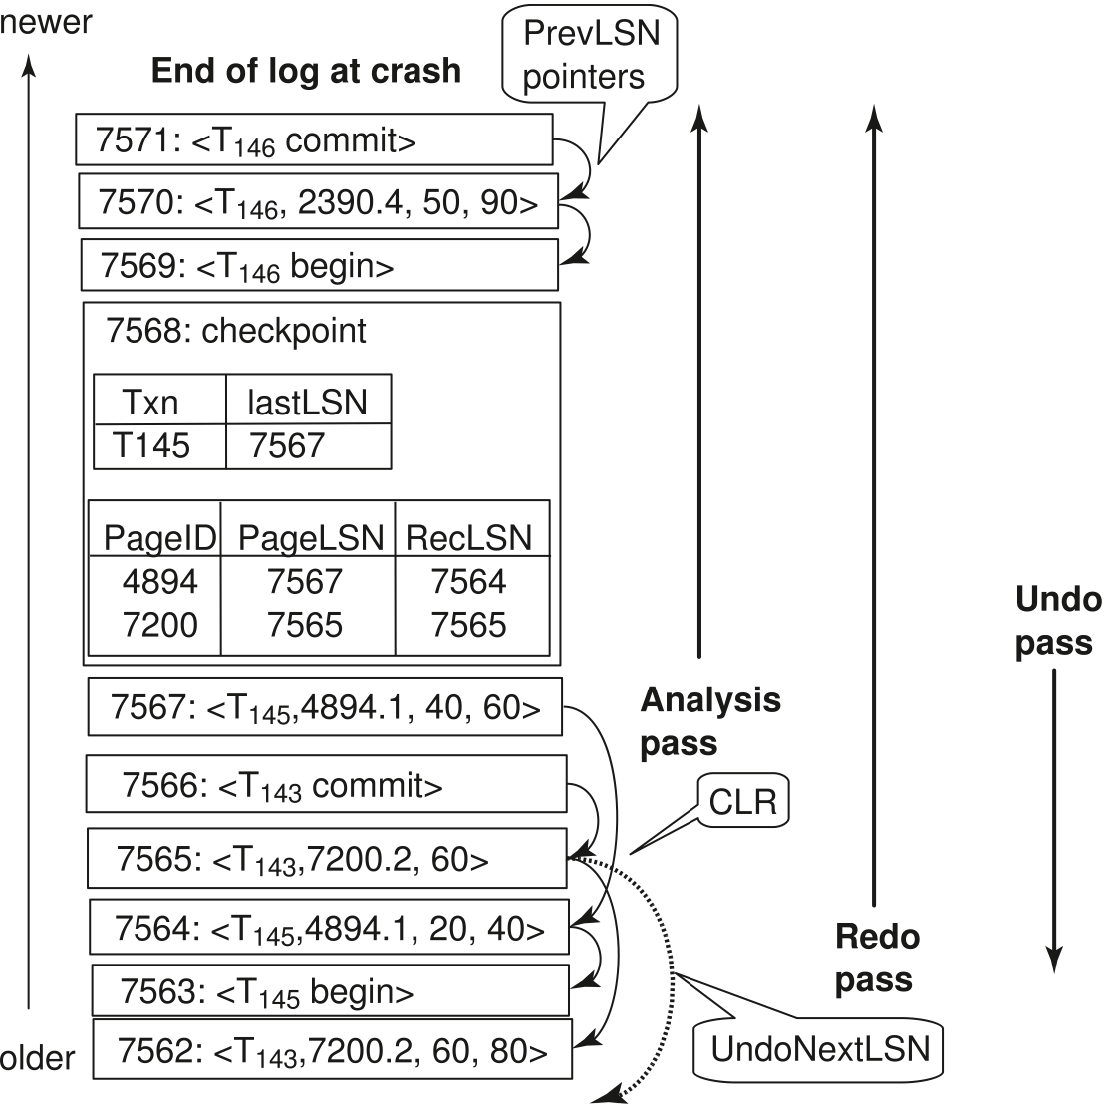
ARIES Example
Assume this was written

Slide 68
ARIES Example
pageID | RecLSN | PageLSN
4894 | 7564 | 7567
7200 | 7565
2390 | 7570
Dirty Page table after Analysis Phase
Redo Starts here
Assume this was written

